Slide 1
Tue/Wed 12/13.06.12
08:00 Probe beam back again
09:44 Fill #2725 Stable beams. Initial lumi's 6.4e33 cm-2s-1.
16:49 Beam dump. Produced 120 pb-1. Trip of S81.
17:21 Access for CMS and ALICE. Parasitic:
MKA test
nQPS sector 78
LBDS TSA surveillance test
Pulse MKD/MKB in local.
19:10 End of access. Recycle.
20:27 Injection.
22:08 Stable beams #2726. 6.6e33 cm-2 s-1.
07:06 Beam dump. Produced 142 pb-1. Electrical perturbation. ALICE and LHCb tripped. 3 PC on FMCM.

Slide 2
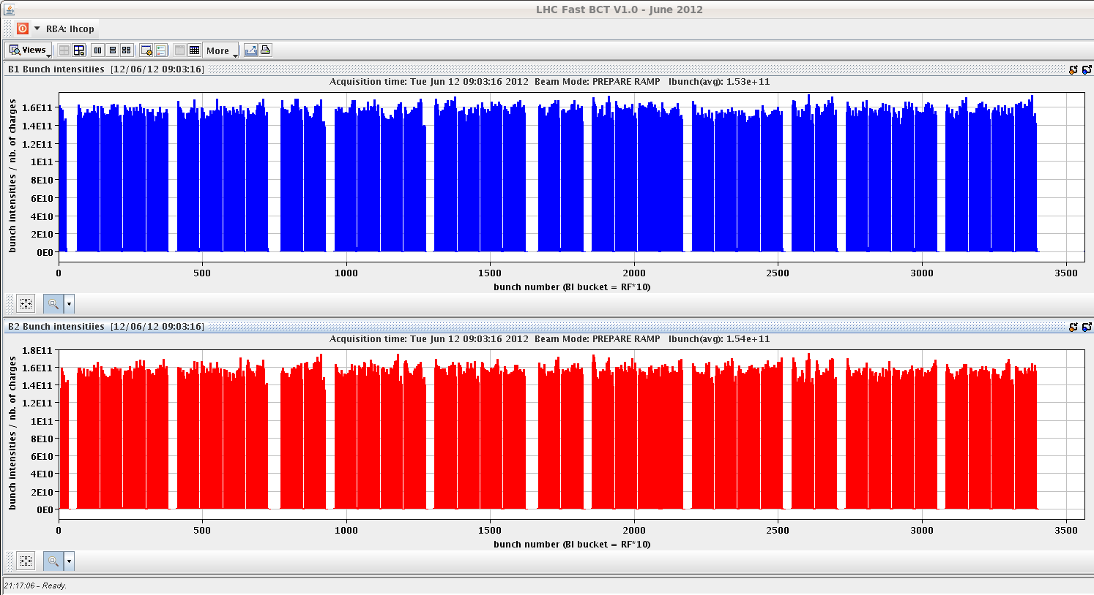
Intensity: Average ~ 1.53e11 p/bunch #2725

Slide 3
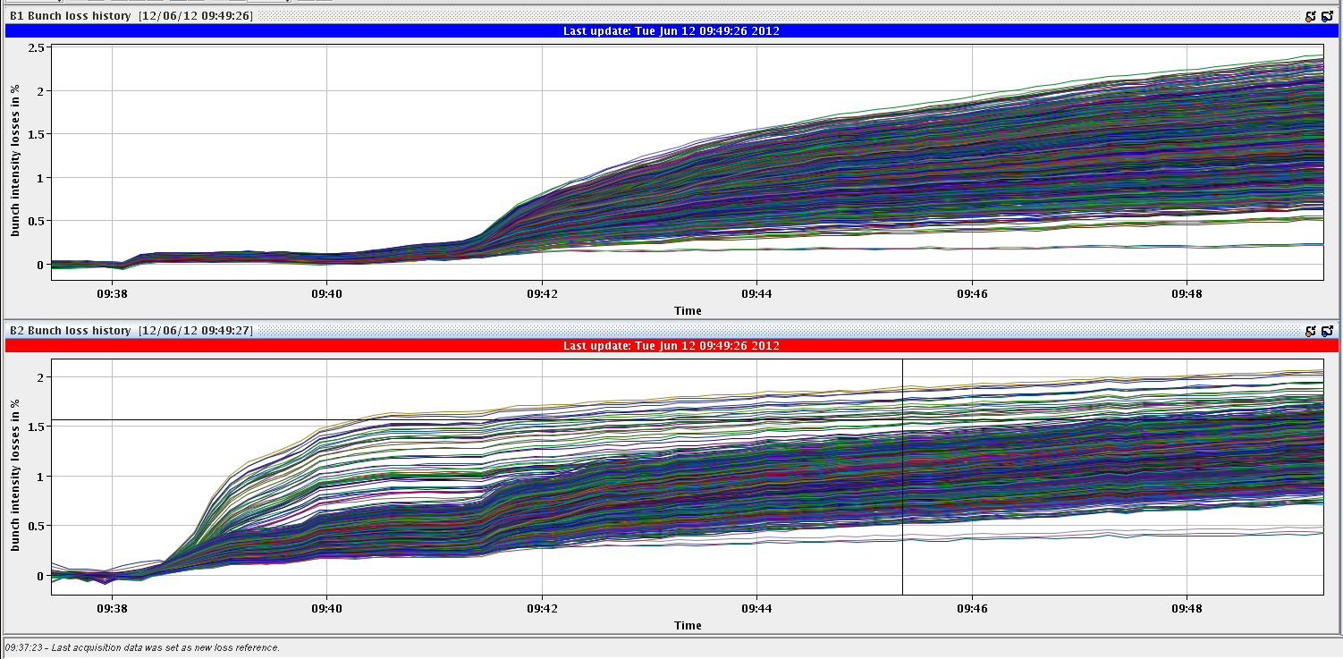
Bunch-by-bunch losses #2725
Low for both beams
B2: some bunches additional losses in squeeze

Slide 4
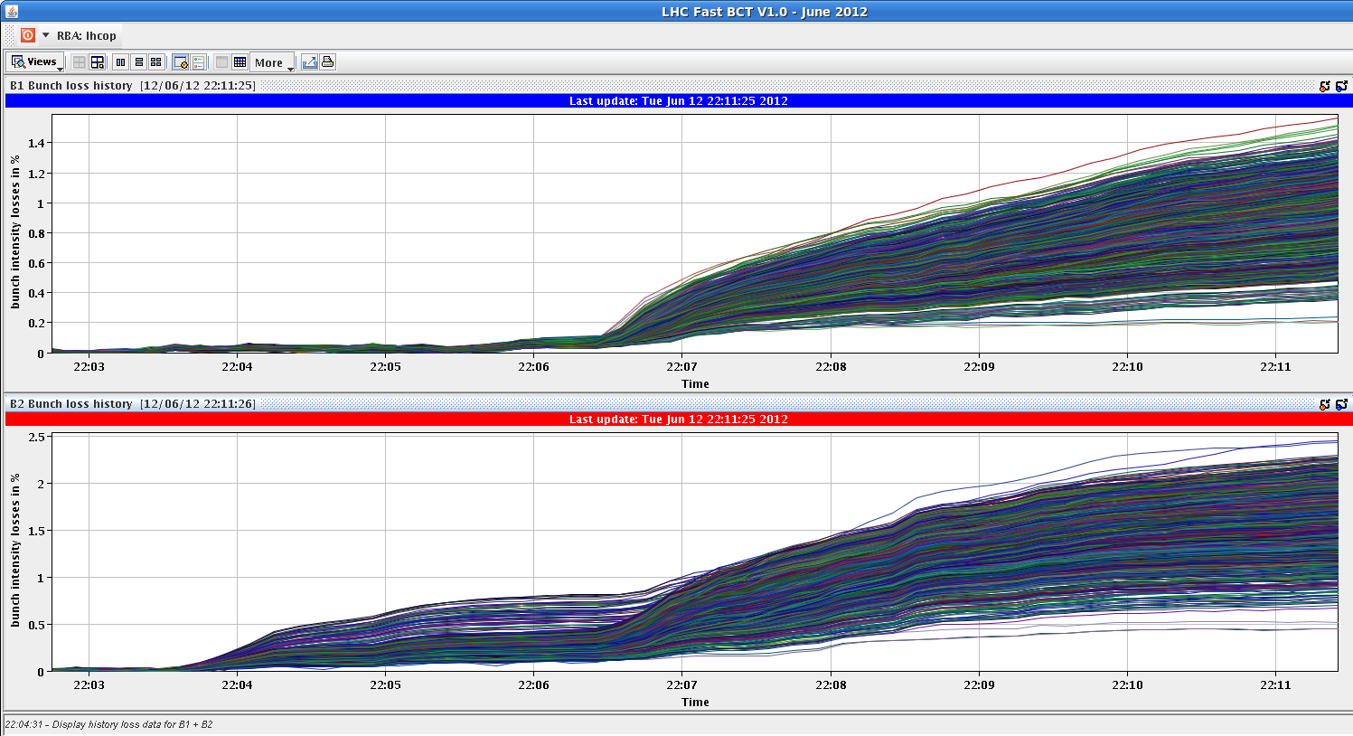
Bunch-by-bunch losses fill #2726

Slide 5
Abort gap population #2725
Around 13:45 the abort gap filled suddenly above cleaning threshold and kept filling.
The abort gap cleaning was switched on at LOW.
After about 15 min the abort gap population went back to a normal level.
10 min later the same thing happened again.
Since then the however abort gap is calm.
Abort gap cleaning is off. The RF experts have not found any explanation yet.

Slide 6
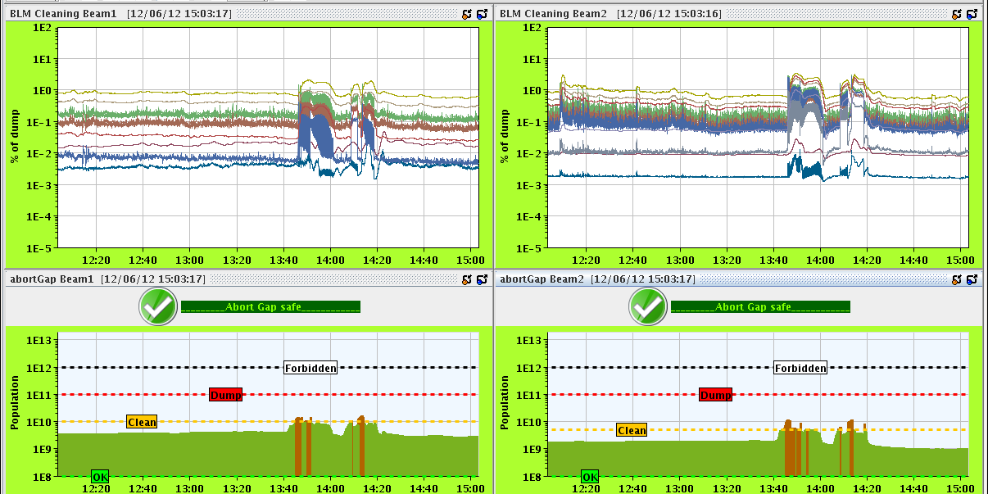
Abort gap cleaning #2725

Slide 7
RF
Philippe (beam control synchro loop):
ramp functions for following RF parameters strange at end of ramp: RFBEAM1,2/SYNCHLOOP_A RFBEAM1,2/SYNCHLOOP_TAU
This affects the stability margin of the beam control synchro loop.
We decided not to change the functions tonight (as this has been present since the start of the 2012 run) but to consult with experts tomorrow morning and take a decision of what to do.
Proposal for blow up at injection (reduce emittance growth):
We propose to blow/up to 1.4 ns after each injection. They should then remain almost constant till the end of filling . That should keep the level of uncaptured beam acceptable at start ramp. It is very low now that the energies have been matched. If losses are small we could increase to 1.5 ns in later fills.
The classic blow/up in the ramp is kept. We expect no change in longitudinal parameters in physics, only hopefully smaller transverse emittance.

Slide 8
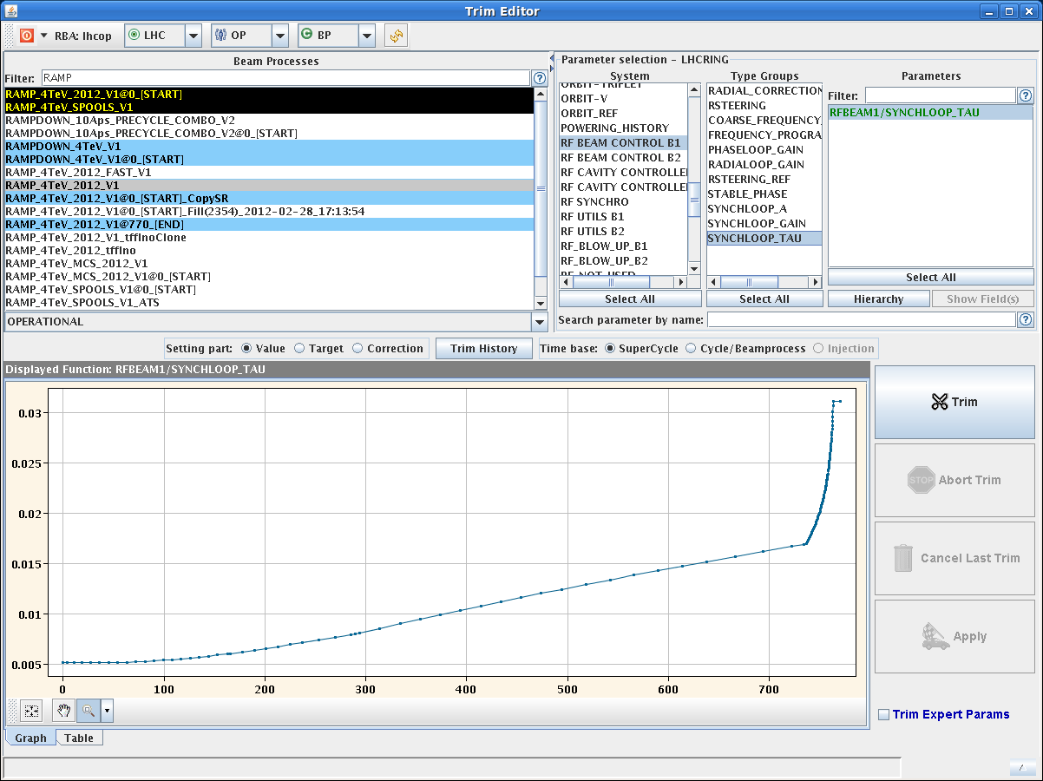
RF function (Synchro Loop)

Slide 9
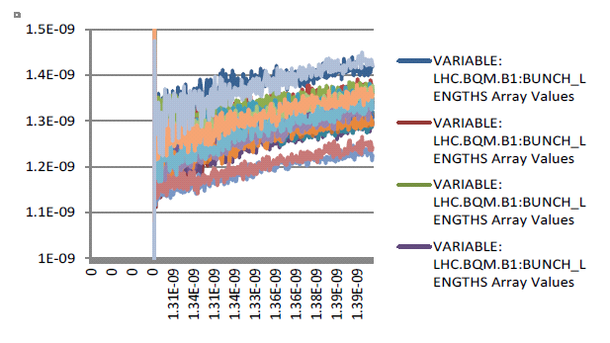
Longitudinal growth at injection (Philippe)
Length evolution of few bunches, third batch B1 in last fill (2723) during the 30 min of filling. Their length grows from 1.1 ns to 1.4 ns.

Slide 10
Planning Ahead
Delivering luminosity…
To be done…
RF:
Synchro loop control functions
Long. blow-up at injection
New filling scheme: 6 private IR8 bunches for ATLAS/CMS
Impact of TETRA on hump / beam.
30 mins at injection with probe bunches.
Access:
CMS electrical problem Muon chambers
ALICE access
nQPS sector 78 (power cycle needed afterwards)
TCLIB.6R2.B1 electronics and LVDT sensor.
MAD PM15: motors of inner doors not working (at least 4 hours).
RQTL11.R7B2 temp DFBAN spikes (~3 to 5 hours). (disappeared)
BI in Pt4 (3-4 hours, working hours).
MKA test in Pt4 (1-2 hours) in preparation for MD
LBDS TSU surveillance check
Pulse MKD/MKB in local in preparation for TS2
TOTEM vacuum gauge (3 hours).
MCBV18.L4B1 and RCO.A12.B1 to be repaired.

