Slide 1
Monday 7/5
06:40 Stable beams fill 2593, 1092b, 3E33 cm-s-1
11:14 Beam dump. FMCM another electrical network glitch
Reverted to transverse feedback settings before the technical stop
12:40-15:00 Injection checks. Verification of the scraping in the SPS ==> H-scraping not working properly ==> switch to spare scraper
15:00-17:30 High bandwidth orbit feedback test
17:30-18:30 Check of the alignment of TCPs in point 7 and TCSG in point 6
FMCM check (RD34.LR7)
19:00-21:00 Issues with RF control problem and BPM LSS6
22:36 STABLE BEAMS #2596. Initial L ~3.6x10³³cm⁻²s⁻¹

Slide 2
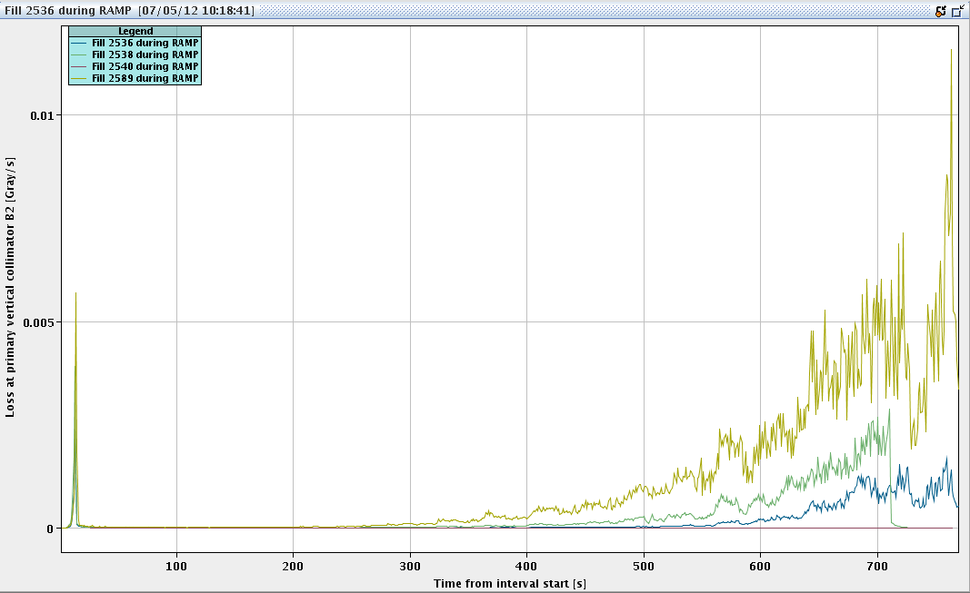
Comparison of losses with 1380 bunches – B2
Deterioration started already before technical stop and continued after technical stop. Effe.cts visible already during the ramp
Fill 2536 – Before technical stop
Fill 2538 – Before technical stop (dump during ramp - HV)
Fill 2589 – After technical stop

Slide 3
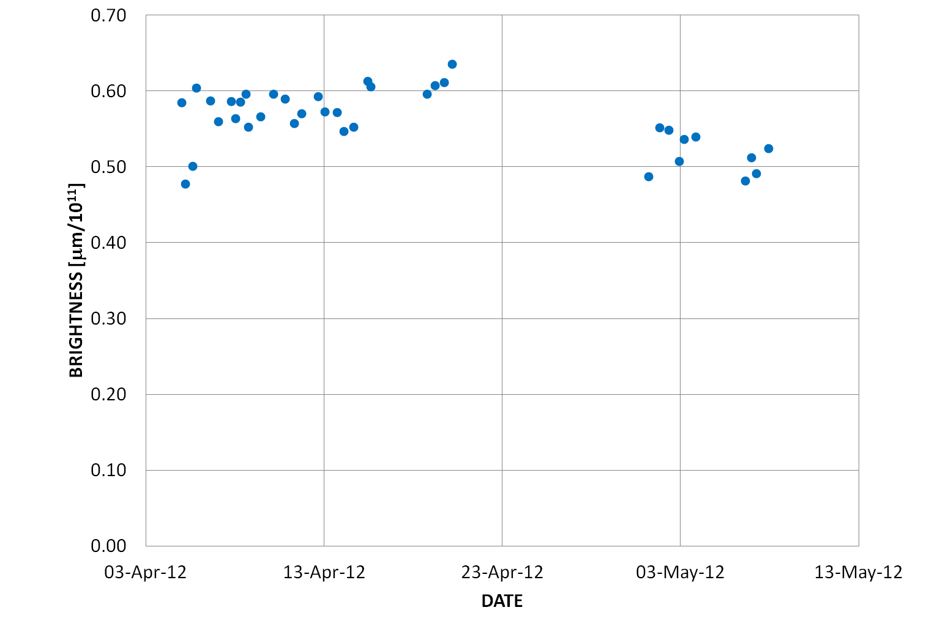
Performance evolution
Loss of brightness 10-20% during technical stop ➔ checking LHC and injectors. Started emittance comparison but large scatter in the emittance data.

Slide 4
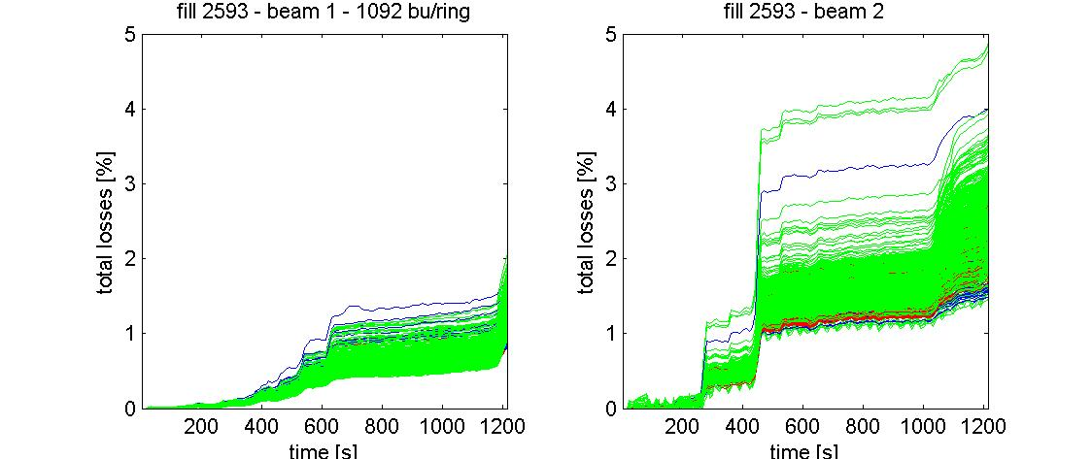
Bunch-by-bunch losses
Losses during the squeeze of the fill yesterday (#2593) shows large asymmetry among bunches
G. Papotti

Slide 5
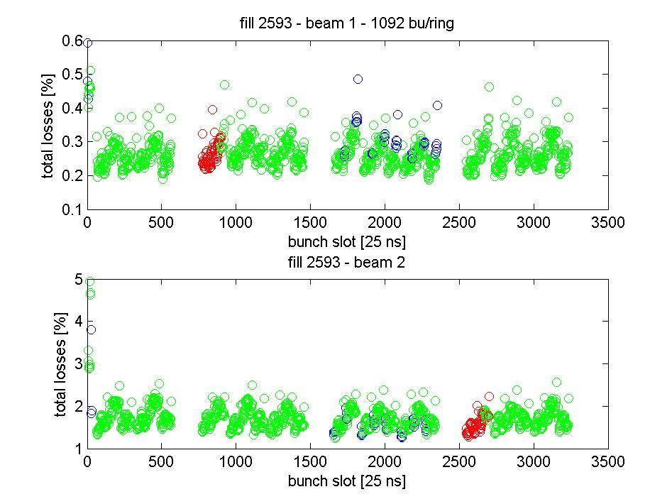
Bunch-by-bunch losses
Losses localized in the first 12 bunches. Found ADT gain modulation still active ➔ disabled and restored ADT functions from technical stop.
G. Papotti

Slide 6
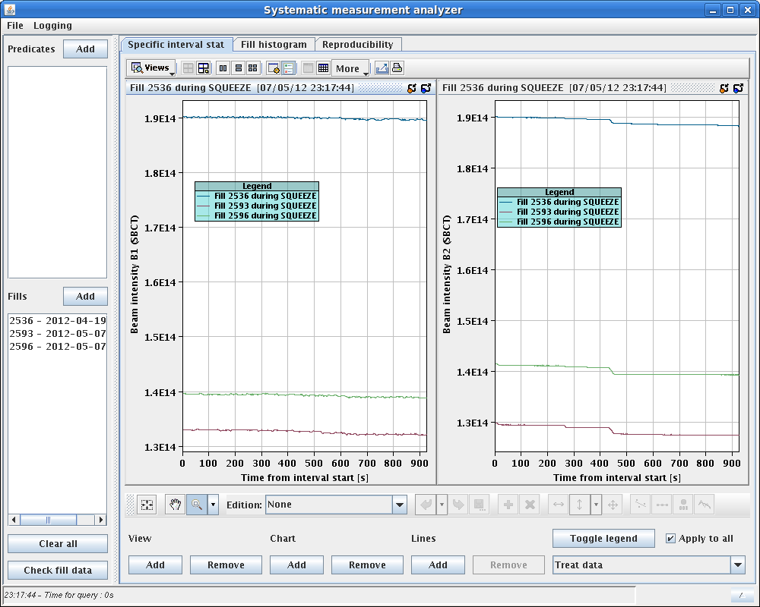
Fill 2593 vs. fill 2596
Tiny improvement (~10%) in the BCT losses. Max. rel. loss ~60% of dump threshold at Q4.L6.B2 at 2 m. No warning level when going in collision. But not yet at pre TS levels. No significant change during the ramp.

Slide 7
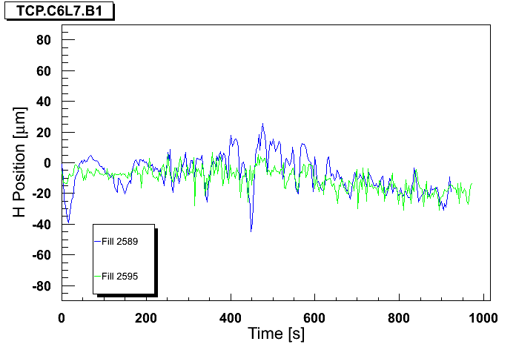
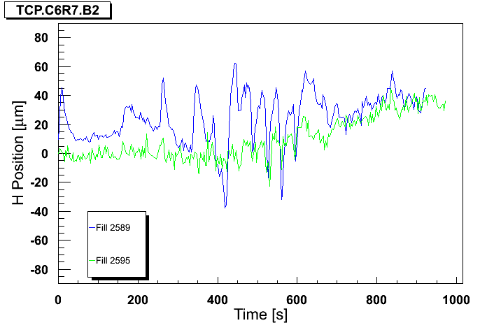
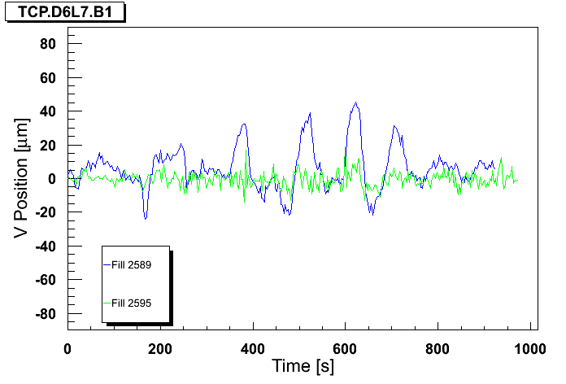
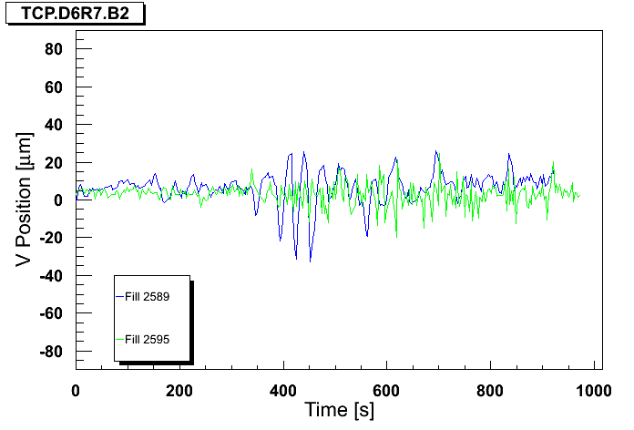
High gain OFB test
R. Steinhagen, J. Wenninger
Blue : standard BW, Green: OFB BW x10
B1H
B2H
B1V
B2V

Slide 8
Orbit Correction
Today implement feedforward after smoothing
Keep low gain for this fill, possibly increase it in future fills by factor 2-3

Slide 9
Collimator alignment check
Summary of TCP IR7 and TCSG IR6 BB Centre checks (G. Valentino) ------------------------------------------------ Collimator OLD (mm) NEW (mm) TCP.C6R7.B2 0.520 0.430 TCP.D6R7.B2 0.770 0.690 TCP.B6R7.B2 -0.235 -0.292 TCP.C6L7.B1 -0.178 -0.235 TCP.D6L7.B1 0.240 0.202 TCP.B6L7.B1 -0.320 -0.415 TCSG.4R6.B1 0.125 -0.035 TCSG.4L6.B2 -0.188 -0.093
The offsets are comparable with the orbit variations observed during the squeeze.

Slide 10
Plan
Dump this fill at 09:00
Next fill (1092 – same intensity) after feed-forward
Looking at the results to see next step ➔ change one parameter at a time
Need to gain more margin on BLM levels before going to 1380 bunches
Pending: TDI checks (Deformation observed before the technical stop not reached yet: half of it)

Slide 11
Pending issues
BPMSA.B4R6.B2 HOR is still sensitive to the probe even when in low sensitivity mode ➔ access to insert some further attenuation in this channel, although it should already be the same as last year (R. Jones).

