Slide 1
Monday morning
08:30: Fill with 2 nom. bunches/beam to collisions.
LHC polarity – (PC).
Vertical lumi scan correction consistent with polarity +.
Horizontal lumi scan corrections differ by 60 um/beam ~ 1 sigma.
Functions for collision BP updated with the new settings.
10:00 TCT alignment check in IR8.
LHCb separated to initial state for leveling.
TCT settings consistent with pol+ settings within 0.5 sigma.
11:00 Loss map with standard collimator settings (the ones established for LHCb pol+).
Betatron and off-momentum (+500 Hz), all OK.
Losses for V plane B2 down a factor 20 in IR2 – as expected with corrected TCTV position.
B1V loss map OK but weak (too little beam) → to be repeated.

Slide 2
Morning/ afternoon
12:00 In the ‘shadow’ of the ramp-down exchange of a weak BLM card – generated fake dumps correlated to temperature. Introduced a delay of 4 hours…
Problem with a BI BLM application for HW parameters due to a special crate configuration.
17:00 Start of TDI check – nominal position 6.8 sigma
Jaw alignment with ADT blowup, TCP defines reference.
TDI.B1 upper/lower : 6.4/6.5 sigma
TDI.B2 upper/lower : 6.5/6.6 sigma
Both TDIs are slightly further in, but within tolerance.
Checked protection of TDI for oscillations in phase with TDI – ok.

Slide 3
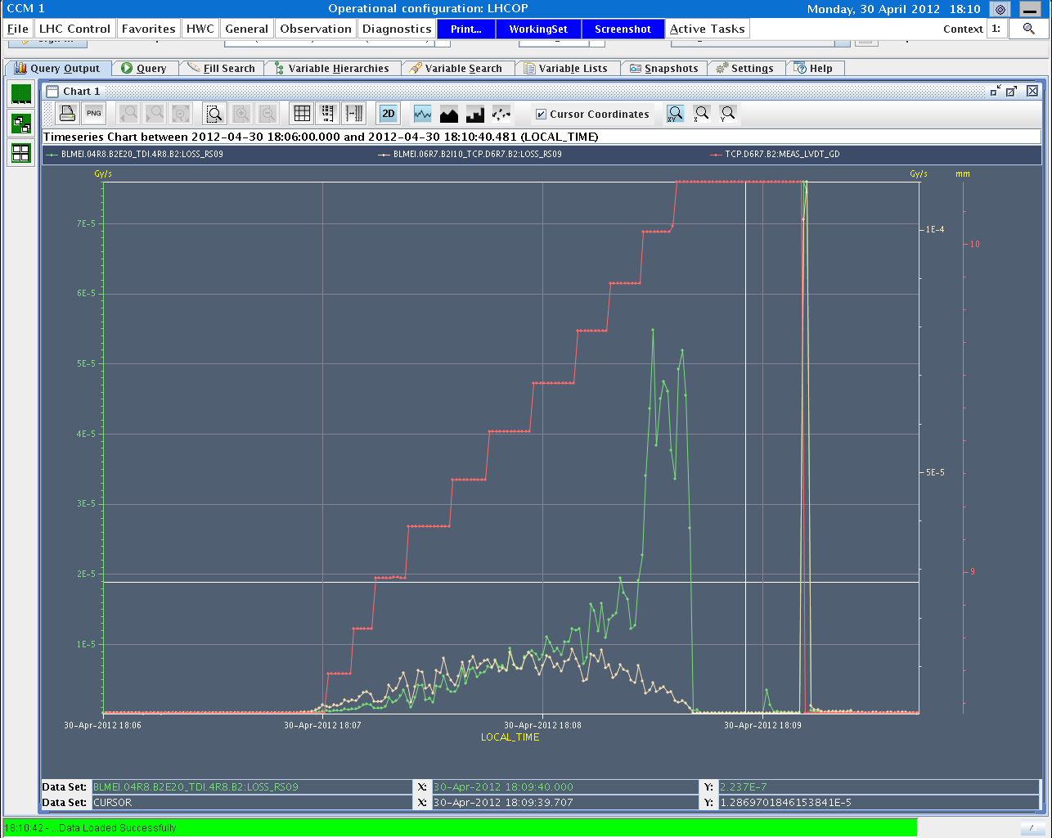
TCP versus TDI
TDI losses
TDI position
TCP losses

Slide 4
BPM interlock IR6
BPM crate in IR3 fixed.
BPM interlock check IR6.
Quality of the results have not improved. Too many triggers (again) on a BPMSA.B4R6.B2.
Checks not complete – to be done (again).
More sensitive with probe to injection oscillations? tbc

Slide 5
Evening
20:30 RF cavity phasing for B1.
Check after discovery of loose cable before TS1.
2 modules were found 9 deg out of phase.
Settings now close to April 2011 situation.
23:30 Loss map at flat top.
Betatron and off-momentum loss map (+500 Hz). Looking good.
During the recovery problem with mode change.
DB storage issue – solved by CO-DB expert.
03:00 Filling for 84+4 bunches.
Injection not great… 1.2E11 / bunch.
05:30 Stable beams
Lumi peak in LHCb when going to collisions?
IP5 (again) rather far off.

Slide 6
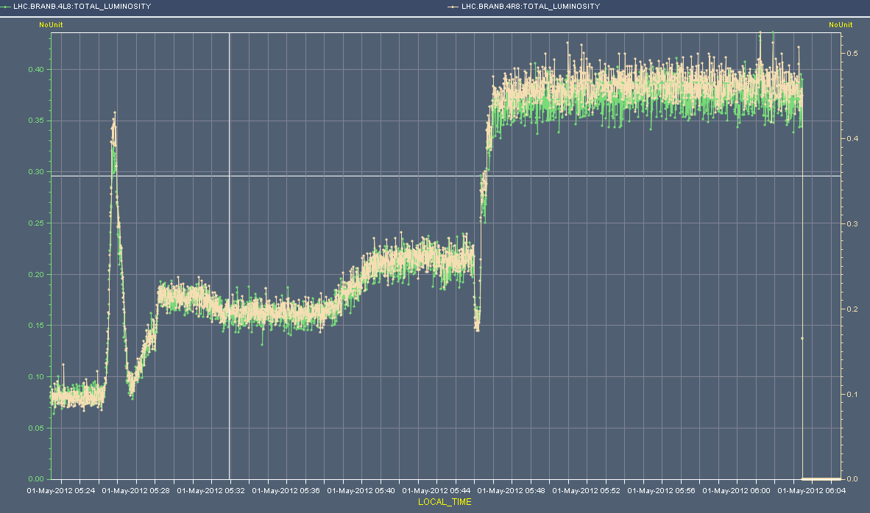
LHCb lumi

Slide 7
Early morning
06:03 Power glitch – 400 kV
Site wide glitch.
All PCs tripped.
All exps off except for CMS.
Cryogenics partially affected (S12, S34, S45, S81).
Cold compressor Pt2 stopped, quickly restarted.
Access.
LHCb, ALICE…

Slide 8
Plan…
Recover machine – end of the morning?
84+4b / length scale
What about ATLAS?
MKI8 kicker synchronization
480b
…and loss map in collision to be repeated.

