Slide 1
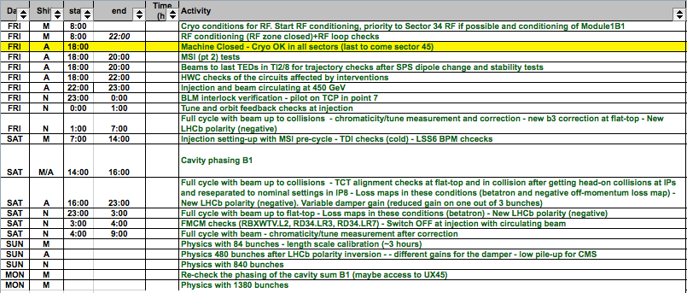
LHC Status Sat Morning 28-April
Gianluigi Arduini, Bernhard Holzer
Restart after Technical Stop:
tentative plan ... as discussed Fri Morning

Slide 2
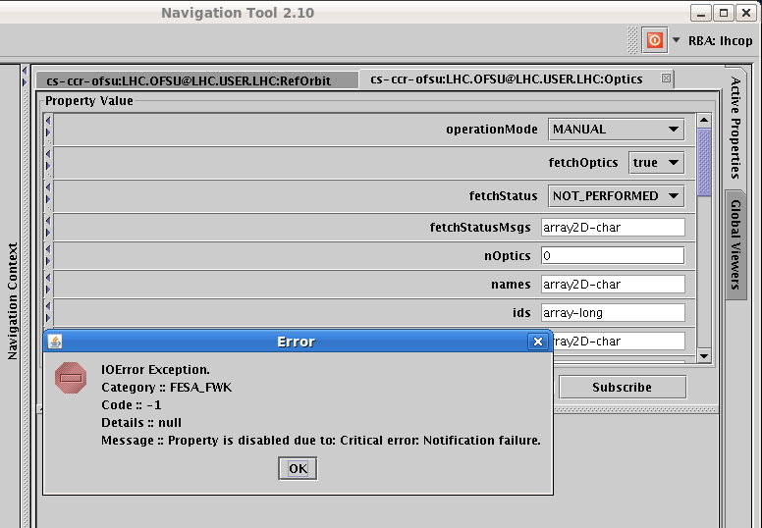
Fri Morning / Late restart after Technical Stop
16:14h Error during the fetch optics again on OFSU,
had to restart the OFSULHC_M process
The OFSU server has been restarted and is working correctly for now. The problem we were experiencing with non responding 'Optics' property is by far not trivial and has to do with Real Time behaviour of OFSU Fesa server. An occasional overload of resources takes place, so that the Communication part of FESA, does not get time to service its notification/get queues.

Slide 3
Fri Late
15:53 LHCb set to “Negative”
16:00 ROF.A81.B2 back in operation
18:00 RP reported that RAMSES monitoring stations are not fully operational.
After the RAMSES system upgrade (started on wednesday),
the monitoring stations are not able to send measured values to be logged
the RP montoring devices are partially blocked and need to be manually rebooted.
18:00 Problem with ATLAS Toroid: power converter recieved an external fault.
The Beam Imminent Warning failed had to clear the interlock several times
... meanwhile seems ok
22:38 Technical Stop now finished ....

Slide 4
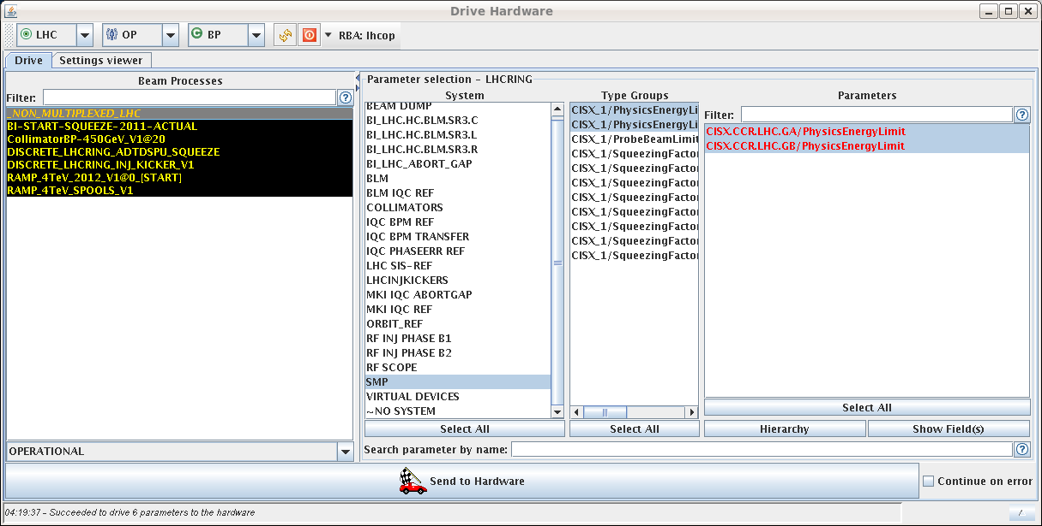
Fri Night
23:45h RBXWTV.L2 tripped (i.e. ALICE compensator)
... it seems as if the water valves on the ALICE compensator were closed.
00:35h RQX.L5 tripped during test-cycle
01:35h DIP-handshake communication problem
... solved via “Chris must have restarted something....”
02:52h problem with loading the ramp functions for the spools: all RCDs have a ref mismatch fault.
03:22h exception for RCBV28.L8B1
04:20h Error during MCS checks
with PHYSICS energy lower/upper.

Slide 5
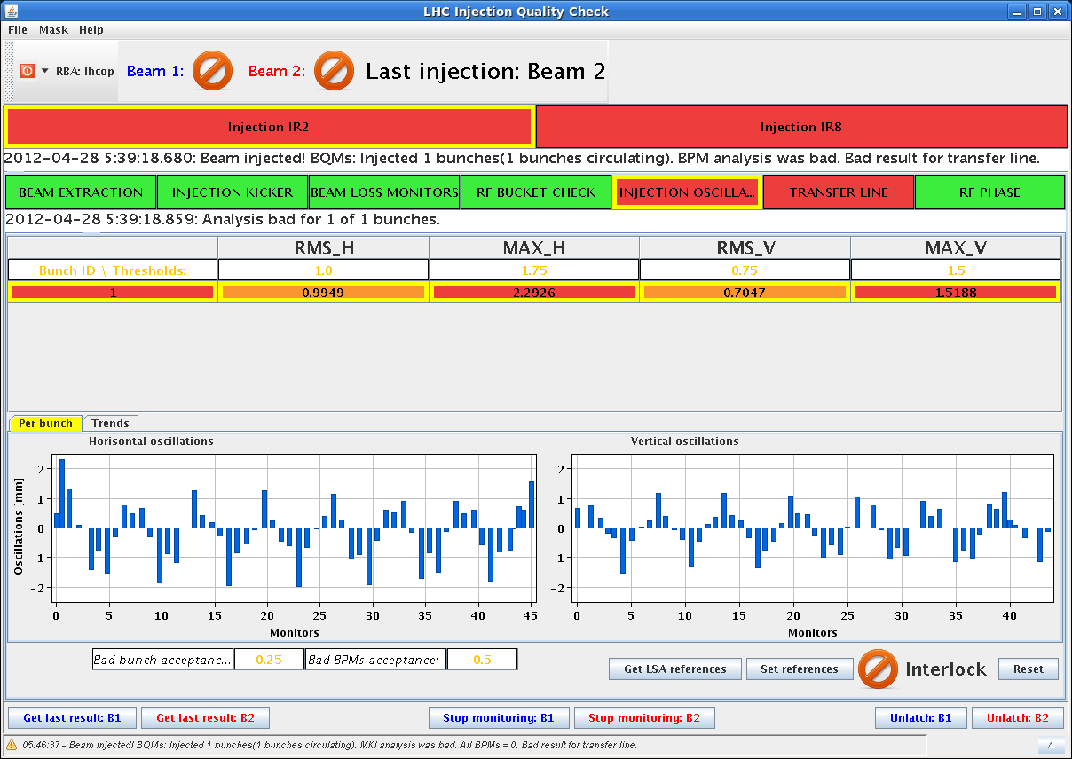
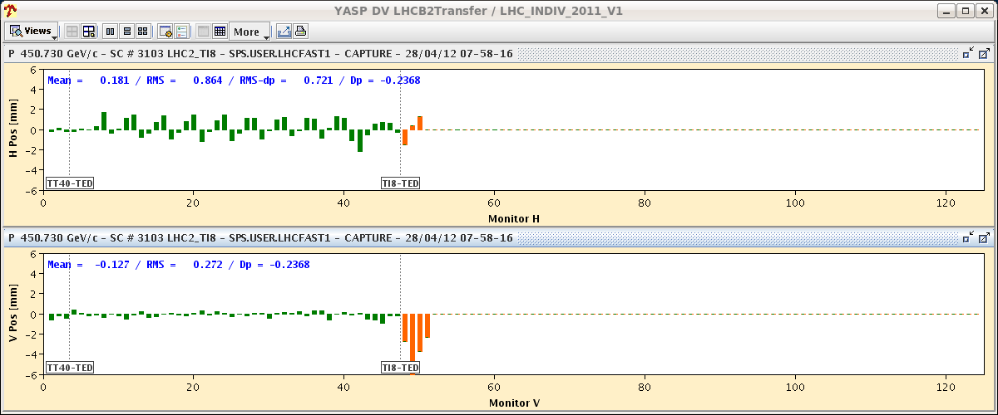
Sat Morning
05:40h FINALLY !!!
B1 probe injected
but high injection oscillations
B2 dumped right at the injection
too high injection oscillations.
Oscillation beam 2 H starting in the arc of TI 8 ...
... meanwhile ok

Slide 6
Sat Morning TDI checks (CB, VK, WB)
Rechecked TDI settings: - blowing up the beam (Tune Kicker) to the TCP - closing TDI jaws (50 um step size) starting from the operational values (angles in) separately until beam is touched Results are consistent wrt measurements on 26-March-12 and also last year's measurement: B1: measure a gap size between the two jaws 30 um smaller than at the TCP B2: measure a gap size between the two jaws 100 um bigger than at the TCP Looking at the gap size for the jaws separately: for B2 both jaws behave similarly, B1 jaws show a difference wrt to TCP setting of up to 500 um; still within our tolerances (angular + position tolerance = 1 sigma) but this eats up our margin left for deformation.
Still missing: repeat validation for TDI 8, and setting check of TDI versus TCP with blow-up (~3 hours)

Slide 7
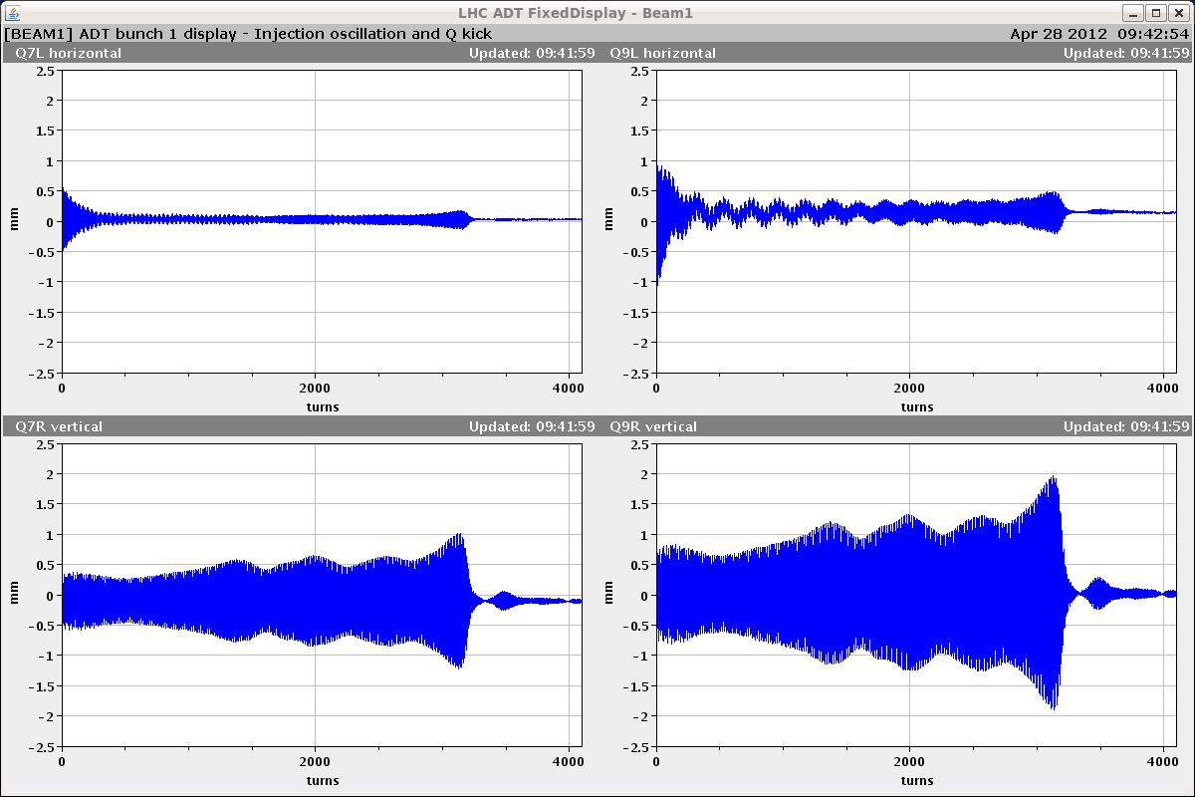
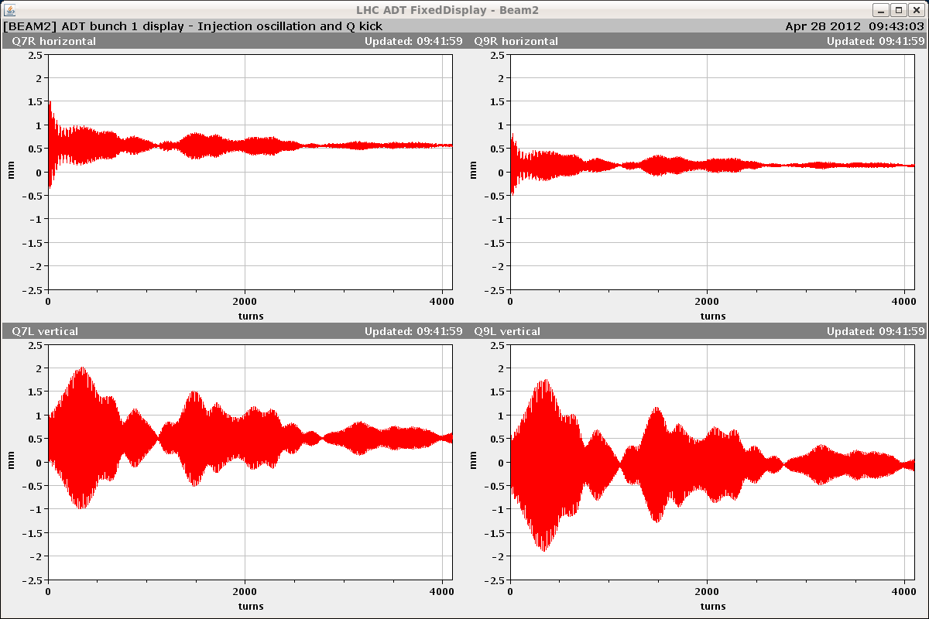
Sat Morning
Damper driving the beam unstable mostly on V-plane
No problem found in the settings (left off for the time being but needed for nominal bunch ramps)
Could be the result of the maintenance on the power amplifiers ➔ need further investigation wit beam
... meanwhile ok

Slide 8
RQF.A12
Sat Morning
12:04: Trip of RQF.A12. Earth fault.
12:04-01:30 Earth fault on RQF.A12
Lengthy diagnostics requiring separating the various parts of the circuit:
Excluded power converter after disconnection of the cables
Excluded cold part after disconnection of the cables at the DFB
Reduced area to energy extraction switch + one warm cable to power converter after disconnection of dump resistor
Inspection at height revealed a metallic collar around the water cooled cable touching the metallic protection surrounding the cables. This was there since few years. Result of vibrations? Actions to be taken under investigation as we have several of these collars.
Re-commissioning of QF.A12 required: started (very carefully) with energy extraction at 100 A after closing the machine

Slide 9
View from below
Sat Morning

Slide 10
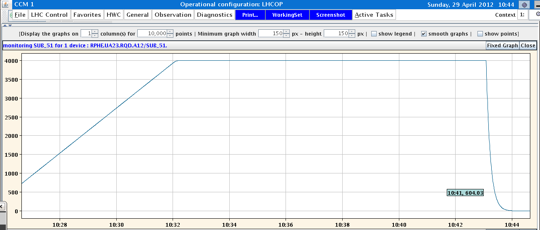
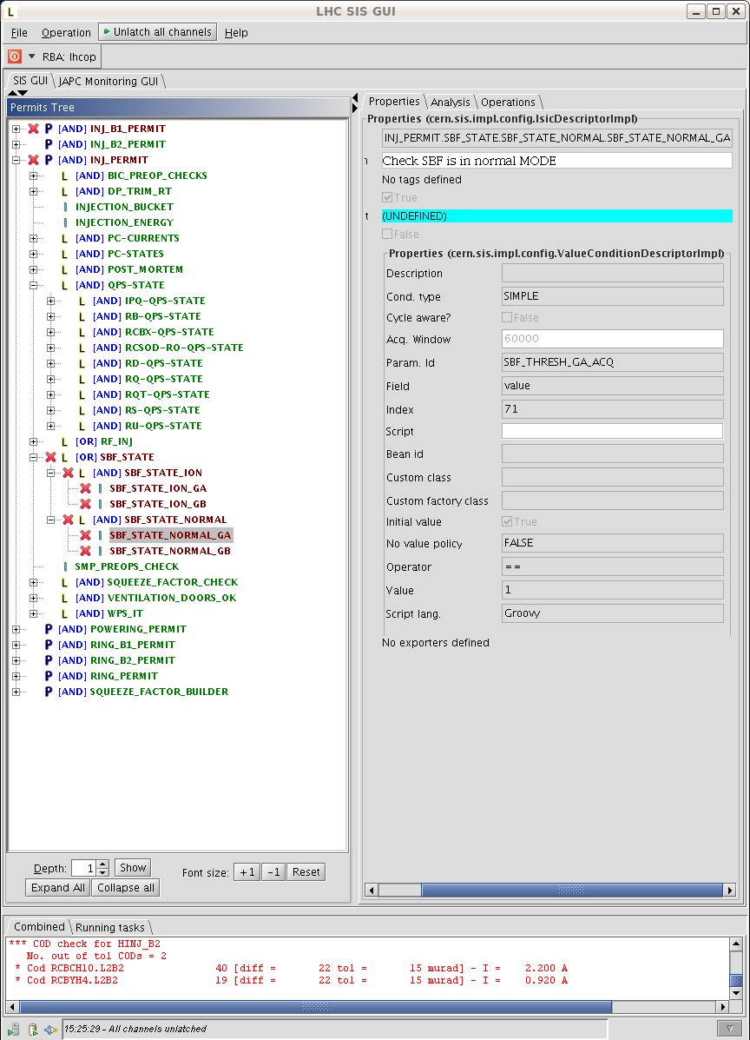
Sun Morning
10:44h Restart, RQF checks
energy extraction checks
“RQD and RQF look identical
Can carry on.”
15:00h Injection set up ... with some hick-ups
SIS SBF_NORMAL interlock needs masking again

Slide 11
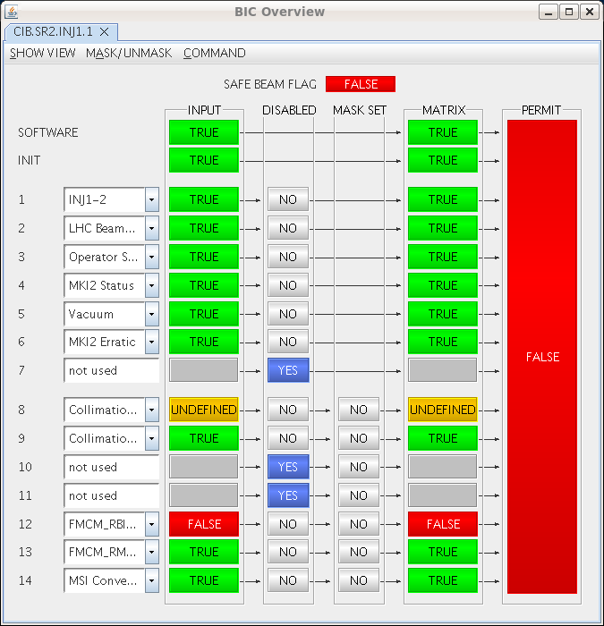
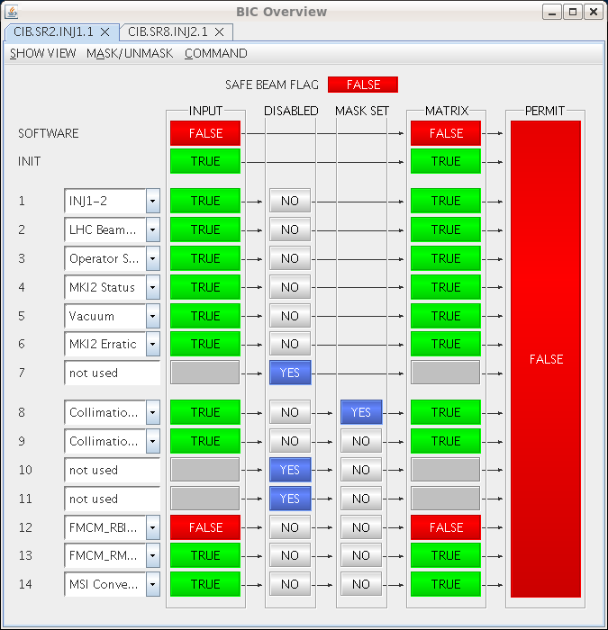
Sun Morning
15:00h Injection set up ... with some hick-ups
Inconsistency of BIS inputs of
collimation on INJ1.1 ... masked for machine set up
21:26h it’s a kind of magic ...
problem disappeared

Slide 12
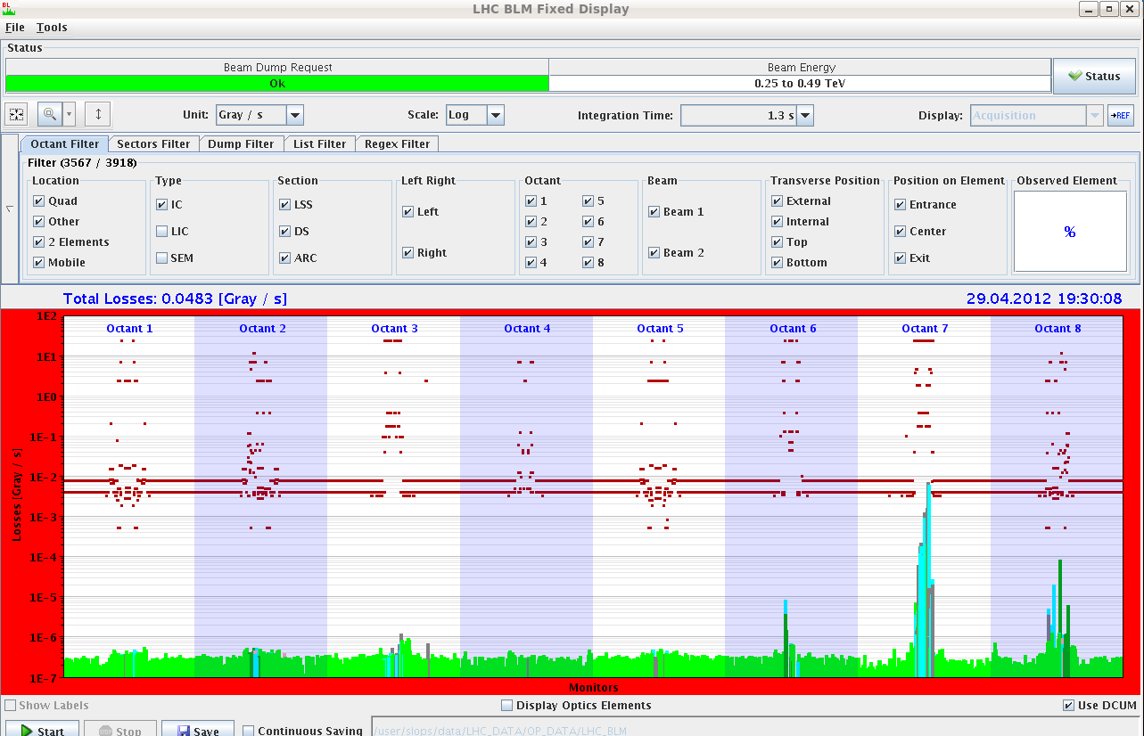
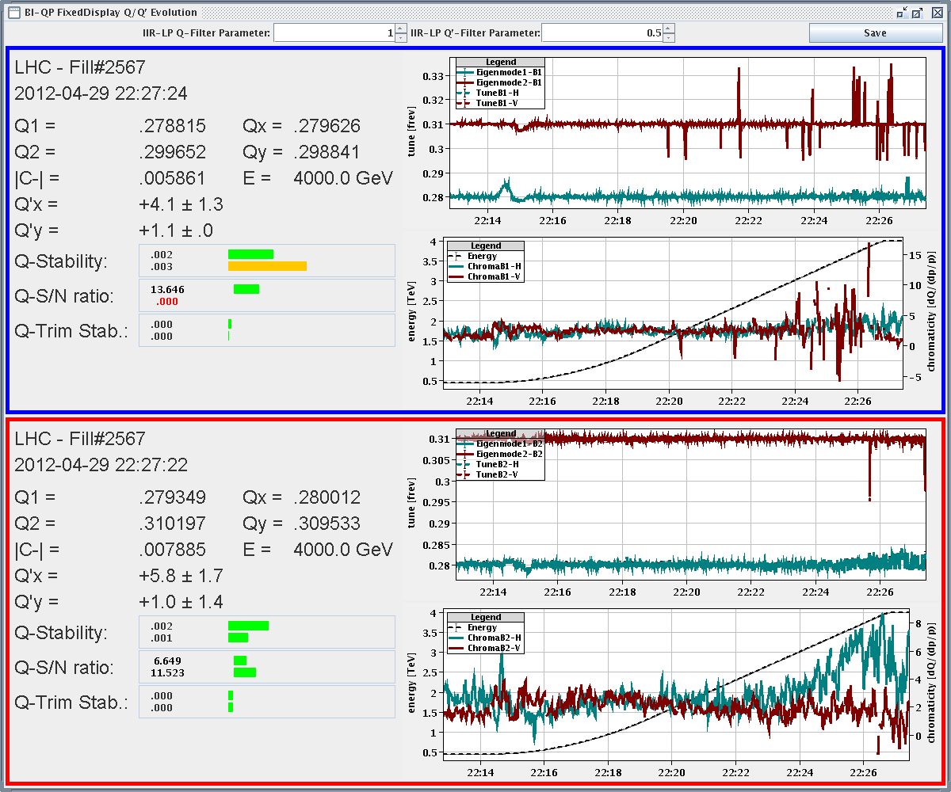
Sun Late ... finally back in business
17:34h BLM tests ... as planned (Christos)
new cards installed during the TS1 to mitigate the HV drop-outs that triggered beam dumps (through the SIS).Cards have been forced to initiate a beam dump by closing an adjacent collimator and injecting a pilot beam and thus completing successfully the agreed verification tests.
18:19h OFB and TFB checks ... as planned
22:14h Test Ramp started
measure Q & Q’ ... fine tuning needed ?

Slide 13
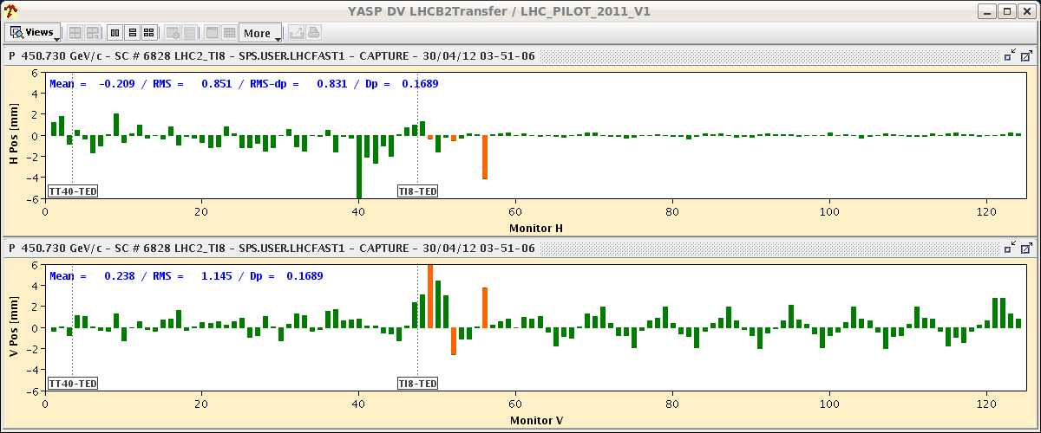
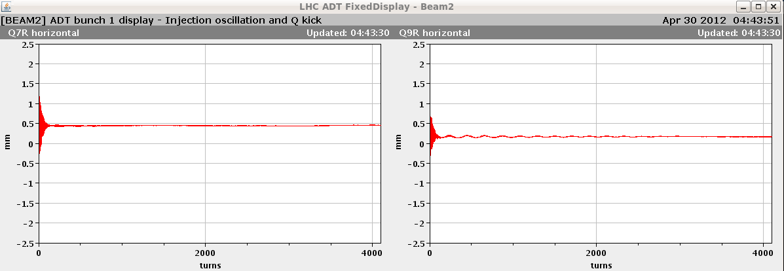
Sun Night ... as planned
23:00h test-Squeeze, correcting Q, Q’, Coupling
beam dump generating a fault on RD34.LR3 (FMCM test)
03:53h injection set up & correction
04:38h injection for ADT checks
just perfect
05:12h injection probes for FMCM checks ...
... on going

Slide 14
ISSUES
* orbit of B2 data from one crate (cfv-sr3-bpmb2lb) is not being recieved by
YASP/OFB. (“work around” installed by Lars)
* BLM crate (SR7.E09) at pt 7 that appears to go erractic (and cause an interlock)
when the ambient air temperature exceeds 28 degrees C (Christos)
* undefined BIS input for Collimation movement (TDI) on the CIB.SR2.INJ1.1
BIC ... re-cured suddenly “durch Handauflegen”
*correctors RCBV17.R7B2 and RCBV28.L8B1 are off (were actually on at
standby causing orbit problems)

Slide 15
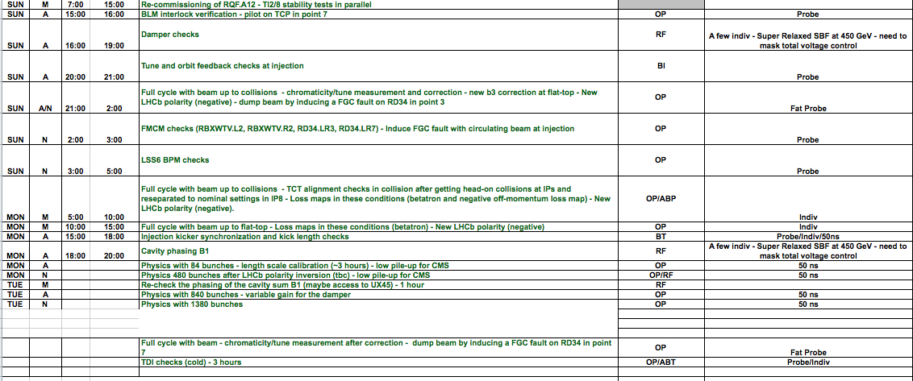
PLAN
✔
✔
✔
✔
✔
✔

