Slide 1
Tue 18.04.12
04:01 Injection kicker timing problems B2
Injection pre-pulse shifted, causing BETS to inhibit beam injection. 144 bunches on TDI.
Run without ROF.A81B2 until TS. The current of the other octupoles increased in functions to compensate.
10:30 Filling 1380 x 1380.
MKI resonant charging length increased.
11:48 Dumped by operator during ramp.
Losing almost all BPM crates on beam 1
13:00 Filling 1380 x 1380
13:47 Dumped by operator during ramp.
Again lost orbit reading on many crates, beam 2

Slide 2
Tue 18.04.12
14:00 BPM investigation.
Decide to perform PS intervention on septum in the meantime.
Access Atlas and beam dump.
Restart of SIS with slightly tighter tolerances on COD trips.
16:32 Injection. BPM investigation ongoing.
When rebooting the BPM concentrators, it was observed that all the B2 front ends rebooted. This is not normal, and so we should not reboot concentrators with beam in until this issue is resolved by BI.
17:54 BPM issue solved by rebooting CS-CCR-COLSA (→ report Alastair Bland).
18:31 1380b filled.
19:19 First stable beams with 1380b. New LHC record luminosity: ~5.1e33.

Slide 3
LHC beam dumps at 11:48 and 13:47 18/4/2012
Alastair Bland
BE/CO

Slide 4
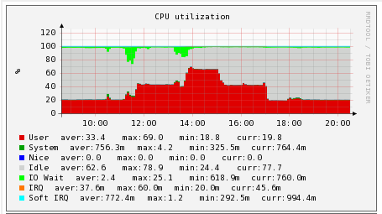
First Beam Dump at 11:48
The CPU load and memory use on CS-CCR-COLSA (Concentrator for BPMs and BLMs providing data to the YASP steering program) rose a lot from 11:30. Marek Misiowiec restarted the Injection Oscillation programs on this machine at 11:37. A few minutes later the CPU load (perhaps due to lack of memory) rose for BUNCHORBIT processes.
From 11:45 to 11:48, nineteen of the Beam1 BPM Front End Fesa servers crashed and restarted after 20 seconds.
At 11:48 Verena dumped the beam as she could not see Beam1 any more.

Slide 5
Second Beam Dump at 13:47
A similar scenario occurred from 13:45 to 13:48 when ten of the Beam2 BPM Front End FESA servers crashed. Verena dumped the beam at 13:47.
Note that there was an unrelated event at 13:52 when the General Purpose Network Router of IT/CS for the CCC and Prevessin site crashed.
Later in the afternoon there were more problems with missing BPM data and unusual BPM response times in YASP so I rebooted CS-CCR-COLSA at 17:54 to clean up the memory.
The machine was swapping again, but less, during the injection around 18:30.

Slide 6
Recommendations
Add more memory to CS-CCR-COLSA tomorrow, and/or during the Technical Stop next week, upgrade to a more powerful machine.
Marek says that the amount of memory used by the CS-CCR-COLSA processes is proportional to the number of bunches requested.
The reason that the BPM Fesa servers on the Front Ends crash when there is a slow client like CS-CCR-COLSA needs to be investigated.

Slide 7
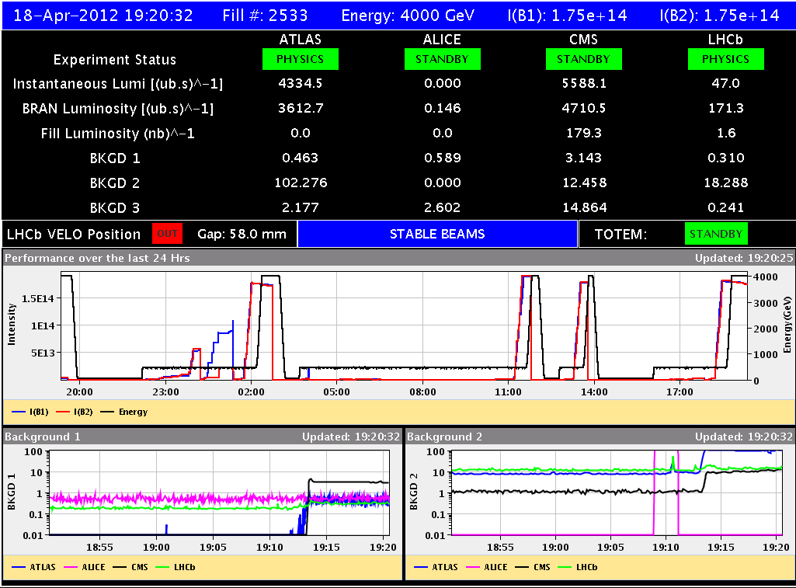
Stable beams 1380b (114 MJ)

Slide 8
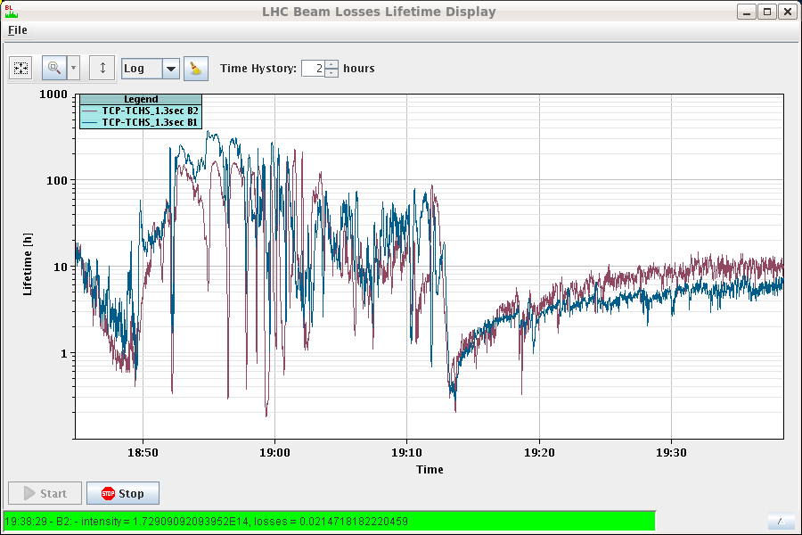
Lifetime Ramp & Squeeze & Collision

Slide 9
Vacuum conditions at Pt 2 left side ....
ALICE can still not take data ~2h after start of fill
Highest pressure at VGI.514.4L2 (109 m from IP i.e. at end of 80cm diameter vac chamber in front of D2)
Also left right comparison of VGI.514 gauges
Seems that the increase in intensity has an effect on the e-cloud level in the large vac chambers on both sides of ALICE, but it is worth noting that for fills with 1096b the vac pressure rise decreased with number of fills
Alick

Slide 10
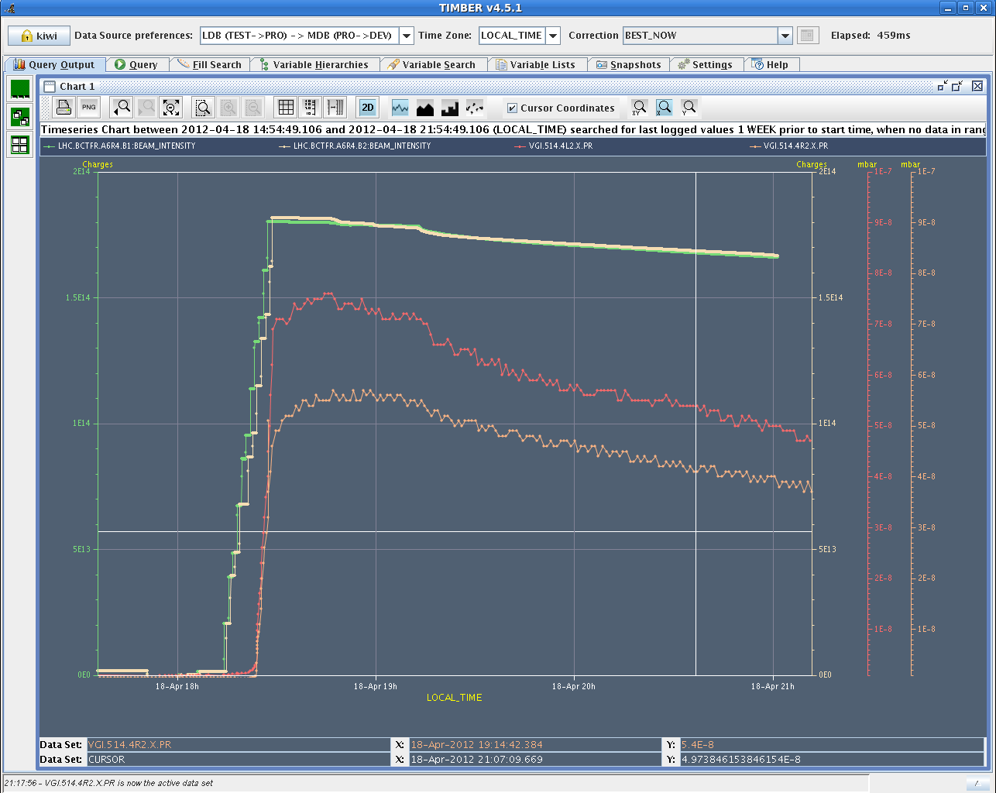
Left –Right Comparison Vacuum IR2

Slide 11
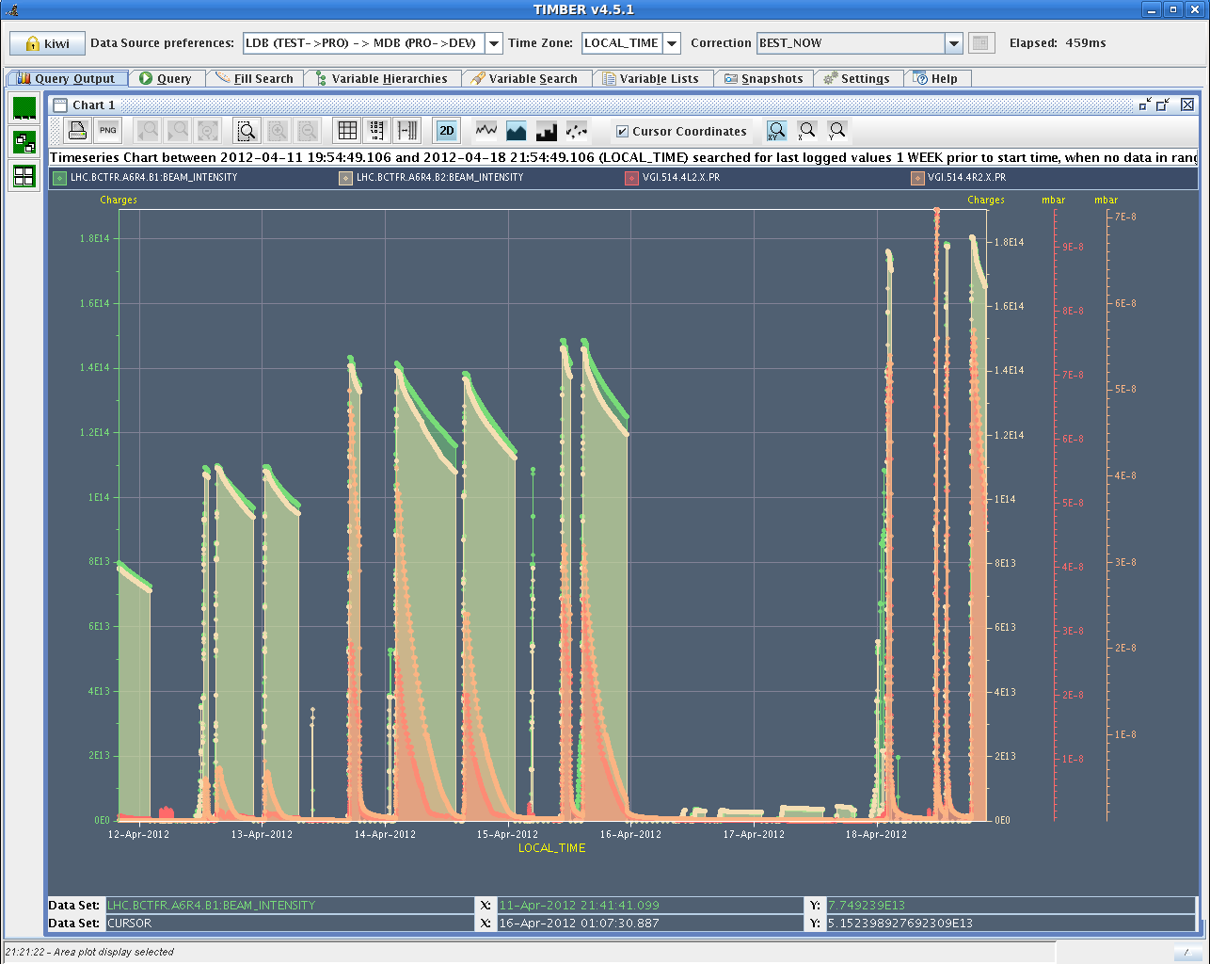
History Last 6 Days

Slide 12
Tue 18.04.12
21:53 Abort gap population creeping up for B1.
22:14 Abort gap cleaning switched on.
RF low level piquet checking: phase loop for beam 1 more noisy, but is this the problem?
01:53 RCBV17.R7B2 tripped as happened few days ago: SIS intercepted.
TDI interlock:
The interlock treshold has been change for TDI.4R8/InterlockThresholdFunct#dump_inner_gap_upstream from 9.3117 to 9.27, and we don't touch position.
05:54 Stable beams, 1380b.
Again rapid debunching, this time starting much earlier in collision.
RF checking (Themis)

Slide 13
B1 Issue (Debunching → RF?)

Slide 14
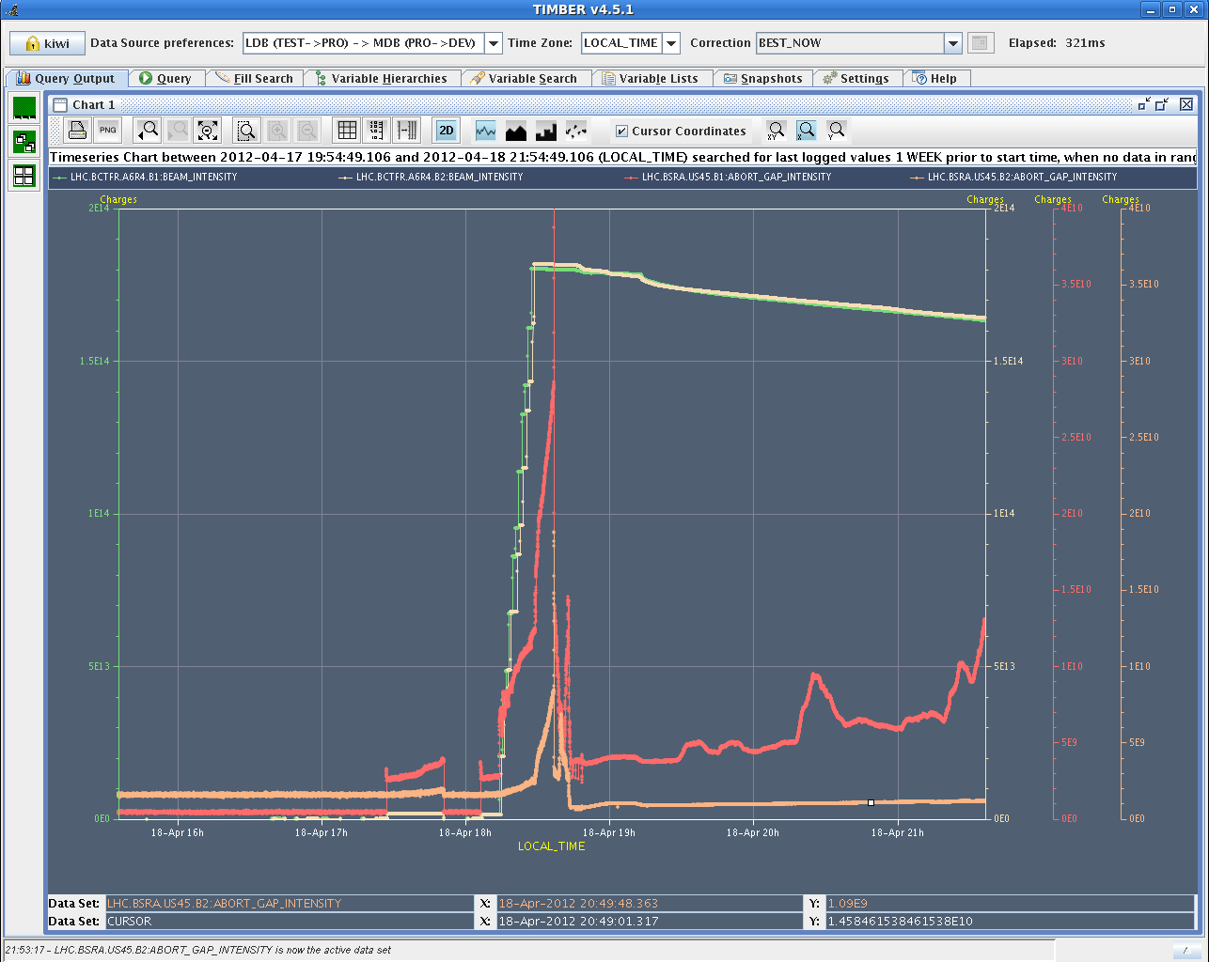
Abort Gap Population

Slide 15
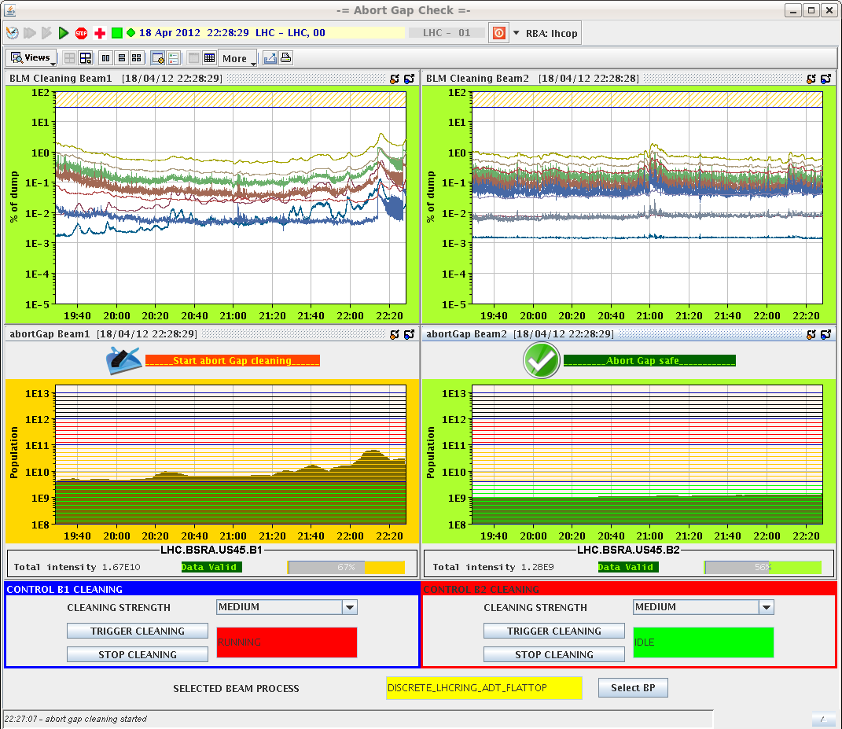
Abort Gap Cleaning

Slide 16
First and second fill: Intensity

Slide 17
First and second fill: Lumi

Slide 18
ADT Issue (Wolfgang H.)
Currently one amplifier for beam 1, vertical (ADT) down.
There is one bad tetrode in there and the amplifier has been put in an idle state by blocking both tubes with the Ug1 voltage. The result is that we have with a loss of this amplifier 25% less gain and kick strength for vertical beam 1. For me this is acceptable. The intervention has been done by Gino Cipolla on the surface in SR4 (to take out the amplifier).
Ahead of the MD and the technical stop:
we from the LLRF (Daniel and myself) would like to go through all amplifiers of ADT with a test signal when there is no beam to check if there are other weak tubes that need attention before the MD or during the technical stop.
The matter is not so urgent, but still can you contact us at the earliest tomorrow a.m. for such a check when there are slots of 1 hour without beam ?

Slide 19
Planning Ahead
Thu – Fri Physics with 1380b.
Sat 06:00 Start of LHC MD #1 (cut short by 1 day)
Mon 06:00 Start of LHC technical stop (new software for orbit feedback)

