Slide 1
Tuesday 10th April - morning
Access for:
point 3 Jerome Landaro TCSG one jaw didn't move
point 5 Qps expert on RPMBB.UJ56.RCBXH1.R5
point 6 TCDQ diagnostics
10:30 PM65 lift doesn't work!
11:45 Lift back in action
13:05 Access over
13:30 Pre-cycle
14:40 Problem with TCSG.5L3.B1…
See Roberto Losito

Slide 2
Tuesday 10th April - afternoon
15:15 beam in
Two loss maps at 4 TeV unsqueezed – efficient
Q’ on the ramp
19:20 ramp 624 for physics
Short life time dip in squeeze
warning on BLM (TCLA.B6L7.B2) around 2m
Up to 77 % of dump threshold during collisions BP
on RS 5.2 s for BLMQI.5L7.B2I10_MQWA.E5L7
around 35% on TCLS.C6R7.B1 on RS 20.9s
(note 30 minute lifetime for 10 seconds dumped beam on the 1.5e11 fill yesterday night)
20:00 Stable beams #2500
2.3e33 cm-2s-1, 1.33e11 ppb

Slide 3
Tuesday 10th to Wednesday 11th
01:45 #2500 lost to controls problem (fibre optics repeater) which impacted cryogenics
Cryo maintain lost in MSL2 and ITL2, sector 12.
2:20 rest of S12 tripped
consequence of the loss of comm: the DFBs are no more under control and the temperature of some leads has increased. U_HTS of lead 3 is exceeded the 3 mV and the fast abort is sent.
Pre-cycle, re-injecting around 6:15
08:00 Stable beams
Lift horizontal tunes to nominal before collisions – losses down to 42% of dump threshold going into collisions

Slide 4
TSCG
The issue with the collimator TCSG.5L3.B1 was traced back to a mechanical problem with a roller screw on one motor axis of the left jaw.
The repair would requires realistically half a day and could hardly be done immediately. We therefore propose to continue the operation without moving the left jaw from the its injection settings. The other jaw can be "ramped" with the usual functions (one-sided cleaning at top energy).
Expect a small effect on the system performance
validate these new settings with off-momentum loss maps at flat-top (both signs) – done – loss maps OK
Stefano Redaelli

Slide 5
TCSG
Actions taken by collimation team
1. Flatten functions for left jaw during the ramp: constant at injection settings.
2. Updated interlock limits for left jaw and gap.
3. Updated energy limits for the gap.
4. Updated parking positions for left jaw only in order not to move it during the "precycle".
Injection positions are not affected. No actions are required for squeeze and collision functions because these collimators reach their final positions at the end of the ramp.
Stefano Redaelli

Slide 6
Orbit feedback reference problem
Circumstances in which the problem arises understood although not the problem itself (yet)
Situation can be categorically diagnosed before starting ramp and squeeze
Actions:
Manual checks before ramp and squeeze
Sequencer task to check set against requested (Laurette, Roman)
SIS interlock checking values of published reference orbit (Jorg)

Slide 7
Orbit feedback reference problem
In the meantime, Maxim will take advantage of the current access to stress test development version with the sequencer with the help of Laurette.
Also agreed that CCC will be is Maxim’s new office until the problem is solved so he will have a chance to better diagnose the issues!
Problem probably understood
Race condition between server task and real-time task (missing mutex protection) – if confirmed – simple fix
Meeting this morning to discuss strategy
Jean-Jacques Gras

Slide 8
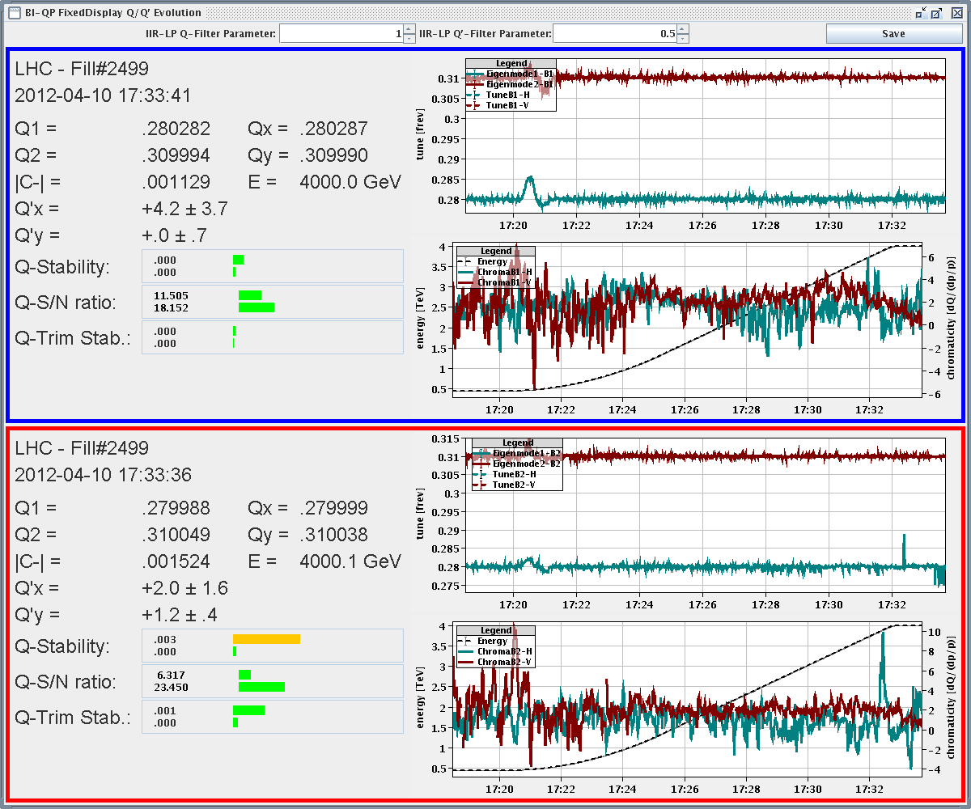
Q’ on ramp

Slide 9
On the list
Raise thresholds of long RSs of MQWA BLMs etc.
Bunch length ~1.2 ns on flat-top
Lifetime dip in squeeze around 2 m – orbit?
840 bunches
FMCM test at injection and 4 TeV with safe beams
Active filters of RDs on/off MZ
EOF Losses either side experiments with TCL in/out SR
TL stability studies
require 1.5h of beam extracted from the SPS onto the TED in TI2/TI8(beam not injected). Lene

Slide 10
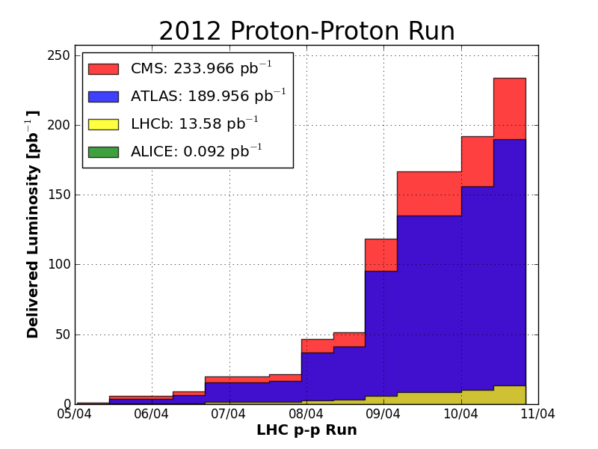

Slide 11
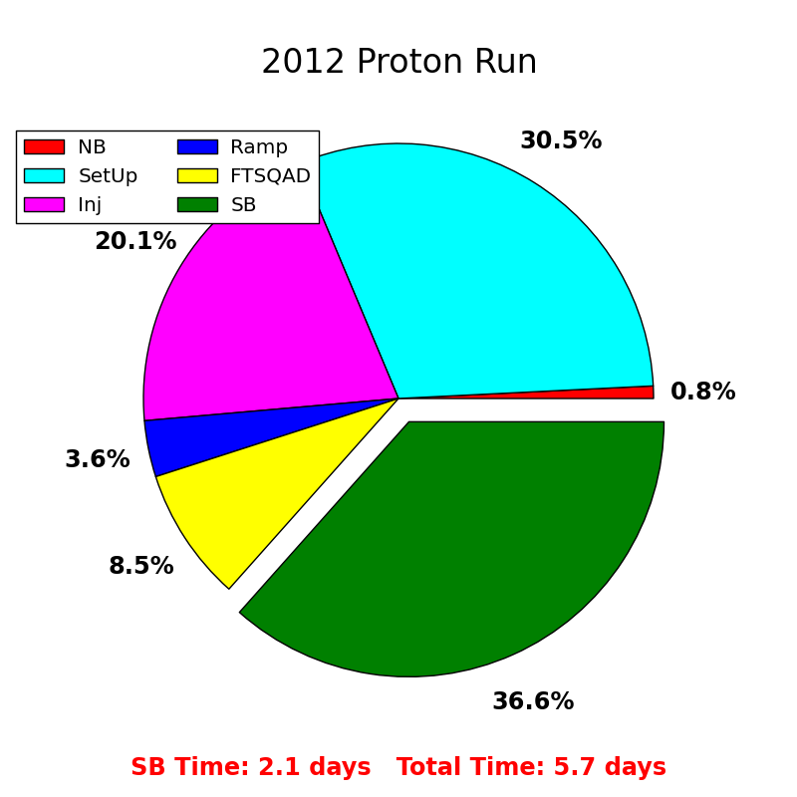

Slide 12
