Slide 1
Saturday 7.4.2012

Slide 2
Saturday Morning and Afternoon
7:58 Fill 2483 (264 bunches) dumped by reference orbit set to zero in V plane in the last step of the squeeze → new SIS interlock triggered as it should
Problem investigation
Fill 2484 to test the procedure for collisions in IP8 (3 bunches);
12:13 dumped by OFSU problem during squeeze
Fill 2485: Corrected the beam process for going to LHCb tilted crossing without having head-on collisions at LHCb. → tested successfully
Loss maps: B1 H + V, B2 H + V + longitudinal (-500 Hz)
19:17 – 20:47 stable beams fill 2486 (84 bunches)
Average intensity
start of ramp: 1.35x10¹¹ ppb
start of stable beams: 1.33x10¹¹ ppb
Initial luminosity: 2.9x10³²cm⁻²s⁻¹
1.4 pb⁻¹delivered in 1:36 hour

Slide 3
Saturday Night
22:00 – 23:23 no beam from SPS: trip of main power supply (Depart 18 kV BA3) – only 36b missing for B2
0:48 – 5:09 Fill 2488 stable beams (264 bunches)
Average intensity
start of ramp: 1.34x10¹¹ ppb
start of stable beams: 1.31x10¹¹ ppb
Initial luminosity: 9.6x10³²cm⁻²s⁻¹
10.5 pb⁻¹delivered
7:17 Fill 2489 stable beams (264 bunches)

Slide 4
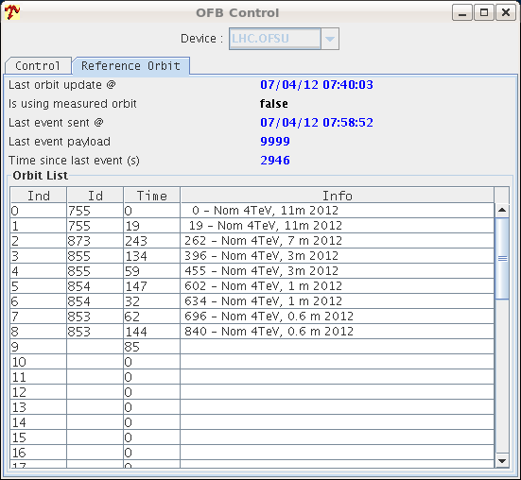
Orbit feedback missing reference
Problem with transmission (or reception) of the references to the OFSU
Caught with the new SIS interlock
Found a way to diagnose the problem before launching the squeeze → repeat the sequencer task sending the orbit references till they are received all right
Origin of the problem to be investigated/solved next week
Missing orbit reference

Slide 5
OFSU crashing during the Squeeze
Problem unrelated to the previous one
OFSU reconnected automatically and with the correct reference orbit, but it was disarmed.
→ rearmed it → it did take the correct reference, but with a scaling factor of zero → beam dumped by SIS
→ if it had not been rearmed, it would have continued with a frozen orbit reference and the SIS would not have dumped. It would have driven the orbit towards the collimators.
→ SIS interlock for OFSU down was reduced to 9 sec during the squeeze by Joerg, to catch this problem. Deployed and tested successfully.

Slide 6
LHCb tilted crossing
Translating of the procedure into functions:
0 – 40 sec:
Reduce vertical separation -650 um-> -100 um
40 – 60 sec:
create vertical crossing angle 0 -> + 90 urad
100 sec – 220 sec:
create horizontal separation 0 -> + 42 um to get the beams in the leveling plane (diagonal)
collapse horizontal crossing angle -> 0 urad
All positions calculated relative to the measured (30.3.) position of the head-on collisions.
All signs apply for beam 1 and have the opposite sign for beam 2.
All settings for positive LHCb polarity.

Slide 7
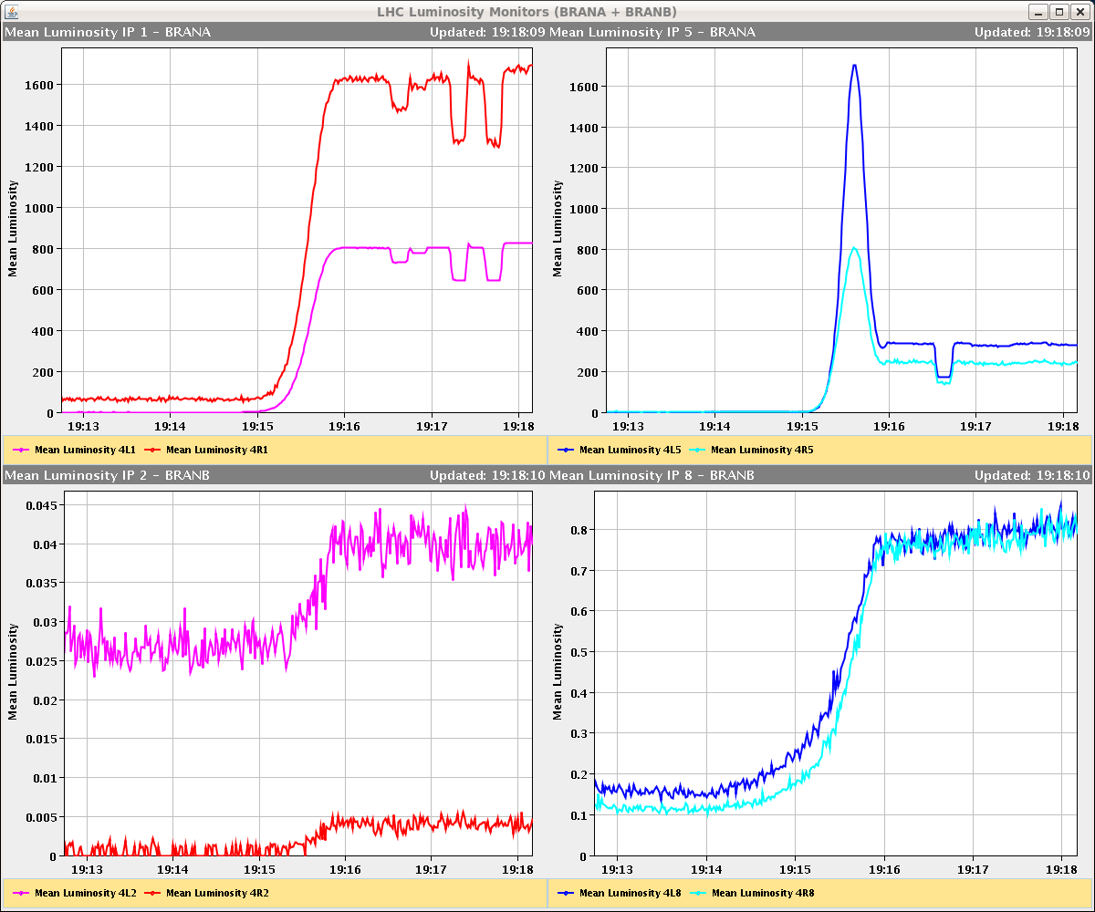
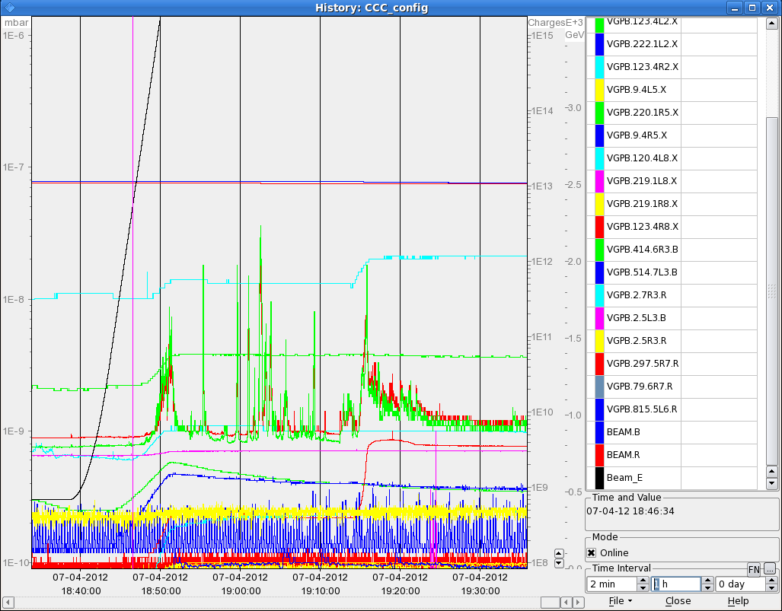
Fill 2486
LHCb: beams stay separated during the physics process; automatic leveling worked fine
CMS: collapsing of the separation goes to far → updated settings
Some vacuum activity
4L8 and 6R7

Slide 8
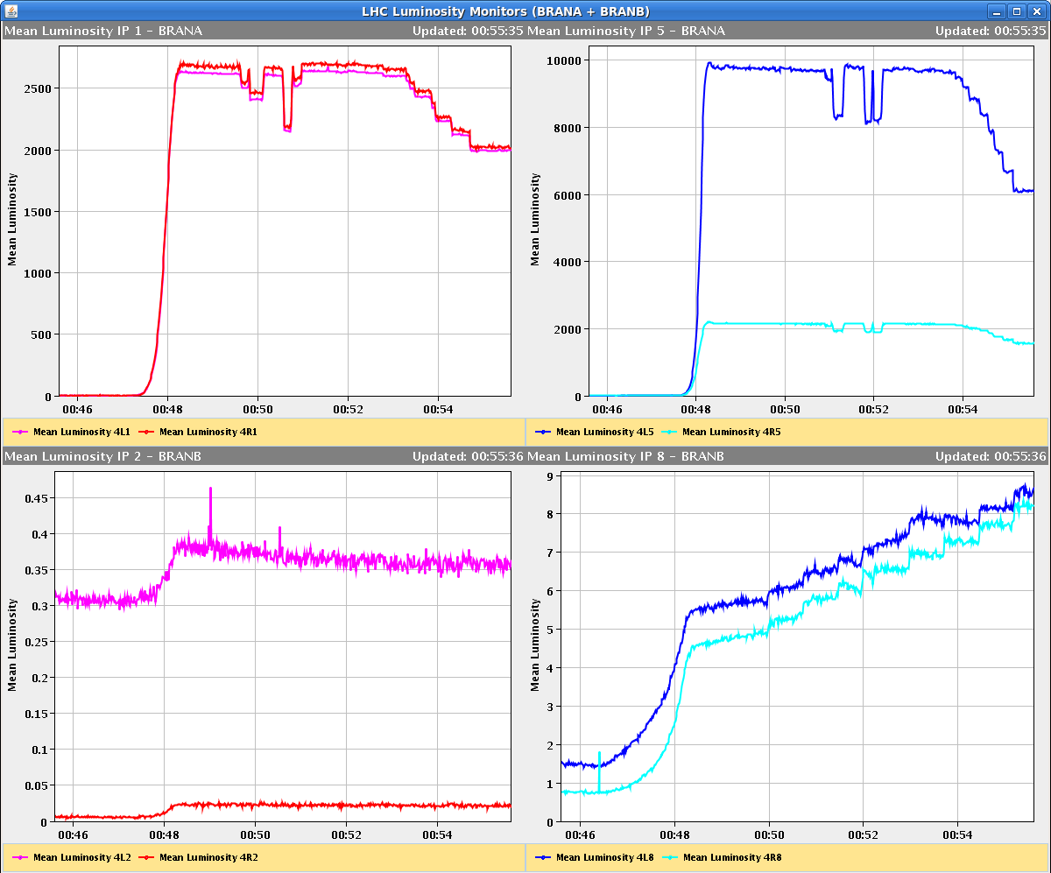
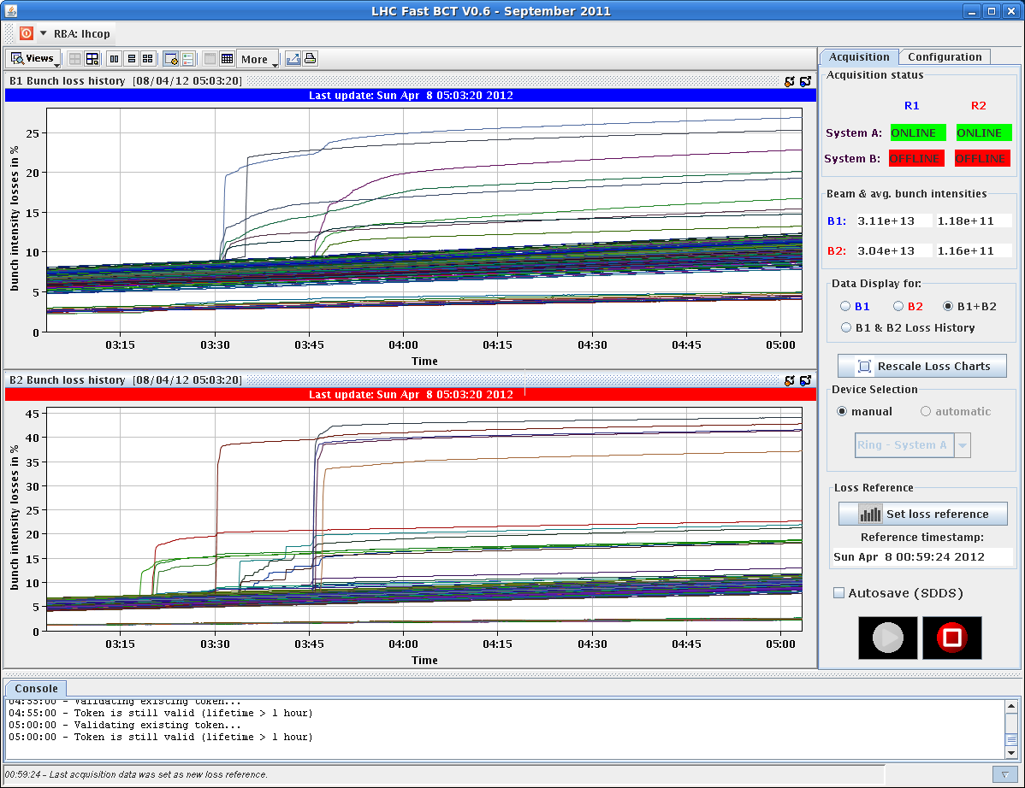
Fill 2488 – 264 bunches
Atlas and CMS separated to 75% peak luminosity and stay with constant offset for 1st hour
Atlas and CMS at 100% for 2nd hour
3rd hour separated to 75% again (2:59)
3:20 – 3:50 Sudden losses on several bunches
4:04 back at 100%
5:09 beams dumped

Slide 9
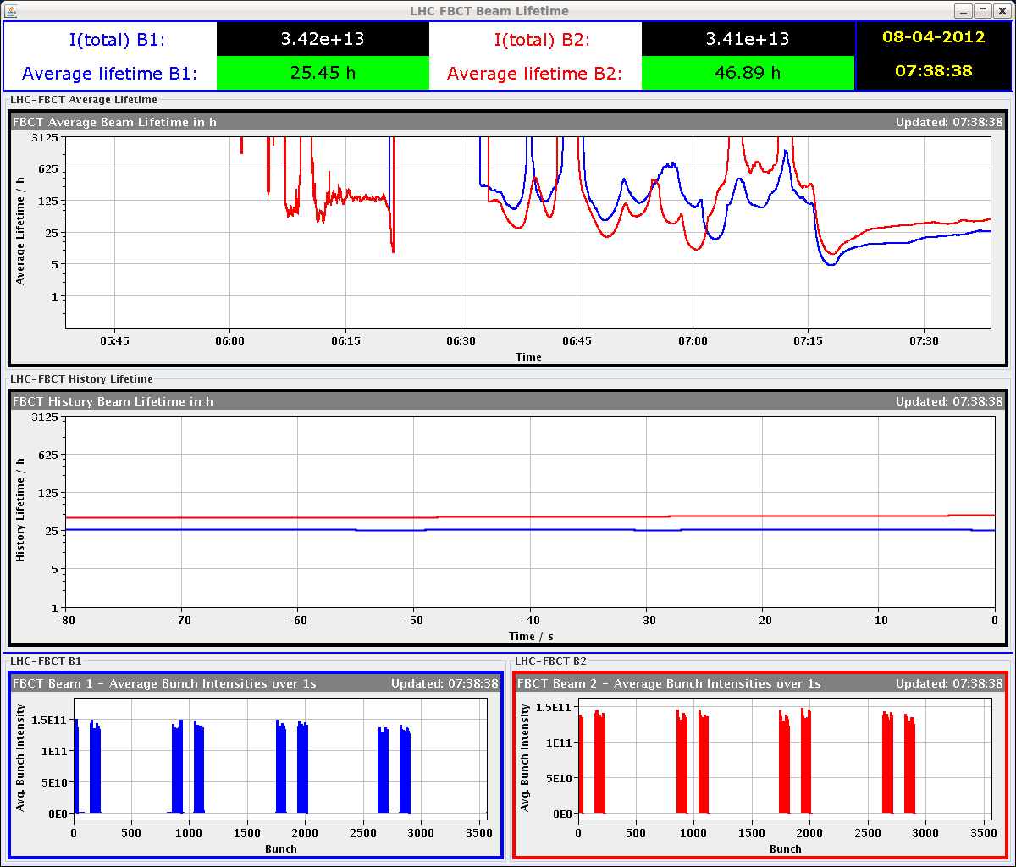
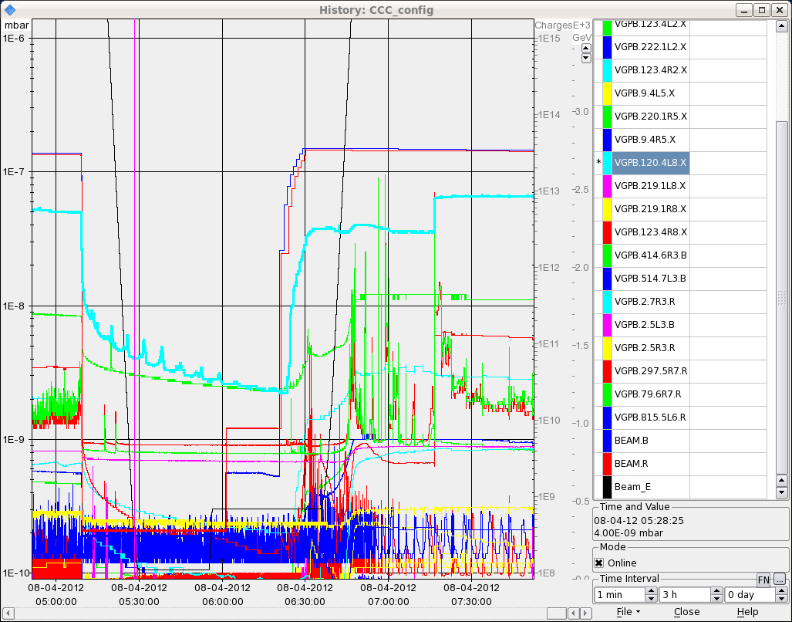
Fill 2489 – 264 bunches
Atlas and CMS separated to 95% peak luminosity and stay with constant offset for 1st hour
8:24 Atlas and CMS at 100% for 2nd hour

Slide 10
Fill 2488 – 264 bunches, cont.

Slide 11
Others
Tune change in the collisions beam process:
B1: previous increase was reverted back to a flat function
B2: increase by 2E-3 both planes
ADT: increased by a factor of two (from 0.02 to 0.04) on Friday
Trip of ADT (module H2B1)
At the moment: tune FB off during squeeze and collision
Problems:
Orbit feed-back reference
High losses on some bunches

Slide 12
Planning

Slide 13
Planning
Friday till Monday the morning meeting will be at 9:00
Tuesday 8:30 summary of the week
2-3 fills and 4-6 hours with 264b and 624b (cycle validation)
3 fills and 20 hours with 840b, 1092b, 1380b (intensity/lumi related problems)

Slide 14
Intensity ramp-up
2-3 fills and 4-6 hours with 48b, 84b, 264b and 624b (cycle validation)
3 fills and 20 hours with 840b, 1092b, 1380b (intensity/lumi related problems)
MP checklists after 84b, 624b, 840b, 1092 bunches
Regular MP checklists every two weeks when operating with 1380b
Bunches | Max number of bunches injected | Alice
3 | 1 | Main-main
48 | 12 | Main-satellite
84 | 36 | Main-satellite
264 | 36 | Main-satellite
624 | 72 | Main-satellite
840 | 108 | Main-satellite
1092 | 108 | Main-satellite
1380 | 144 | Main-satellite

