Slide 1
Wednesday 21 March 2012

Slide 2
Wednesday
7:45 – 8:15 test longer squeeze functions
9:00 start collimation set-up at 450 GeV
During the morning and afternoon: Several unavailabilities of beam from the injectors due to PS POPS problems, TI2 converter faults, 40MHz cavity trips in the PS, and ISOLDE DSO tests (6 out of 16 hours in total, but LHC program could partly continue)
10:00 MPS test by creating a beam dump via switching off the MKB (diluter dump kicker) generator
FIDEL problem: ‘network unavailability glitch’ for cfv-ccr-ctmlhcgw
22:57 after a QPS trip, lost the circuits of RCD.A34B1 and RCO.A34B1 (beam stayed in the machine)
23:48 Collimator set-up at injection finished

Slide 3
Collimator set-up
All 86 collimators set up, took on average 7 minutes per collimator.
B1: new setup algorithm (Hz movement and BLM data)
B2 in parallel on a different console (1 Hz). Fast 8Hz BLM signals can presently only be extracted at one console simultaneously
Fast setup algorithm showed significant increases in setup speed. Automatic pattern recognition and threshold adjustment worked for the 1 Hz data.
Fast BLM data did not show the loss spikes on all collimators. Also sometimes noisy with false spikes. A few collimators had to be re-aligned using the 1Hz movement, when unrealistically large beam size ratios were found.
After set-up: preliminary loss maps
ADT, worked only in the vertical plane. Used resonance crossing in the horizontal plane. No apparent hierarchy violation was found although a detailed offline analysis is required.

Slide 4
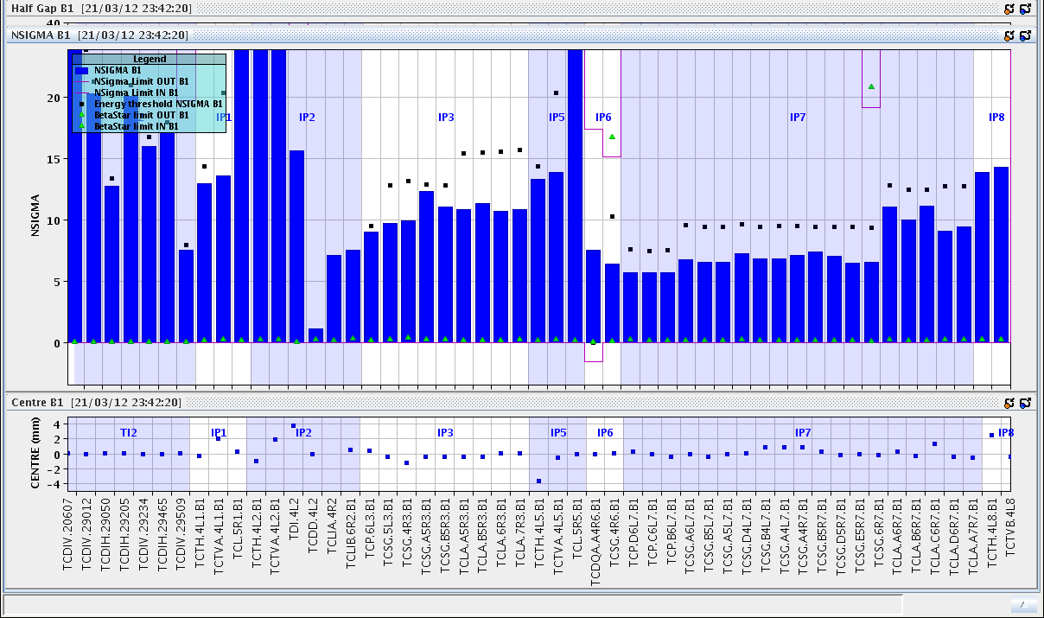
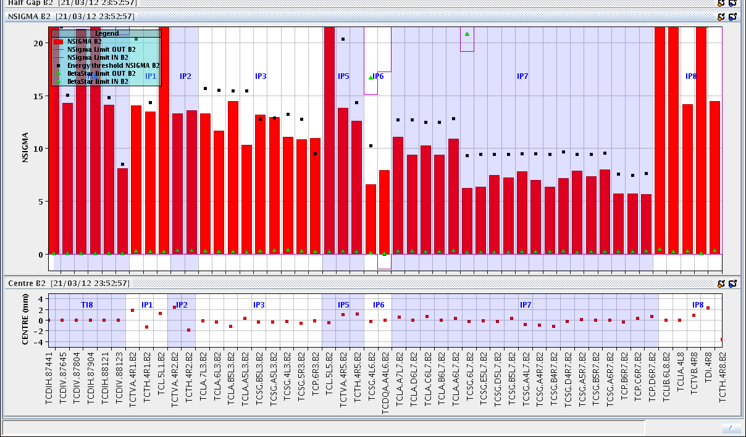
Collimator settings

Slide 5
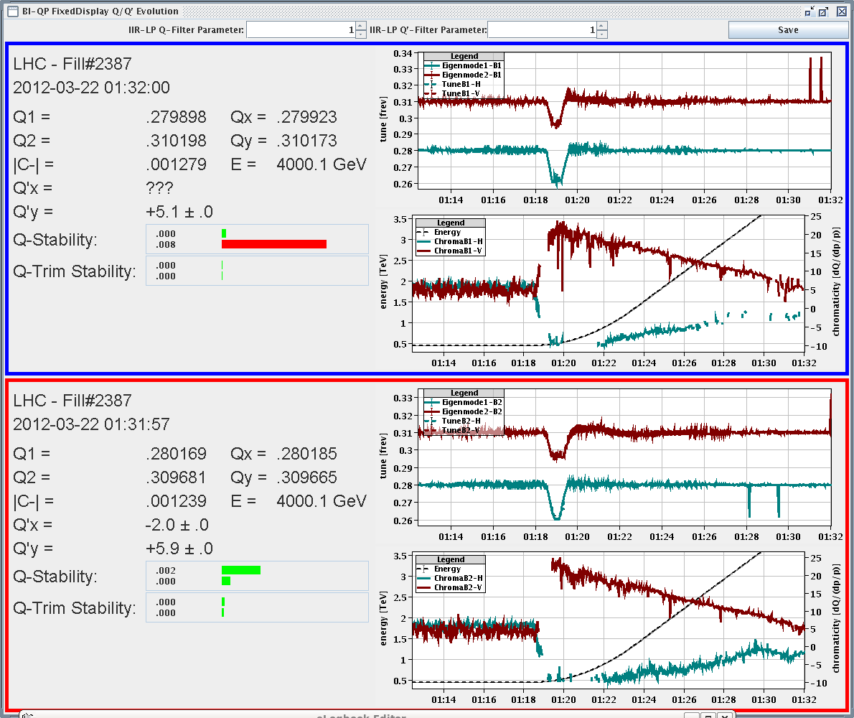
Thursday
0:20 start with “Squeeze function stretch and orbit at 4 TeV”
1:05 Fidel server crashed again
Chromaticity in the ramp measured, corrected back to +2 and incorporated into the ramp settings.
2:42 End of squeeze set-up.
MPS test for FMCM: tripping the D1 LR1 (with probe beam at 0.6 m beta*)
WIC (warm magnet interlock system) triggered first. No visible orbit change. Losses on the TCT in IR1 from the dump as the TCDQ is not set.
1 hour no beam from PSB

Slide 6
Summary of new long squeeze (Joerg, Matteo, Verena, Giulia)
The PCs are tracking pretty well, still one is slightly late when arriving at 0.7 m (RQ6.L1B1), but the current error is small and should be OK.
Orbit was fine all along (only one correction on the way)
In the ramp we have no NOMINAL separation and no Xing angles up to the flat top.
→ The next step is to switch on the Xing angles and separation all along the squeeze, and to join the collision beam process including the rotation of the Xing plane.
The settings for collision beam processes are prepared, including beat-beating corrections etc (could be done Thursday PM).
Problems:
Bad data quality for tune measurement and QFB switching off most of the time (with chirp on)
Bad beam lifetime (longitudinal blow-up together with the dp/p modulation for the chromaticity measurement?) → recommend to switch off the longitudinal blowup for the next ramps with pilots

Slide 7
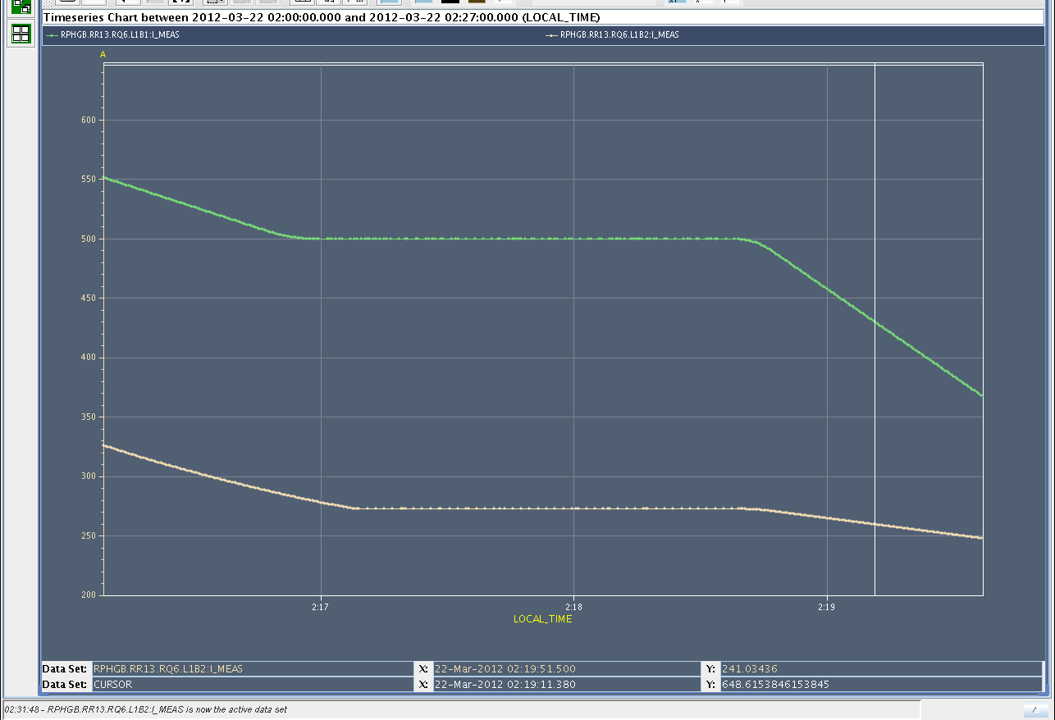
zoom on RQ6.L1B1/2 at the matching point at 0.7m
B2 arrives slightly later than B1 but it should be fine now

Slide 8
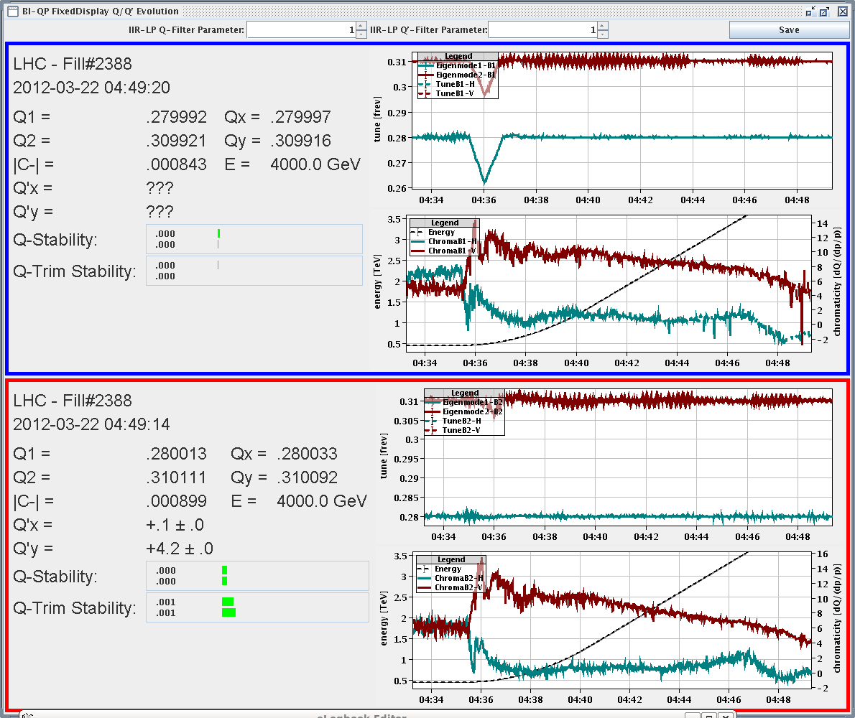
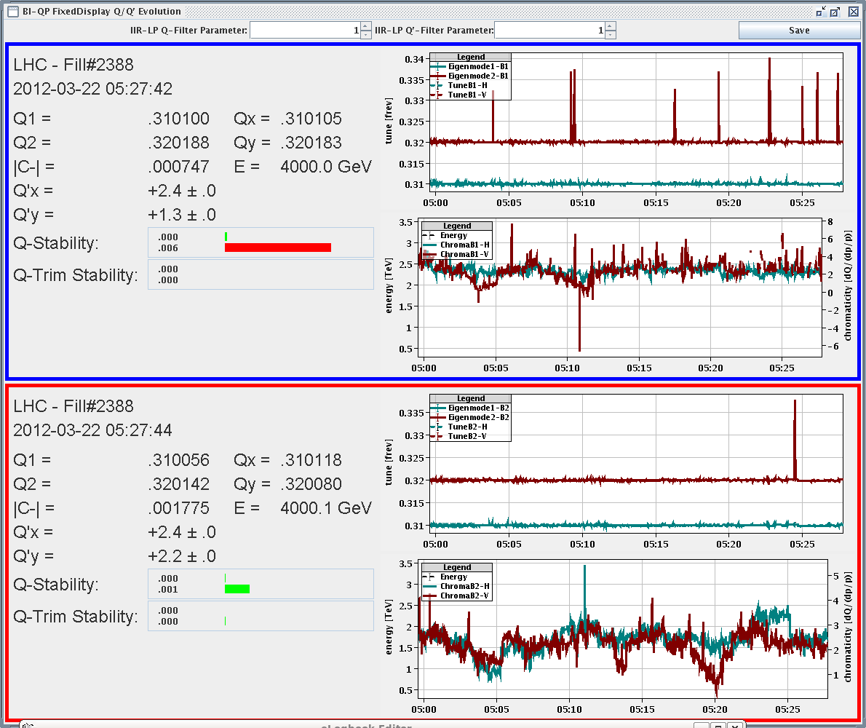
Second cycle with stretched squeeze (2:40 – 5:30)
Longitudinal blow-up off
Very good tune signal
Chromaticity measurement through the ramp and squeeze.
Feedbacks never switched off.
Chromaticity was corrected again through the squeeze
Coupling was already good.
Chromaticity through the ramp
Chromaticity through the squeeze

Slide 9
5:46 – 7:00 TI8 stability check, bunches onto TED (new MKE delay)
7:26 Fidel calculations and trims not working

Slide 10
Plan - details under discussion
Thu 08:00 – 13:00 | K-mod check 4 TeV
Thu 13:00 – 14:00 | Splashes Atlas (5 – 10)
Thu 14:00 – 20:00 | Energy feedback, Crossing etc throughout the squeeze, LHCb special
Thu 20:00 – 7:30 | Injection protection set-up (including TCDQ)
Fri 7:30 – 8:00 | prepare access
Fri 08:00 – 11:00 | Access – FGC release (access IP4 tunnel only till 9:00)
Fri 11:00 – 23:00 | Aperture at 0.6 m – check with Daniel for ADT at 4 TeV
Fri 23:00 – Sat 8:00 | With new collimator ramp functions. Full LHC cycle with 1 probe bunch per beam (chroma measurements during the ramp) squeeze, collision, MPS test (switch D1 etc off) and repeat as often as possible
Sat 08:00 – 23:00 | 1 nominal bunch to 4 TeV and Collimation at flat top
Sat 23:00 – Su 4:00 | Loss maps at 450 GeV and async dump test
Sun 4:00 – 11:00 | FIDEL measurements at 450 GeV; Full LHC cycle with 1 probe bunch per beam (croma measurements during the ramp) squeeze, collision, MPS test (switch D1 (etc – create list of magnets) off) and repeat as often as possible
Sun 11:00 – 15:00 | Coarse TCT set-up for squeeze and collision settings
Sun 15:00 – 23:00 | Injection and beam dump
Sun 23:00 – Mo PM | Tbd.
Mo afternoon | 2-3 nominal bunches to flat top and through the squeeze (after collimator set-up)

Slide 11
Access requests
LHCb 1 hour
Atlas 2 hours
CMS 2 hours
ALICE 3 hours
BPMS point 6 1 hour (?)
FMCM RD34.LR7 1 hour
Suspected electrical problem on a fire detection unit in UX85. Access required at the next occasion
RF UX45 1 hour
BIS
PC piquet: RQX.R2 and UA.87
BPMSW.1L1.B1 and B2
Diamond BLM UA87
HT monitor cable extension 6R4
Collimator LVDT position sensor IP3
BCTFRA UA47
Please fill in IMPACT!

Slide 12
To be sorted out – mostly scheduled for Friday
During Friday morning:
SBF glitches: Use 1 second (or more?) moving average DCBCT data transmitted at 10Hz to the SMP system or increase SBF limit…
BCTFR needs frequent reboot
FGC adapting the functions when they cannot be played
Polarity of BPMSW.1L5.B1/2 – V plane access
BPMD (dump line BPMs) for B1 shows often many bunches in the machine (50+), even when there is only one in the machine access
IP6 interlock BPMs access
Other:
Squeeze length
TCTVA.L2 out at injection as it shadows TDI
orbit feedback switched off in H both beams during the step to 2m. When checking the reference, found plan H at zero both beams
FIDEL

