Slide 1
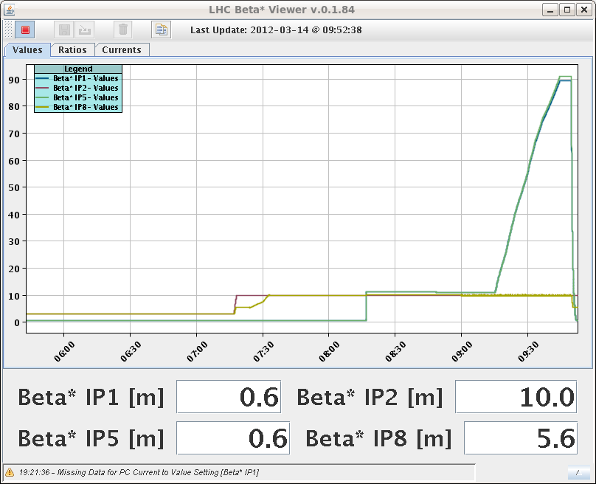
Wednesday
10:00 test of the un-squeeze to 90 m at 4 TeV.
Successful – no PC trips.
11:0 Ramp down, leveling test with CMS.
13:00 Final test of the injection kicker MKI.
Synchronization after correction of the offsets (~160 ns).
BETS on kicker voltage.
90 m

Slide 2
Wednesday
16:00 SPS ready, Preparing for beam – pre-cycle.
17:00 ATLAS magnet ramping down…
18:00 Extraction into TI2 and TI8.
TI8 to downstream TED OK.
No beam extracted to TI2 – extraction kicker MKE6 does not trigger, despite correct conditions (BIS, BETS).
When trying to inject B2, discover that the Probe Beam Flag of the SPS SMP is always FALSE.
Must be TRUE to inject into empty ring (ensure low intensity).
Reception error on the SPS SMP in the CCR – since 08.03.2012.
19:30 MKE6 problem traced to an electronic card.
20:15 MKE6 pulsing again, but a problem on the pulse delay (affected by the card change).
21:30 MKE6 delay problem finally fixed.

Slide 3
Night
22:30 SMP problem solved by SMP team + CO piquet with support from BI and CO/HT.
Beam injection was blocked as the SMPC SPS could not receive information from the BCT4 / 40S in SPS.
The problem was traced to a low RS485\MIL1553 transmission level in BA4, resulting in a low value of power being received in the CCR, which was unable to be decoded by the SPS SMPC.
CO Piquet was called to replace transmission module, this did not rectify the issue. Finally, a set of electrical repeaters were installed in BA4 to boost the signal strength to levels which could be decoded in the CCR.
Consolidation is required at next opportunity.

Slide 4
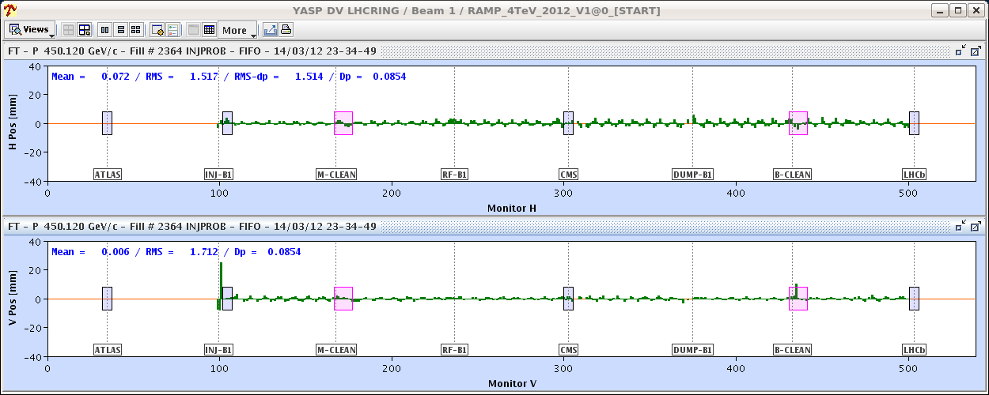
Night – beam into the LHC
23:00 Injecting into LHC and moving from one IR to the next (collimators).
Very little steering required.
A few post-mortems from BLMs – seems the TCTVA thresholds in IR2 could be a bit low…
23:40 B1 circulating and partly captured.
00:30 B2 circulating and partly captured.

Slide 5
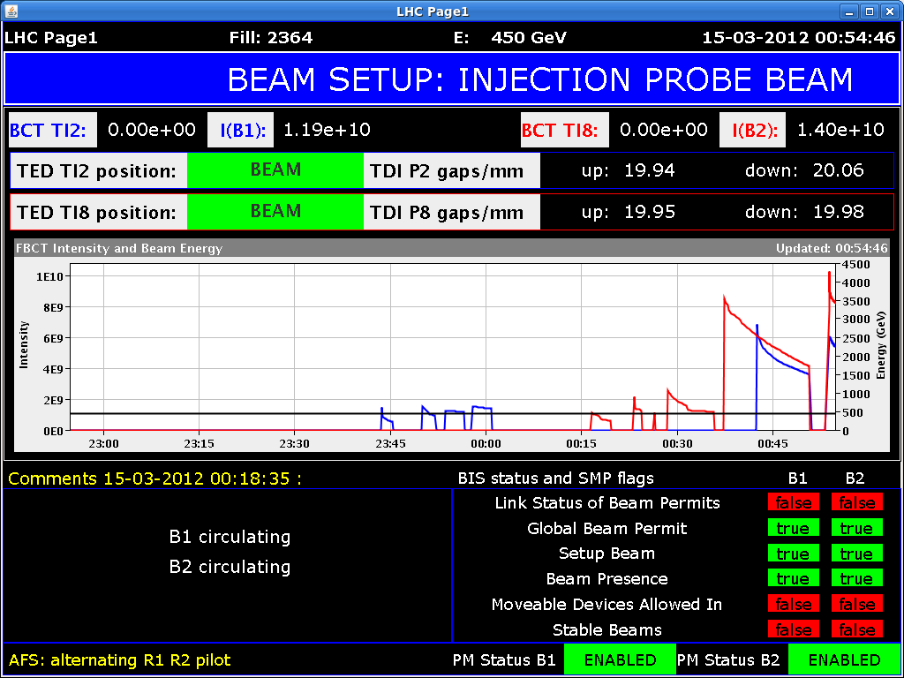
Progress on capture and quality
Working on orbit, tune, Q’ – in parallel RF team in SR4.

Slide 6
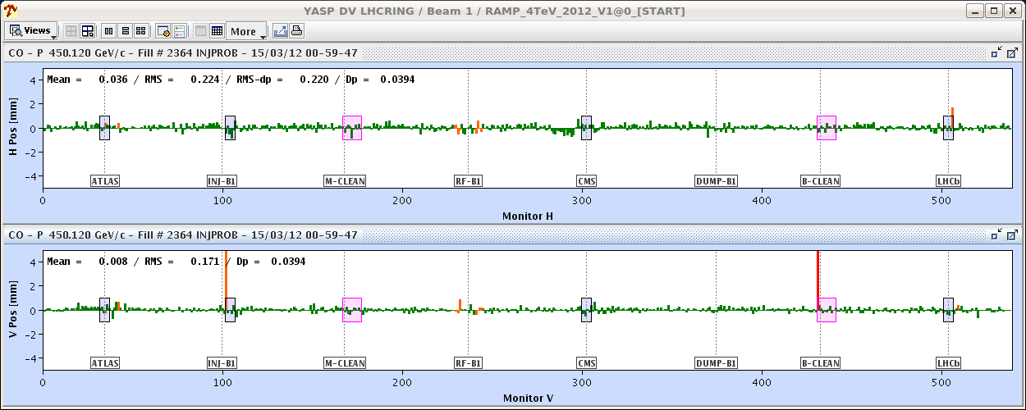
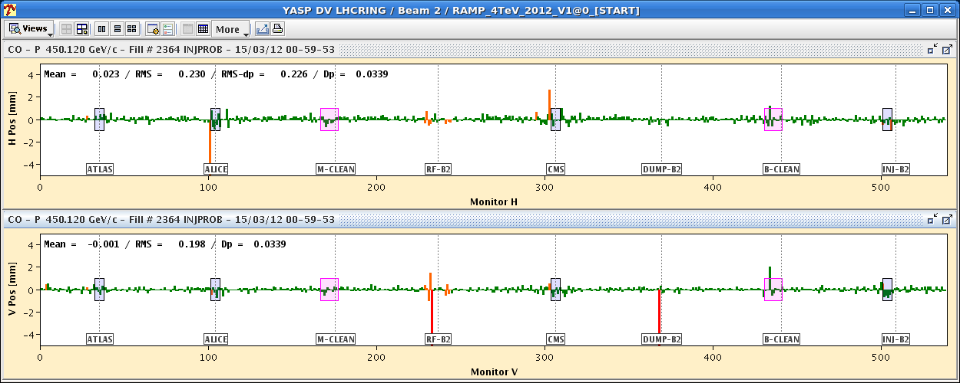
Orbit
01:00 Closed orbit corrected to within 0.2 mm rms of the 2011 flat orbit reference.

Slide 7
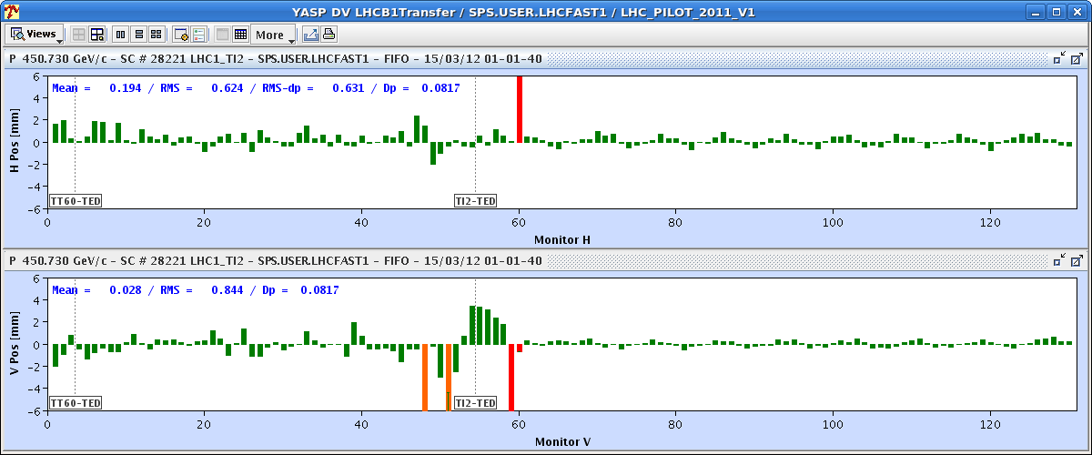
Injection oscillations

Slide 8
Tunes
Vertical Q was too low by ~ 0.06
final settings for B1 and B2 (|C-| about 0.01);
LHCBEAM1/CMINUS_IM.IP1 0 LHCBEAM1/CMINUS_RE.IP1 0 LHCBEAM2/CMINUS_IM.IP7 -0.045 LHCBEAM2/CMINUS_RE.IP7 -0.02 LHCBEAM1/QH_TRIM 0.001 LHCBEAM1/QV_TRIM 0.06529 LHCBEAM2/QH_TRIM -0.03 LHCBEAM2/QV_TRIM 0.07
Q’ found around +25 later in the night.
Trimmed down by -20…

Slide 9
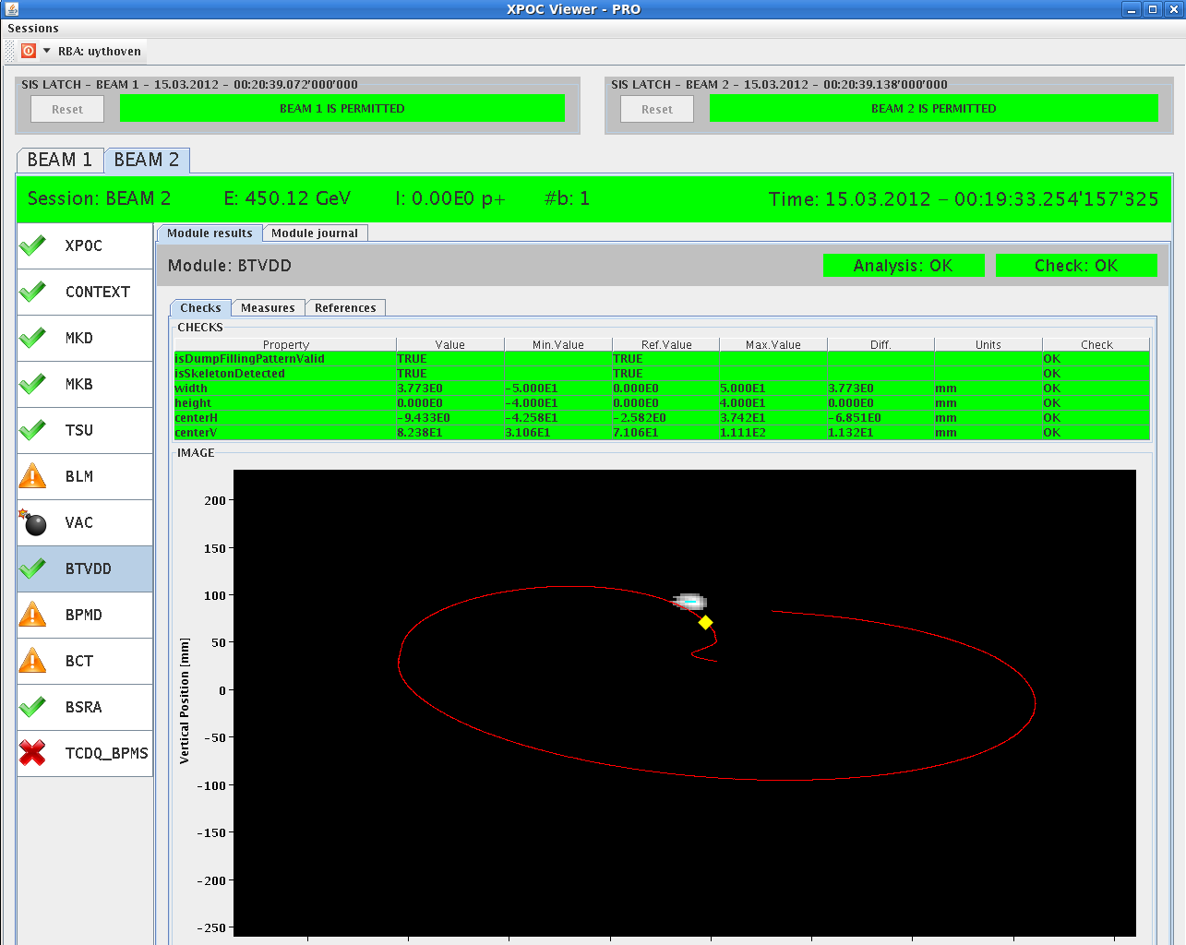
First dumps

Slide 10
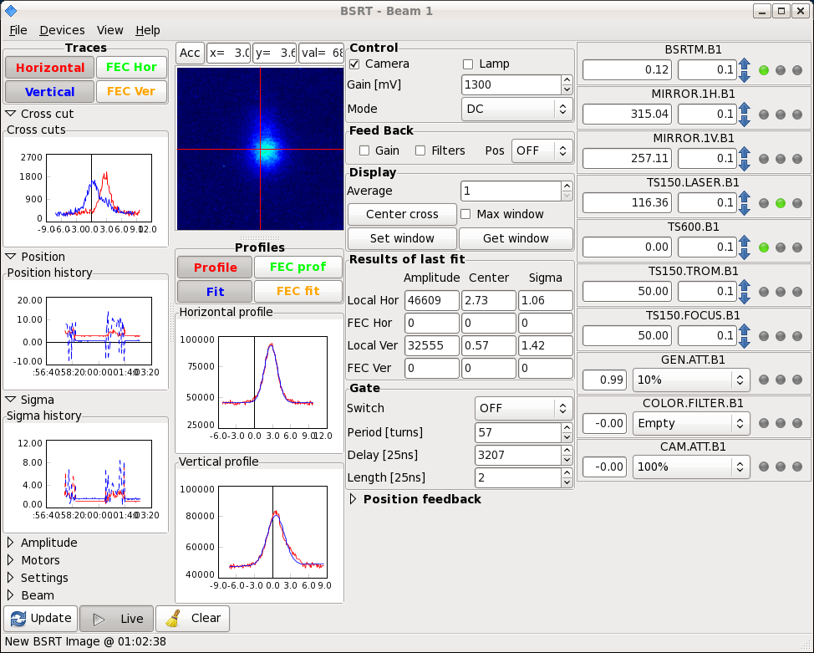
BSRT

Slide 11
Night
04:00 RF setup finished. Phase adjusted. Offset of 5 ns corrected. Setting up should be OK up to 1.5E11.
Should check the frequency trim of -10 Hz that was applied, as it is de-centered the orbit. Some energy matching with H cods to be done..
Optics team starting their work…

Slide 12
Today
Optics measurements and correction at 450 GeV
Injection and orbit with nominal bunch.
FB setting up.
BI shift overnight.
2 | THU | M | 8 | Beta beating measurements and correction @ 450 GeV
2 | THU | M/A | 4 | Injection of nominal bunch
2 | THU | A | 4 | Flat reference orbit at injection with nominal bunch, FB setup
2 | THU | N | 8 | BI shift
3 | FRI | M | 8 | RF and Damper setup for nominal bunch
3 | FRI | A | 4 | Feedbacks – re-commissioning at injection (Q, orbit, radial)
3 | FRI | A | 4 | Ramp to 4 TeV - test QFB & OFB
3 | FRI | N | 8 | Aperture at injection

