Slide 1
Wednesday 30th November
10:00 Access PZ33 for RP, Cryo, EPC, ELQA
Ludo Mourier (VSC) and Cryo operators et al
Various accesses in shadow
ATLAS; ALICE; QPS: installation of measurement device for beam induced quench test in L7; BI; and RF (change of klystron filament measurement sensor).
16:30 cryogenics conditions in S34 OK
ELQA team working through the afternoon
17:00 EPC finished the de-condamnation of circuits.

Slide 2
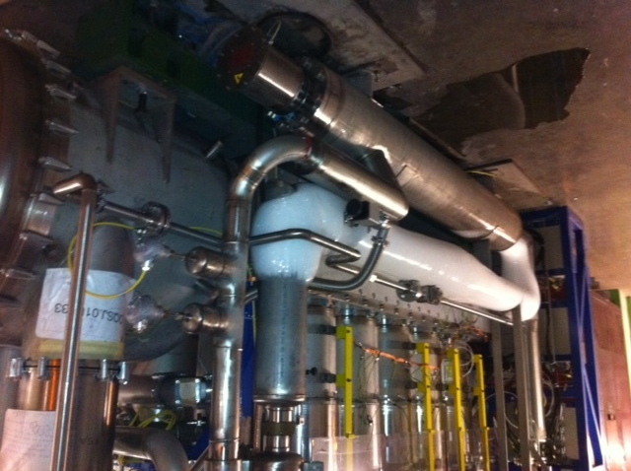
DFBLC/DSLC
Type of vacua: Beam vac, Cryo insulation vac, anti-condensation vac
=> They should never be mixed !!!
Vac volumes separated, each pumped separately
Heater electrical part protected in case of power failure and re-icing
Serge Claudet

Slide 3
Wednesday evening
Revalidation of circuits via HWC powering tests. PIC2-Circuit quench via QPS and PNO.A3 were done on the following:
RQS.A34B2, RQTL7.R3B1, RQTL7.R3B2, RQTL8.R3B1, RQTL8.R3B2, RQTL10.R3B1, RQTL10.R3B2, RQTL11.R3B1, RQTL11.R3B2, RQT12.R3B1, RQT12.R3B2, RQT13.R3B1, RQT13.R3B2, RQTL9.R3B1, RQTL9.R3B2, RSS.A34B1, RSS.A34B2, ROD.A34B1, ROD.A34B2, ROF.A34B1, ROF.A34B2
22:57 MP3 confirmed all circuits tested are fine. PIC 2 circuit quench via QPS and PNO.a3 have been carried out. Resistances have been measured and no relevant changes have been found! Precycle can be launched
Mirko, Matteo, Sandrine

Slide 4
Wednesday night
23:00 Pre-cycling
23:15 Etienne just called to say that MKD-B2 generator is faulty and has a problem at the level of the power trigger unit/controller.
00:25 Access starting in PM65, Etienne, Markus and Diego.
Etienne changed the power trigger controller card on MKD-G (B2) which turned out to be at the origin of the generator fault. He suspects a problem with the ADC on that card. After the card change Etienne performed a series of local pulses to validate the correct functioning of that device.
Problem with the automatic space allocation in the LSA database – resolved by Chris Roderik
TI8 PC problem - EPC piquet power cycled the electronics

Slide 5
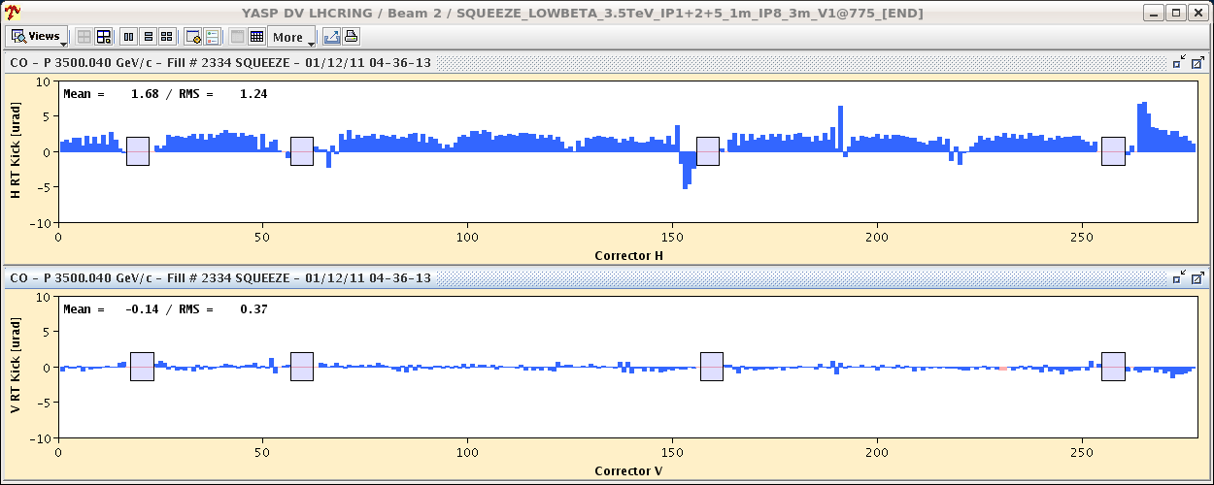
Thursday morning
03:00 Beam in
05:00 Stable beams #2334
Systematic offset introduced by OFB in R&S

Slide 6
Today
End-of-fill
checks of luminosity scan knobs range/Software interlocks – VdM precursor,
Atlas length scale calibration
Re-fill for Van der Meer scans
200ns_358b_356_336_0_24bpi15inj_IONS
normal "high intensity" 200ns ion batches
verify satellites and ghost charge with LDM (see
FIRST FILL: ALICE
SECOND FILL: ATLAS & CMS (Friday)

Slide 7
Incoming
Ion Quench test MD (> 8 hours). Proposed for Mon 5/12
Aperture scan in point 2 at 3.5 TeV squeezed – proposed to skip it
ADT tuning and verification tests (2 hours total) ➔ no real need of damper excitation for Quench ➔ proposed to skip it.
ADT: physics fill with gated damping (24 bunches not damped) to assess possible coexistence damper/BBQ measurement - keep

Slide 8
Cavity 2B1 back in action
Following the intervention of the RF power team to-day, we have decided to switch cavity 2B1 back in action...
Modified the functions (voltage partition) accordingly in both filling and ramp. Incorporation should be OK. Let it ON till we inject beam (whenever that is). If it trips, call Luca and, if we switch it OFF, call PB to revert the functions.
Nothing changed in total voltage: capture with 8 MV, ramping to 12 MV
Philippe Baudrenghien

Slide 9
Plots from Adam Jeff
Satellite & ghosts: fill 2334
Overall the situation is rather good. ~3% although we got cases down
The satellites at 10 and 15 ns disappeared but we have now some more satellites at 5 ns

