Slide 1
Monday
Morning – recovery from cryo.
11:00 Injection, orbit FB gain test @ 450 GeV, test dump.
Ramp for test dump and orbit FB test @ 3.5 TeV
Beam lost on RF trip M2B1, line 7B1 cathode klystron current too high.
14:00 Back at injection – trip of undulator. Lost cryo conditions in matching section L4.
15:30 Performing a ‘pre-cycle with beam’ (2 bunches) of the matching section.
16:15 Orbit FB gain tests at 3.5 TeV.
17:00 Again beam lost on RF, this time M1B2.
Loss of communication with PLCs.

Slide 2
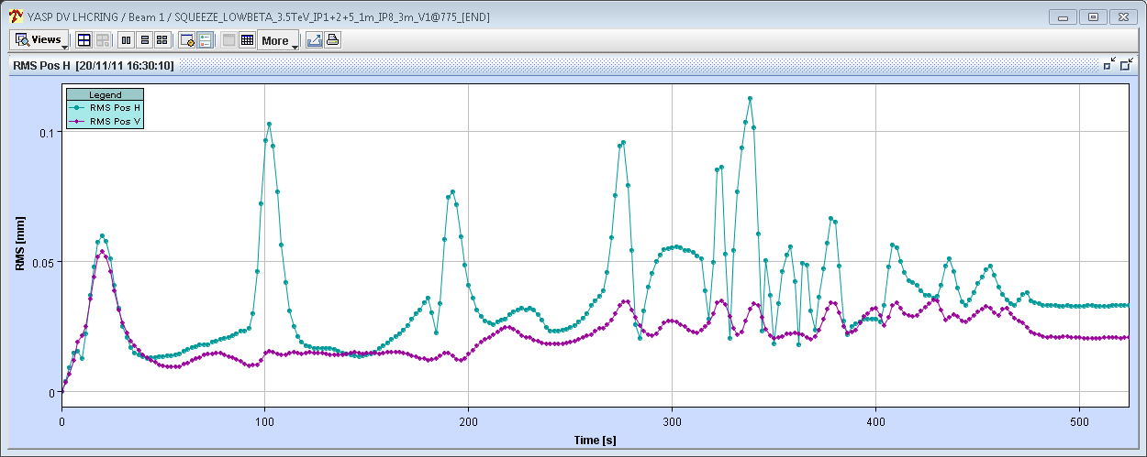
Orbit FB test - motivations
Orbit transients at the ‘matched points’ (where we pass a matched optics) – issue for tight collimators.
Transients are due to mis-match of the Xing and separation bumps due to optics interpolation between matched points.
LHCb Xing bump of 250 urad is driving source !
Simplest cure: faster orbit FB for better damping…
Beam 1
Squeeze to 1.5 m

Slide 3
OFB gain – response to a kick – 450 GeV
Default
Gain x 5
Gain x 10

Slide 4
OFB gain – response to a kick – 3.5 TeV
Default
Gain x 5
Gain x 10
IR 1+5 at 1 m, with
Injection optics

Slide 5
Monday PM
18:30 Filling for physics.
LHCb blocking again injection after PM…
20:30 Ramp and squeeze.
Feedback gain increased by a factor 10 (machine coordinator clearly said no more than 5 !)
First squeeze very good but then….
Feedback diverges in the IP2 squeeze where the RT corrections are larger.
Dump by losses in DS of IR7, B2.
So far ~ no feed-forward done on this part (due to ‘technical’ issues). Larger RT trims and larger optics differences may have conspired as trigger.

Slide 6
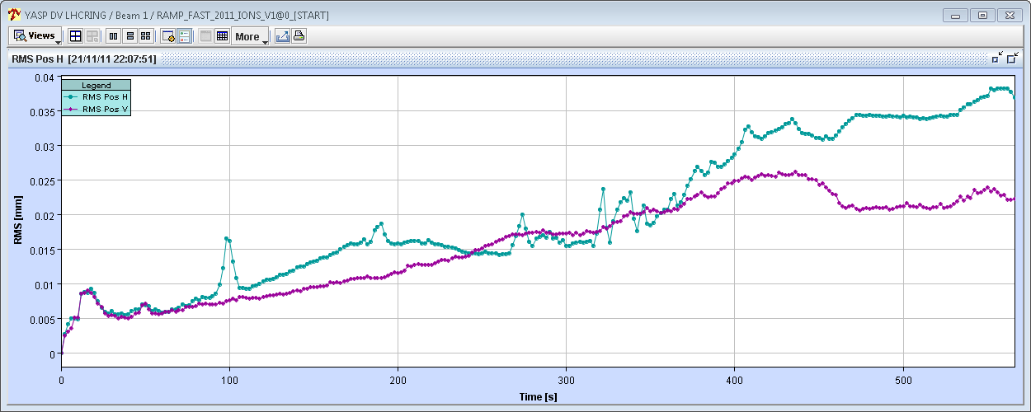
The good… IR1+5 to 1 m
40 um
Gain x 10
40 um

Slide 7
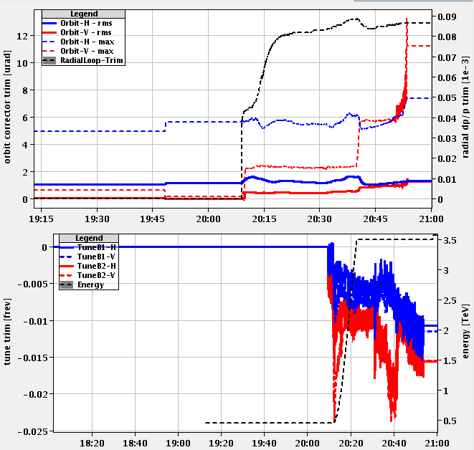
The bad… RT trim oscillations IR2 to 1 m

Slide 8
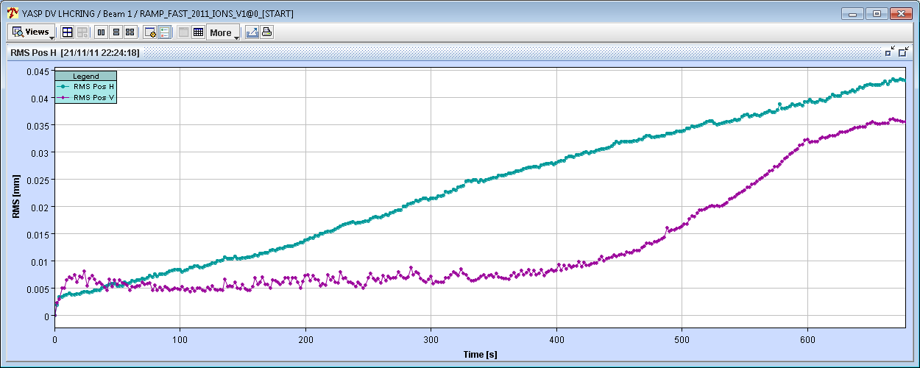
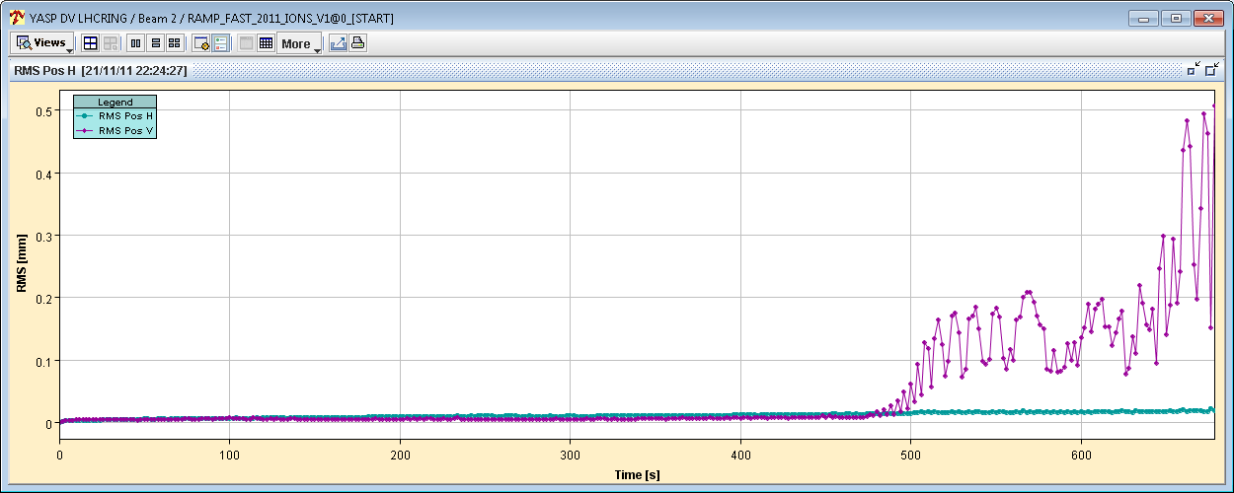
The ugly… orbit instability in IR2 squeeze
Beam1
40 um
Beam2
400 um

Slide 9
Night
‘Lot de consolation’: the RT trims for the first squeeze could be fed forward now as a test to suppress the spikes without FB… needs some SW changes.
OFB gain set back…
21:30 Refilling
23:30 Stable beams fill 2314, 4E26 cm-2s-1.
23:50 Fill dumped, quench loop RB.23 opened.
02:30 Re-injecting… intensity slightly down.
04:30 Stable beams fill 2315, 3.5E26 cm-2s-1.

Slide 10
This week
Physics…
Source refill – Friday
ALICE polarity – next Monday.
Requires some preparation work this week.

