Slide 1
Aperture measurement IR2
Starting configuration:
squeezed beams (1m),
-80 urad crossing angle,
separated by 2 x 700 um.

Slide 2
Aperture measurement method
Aperture measured relative to TCT (1σ ↔ ε= 3.5 um)
Touch TCT with beam
Retract TCT
Triplet
Triplet
TCT
TCT
Follow with beam
…until loss moves to triplet
Triplet
TCT
Triplet
TCT

Slide 3
Aperture measurement sequence
In practice orbit steps ~ ½ TCT steps.
Characteristic loss sequence (as long as TCT is limit).
TCT
TCT
TCT
TCT
Loss spike
Loss reduction
(step = ½ σ)
No loss
Loss spike

Slide 4
Abnormal loss sequences
Beyond 15-16 sigma, we observed abnormal loss sequences… in particular in V.
TCT
TCT
TCT
Loss spike
Loss reduction
Loss spike !
Spike around TCT and not triplet !

Slide 5
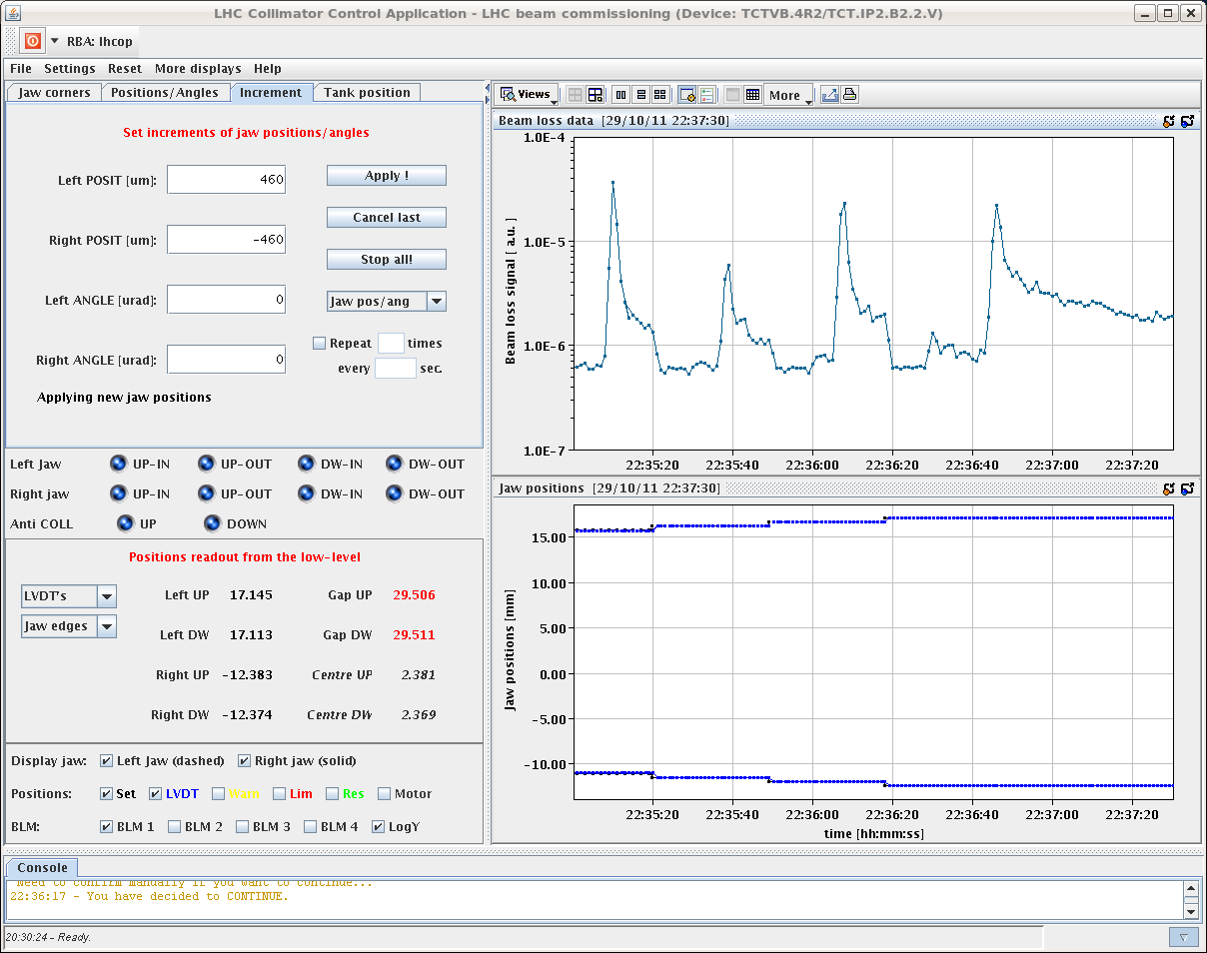
Example
Not the most striking example (but the best documented !)
Orbit
TCT

Slide 6
Preliminary summary
The minimum aperture for the vertical case were found to be (but not at the triplet !):
B1-V -> 15.5 to 16.0 sigmas
B2-V -> 16.0 to 16.5 sigmas
B2-V : clear triplet losses around ~18 sigmas
For the horizontal planes, the measurements were cleaner – triplet:
B1-H -> 16.0 to 16.5 sigmas
B2-H -> 15.5 to 16.0 sigmas
Due to the uncertainties, the V measurement was only made on one side – other side to be done (for polarity inversion).

Slide 7
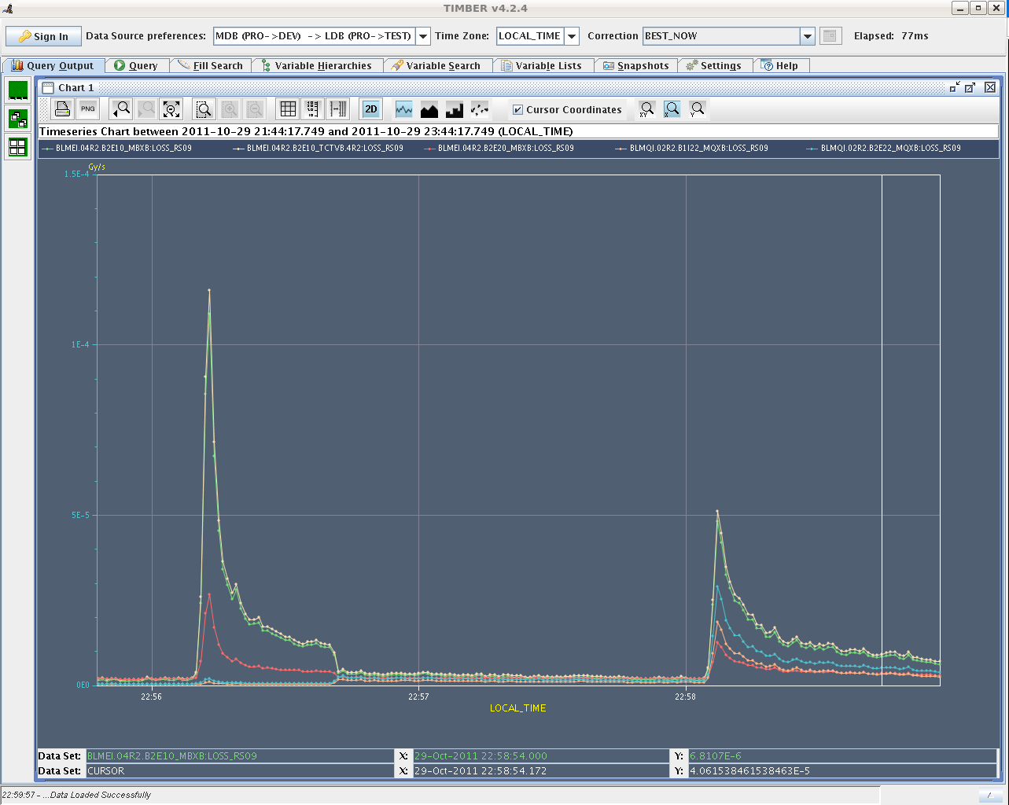
B2-V triplet losses
By pushing the beam further (despite strange observations of losses at TCTV) find triplet ~ 18 sigma.
TCT
Triplet

Slide 8
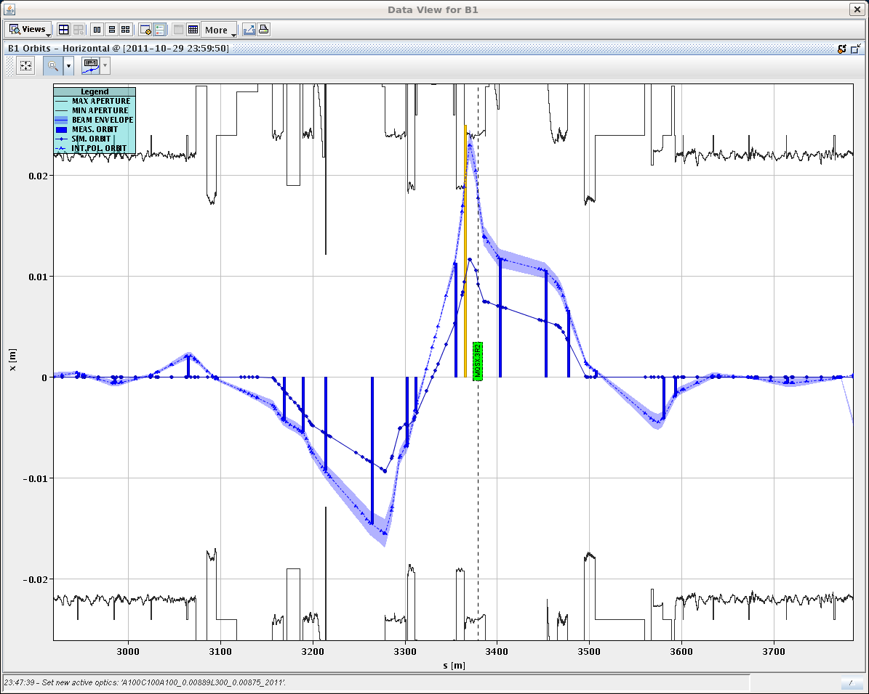
H plane B1
Observed limit consistent with triplet AP!

Slide 9
From 80 to 140 urad
Operation at 140 urad requires 2.8 mm more orbit margin (peak) in the triplet.
Beam size with ε=3.5 um is 1.5 mm at beta* 1 m.
We need additionnal 2σ to accommodate the 140 urad crossing angle (wrt situation for the AP measurement).
>> minimum triplet aperture of 16 sigma with 80 urad to ensure that the triplet is >= 14 sigma with 140 urad.

