Slide 1
Sat 15/10
New record bunch population profiting of the scrubbing period on Friday. N_{b}~1.42x10¹¹p/bunch ➔ 110 MJ at 3.5 TeV.
Filling slowed down by ZS sparking in the SPS
Tune feedback (VB2) switched off a few times during ramp-squeeze
09:30 Stable beams #2216, 3.3x10³³ cm⁻²s⁻¹. Emittances in collision ~2.5 μm.

Slide 2
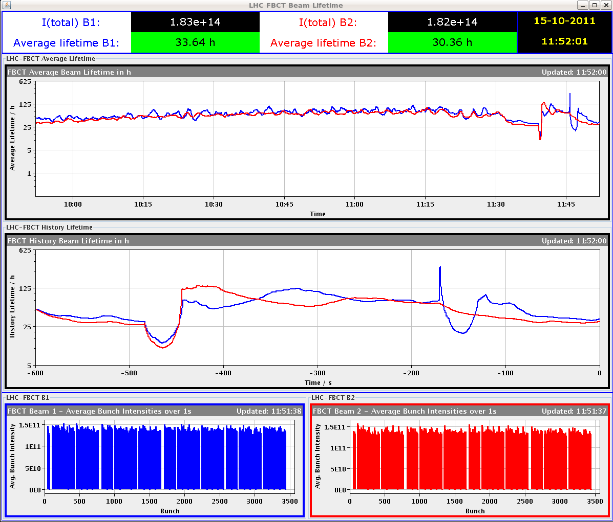
Sat 15/10
Dips in lifetime but no abort gap population changes during that period or just before.
No correlation with BLM signals in LSS3 or LSS7, beam size variations or BBQ signals ➔ Real?

Slide 3
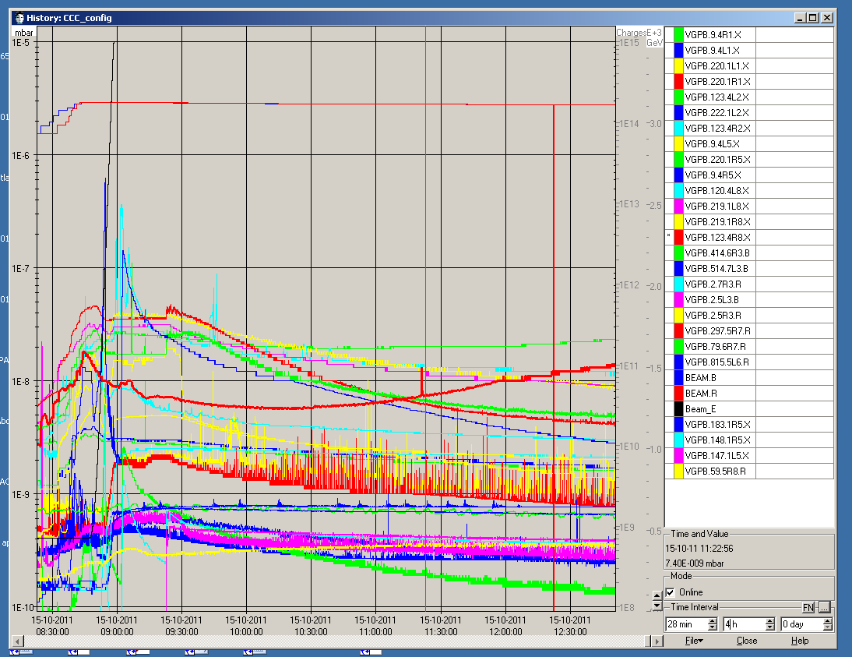
Vacuum

Slide 4
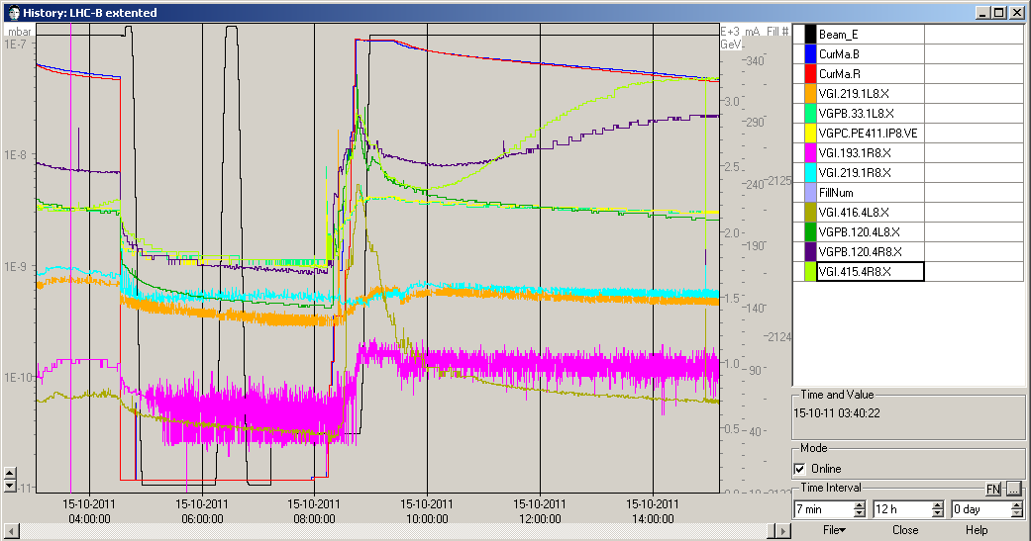
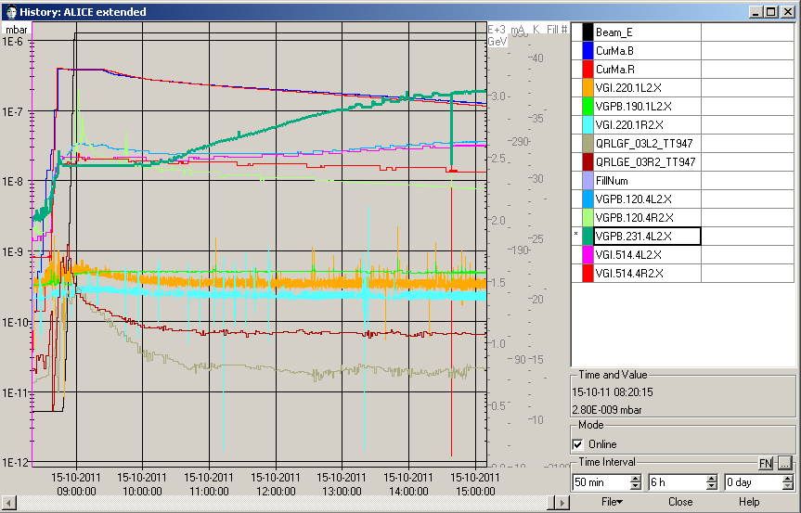
Vacuum at TDI
Vacuum pressure increase at TDI at point 2 and point 8 ➔ Too high background for ALICE for some hours

Slide 5
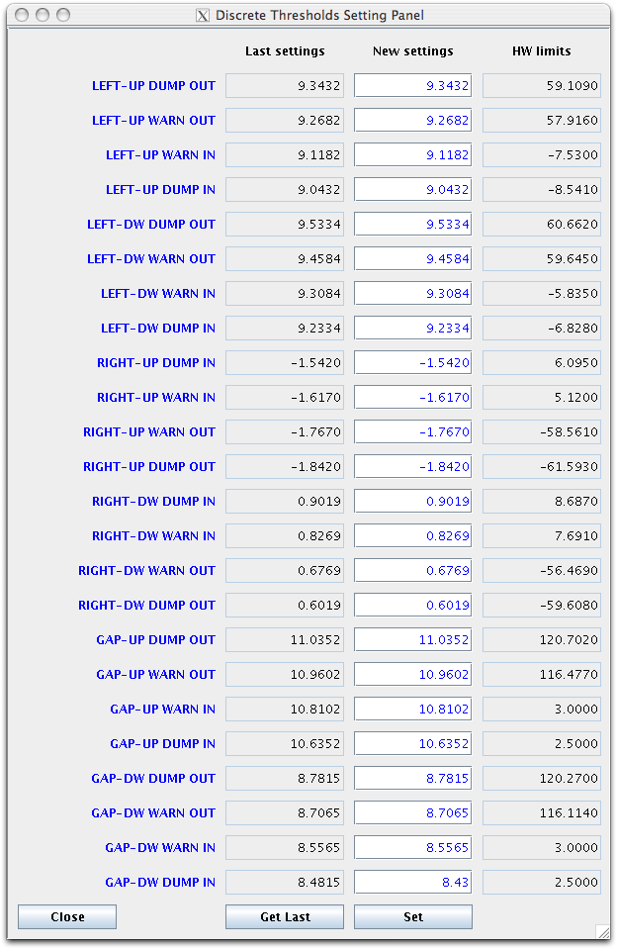
20:45 Trip of RQT12.R5B2. End of fill #2216. 92.5 pb-1 in ~11h
Not able to reset interlock on TDI position in point 2:
As requested by Brennan and Alessandro, I changed by ~50 um the inner thresholds for the downstream gap of the TDI.4L2. This change was proposed to reduce the risk of interlocks triggered by electromagnetic noise on the TDI (Stefano)

Slide 6
Filling #2217: new filling scheme with main-satellite collisions in ALICE ➔ 1% more collisions to ATLAS/CMS and 2% more to LHCB
North area stopped during filling with high intensity to avoid ZS sparks in the SPS
01:46 STABLE BEAMS #2217: 3.44x10³³ cm⁻²s⁻¹ with 1.4x10¹¹ p/b (3.5x10³³ cm⁻²s⁻¹ seen during the adjust phase)
02:55 Beams dumped by RF (HOM temperature): 14 pb⁻¹ in ~1h

Slide 7
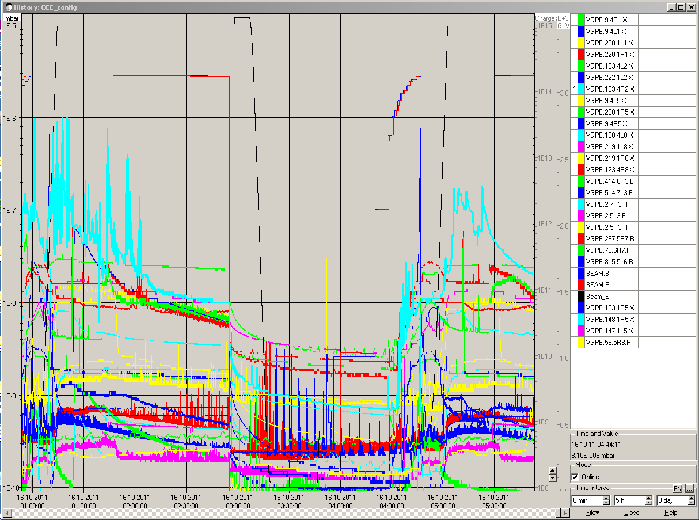
05:30 back in physics (2:35 h turnaround – some delay to due to temperature on MKI8)
STABLE BEAMS #2218 3.49x10³³ cm⁻²s⁻¹ with 1.4x10¹¹ p/b
08:08 Beam dump due to power converter problem on RQT12.L5B2

Slide 8
Now we have more than 5fb⁻¹ delivered to ATLAS and CMS ins table beams at 3.5 TeV

Slide 9
Pending issues
A fault on the powerPC of the PAD in UJ16 prevents anyone going into UJ16 until after the access piquet makes an intervention. This intervention is not yet scheduled, and will wait until needed
Several restarts of DIP proxy server

Slide 10
Plans
Physics
Work on the EDF electrical network (Verbois) tomorrow starting at 07:00 (should be transparent)

