Slide 1
Friday 30th September
06:00 Operator dump fill #2171, int. lumi about 75 pb-1
Previous operator dump from physics was on 14 September !
07:00 Start of 90 m β* “run”
The Collimator piquet disabled a resolver that was giving wrong measurement -> fix Saturday morning
10:07 At flat top for 90 m optics, problem with TCTs IP5
12:50 In collision, except IP5, dump beam to give access for collimators in point 5
15:30 Collimator access finished
17:11 Ramping
19:00 Beams into collisions: Collisions found.
20:00 ALFA puts pots in on B1 and Totem on B2
20:30 Beam dumped due to an inner limit on ALFA RP that had not been updated. B1 dumped. Dump B2 manually afterwards. Refill.
22:00 Injecting again – decide to go for optics measurements as time is tight to do pot alignment and data taking before 7:30 deadline Saturday morning
00:23 Lost end of squeeze: We lost the RQTF.A45B2
03:03 Second ramp of the night. During squeeze, UPS down in UJ56

Slide 2
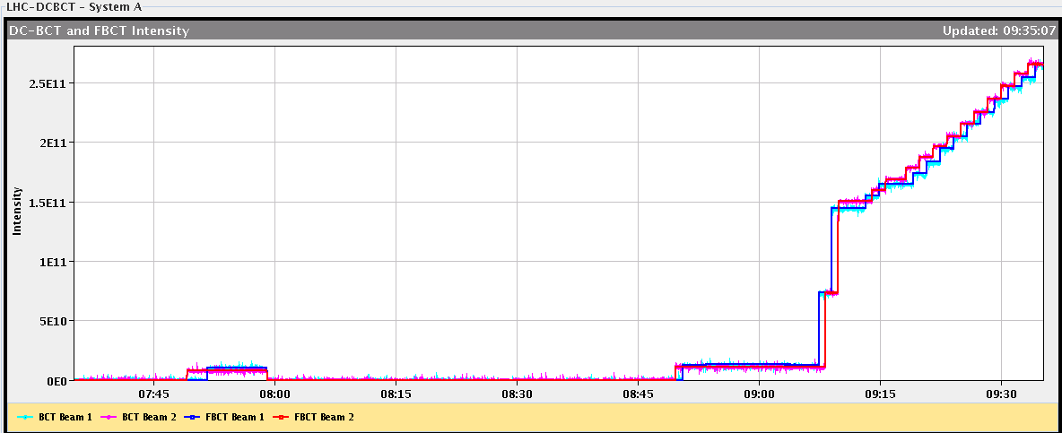
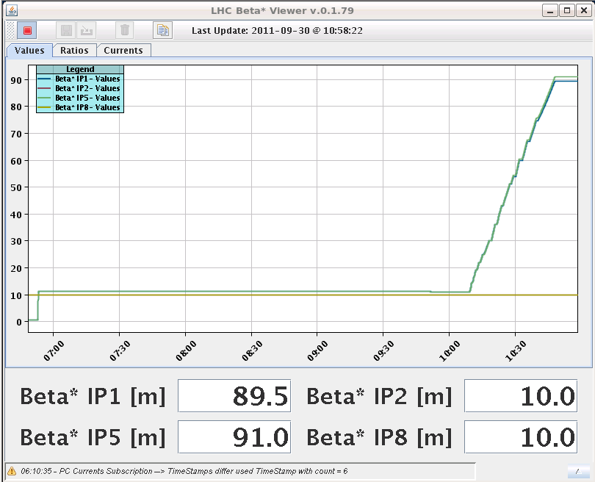
90 m optics
Filling scheme: 2 big, 13 small bunches

Slide 3
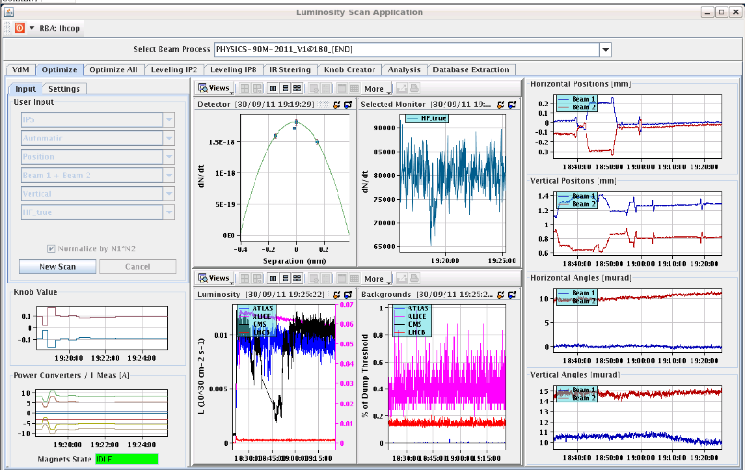
Collisions found
Optimization of IR 1 and 5 after collisions were found
The BRANS in IP1 and 5 show noting, but signals can be seen in IP 2 and 8

Slide 4
Collimator in IP5: TCTH.4L5.B1 and TCTVA.4L5.B1
Found a short circuit somewhere on the 24V power supply used for switches and also other components
Problem came from the downstream anti-collision switches at collimator side (in the tunnel). There was a short circuit between one of the conductor and the ground of the connector
In the tunnel and finally we found that inside a 50 pins connector of the long cable, a small wire of copper was not correctly crimped and was slightly in contact with the metallic cover of the connector
This cable and his connectors have been installed during the cabling campaigns in 2006 and never touched since, so it's difficult to understand why the problem occurs only now...
Jerome Lendaro

Slide 5
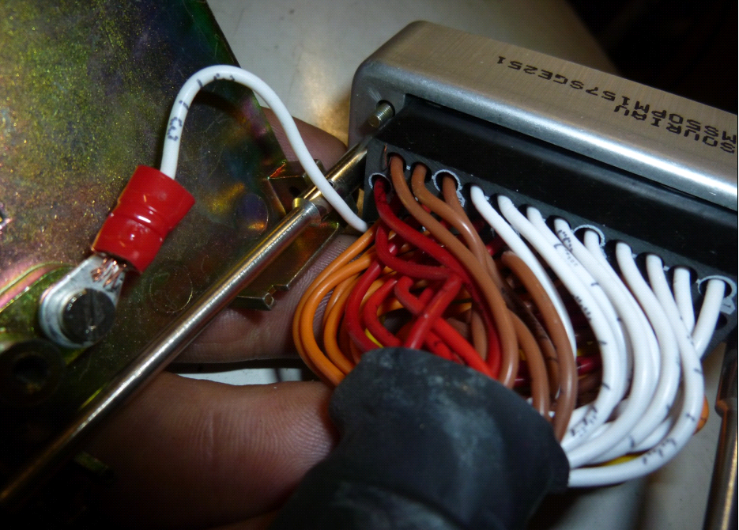
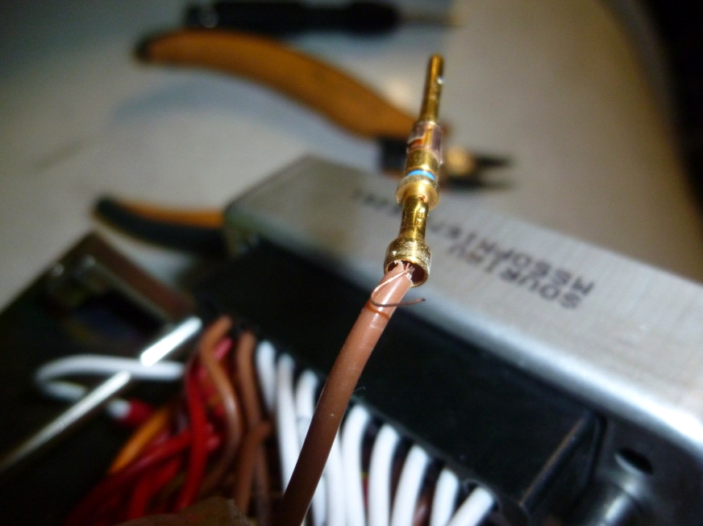
The small wire of copper...

Slide 6
Optics measurements for β* = 90 m
Ramp 1:
We lost about 1/3 of the beam at the start of the ramp. It seems that the longitudinal blow-up was pushing the bunch length up a lot and we had huge off-momentum losses at point 3.
End of un-squeeze, beams lost due to trip RQTF.A45B2
Ramp 2:
Loss of a UPS in the middle of the unsqueeze
To be noticed that for both unsqueeze, the QFB was continuously switching off for B1
Using 3 fat pilots per beam
Should be better without longitudinal blow-up

Slide 7
Plan
Saturday
7:30 Dump beam to prepare for VIP visit Point 2
8:15 RP check IP2 and IP5
9:45 RP check IP1
Around 12: search IP2, close machine
Pre-cycle and then back to Physics
Sunday: Physics
Next week (besides physics)
Abort gap cleaning at 3.5 TeV
25 ns MD
Possibly large pile up MD
Expect UPS to be fixed during the morning

