Slide 1
Thu 15/9 – Fri 16/9
09:30 Controls network problem fixed The network problems have been fixed since 9:30am when the network switch for the Service IP57 feeding various important servers such as CS-CCR-LSA1, CS-CCR-CMW1 and CS-CCR-JAS5 was powered off then on. Enzo Genuardi was first called around 2:30am and came in at around 3:30am. He shutdown any machines on Service IP57 that he suspected were sending too much traffic or bad traffic. However this did not fix the problem. All that is known for the moment is that many machines on Service IP57 worked perfectly (e.g. DIAM1, JAS5) however many others could only send a few kilobytes before a TCP connection blocked (e.g. LSA1, DIAM2, Q4DS7). We have not seen a switch working partially before so it took some time to make the decision with Edoardo Martelli of IT/CS to power off / on the switch. Alastair Bland, BE/CO.

Slide 2
Thu 15/9 – Fri 16/9
In the shadow: temporary fix for the ADT gain/saturation was put in place before a proper setting up for high intensity could be done. The limit intensity is now at about 1.7e11 ppb. In case a roll back to the nominal 1.1e11 intensity is needed the RF low level piquet should be called.
10:00 Precycle and prepare for injection
11:30-13:00 LSS6 BPM interlock after modification of the BPM control card (aimed at fixing a long lasting problem on a bunch counting)

Slide 3
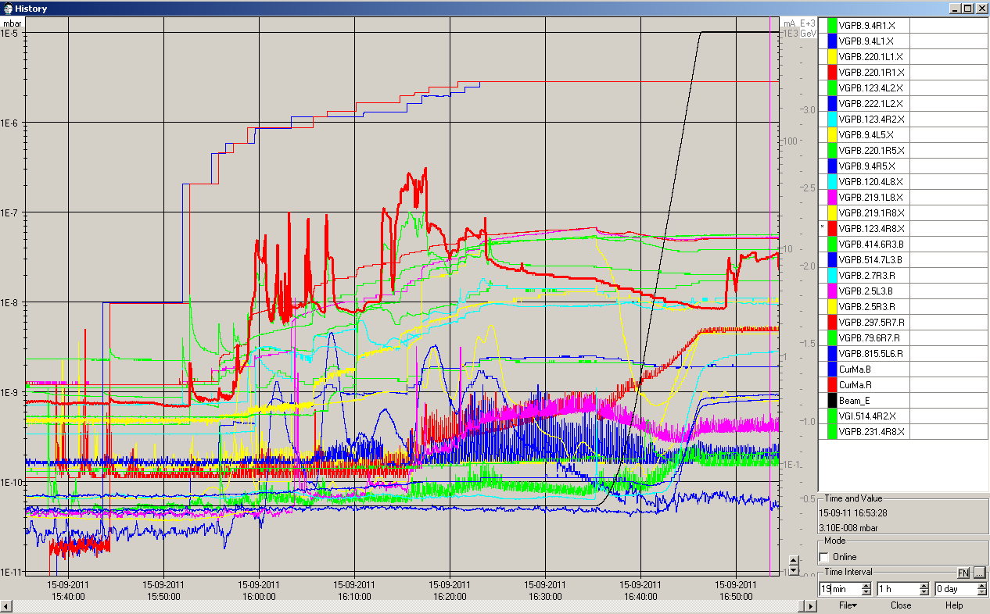
Thu 15/9 – Fri 16/9
13:00-14:00 Poor beam quality from the injectors due to a controls problem on a quadrupole of the PS to SPS transfer line
16:30 finally machine full. Ramping with ~1.38x10¹¹ p/bunch. Vacuum acceptable.

Slide 4
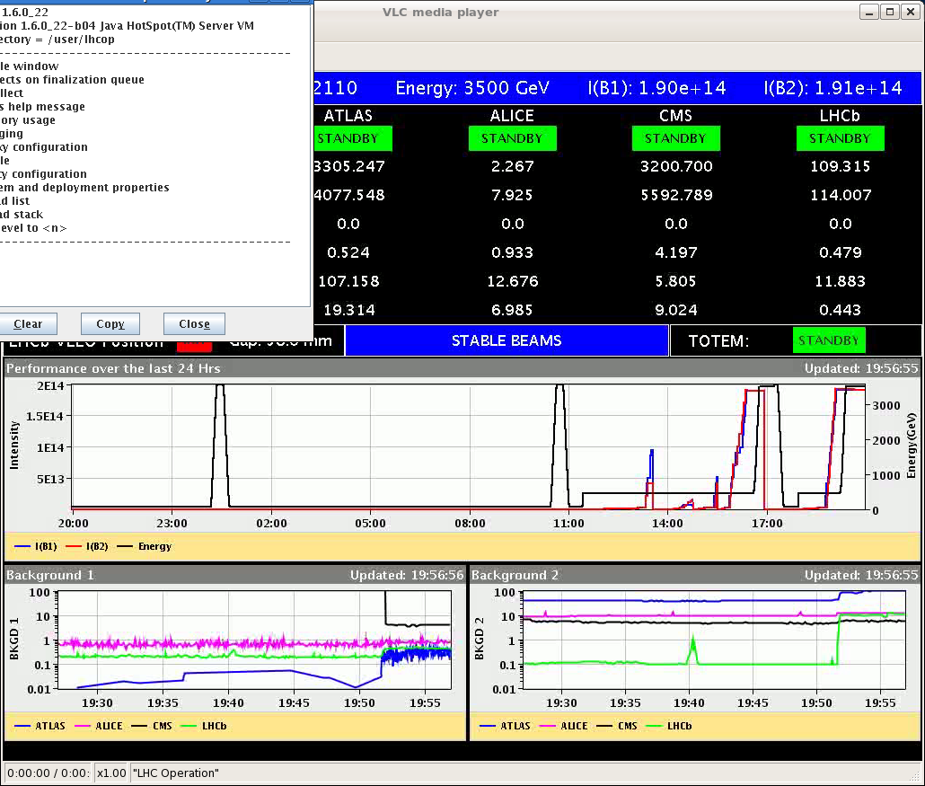
Thu 15/9 – Fri 16/9
Beam dump due to trip of RQTF.A34.B2 during the squeeze to 1.5 m ➔ likely due to tune feedback
19:56 STABLE BEAMS #2110. Initial luminosity >3.3x10³³ cm⁻²s⁻¹. 1.39x10¹¹ p/bunch. Initial emittance ~2.3-2.4 um.

Slide 5
Beta* limits
Beta* limits on new TCT functions (before physics) implemented
S. Redaelli

Slide 6
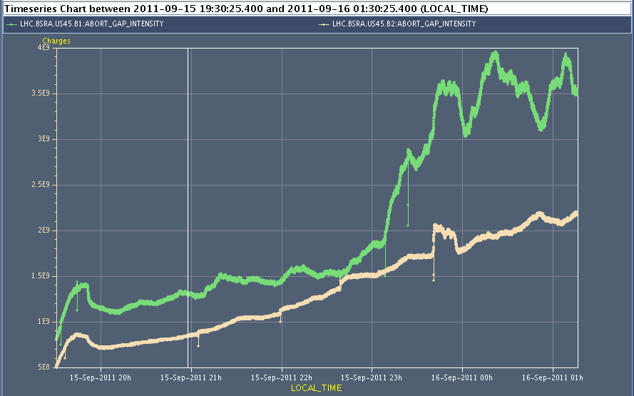
Thu 15/9 – Fri 16/9

Slide 7
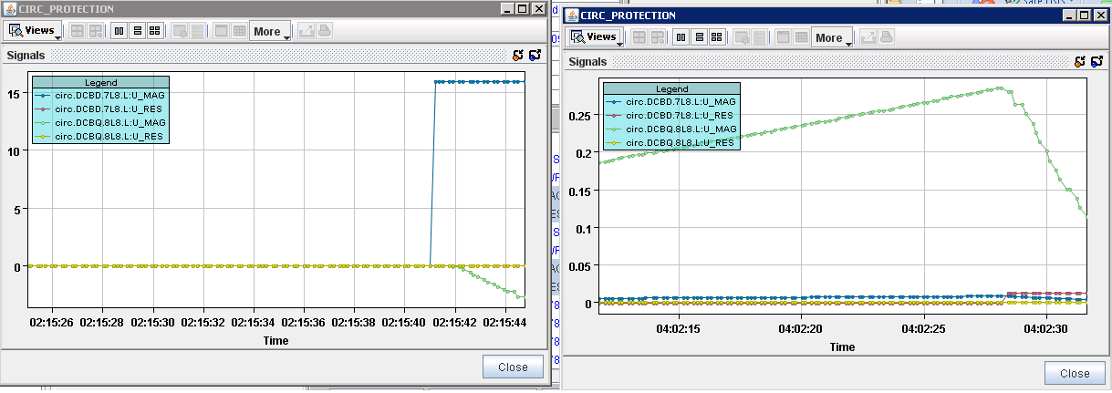
Thu 15/9 – Fri 16/9
02:15 trip of Sector 78 – due to sudden jump of U_MAG signal on nQPS DQAMGS.RB.A78.B9L8 (SEU?). End of physics #2110. 57 pb⁻¹ in 6.5 h.
04:02 second trip of Sector 78 during pre-cycle ➔ power-cycle DQAMGS.RB.A78.B9L8
M. Zerlauth

Slide 8
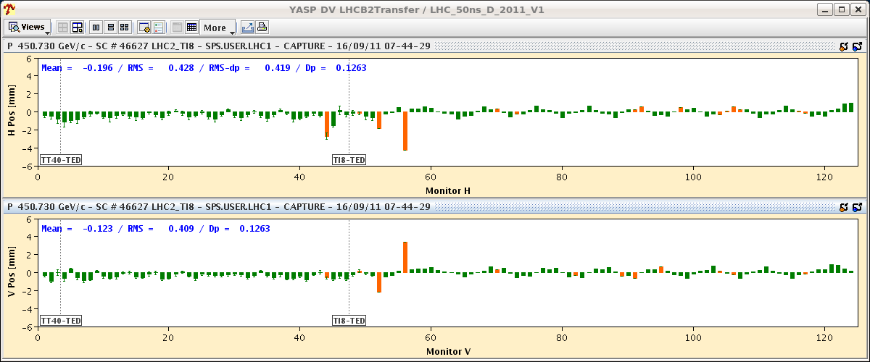
Injection issues (12 vs 144 bunches)

Slide 9
Plans and pending issues
Injection checks and TCDI alignment verification (AM)
LHCb Polarity switch
Physics

Slide 10
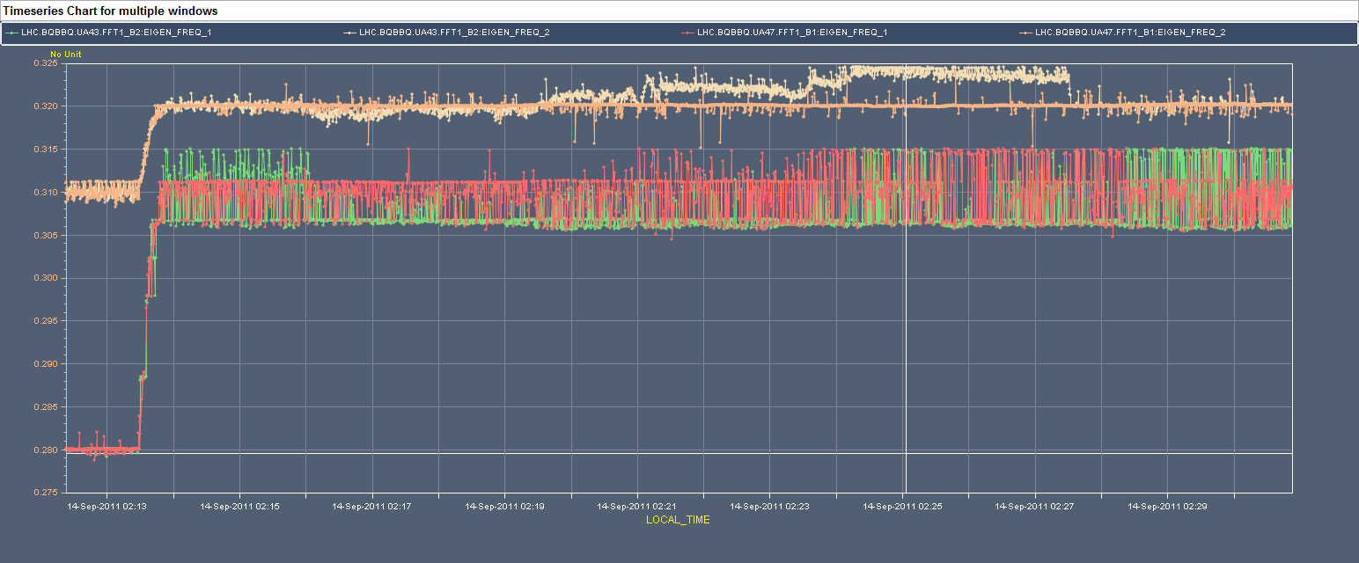
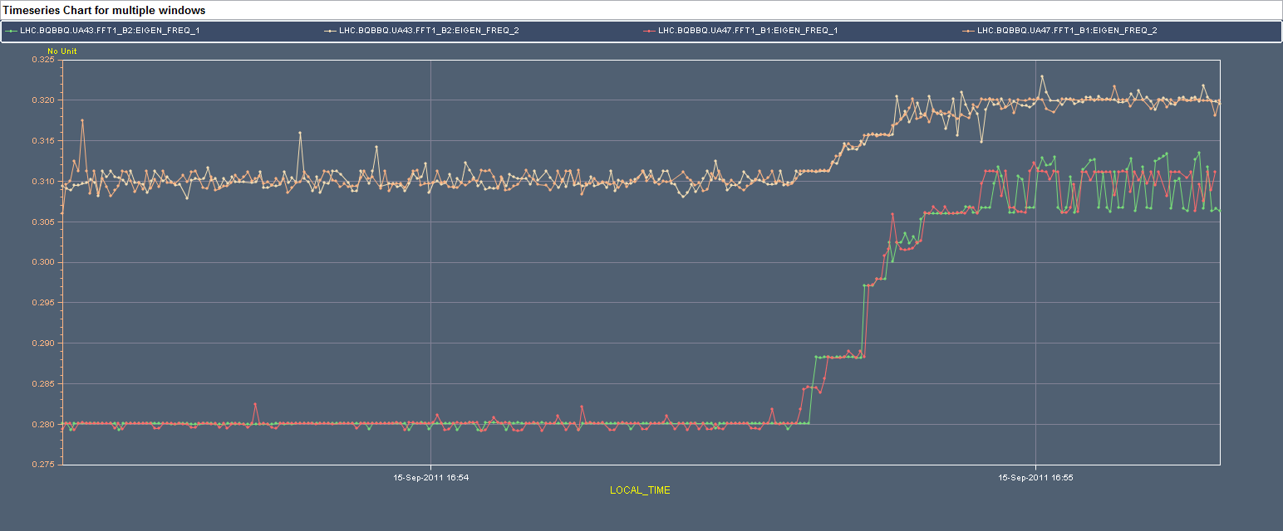
Tue 13/9 – Wed 14/9

Slide 11
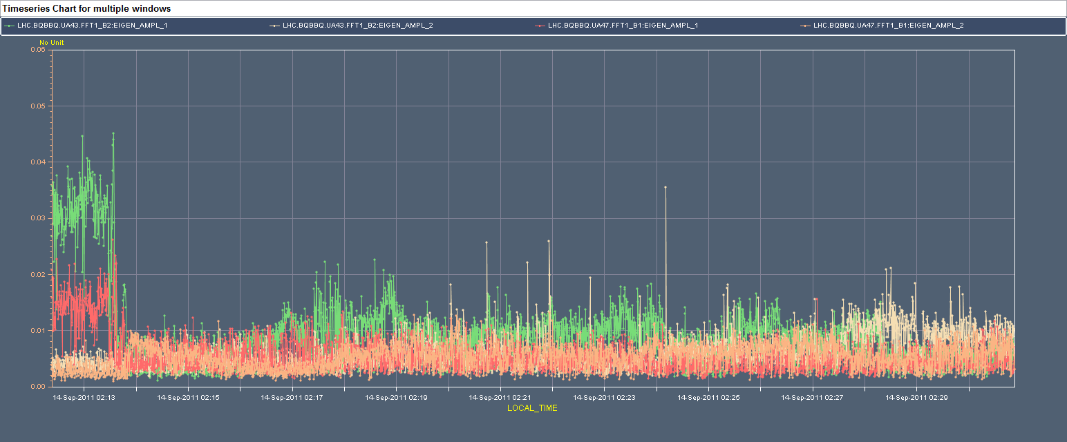
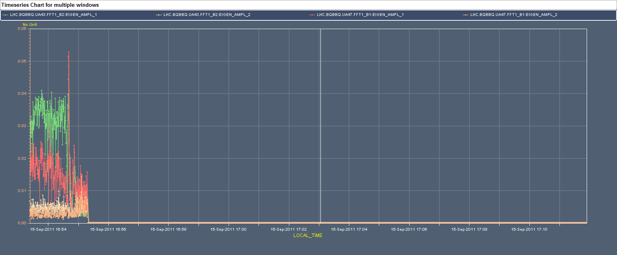
Tue 13/9 – Wed 14/9

