Slide 1
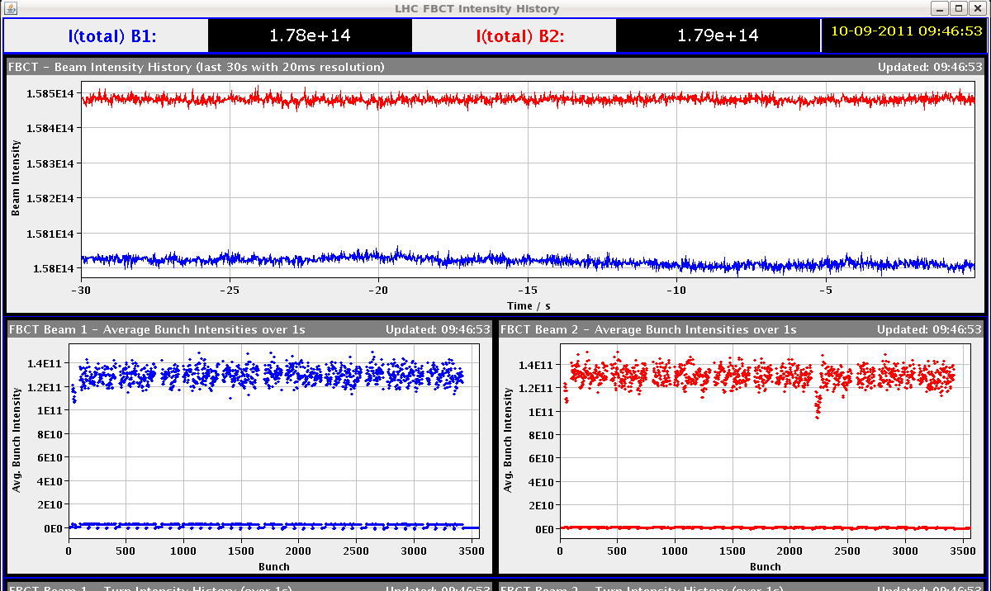
LHC Status Sun Morning 11-Sep
Bernhard Holzer, Joerg Wenninger
09:03h Injection no major problems
nice, constant bunch intensities
N_{p} ≈1.3*10¹¹
Remark:
If the intensity continues to rise the ADT experts need to set them up (as it was announced already before the technical stop).

Slide 2
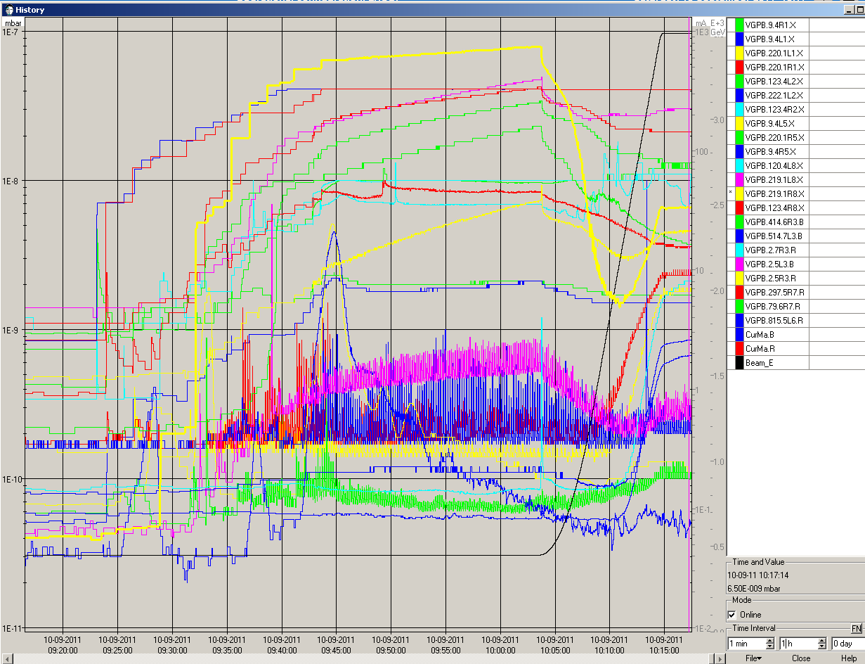
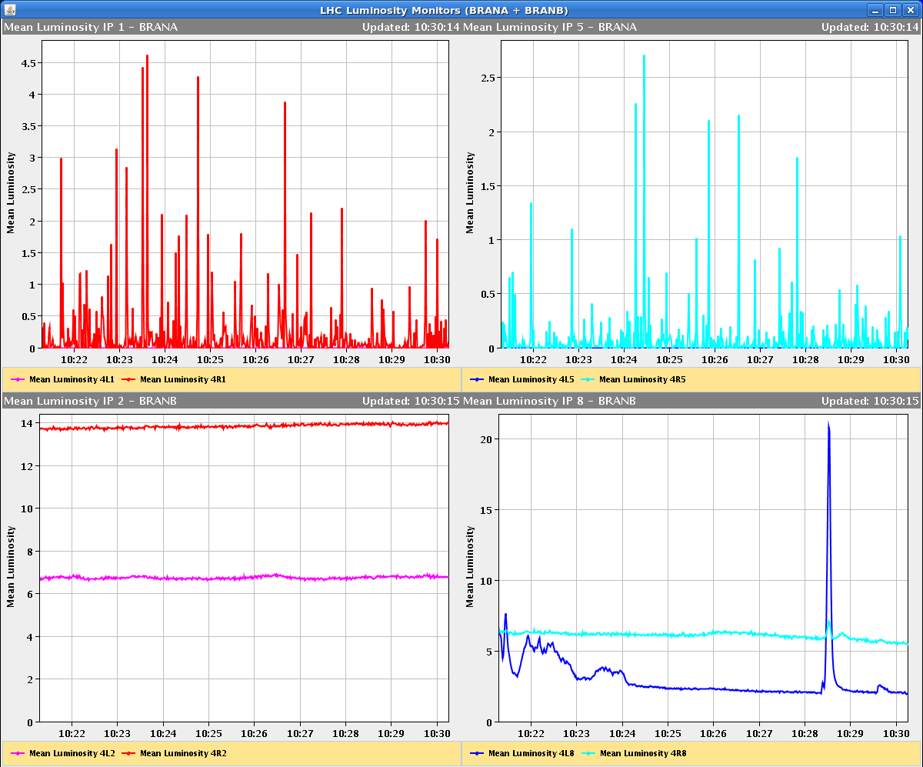
Sat morning
10:46h Ramp, Squeeze:
Lumi spikes due to vac conditions in IP8 during squeeze

Slide 3
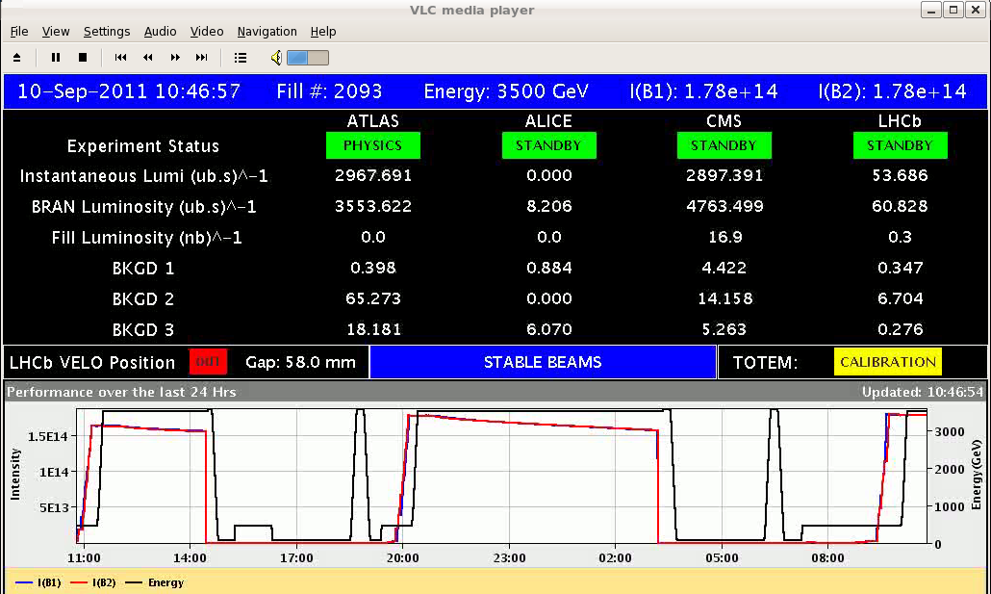
Sat morning
10:46h Ramp, Squeeze, Luminosity no major problems
11:26h Dump
Spurious trip of the RB.A81

Slide 4
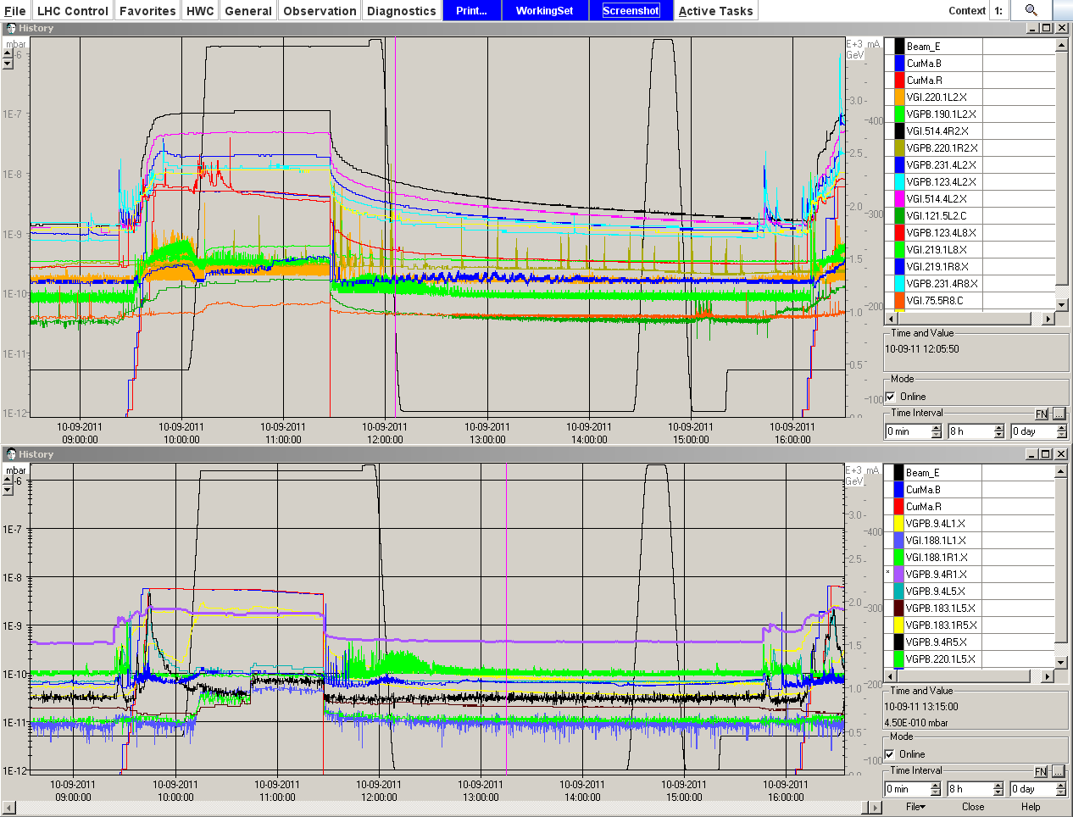
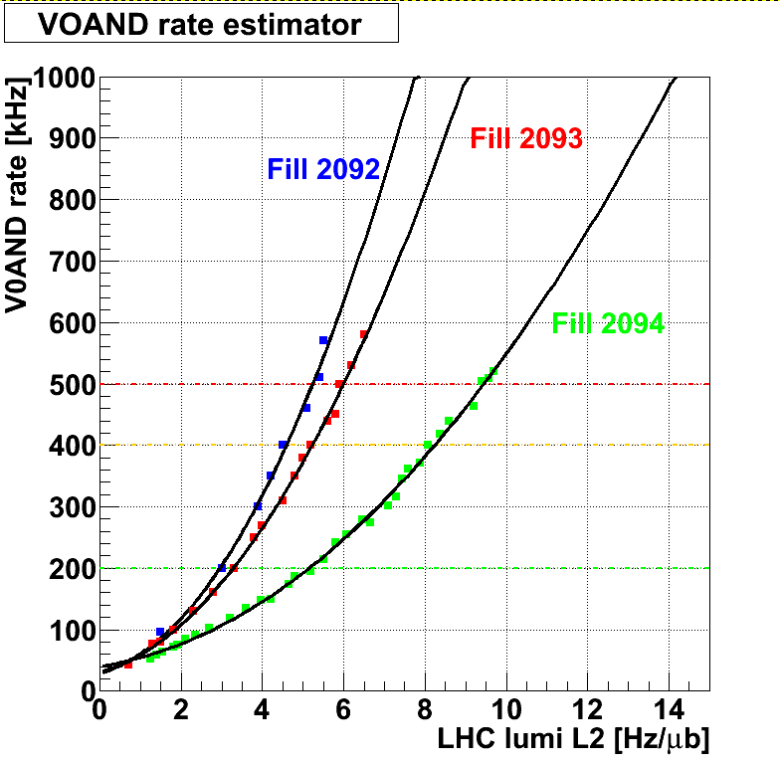
Sat late
15:26h Injection ... B2 reached up to >80% of dump levels.
ALICE reported that they still see too high background so they switch off.
development of ALICE background
over the last fills

Slide 5
Sat late
17:06h Ramp, Squeeze, Luminosity
Luminosity run: some remarks:
* “We are running at >40% of dump thresholds in the triplets if IR1/5”
* Trip of 2 octupole circuits in S12 due to PC fault (not connected to dump)
* Losses in IR2
(Stefano tested larger gaps in the TDI in IP2 )

Slide 6
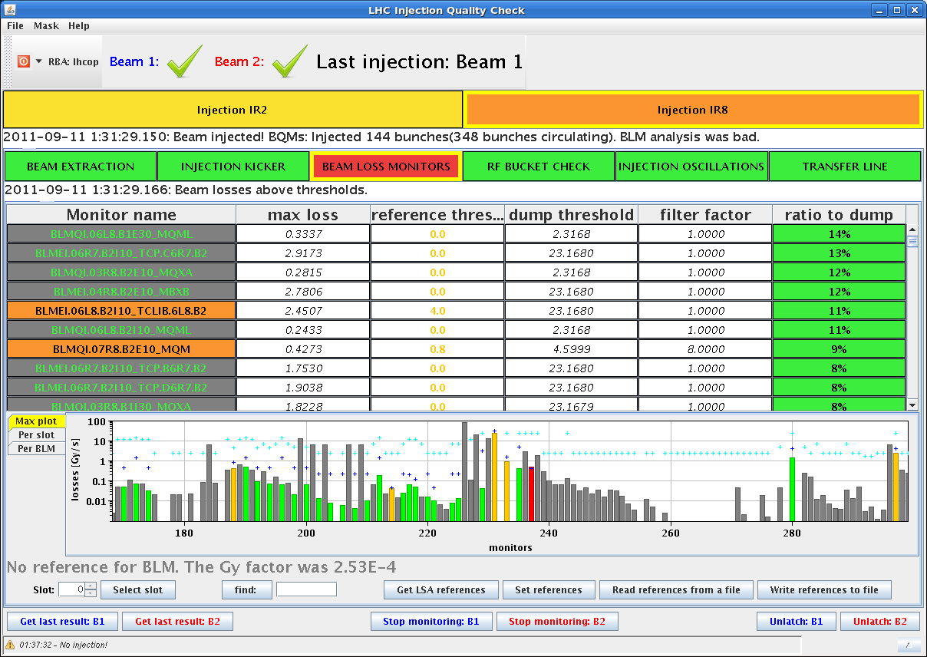
Sat late/night
17:43h Dump QPS triggered quench heaters of the triplet R1.
CRYO lost in the IT-R1.
... cryo recovery, access for Octupoles, restart & precycle
00:37h Injection: orbit correction in both beams

Slide 7
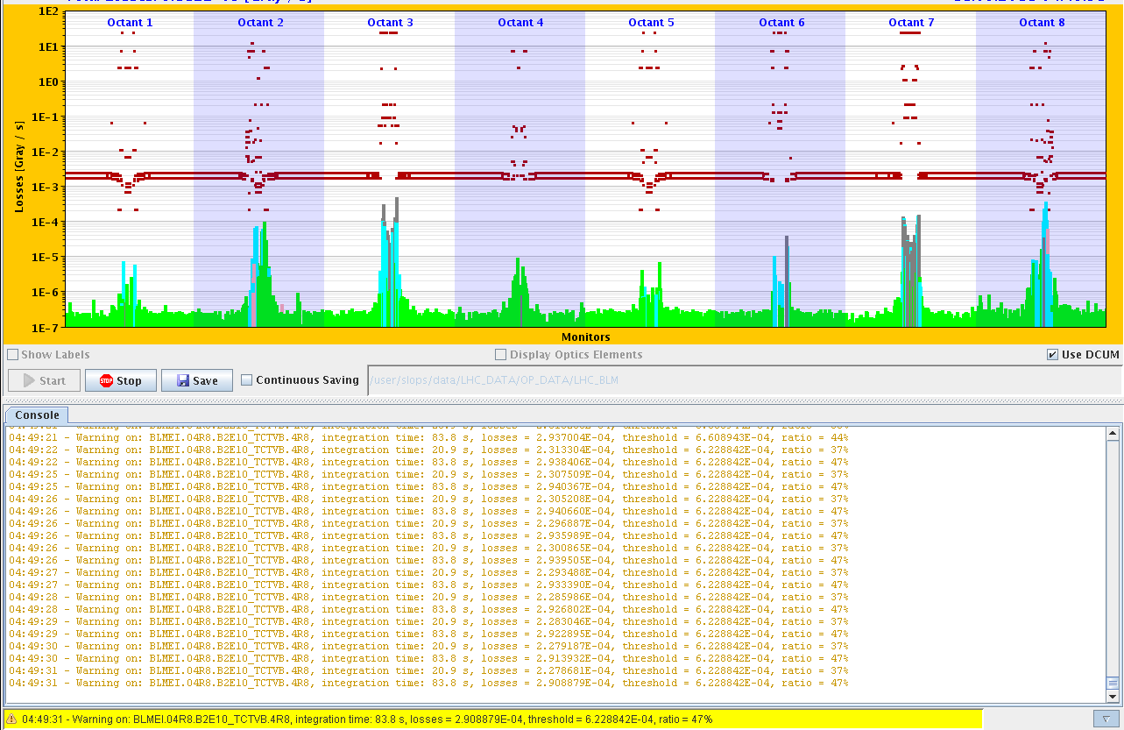
Sat night
02:57h Dump at flat top, BLM point 8.
precycle, injection...
reduced intensity: 1.35 ==> to 1.27.
04:39h Ramp: again some losses
in point 8: “warning level”

Slide 8
Sat night
04:50h Dump at flat top, As before, beam losses due to a vacuum spike in IP8
05:41h Injection: Trip of sector 12: RB.A12 ... reason unknown
Resume:
RB.A81
QPS Triplet IR1
BLM IP8
sector 12

