Slide 1
Summary week 36
Coordination by B. Holzer & J. Wenninger
Commissioning of beta* 1m, ALICE polarity and intensity ramp up

Slide 2
Week 35 and 36 – commissioning plan
Configuration:
β* =1m, 120 μrad Xing angles.
IR3+6+7 collimators at standard settings, TCTs 11.8σ (IR1+5+8)
As decided at LMC: instead of tight collimators and reduced Xing, use recently ‘discovered’ aperture in triplets.
Block A: Aperture at 1m and 120 μrad
Block B: ALICE polarity reversal
Block C: Validation = loss maps
Block D: Intensity ramp up
End of
Week 35
Week 36

Slide 3
Overview end week 35 & week 36
Power cut
LR BB
test
Ramp up
Setup,
aperture
ALICE
TCTs,
loss
maps
Loss
maps
Loss
maps
1380 bunches
Sat
Sun
Mon
Tue
Wed
Thu
Fri
Sat
Sun

Slide 4
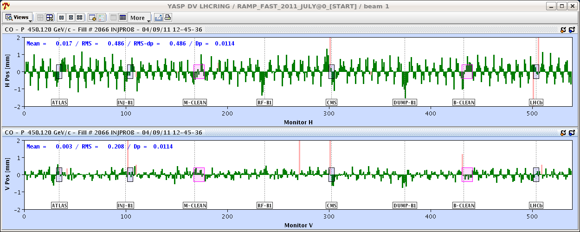
ALICE polarity reversal
Main (side) effects of the ALICE polarity reversal:
Change in coupling ~ 0.002-0.003.
Horizontal orbit change due to coupling of
the large vertical spectrometer + Xing bumps
into the horizontal plane.
Re-alignment of TCTs in IR2 and of injection protection around the inverted external Xing angle.
=> Easy to correct
Orbit change at 450 GeV due to ALICE pol reversal
(excluding expected external Xing angle)

Slide 5
Triplet aperture measurements – week 35
Aperture confirmed at 1 m: there is enough aperture for β*=1m & 120 µrad Xing angles, with around 2 sigma additional margin.
Consistent with measurements at 1.5 m beta*.
For the squeezed/separated case:
Aperture >16 sigmas in the separation plane (IP1 H & IP5 V)
For the crossing plane in collision conditions (with lumi scan corrections):
Aperture at 14.8 -> 15.3 sigmas (IP1 V)
Aperture at 15.3 -> 15.8 sigmas (IP5 H)
Probe intensity loss maps with the TCTs opened to 14 sigma (= nominal + 2.2 sigma) did not show any losses at the triplets.

Slide 6
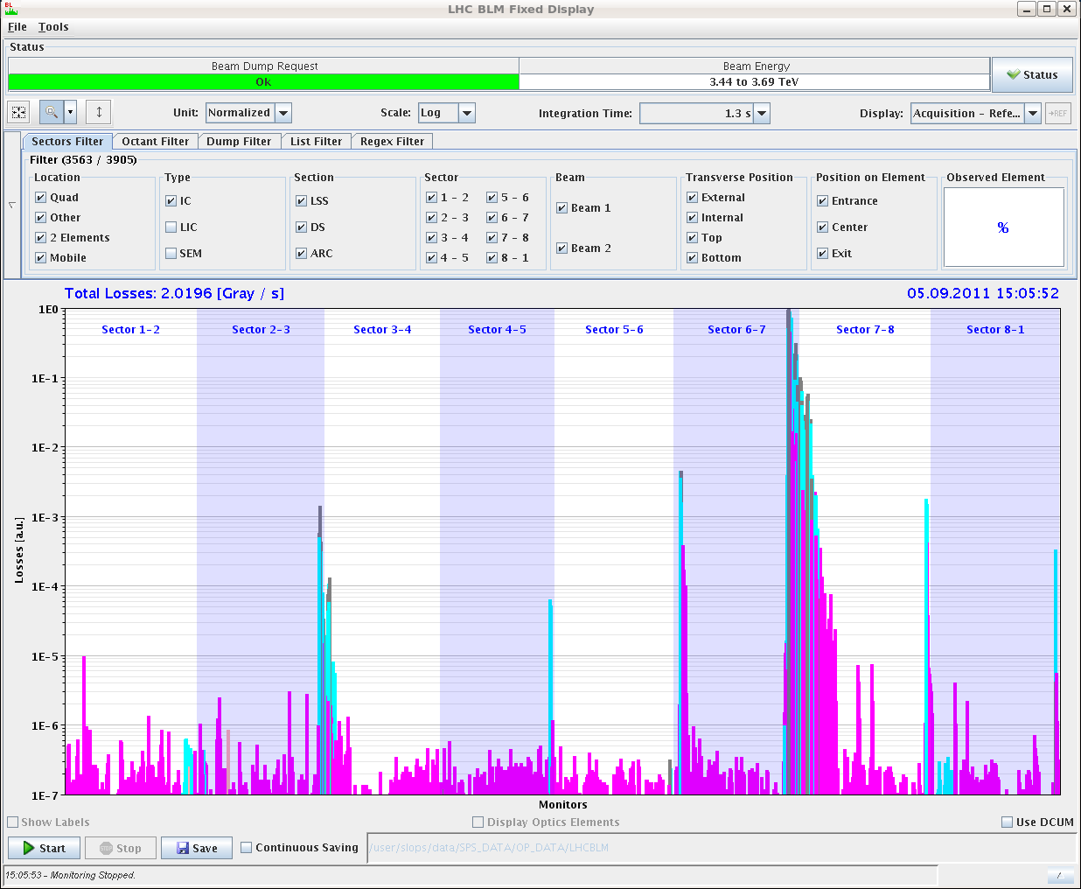
Triplet aperture check
Loss maps with the TCTs opened to 14 sigma (= nominal + 2.2 sigma) were repeated with separated beams at the end of the squeeze (=tightest case) with one nominal bunch per beam.
No/very low losses at the triplets – confirm aperture margins.
B1 H

Slide 7
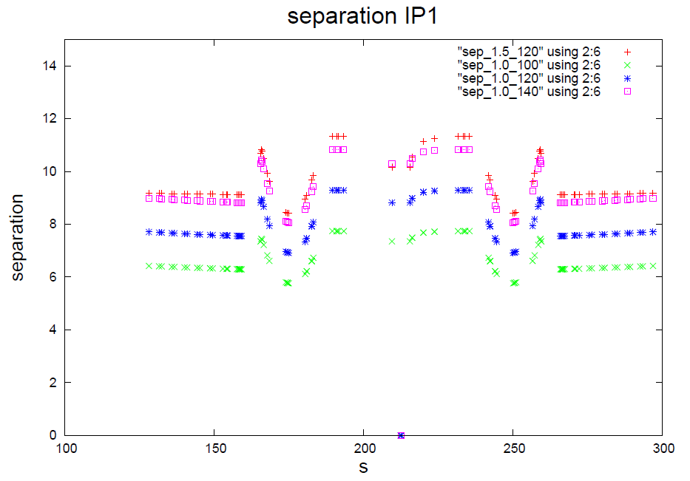
Long range beam-beam separation
Beam-beam separation below 6σ for 100 μrad
With 120 μrad ~ equivalent to nominal (β* 0.55 m)
1.5m, 120 urad
1m, 140 urad
1m, 120 urad
1m, 100 urad
Triplet
Triplet
W. Herr

Slide 8
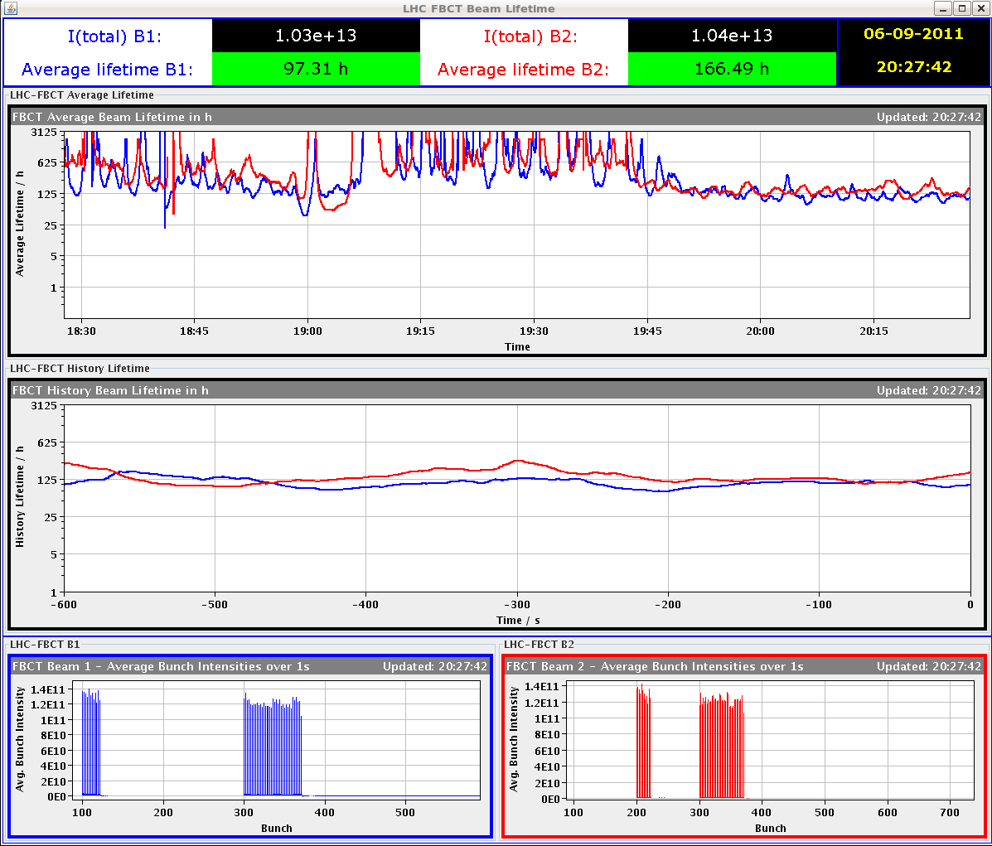
Long range beam-beam
The long range beam-beam test with 84b was finally performed Tuesday evening.
Totally smooth.. Luminosity consisted with beta* of 1 m.
No change of damper gains, octupoles etc wrt 1.5 m.
Collide
125 hours
Gave problems with tight collimators and 100 urad Xing angle!

Slide 9
Hackers intermezzo – Stefan is watching you !
Access to eLogbook from outside CERN
blocked by IT security Tuesday evening !
(for ~ 24 hours)
and we got some expected privacy…

Slide 10
RP settings
Agreed settings (LPC + rMPP):
TOTEM: 14 sigma in V, 18 sigma in H.
ALFA: 7 mm from beam-based alignment center (18-21 sigma).
Station | Top | Bottom
XRPV.A6R5.B1 | 6.8748 | -7.0238
XRPV.B6R5.B1 | 6.4815 | -7.0125
XRPV.A6L5.B2 | 5.9510 | -6.9910
XRPV.B6L5.B2 | 5.7283 | -6.5513
Station | Outer
XRPH.A6R5.B1 | 2.3658
XRPH.B6R5.B1 | 2.7017
XRPH.A6L5.B2 | 2.7314
XRPH.B6L5.B2 | 3.4494
Station | Top | Bottom
XRPV.A7R1.B1 | 7.199 | -6.801
XRPV.B7R1.B1 | 7.175 | -6.825
XRPV.A7L1.B2 | 6.901 | -7.099
XRPV.B7L1.B2 | 6.953 | -7.047

Slide 11
Wednesday morning – setup completed !
Validation campaign finished Wednesday morning.
ALFA-ATLAS data taking exercise before last dp/p + loss map.
Small leakage ~1e-5 seen at RPs.
Condition | Betatron H | Betatron V | Dp/p + | Dp/p - | Dump
Injection | OK | OK | OK | OK | OK
Flat top | OK | OK | --- | --- | OK
Squeezed | OK | OK | --- | --- | OK
Collisions | OK* | OK* | OK* | OK | OK*
* : with ALFA and TOTEM RPs.

Slide 12
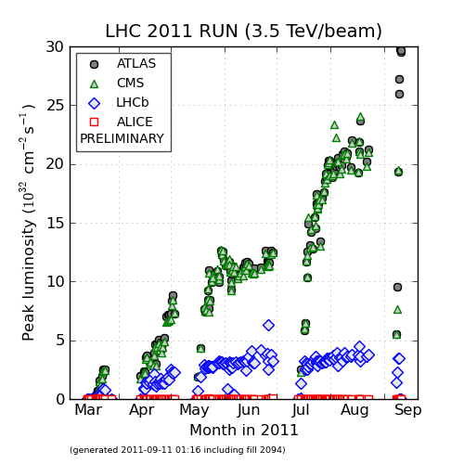
Rocket ramp up
Perfect ramp up over 4 fills to 1380b.
264b, 480b, 912b, 1380b.
Luminosity consistent with 1 m beta* and emittances slightly above 2 um !
1380
912
480
264

Slide 13
Stable beams
L > 3x10³³ cm⁻²s⁻¹ in ADJUST
QPS?
Bunch intensity ~1.3E11
EL
QPS
3x10³³
QPS
RF
OP
Power
cut
OP
OP
Wed
Thu
Fri
Sat
Sun

Slide 14
Stable beams fill list
Fill (nb) | L (10³³ cm⁻²s⁻¹) | Length (h) | Int. L (pb-1) | Dump cause
2083 (264) | 0.57 | 6 | 10 | OP dump
2085 (480) | 0.94 | 6 | 15 | OP dump
2086 (912) | 1.97 | 10.2 | 50 | OP dump
2090 | 2.75 | 1 | 10 | QPS Q8.L5. SEU candidate
2091 | 2.65 | 2.5 | 20 | RF trip B1 (80 MHz cable)
2092 | 2.98 | 6 | 52 | El. circuit breaker on QPS RQF.12
2093 | 2.95 | 0.7 | 7 | Spurious quench loop opening on RB.81
2094 | 2.99 | 0.6 | 6 | QPS RQX.R1 SEU candidate
Red = intensity/luminosity related
Integrated luminosity 170 pb⁻¹ in ≈4x24 hours

Slide 15
> 3 fb-1 end of week 37 !

Slide 16
Injection of beam1
Injection protection had to be setup around new external Xing angle of ALICE (now -170 urad at 450 GeV).
Since we inverted the ALICE polarity we have observed increased losses at and behind the TCLIA.R2.
Dump trigger from losses collected by the beam 2 TCTH.
ALICE
TDI
TCLIA
TCTH.B2
triplet
triplet
Q4
D1
D2

Slide 17
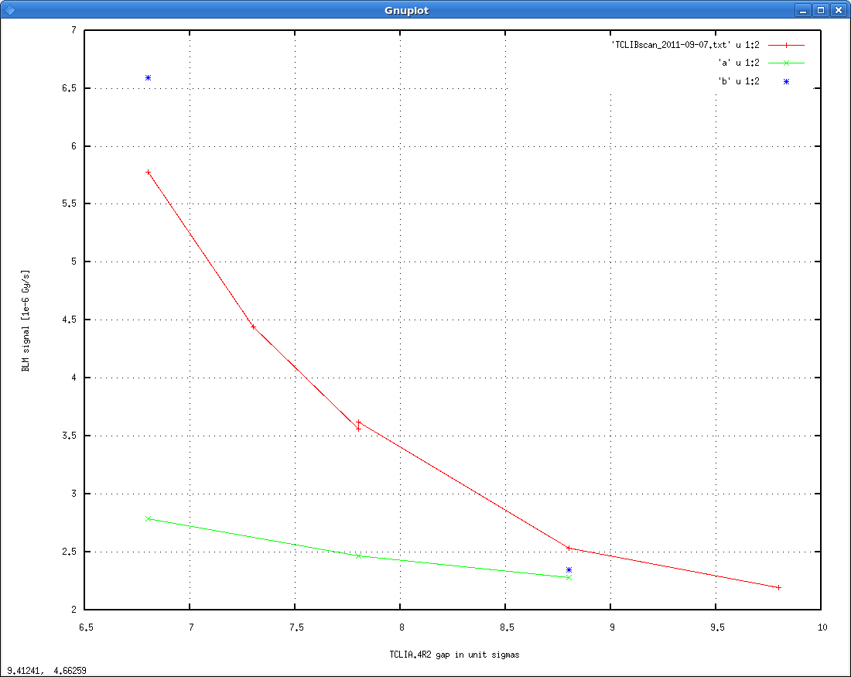
TCLIA issue
Scan of the gap – losses go down when opened.
Most sensitive to the lower jaw.
Lower jaw
Upper jaw

Slide 18
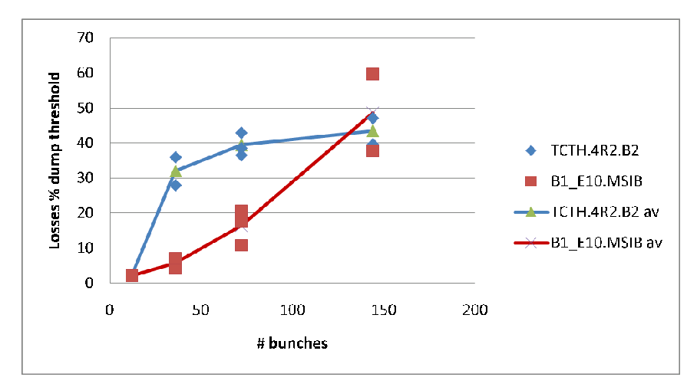
TCLIA issue
Scanned the aperture around TCLIA.
No apparent obstacle found in front of TCLIA.
Opened lower jaw by 1 sigma, then scan of number of bunches.
Losses ≈constant
above 36b.
Similar losses were found during August, but they were just a factor 2 or so lower.

Slide 19
Injection status
TCLIA.R2 lower jaw opened temporarily by 1 sigma.
Where do the particles come from? Nice case for the diamond detectors !
Injection quality fluctuating – no a major issue, but annoying.
SPS scraping was limited to 3% to limit radiation in LSS1. Not sufficient according to Verena.
Alignment issue: in some planes it is no longer possible to zero the injection oscillations and to pass in the center of the TCDIs at the same time – tricky case. With us since a while…
Ideally one should re-align the TCDIs to restore a clean situation…

Slide 20
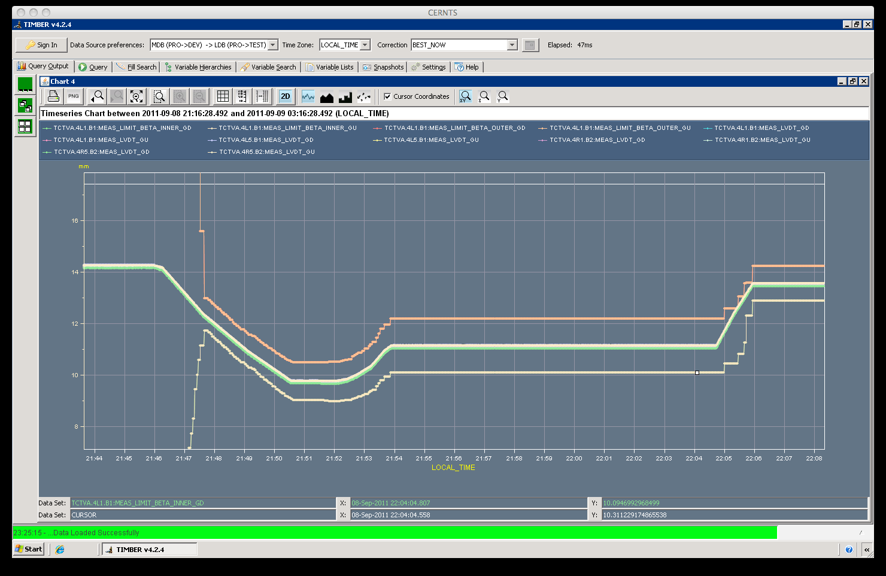
Collimator beta* interlock limits
Attempt to adjust/tighten the beta* limits for TCTs in IR1/5 failed (dump at 1 m) due to the granularity of the beta* info in the timing (0.1 m).
Improved (and working) version tested last night.
Beta* limits deactivated for the moment, normal position interlocks active of course !
10 → 1.5 m
Gap
Limit
Limit
1.5 → 1 m

Slide 21
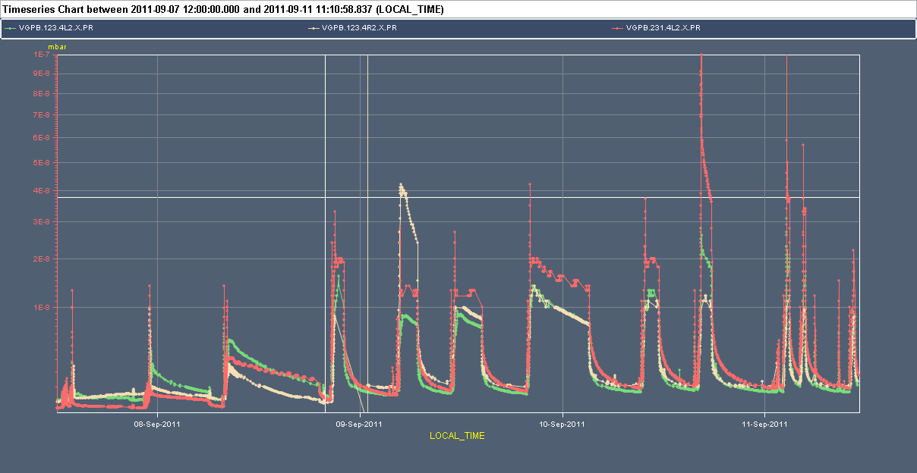
ALICE vacuum
Since we have ramped up the number of bunches to 1380, the vacuum in LSS2 has degraded a lot. ALICE cannot switch on in stable beams.
No (significant) cleaning observed..
1E-7
TDI parking
to ± 40 mm
1380
264
480
912
1E-8

Slide 22
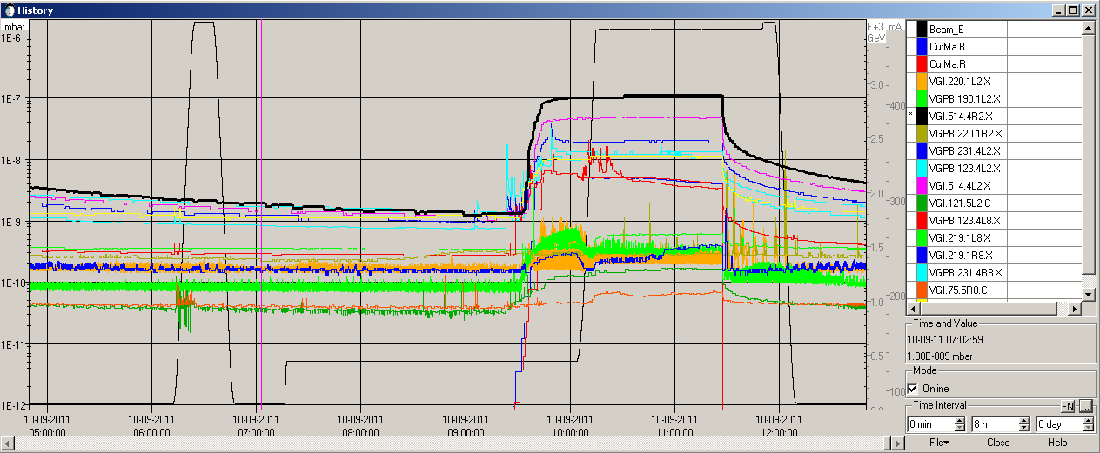
ALICE vacuum
The highest pressure are observed near the ZDC / special 80cm ∅ vacuum chamber (no solenoids, no NEG).
According to vacuum colleagues this could be electron cloud – following the reversal of polarity.
Steady pressure rise at injection.

Slide 23
Losses fill 2092 – 1380b
Vacuum

Slide 24
Steady losses 2092 – normalized to threshold
IR1 & 5 triplets at 30-40% of threshold (luminosity)
RS12 = 84 s

Slide 25
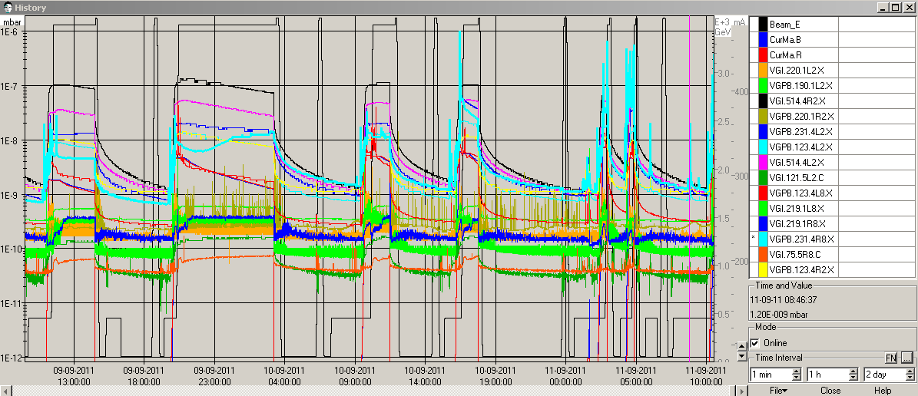
More vacuum – IR8
Since Saturday afternoon, vacuum spikes at Pt8 (in particular R8) have re-appeared.
2 beam dumps on flat top in night Saturday-Sunday on TCTVB.4R8
Started/degraded after change of TDI parking – coincidence?
TDI parking to ± 40 mm
Fri
Sat
Sun

Slide 26
Vacuum IR8
BS regulation apparently OK – worth checking today !
Vacuum activity already present during injection.

Slide 27
No and more issues…
The first machine access after the TS was last Friday !
‘No HW issue period’ extended well into week 36.
What a pleasure – probably helped by the low intensity !
Two ‘spurious’ events on RB.81 (stable beams) and RB.12 (injection).
Quench loop opened, but source not identified.
MP3 still investigating.
Tune signals not always at their best – in particular with low number of bunches.
Lead to a few RQTD/F trips (& dumps).
Switch QFB off when signals to poor.
Seems OK with 900+ bunches.
Worth checking (and correcting the tunes) before/after collision.

Slide 28
The great final
Sunday 10:40 – power cut – affected mostly Meyrin and P18.
Cryo S12 off.
LHC RF off.
LHC collimator motors ok.
Meyrin site machines hit severely (PS, PSB, LINAC off).
SPS basically OK.
Cryo recovered this morning at 04:00.
Pre-cycled.
Injection…

Slide 29
The grand summary
Beta* 1 m works very well and was ready faster than we dared to hope !
Luminosity increase already in the pocket !
Of course higher lumi means more frequent SEUs…
Thank you to the reduced teams that made it work while most of CERN was at IPAC !
Outstanding issues are related to the vacuum situations in IR2 and IR8.
Probably different causes.
TDI parking back to ±20 mm for the moment.
Injection (boundary) conditions to be checked.
TCLIA.R2, steering, scraping.

Slide 30
Todo’s
BLM SW update (C. Zamantzas, S. Jackson).
Damper dynamic range adjustment (partial saturation on some bunches for average of 1.3E11).
CMS observing its vacuum conditions on R5 side.
Agreed procedure with vac colleagues if pressure rises again.

Slide 31
Silence – on tourne !
France 2 will film in the CCC today 13:30 – 17:00.
They will block parking space.
Expect perturbations !
Staring the week 37 coordinators:
G. Arduini
R. Assmann

