Slide 1
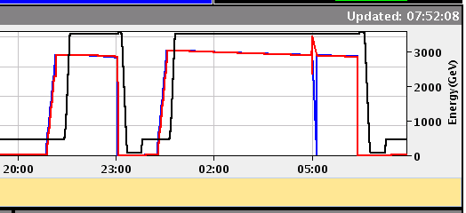
Wednesday 17th August
Rocky, short fills, initial luminosities are good
LHCb polarity change to negative seems ok

Slide 2
Fills after cryo recovery
Tue: 23:55 Fill #2028, Stable beams, initial lumi 1.9e33.
Wed: 02:59 Fill #2028 dumped, RF interlock, int. lumi 19 pb-1.
05:41 Fill #2029 Stable beams, initial lumi 2.1e33.
09:48 Fill #2029 dumped, ATLAS beam loss after UFO near triplet R1. Int. lumi 26 pb-1.
Change LHCb polarity.
13:59 Fill #2030 Stable beams, initial lumi 2.2e33.
15:37 Fill #2030 dumped, RQX.L5 tripped, could be SEU. Int. lumi 12 pb-1.
22:12 Fill #2031, Stable beams, initial lumi 2.1e33
23:04 Fill #2031 dumped, Electrical glitch, FMCM Int. lumi 6.1 pb-1
Thu: 01:10 Fill # 2032, Stable beams, initial lumi 2.4e33 (!) bunch intensities of 1.27e11p
06:23 Fill #2032 dumped, Electrical glitch, FMCM Int. lumi 36 pb-1
08:04 another electrical glitch during filling

Slide 3
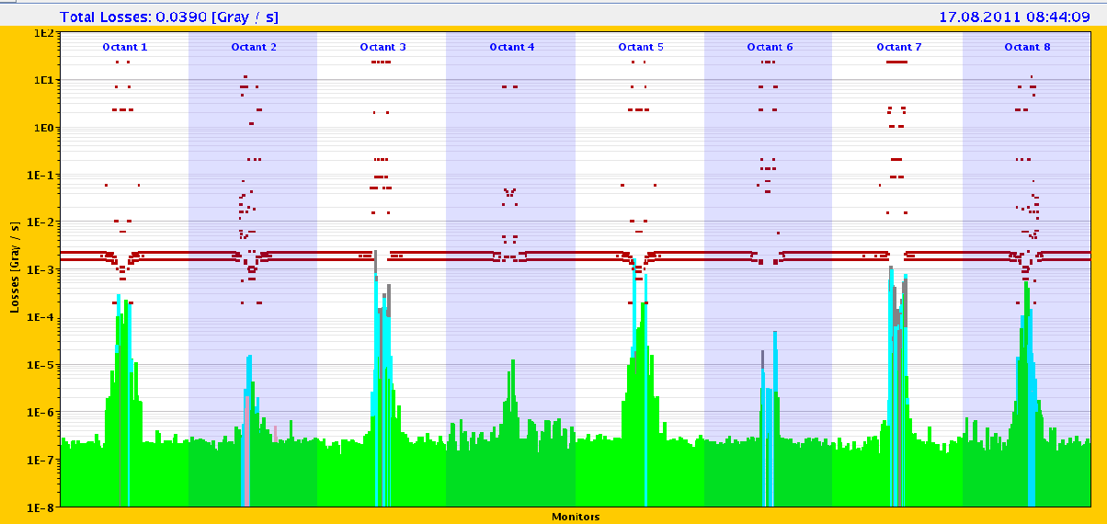
BLM long running sums
Fill #2029 BLM Reaching 35 % now, in TCTVB.4R8
Seen also before cryo stop
Miguel is suspecting (HOM) heating of the TDI causing degraded vacuum R8 and L2….
Fill #2032 Overnight: we had a lot of activity in P2: losses on the TCTs reached 80% of the dump thresholds

Slide 4
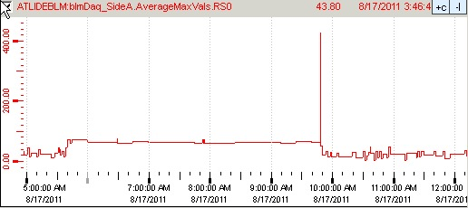
ATLAS Beam Abort 17-08-2011
On 17.8. at approximately 9:48 am the ATLAS BLM aborted the beam (fill 2029).
Both BLM sides showed a significant peak in activity in Average Max Values RS0 (40µs running sum).
Also ATLAS BCM saw large signal (totally independent detector).
Both signals are compatible with an UFO close to ATLAS (beam 1)
A-side: 2x abort threshold (thr=230)
BLM A-side 40µs running sum during the whole fill 2029
BCM high gain channel
bin-width = 5µs
Right: BCM signal from the post mortem buffer.
Big signal also seen in ATLAS BCM.
Also there the beam abort condition was reached, but ATLAS BCM is masked in the abort logic.
BCM low gain channel
bin-width = 5µs

Slide 5
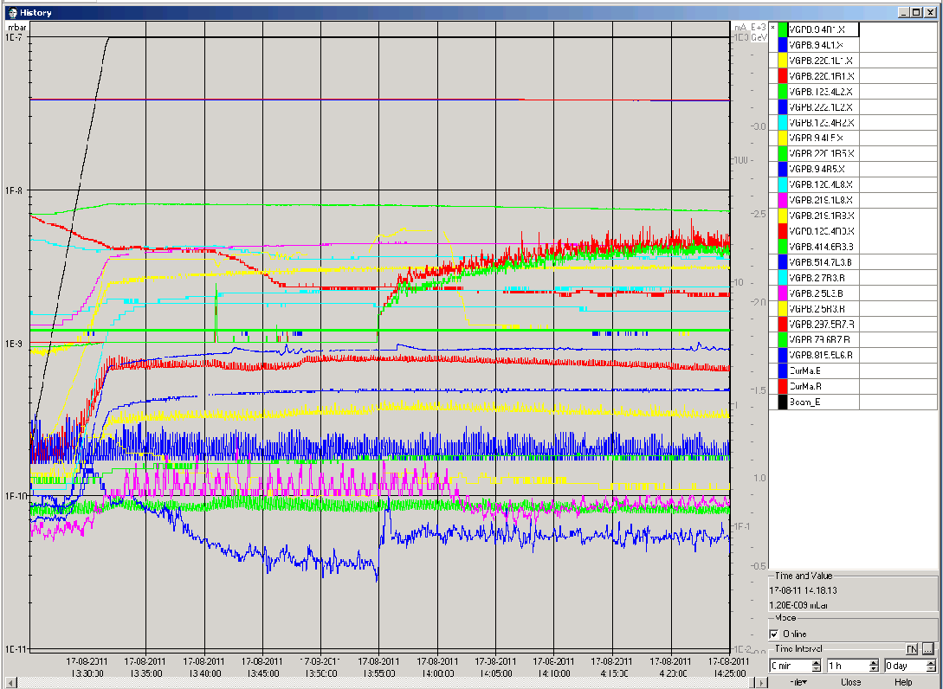
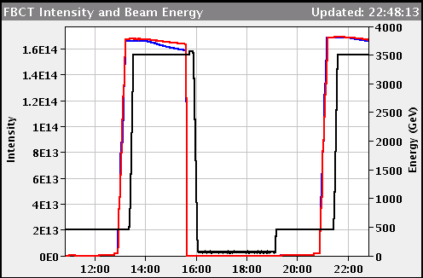
LHCb polarity
LHCb polarity changed to negative
Vacuum ok
Background ok
Only slightly reduced B1 life time, but also seen on other fills before

Slide 6
Dump fill #2030
Dump Classification: Power converter fault(s) Operator / Comment: ralemany / The current measurement for RQX.L5 was stuck for some time and this provoked a fault in the FGC.
Comment from Hugues: To reduce the noise at the output of the IA and IB digital filters, these filter are reset every day. Normally, this reset is transparent for the beam operation. Today it was not the case for RQX.L5 and the converter tripped by I_MEAS error.
RQX.L5 tripped again during the precycle

Slide 7
Outstanding
TOTEM & ALFA moving in during stable beams
Totem: earliest on Monday
Alpha: on demand, allowed after 6h of stable beams
‘End of fill’ tight collimators
After about 10 h of stable beams and during day time
In Adjust
Transverse damper set-up at injection for higher bunch intensities
Need at least 1.3e11 p+ bunches from SPS
Daniel foresees about 2 h – foreseen for next week

