Slide 1
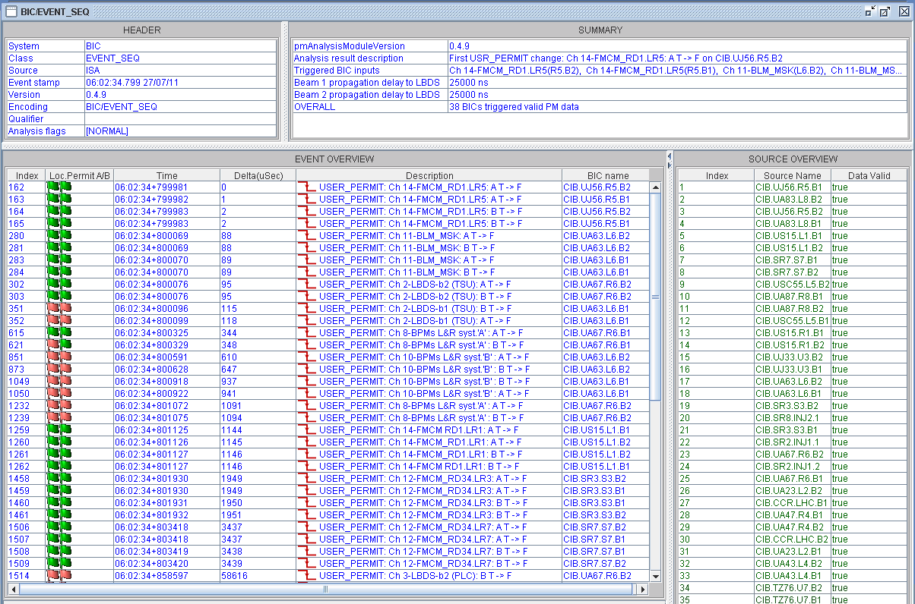
Electrical Glitch 06:02
Electrical glitch is seen on all circuits connected to the 18kV (RD1.LR1, RD1.LR5, RD34.LR3, RD34.LR7)

Slide 2
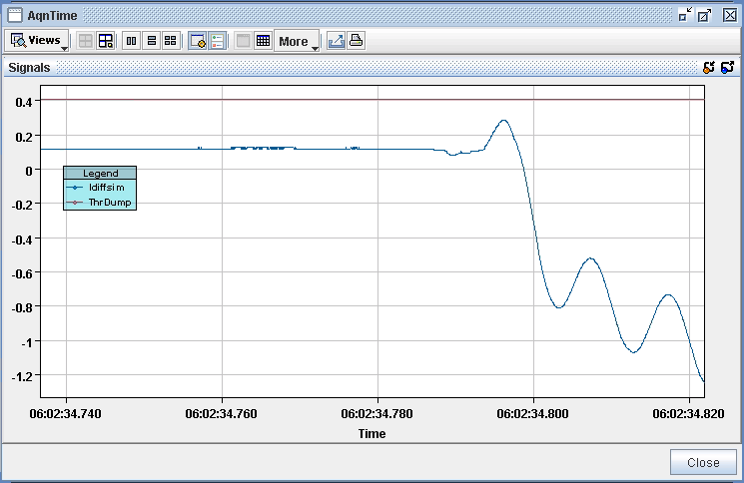
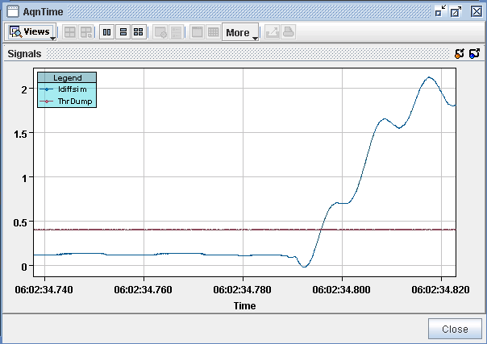
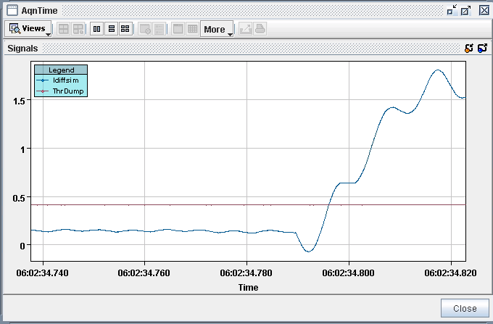
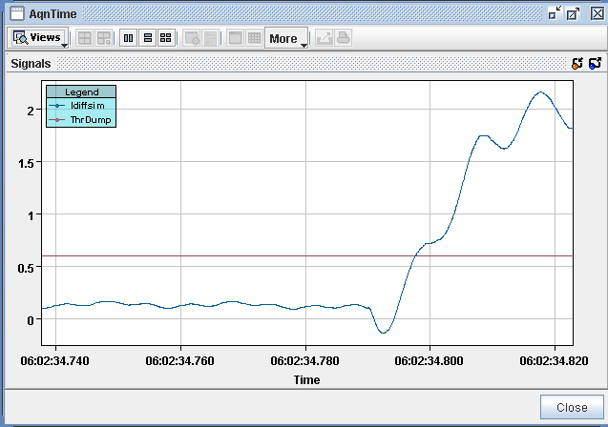
FMCM signal vs Threshold
RD1.LR5
RD1.LR1
RD34.LR3
RD34.LR7
[11]
2

Slide 3
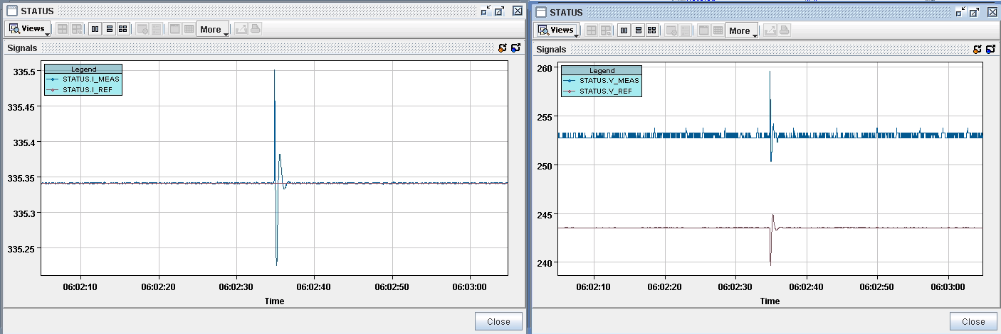
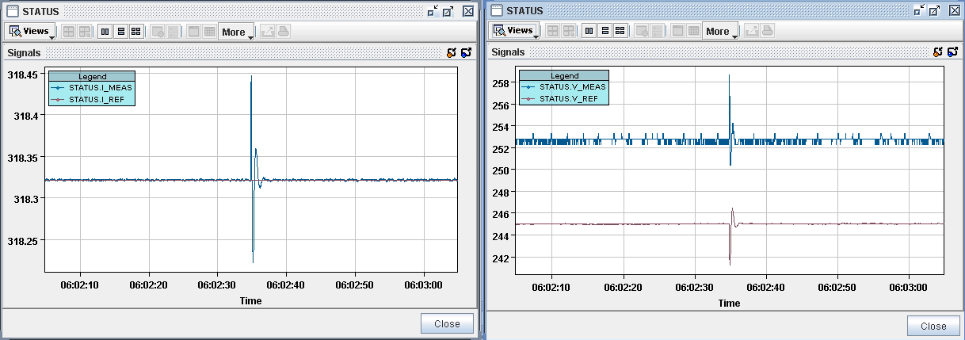
Converter Current & Voltage
ΔI/I=8.95E-4
ΔV~5V
RD1.LR5
ΔI/I=6.3E-4
ΔV~5V
RD34.LR3
[11]
3

Slide 4
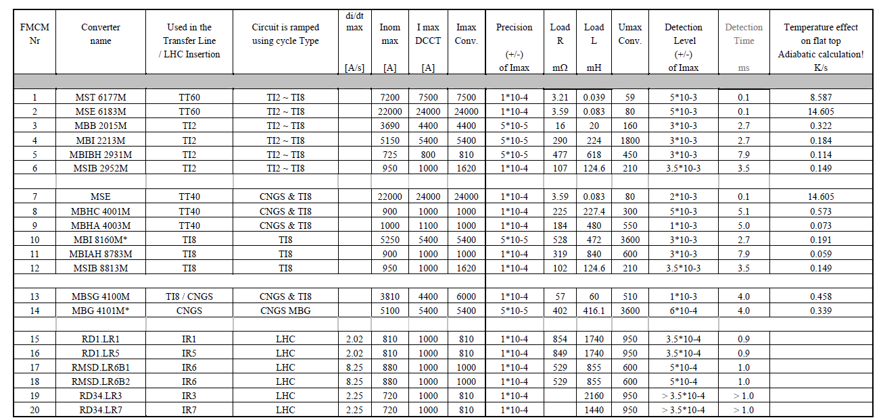
Protection requirements
Beam dump(s) are consistent with defined protection requirements (for all 2011 triggers)
Reminder: FMCMs are protecting the beams, not the powering equipment!
The fact that no power converters trip during the perturbation does not mean that the beam dump could be avoided by increased FMCM thresholds (current changes induce orbit movements and eventually dumps on losses

