Slide 1
Thursday 21.7.2011
Luminosity production 1380 bunches
Alice: main – main collisions

Slide 2
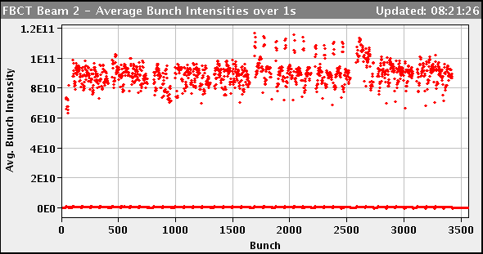
15:26 hours stable beams Fill #1962
In stable beams since Wednesday 22:30
Thursday 13:54 dumped by CMS BCM
after 10 hours of
collisions:
Colliding in IP8 (and few in IP2), but not in IP1 and IP5
Colliding in IP 1 and IP5 (and few in IP2), but not in IP8
Beginning of fill

Slide 3
46 / 44 pb⁻¹ Luminosity delivered to Atlas / CMS

Slide 4
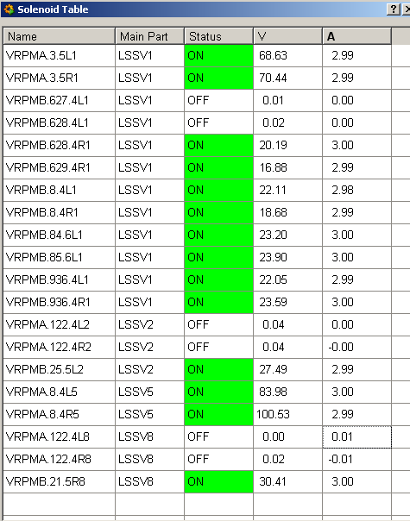
Switching e-cloud solenoids off
And leaving them off for cleaning (V. Baglin)
Location | Pressure increased by [mbar]
D1L8 | 1E-10
Q3L1 | 4E-9
Q3R1 | 6E-9
D1L2 | 9E-9
D1R2 | 2E-9
D1R8 | 13E-9

Slide 5
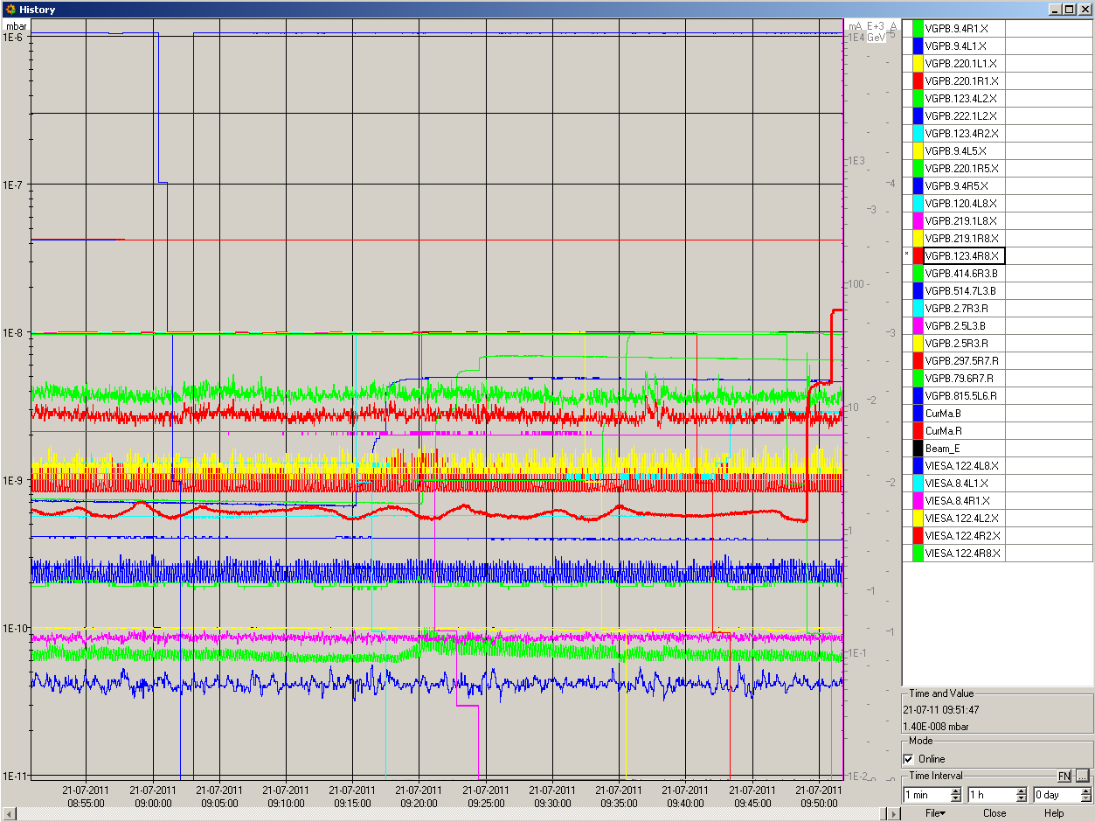
Switching e-cloud solenoids off for cleaning
9:00 – 10:00

Slide 7
A couple of problems when going for the next Fill
14:17 – 16:00 access for Atlas and CMS
16:30 pilots injected
17:30 LHC ready for physics beam but no beam from SPS
problem with SPS MKD
22:33 injection pilots
23:12 dump RF problem: M2B1 crowbar
00:38 dump on injection losses B1 MSIB (107% of BLM threshold)
had planned to dump anyway because of couple of low intensity bunches (8E10 ppb)
2:35 Dump on QPS on RQTF.A67B1 during squeeze
03:28 Lost communication to ventilation doors.
Software interlock masked it as the external envelope is safe.
Back to OK after 7 minutes.

Slide 8
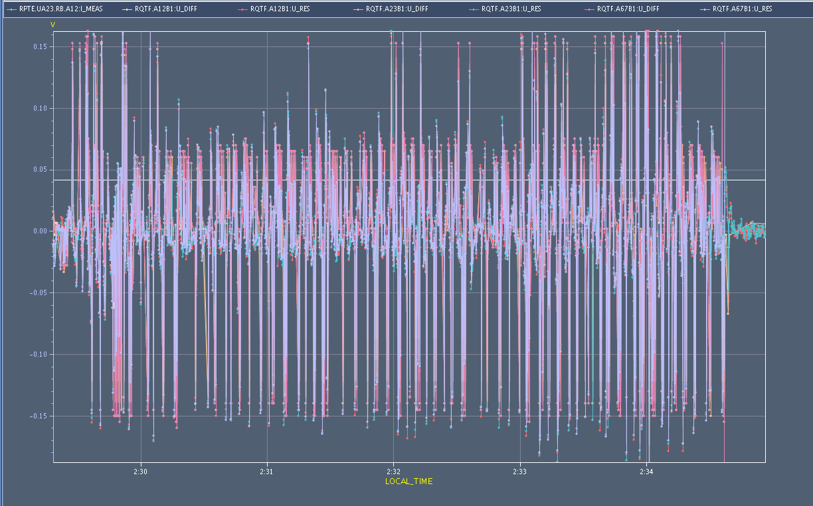
Voltage on RQTFs during squeeze – big excursions

Slide 9
Cont.
3:40 – 4:00 absolutely clean injections
4:28 dump power converter RCBXH1.R1 (inner triplet horizontal separator) at the end of the ramp
→ Access in PM15 to reset power converter
7:16 RCBXH1.R1 OK, but now a problem on RQTL11.R5B2
Others:
FBCT cfv-ua47-bctfra needed twice a reboot
OFSU reboot
Outlook:
Luminosity production 1380 bunches
Alice: main – main collisions

