Slide 1
Summary of week 25
R. Assmann, J. Wenninger
with the support of many !
Goals:
Luminosity production
1236 bunches

Slide 2
Fill overview
Fill length – saw the extremes !
  very long or super short
Fill | Bunches | Peak L (cm-2s-1) | Length (h) | Int. L (pb-1) | Dump cause
1883 | 1092 | 1.1E33 | 18 | 47.5 | SIS – no orbit data
1889 | 1236 | 1.26E33 | 2.7 | 10.7 | AUG TI2
1890 | 1236 | 1.15E33 | 14.1 | 45 | Cryo Pt5
1893 | 1236 | 1.15E33 | 0.6 | 1.8 | Vacuum B2, IR4
1894 | 1236 | 1.15E33 | 2.1 | 8 | Vacuum B2, IR4
1895 | 1236 | 1.15E33 | 0.3 | 0.4 | Vacuum B2, IR4
1898 | 1236 | 1.15E33 | 1.8 | 7.3 | S34
1900 | 1236 | 1.25E33 | >6 | 22
Total |  |  | 46 | 142
Friday !
46 hours over a week : 27%

Slide 3
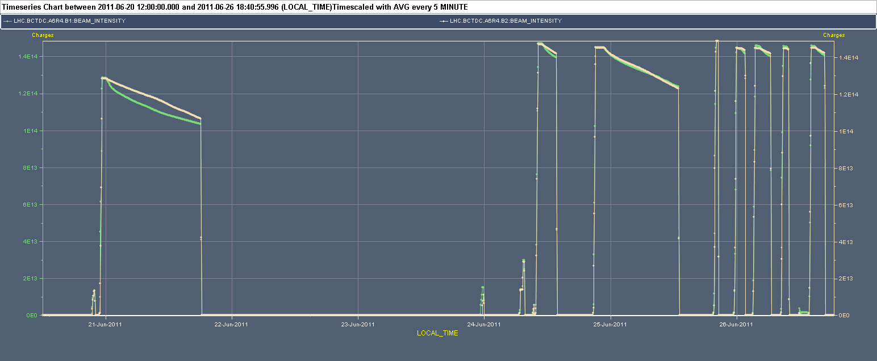
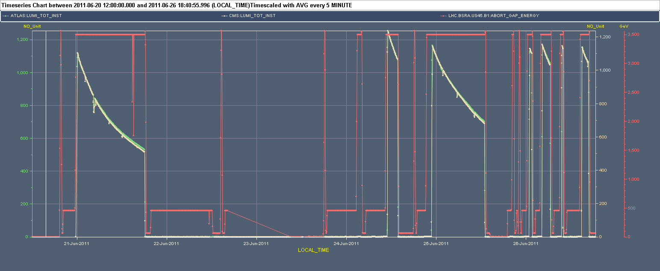
Week 25 → Sunday PM
Intensity
1.4E14
1236
1092
2 days lost…
Strike
SPS RF
Thunderstorm
Luminosity
1E33

Slide 4
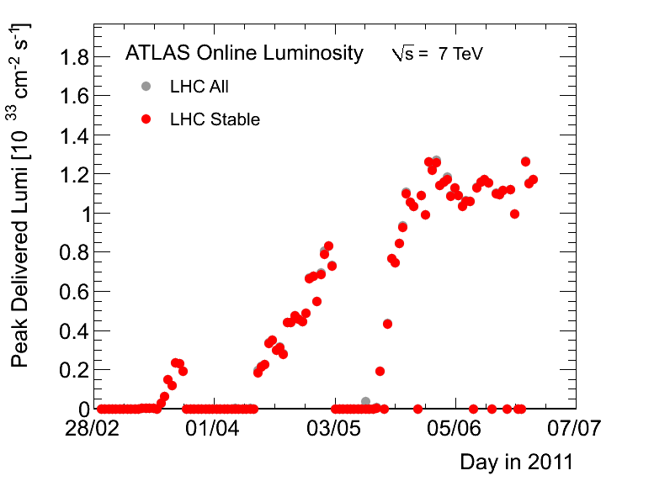
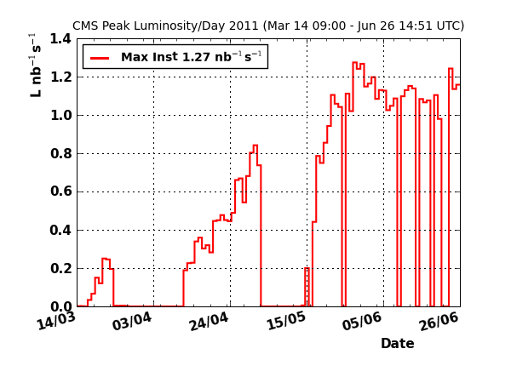
Records – all (except lumi?) in week 25
1236 bunches colliding at 3.5 TeV
Stored energy : 81 MJ
Longest fill 1883 @ 1092b : 18 h
Most productive fill 1883 : 47.5 pb-1
Record luminosity : 1.26(7) x 10³³ cm⁻²s⁻¹
  More or less same peak with 1092 and 1236.

Slide 5
From 1092 to 1236, and beyond
Initial fill with 1236 saw more or less the expected intensity increase.
Subsequent fills (except last) had lower luminosity.
  Mixture of lower bunch intensity, possibly larger emittance.
  Emittance differences are difficult to evaluate.
  Rocky operation did not encourage to push bunch intensity.
At the present stage increasing bunch intensity or lowering emittances can have more effect on L than increasing the number of bunches.
In principle we could move on to 1380 bunches – was foreseen at some point for Sunday.
  Machine protection is no longer dictating the pace.

Slide 6

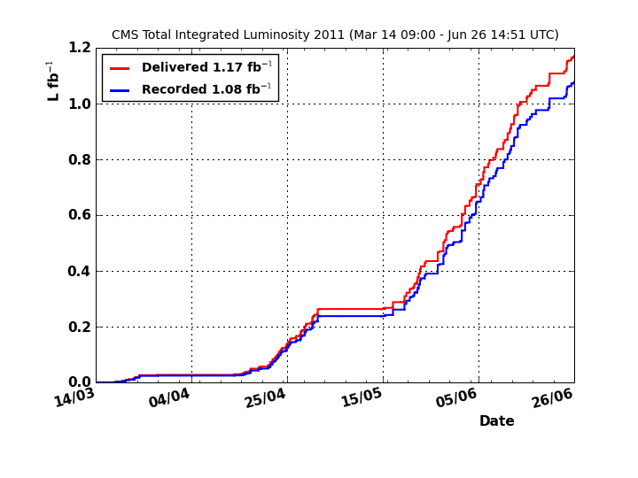
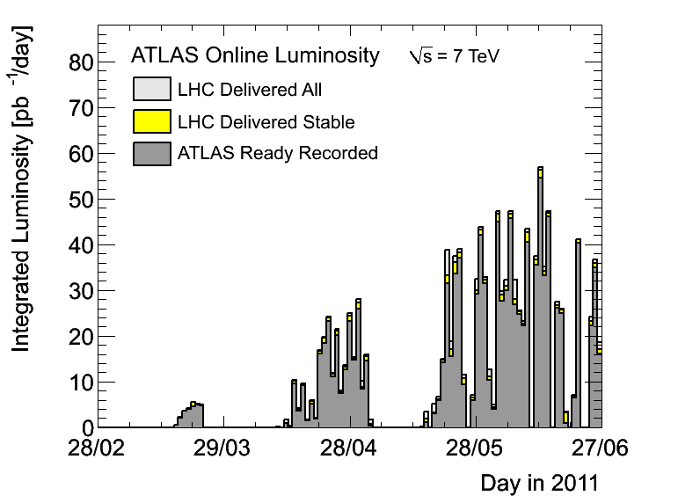
Integrated luminosity
Approaching 1.2 fb-1.
We have peak lumi, but we have too little integrated lumi !
~0.2 pb-1/week
~0.12 pb-1/week

Slide 7
‘Faults’ – the integrated L suffered from
The major events:
  Cryo problem (compressor Pt8) week 24 ~ 3 days,
  Thunderstorm in week 25 ~ 1 day.
The usual suspects:
  Dump by and access for QPS (or EPC).
  Injection issues.
Random events:
  SPS RF noise,
  AUG TI2,
  Work stoppage,
  SIS interlocks.
Weekly systematic ‘series’:
  Vacuum spikes/valve closures in IR4.
A proper mix of those takes us out very effectively !

Slide 8
Cryogenics
Last Monday a problem was discovered on one of the compressors in Pt8 – clogging the oil filters.
  Compressor had to be stopped.
Serge’s team is making miracles.

Slide 9
P8 configuration, last week
Validated for P2 (TS) !
Leaky HX (Jan’11)
TuA (Spring11)
CV615 valve (P2)
Tests for relocation
CCs
CCs
QUI
Sector 78
Sector 81

Slide 10
P8 configuration, week-end
Extra flow
Until next Tech. Stop if CP6 oil filter OK, otherwise …
Validated for P2 (TS) !
Limitations
Leaky HX (Jan’11)
TuA (Spring11)
CV615 valve (P2)
Tests for relocation
CCs
CCs
QUI
Sector 78
Sector 81
Similar to CP6_P4 ?
Some 35’000 hrs since Jan’07 !!!

Slide 11
Cryo bake-out L8
During stop:
Temp BS >> Temp Mag
“Bake-out” at 35K-40K
Heater
Tinlet
Toutlet
Valve
Vac. gauges
=> Bearly visible effect, re-cooling process confirmed ?

Slide 12
Thunderstorm – Wednesday afternoon
A pretty bad power cut:
  Lost all sectors,
  Almost all experimental magnets,
  Cryo in pt8 (due to cooling water stop),
  All patrols around Pt3,
  Many crates in underground area – power.
24 hours to recover, given by cryo.
  Many people could hide in the shadow of cryo: repair on Thursday morning rather than Wednesday night.

Slide 13
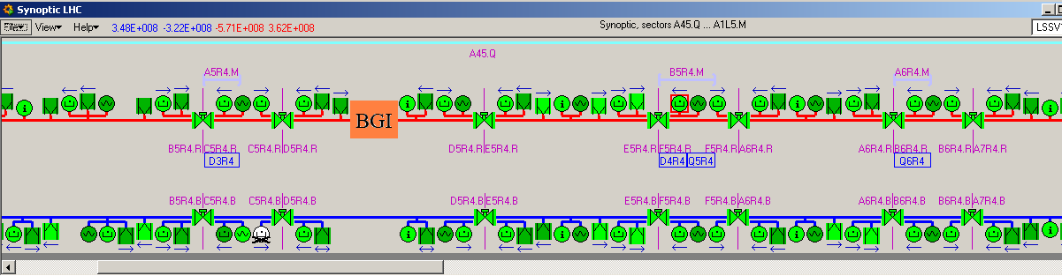
Vacuum IR4
Problem started in night of Saturday to Sunday.
3 consecutive fills dumped by B2 vacuum interlock in IR4 – valves closing.
Identical signatures for all dumps.
  Not understood. Consistently seen on all nearby gauges.
  Sunday morning vacuum interlock threshold increased from 4E-7 to 2E-6 for VVGH.1174.5R4.R.
Beam2
D3.R4
D4.R4
Q6.R4

Slide 14
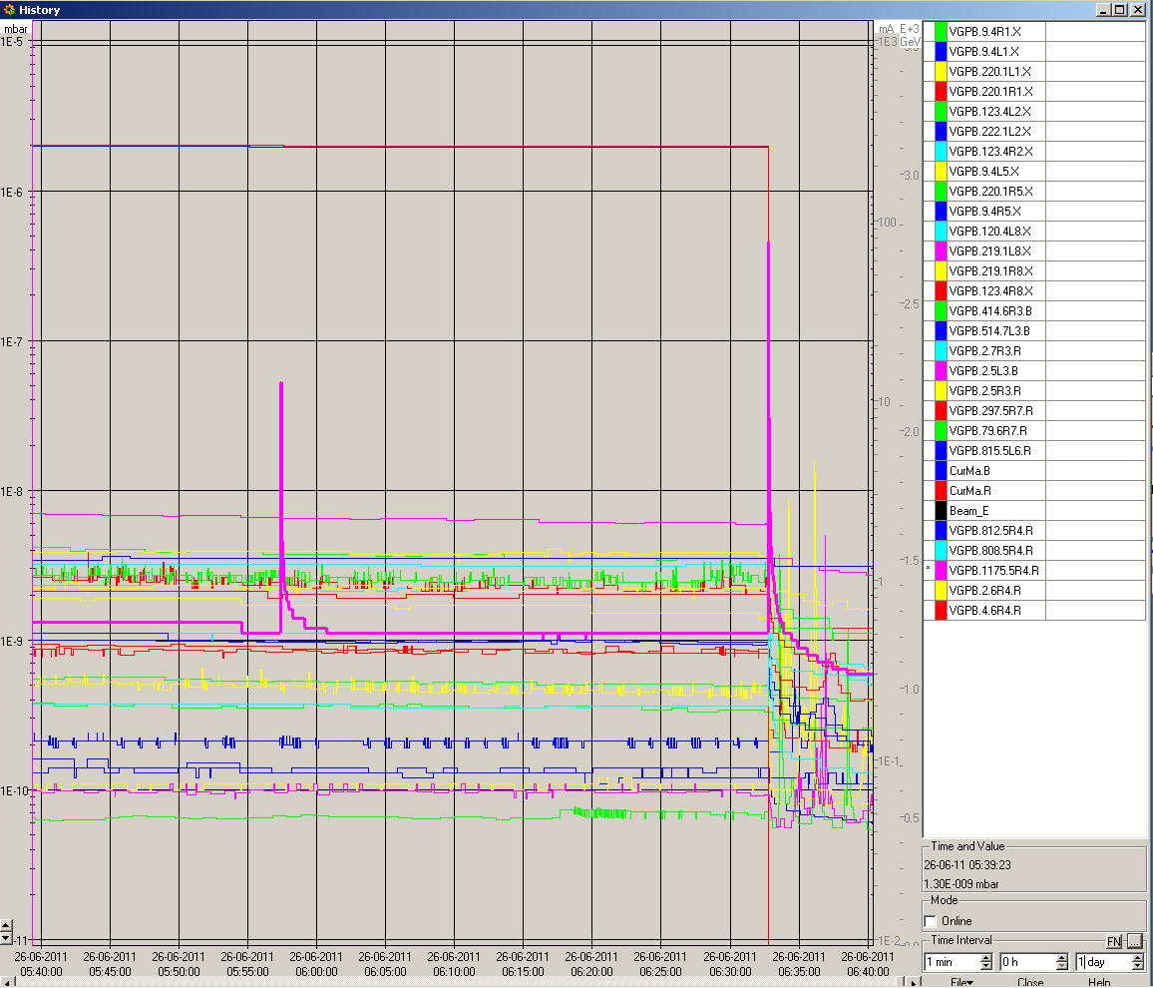
Vacuum spikes fill 1894
Dump
Spike during stable beams

Slide 15
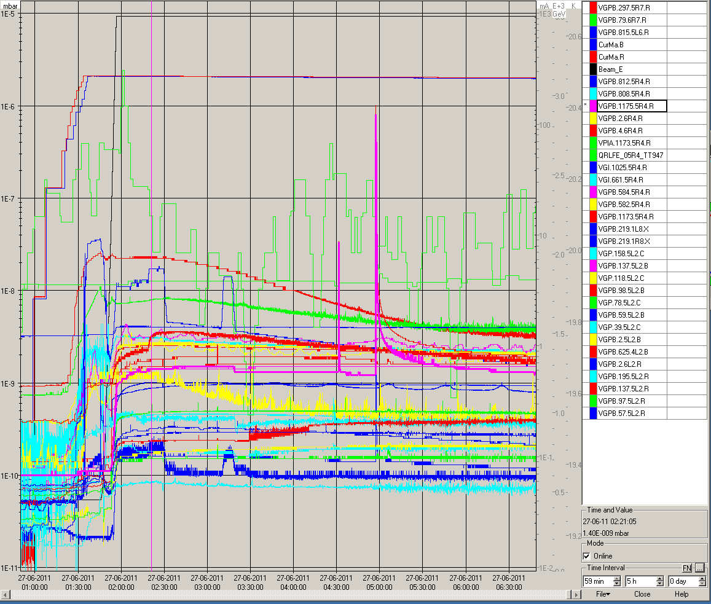
Last night
It is still there… and we got close. Saved by the threshold increase.

Slide 16
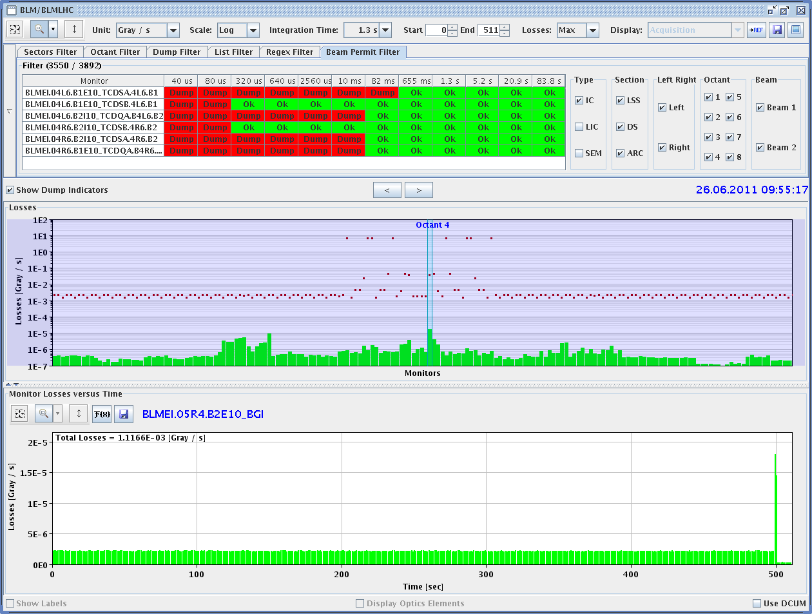
BLM signal – vacuum dumps
For all dumps the BLM @ BGI downstream of vacuum spike region B2 shows unusual losses over ~ 1 second.
  Loss is orders of magnitude below BLM dump threshold

Slide 17
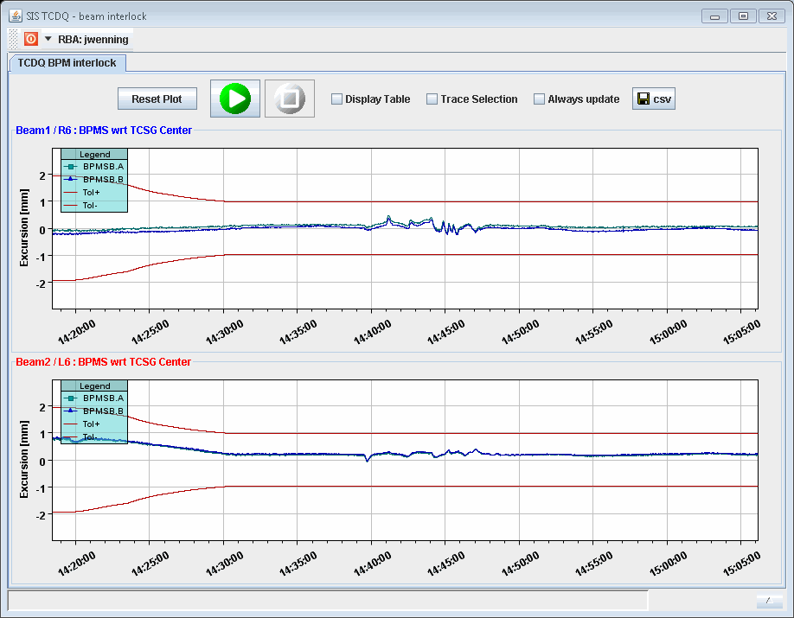
SIS interlocking of beam position at TCSG/TCDQ IR6
One squeeze was dumped on orbit excursion at the TCDQ in IR6 – one BPM developed a lightly offset.
  Eventually readjusted the reference as it goes into the safe direction → closer to the TCDQ.
  Check alignment after TS?
  Nice case for BPMs integrated into collimators.
Squeeze
Collisions
Ramp

Slide 18
Injection
Injection continues to be delicate.
Variability of the trajectories in TI2/B1 seems to come from the MSE extraction septum in SPS LSS6.
  Ripple of 2E-4 (@ 20’000 A) – EPC is on it.
TI2 is very sensitive to transverse and longitudinal tails in the H plane.
  One collimator with large H dispersion at 4.5 betatron sigma close to the LHC. Critical source of beam loss crosstalk..
Due to drifts of various elements, it is no longer possible to center beams in collimators (or in the BPM nearby) and to inject perfectly on the closed orbit.
  Too many constraints.
  Realignment to be considered…

Slide 19
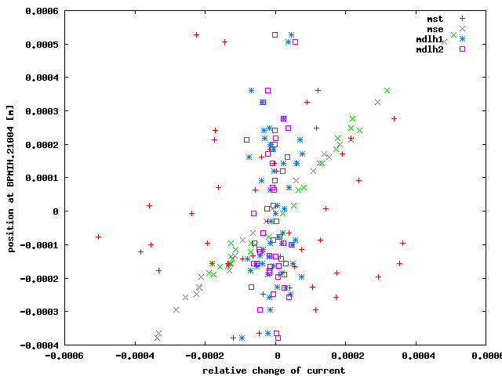
MSE correlation
Simulations of the observed PC ripple/noise (from logging) point to the extraction septum MSE as source.
  ‘Logic’ as this is by far the strongest magnet string (~10 mrad).
Verena, Lene

Slide 20
B1 MKI pulse length
During the trajectory optimization on Monday, it was observed that the 144 bunches of B1 do not fit on the injection kicker waveform.
  The last 5 bunches are systematically kicked.
  Pulse length for beam 1 shorter than for beam 2:
    beam 1: 7.85 us
    beam 2: 8.1 us.
The MKI pulse length was increased by 200 ns on B1.
  Situation is now much better.
  One could increase by another 50 to 100 ns.

Slide 21
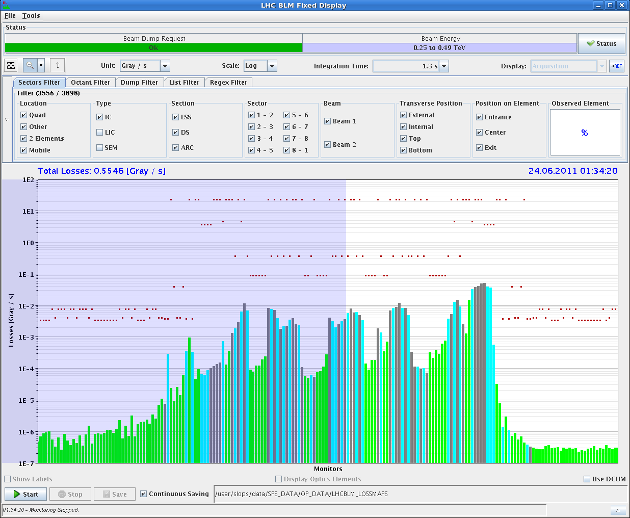
Loss maps
The periodic (1/month) loss maps were performed in the night from Thursday to Friday.
  Full set at injection. Some signs of degradation.
  H, V and dp/p < 0 in collisions at 3.5 TeV. Looking good.
450 GeV, H, B2 – not so nice…

Slide 22
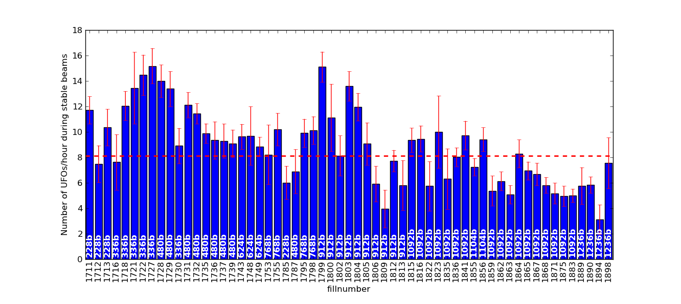
UFO front – status Sunday PM
No drastic change with 1236 bunches…
T. Baer
1236

Slide 23
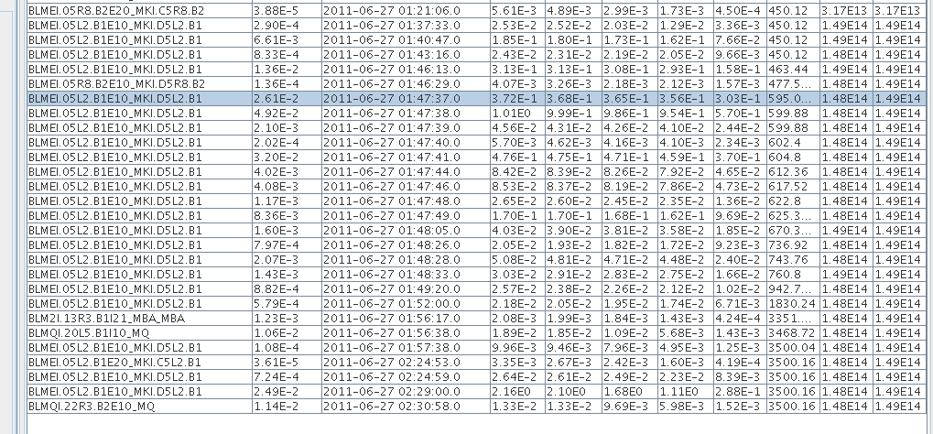
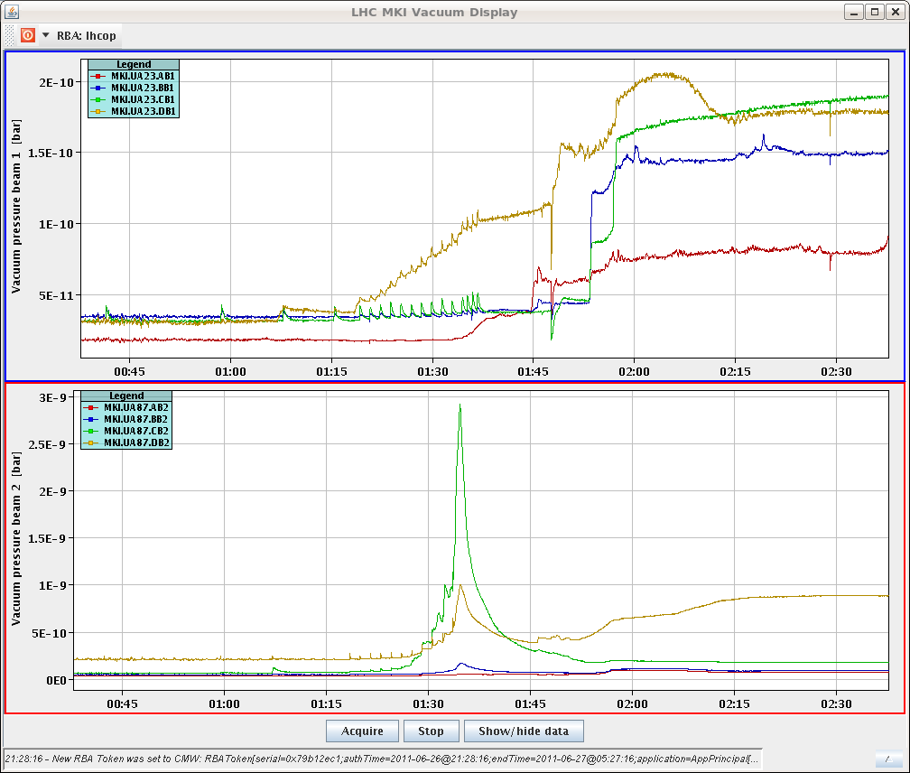
But last night….
Strong UFO activity at the MKI in 2. This time correlated with vacuum activity.

Slide 24
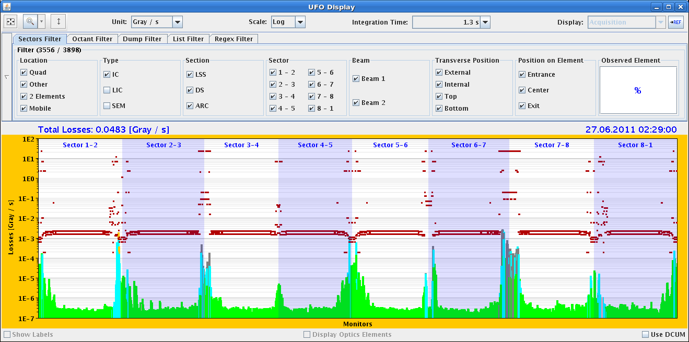
And a large UFO last night – MKI2
Saved by recent threshold increase?

Slide 25
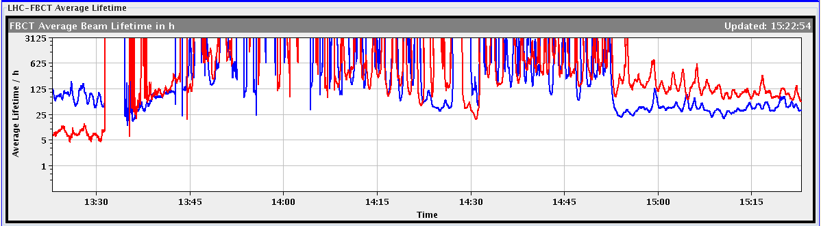
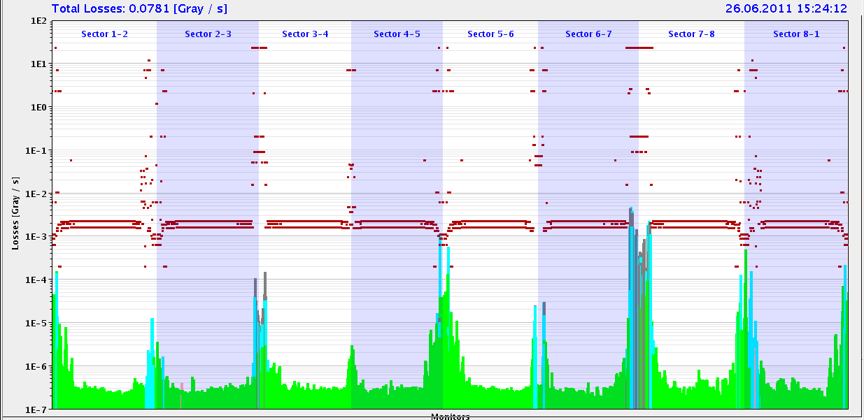
Lifetimes
B1 lifetime frequently worse than B2 – cause not understood. Clearly visible in IR7.
  Example of fill 1898.

Slide 26
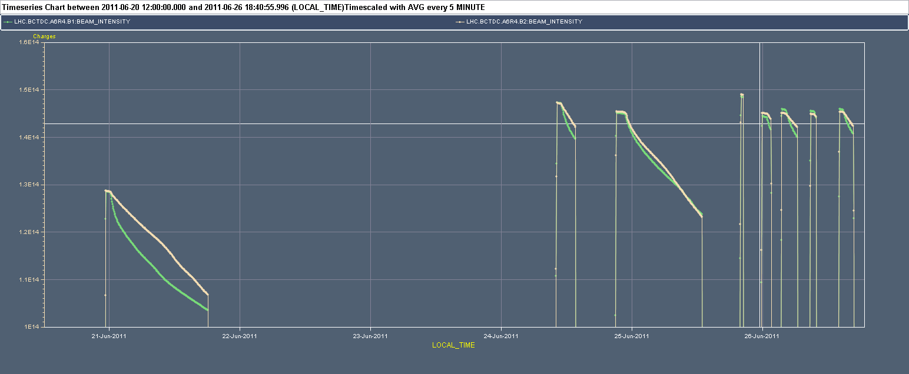
Lifetimes
B1 lifetime was lower in all fills except fill 1890.
  Larger emittance of B1?
B2
B1

Slide 27
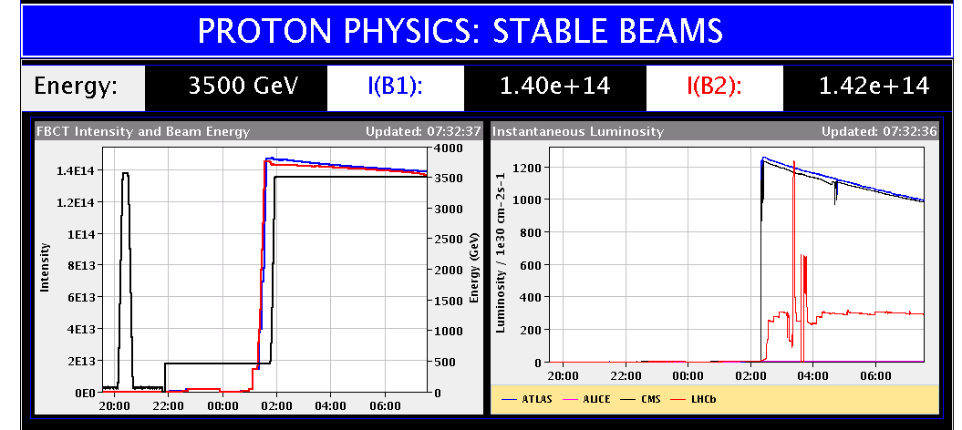
Shit happens… in particular with SW
In the last fill an automated system (code name BIGSISTER), when (re)started on a test server, accidentally switched the mode to BEAM DUMP during stable beams…
Seems to have been a big mess – sorry !

Slide 28
Powering
RPLA.26R2.RCBH26.R2B1 needs access to repair.
  We can operate without it for the moment. Nor urgent.

Slide 29
Next
From MPP side it is OK to move to 1380b.
  But vacuum spikes still present.
  Today is the last chance before the MD/TS.
Tuesday late afternoon: 90 m optics setup + some data-taking for TOTEM/ALFA.
Wednesday morning MD -> TS next Monday.

