Slide 1
LHC Status Tue Morning 3-Mai
Bernhard Holzer, Jan Uythoven et al
1.) ... 12:14h luminosity, collisions 768 x 768 bunches
2.) 12:15h trip of RQD.A81
3.) 14:17h SPS injection terminating resistors of the injection kickers broken
... wait to reduce radiation level ... until Tuesday morning 7:30h

Slide 2
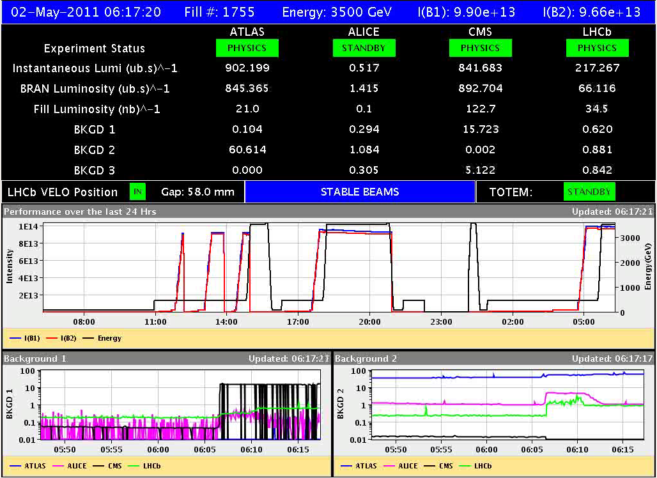
Su 1-5-2011 400kV, Vac IR6, Octupole, Lumi

Slide 3
Mo Morning: beam dump due to PC fault
12:14h end of lumi,
circuits to trip, RQD.A81
The problem was probably originated by the current lead controller
of the Main quads. The reason is not clear. (Noise ?)
14:17h Injection delayed ... MKP in SPS in fault: expert looking

Slide 4
Mo Late: some tests without beam
Un-squeeze test for 90m optics
Early Shift: Trip of RQ4.R5B1 while executing un-squeeze functions!
Late Shift: Another un-squeeze test for the 90m optics. We have updated the beam process and stretched the length of the function segments that caused the problem. The total length was increased by 70 seconds (1772s -> 1842s).
Un-squeeze test successfully finished!!
Test of MD-Cycle: Hypercycle for the MD. - All the PC BPs are cloned (_MD1). Note that the intermediate squeeze points have not been defined. - The other BPs (BI, KICKERS, COLLIMATORS) reused from the normal hypercycle.
Long term test of b3 decay compensation: FIDEL trimming has stopped at about midnight all by itself. ?

