Slide 1
Saturday 30th April - morning
Circuit ROD.A12B1 tripped
The U_res is then jumping up and the circuit QPS is triggered and the circuit goes in FPA.
The circuit RSF1.A12B1 tripped by em coupling and dumped the beam.
Vacuum experts are changing the interlock threshold for all the ITs to 2e-6mbar and they also switched on the solenoids in point 2
10:40 Access over
11:30 Beam in
13:38 Stable beams

Slide 2
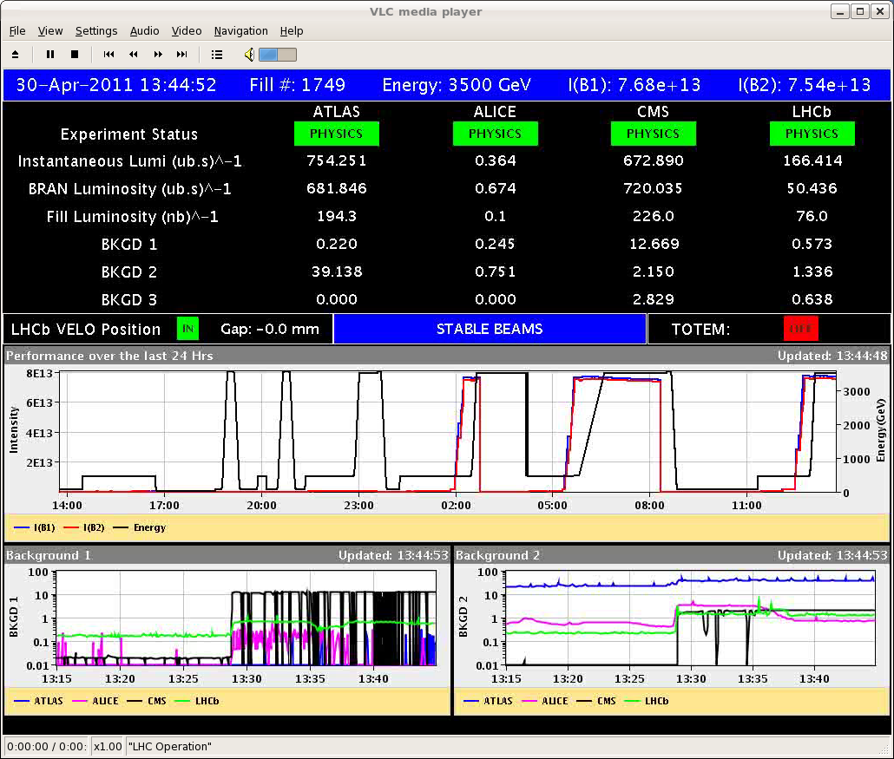
#1749

Slide 3
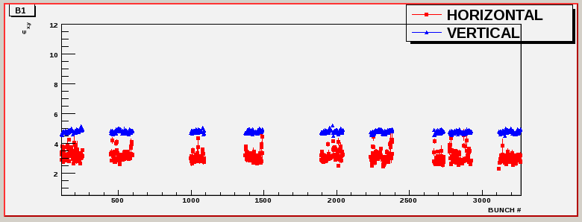
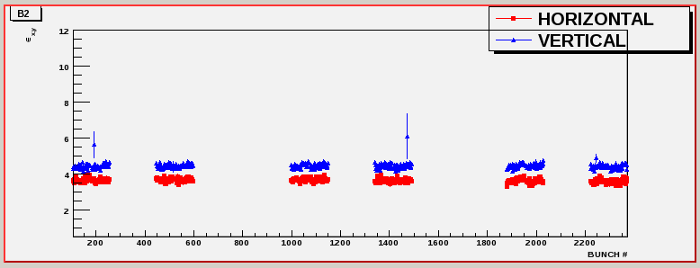

Slide 4
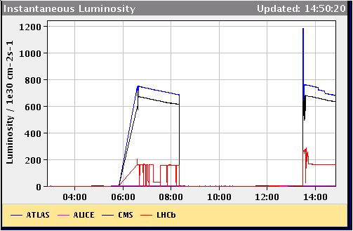
Atlas luminsoity
ATLAS has done some adjustment to their luminosity: the lumi is now reduced by few percent

Slide 5
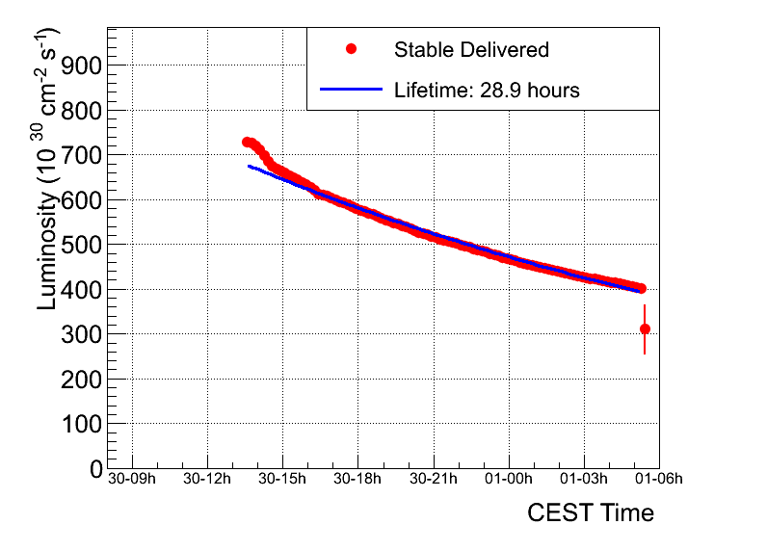
Fill 1749
Peak luminosity | ~6.9 e32
Integrated luminosity | ~29.7 pb-1
Stable beams | 15 hours 53 minutes
Colliding bunches | 598
Average emittance from luminosity | ~2.5 micron

Slide 6
LHCb – lumi spikes
The LHCb luminosity is either measured by the several detectors in the LHCb detector while data taking (called ODIN luminosity) or by an independent scintillator system (BLS) while we are not data taking (before LHCb is configured, run change, crashes etc)
The BLS receives its pileup correction from the ODIN luminosity continuously but the pileup correction has a limited range of validity on its own.

Slide 7
LHC – levelling problems
We have had a few problems in the recent fills:
1. The synchronization between the ODIN and the BLS luminosity has jerked occasionally giving spikes of single values wrong. Trying to fix this today led to a few cases with wrong calibration of the BLS in the last fill which is why there have been spikes with several wrong values.
2. The BLS sees splashes when beam adjustments are made, which in fact translates into luminosity jumps. Normally, there is never any serious leveling done while we are relying on the BLS, only rarely the small automatic lumi leveling changes during the fill.
3. However, we have had some crashes of the data taking right around declaration of Stable Beams in the last few fills. The consequence is that the BLS is transmitted instead. Now, since (I assume) we still have a vertical displacement set to 1.5sigma on collapse of the bumps and we have higher intensity (and we are asking for lower mu currently), there is need for a much more important (manual) adjustment before declaring Stable Beams. With the BLS this becomes a bit like following a moving target if you want to do it fast...as Mirko discovered today.
The solution would be to incorporate a bigger offset (2 - 2.5 sigma) and then I only request leveling (with the enable bit) once I know that the system has "stabilized". This means essentially switching on the leveling as soon as the horizontal adjustment has been made.

Slide 8
Saturday evening/night
18: 30 P. Cruikshank - insulation vacuum in triplet left of point 5 is degrading.
OK with cryo until Sunday morning – intervention required
Filling scheme for 768 bunches created.
Stable beams continued…
05:27 End of leveling for LHCb.
After that, we wanted to try an optimization in the H plane, to see whether we could gain a few percent for LHCb. Got a PM instead.

Slide 9
Beam dump 05:27
First triggered input are BLMs in pt 8, but in the analysis no BLMs in pt 8 have dumped.
glitch? False dump?
BLM sanity checks passed...
Expert called – “communication problem at the crate level”
Looking back at the trims... The last V trims were at 5:22, 5:23 and 5:25. The H trims went in 4 seconds after the dump (if the time stamps are aligned enough).

Slide 10
Sunday morning
Daily access for QPS controller SEU reset (RB.A45)
Vacuum intervention on triplet L5
Insulation vacuum pump repair/replacement ongoing now (Gerhard Schneider)
Markus Zerlauth:
conditions to proceed to the next step are met

