Slide 1
Saturday 2/4/2011
07:00-09:00 Problems with SPS:
extraction septum for B2 due to intermittent fault of emergency stop button
Intermittent trips of QD power supply (ventilator)
11:00-16:00 Collimator alignment and loss maps.
16:00-19:00 Aperture checks in the injection area in point 2 and 8
19:00-02:00 Abort gap cleaning setting-up + Injection gap cleaning. First verification of the injection of 75 ns beam (24 bunches) after technical stop
02:00-07:00 Ramp-Squeeze-collision verification (2 on 2 pilots) + chromaticity measurement after feed-forward. Second ramp with tune feedback on failed due to cryo loss MS.L5 (temperature sensor)
08:00: start collimation setting-up

Slide 2
Issues from Friday 1/4/2011
03:35 Ramp to 3.5 TeV - B2 lost due to RF trip (Wattcher HI) Cavity 6B2 - Switched it OFF and left OFF in the morning after analysis of RF piquet. B1 lost due to TDCQ energy interlock.
06:00 Ramp to 3.5 TeV - lost due to TCDQ energy interlock
Wattcher HI interlock on cavity 6B2 ➔ spurious interlock. Disabled by the RF expert but still compatible with injection of 200 bunches.
Energy interlock on TCDQ observed after the technical stop because this interlock has been enabled during the technical stop. Problem with the functions for the energy interlocks limited to 3500 GeV while the distributed energy goes up to 3500.12 GeV ➔ corrected

Slide 3
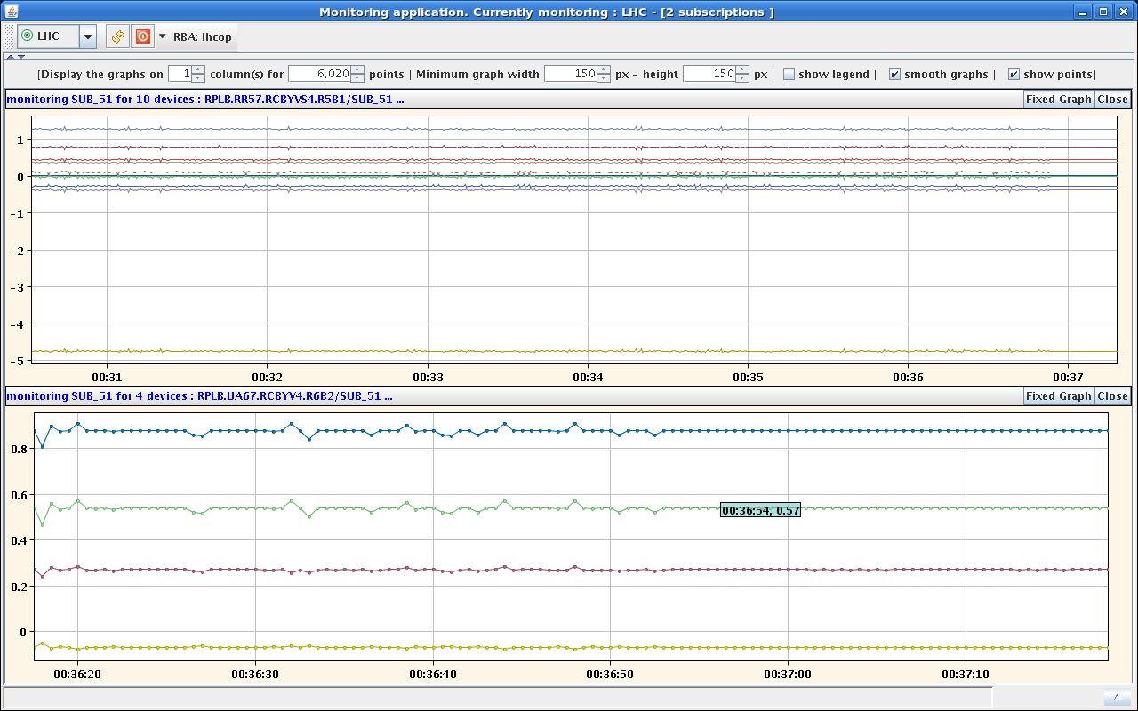
Issues from Friday 1/4/2011
Reset of RT trims
Disappeared mysteriously later even with RT trims ON.

Slide 4
Collimation set-up (F. Burkart, G. Valentino, D. Wollmann)
We re-setup the 3 collimators (TCLA.A7R7.B1, TCTH.4L2.B1, TCSG.A5L3.B2) which have been re-aligned in the tunnel during the technical stop.
Afterwards we performed loss maps (B1h, B1v, B2h, B2v, B1+B2 RF+1000Hz). Results (preliminary):
We don't see any strange losses at the collimators, which we re-setup.
The vertical plane is good in both beams.
B2h is worse than B2v but still fine for operation.
B1h showed hierarchy problems in IR7 and IR3 and therefore we repeated it but found the same results.
Negative off-momentum: hierarchy is ok.
From the preliminary analysis: The problems in B1h need to be addressed

Slide 5
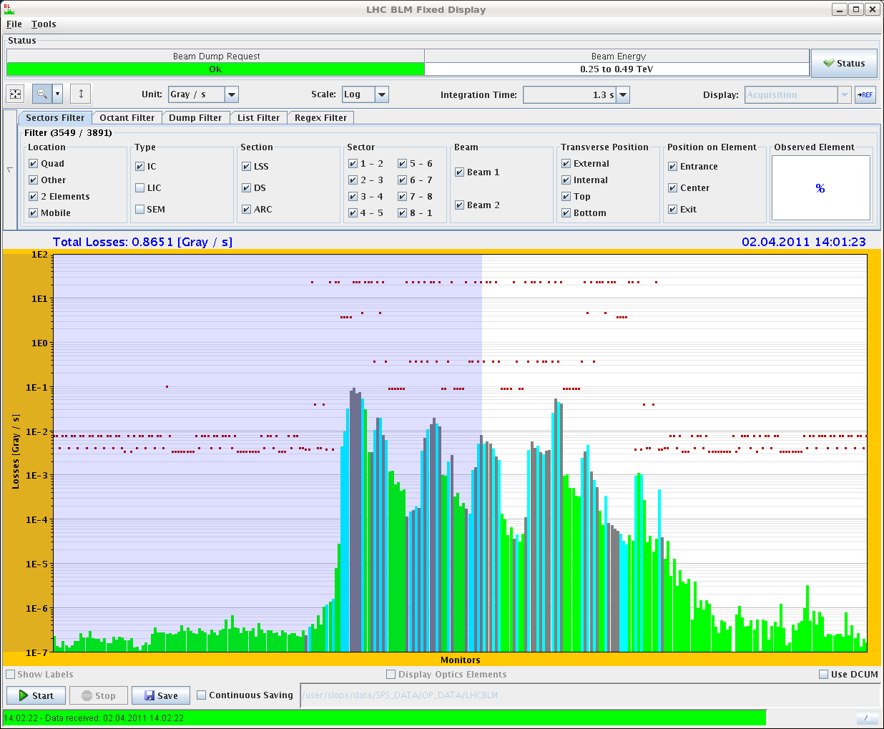
Collimation set-up (F. Burkart, G. Valentino, D. Wollmann)
TGSG.D5R7.B1(BLM at the TCSM.D5R7.B1 behind) only factor 2 below TCP which causes a 0.5% leakage into the TCTs in IR8

Slide 6
Aperture at injection (B. Goddard)
*** Summary of injection region aperture checks *** - Scanned all vertical phases 0, 30, ...,330 deg B1 and B2 - amplitudes upto 6-7 sigma (limited by losses on TDI and not wanting to put too large oscillations through arcs). - No sign of any aperture restrictions in area between MSI exit and Q5 where intermodule inserts were added in 2010/11 TS - Plots copmpare measurements end 2009 and today - solid points where aperture was reached, V error bars show where it was not. - In this regard OK for injection of higher intensity

Slide 7
Injection setting-up (V. Kain, J. Uythoven, D. Valuch)
******* Summary Injection Studies ******* - Aperture in TL checked and ok (see summary above). - Abort gap cleaning working and tested for both beams with 'first' and 'last' bunch in the machine and tests with debunched beams. - Tested BPMS with 3 nominal bunches in the machine: OK - Injection gap cleaning tested with a series of pilot injections for both beams: OK Then tried injection of 24 bunches, as before TS. Losses much higher than before and needs to be sorted out before being able to take reference loss measurements of TDI BLMs with the different cleaning configurations. NB: trimmed TCDQ energy limit functions for problems at 3.5 TeV - to be tried now with test ramp.

Slide 8
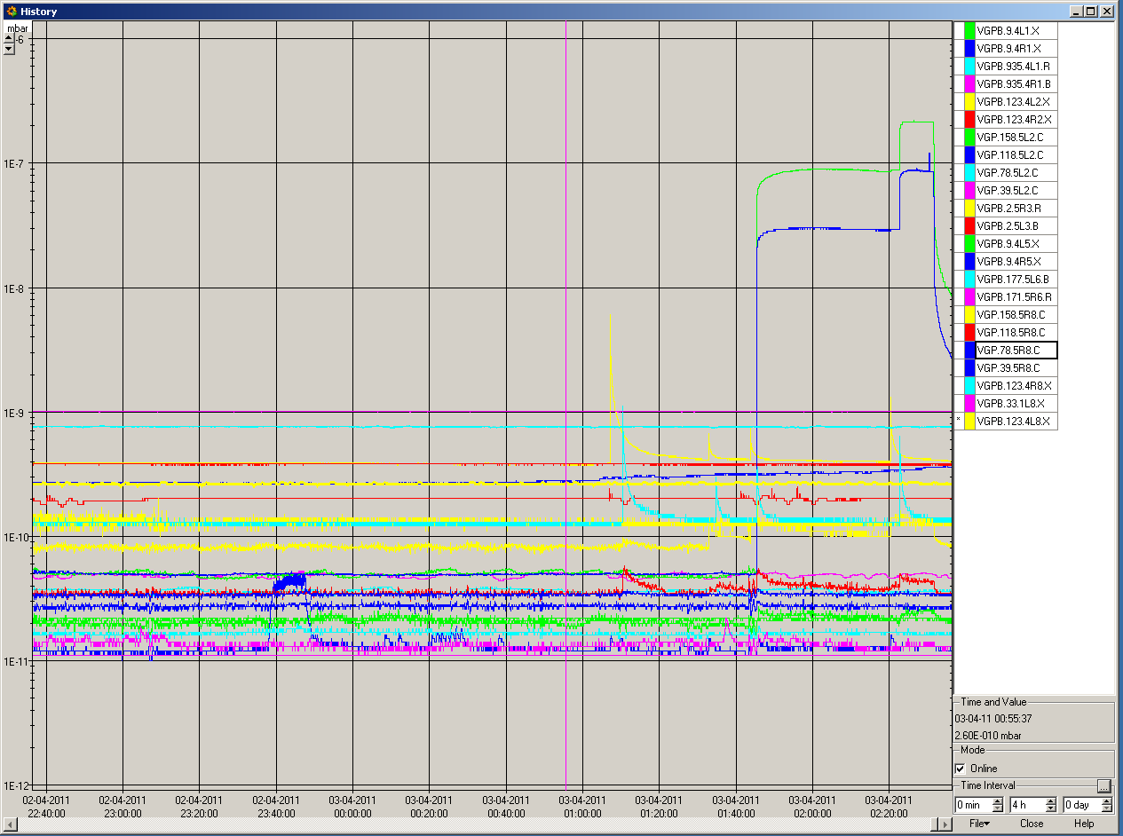
Effect of CMS solenoid OFF

Slide 9
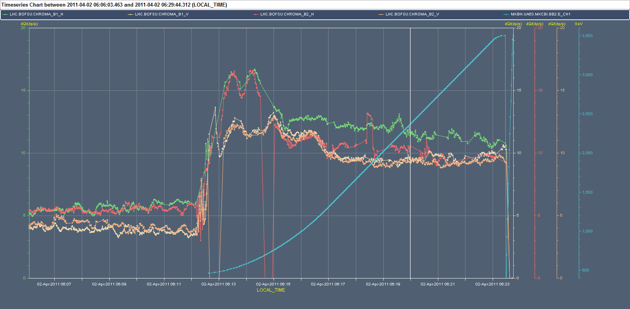
Chromaticity during ramp on Friday night
Feed-forward implemented ➔ to be measured
New calibration curves for lattice sextupoles

Slide 10
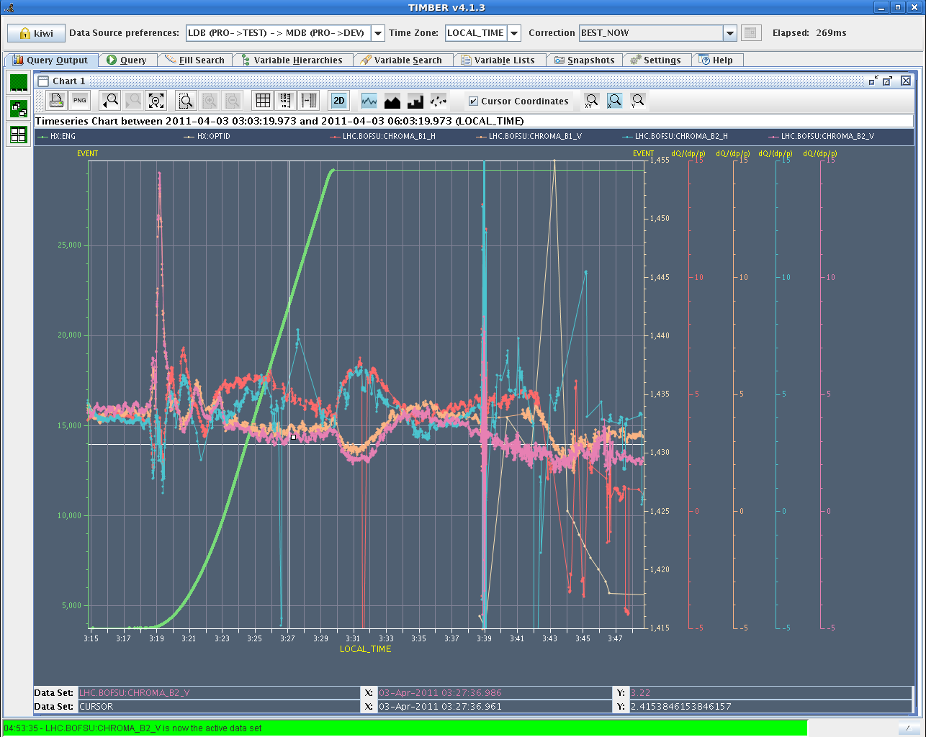
Chromaticity during ramp/squeeze on Saturday night

Slide 11
SPS status
75 ns beam OK up to 4 trains (96 bunches)
50 ns beam up to 4 trains trains injected maximums (144 bunches): still outgassing of the MKDH dump kicker observed. To be continued.

Slide 12
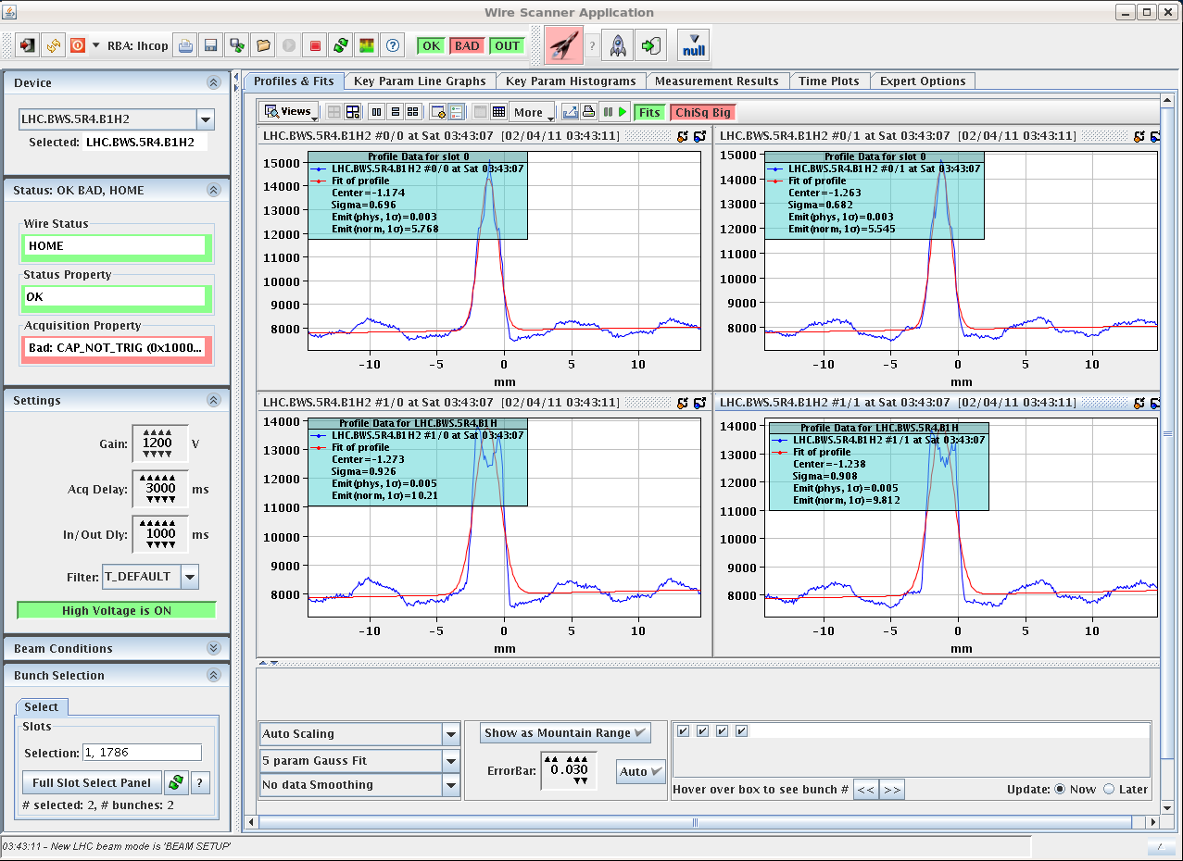
Issues
Still noise on wire scanner B1

Slide 13
Issues
Timing alignment errors (twice at 02:12 and at 06:23) between BICs observed. Being monitored by B. Todd to check whether we have a persistent problem since the Central Timing Receiver upgrade (introduced to minimize sensitivity to missing UTC timings observed 2 weeks ago).
Observed already in the past ➔ being monitored
RF cavity 6B2 still tripping often

Slide 14
Plan
Sun | M | Collimation setting-up (450 GeV)
Sun | A | Injection setting-up (24+ bunches – 75 ns)
Sun | N | Preliminary scrubbing of IR5 with 75 ns beam
Mon | M | Collimation setting-up – t.b.c.
Mon | A | Injection setting-up (24+ bunches - 75 ns)

