Slide 1
Friday, 25.3.
06h10: Stable beams at 1.38 TeV.
09h03: Beam dump.
One bunch dropped too much in intensity and gave BPMS interlock (dump protection).
10h36: Injection:
Bunch length (too long, > 1.7ns) giving injection problems (BQM prevents extraction). SPS working on problem. Improved but not fully solved.
SIS interlocks because of timing mismatch of BPM’s (old acquisition stamp). Solved by SIS reboot.
12h14: Abort gap cleaning commissioning. In shadow: Update BI-QP fixed display (more memory allocation).
14h11: Injection for physics.
14h23: Trip of RB in 81. Water problem on bridge B (Thyristor bank). Access required.

Slide 2
1.38 TeV Stable Beams

Slide 3
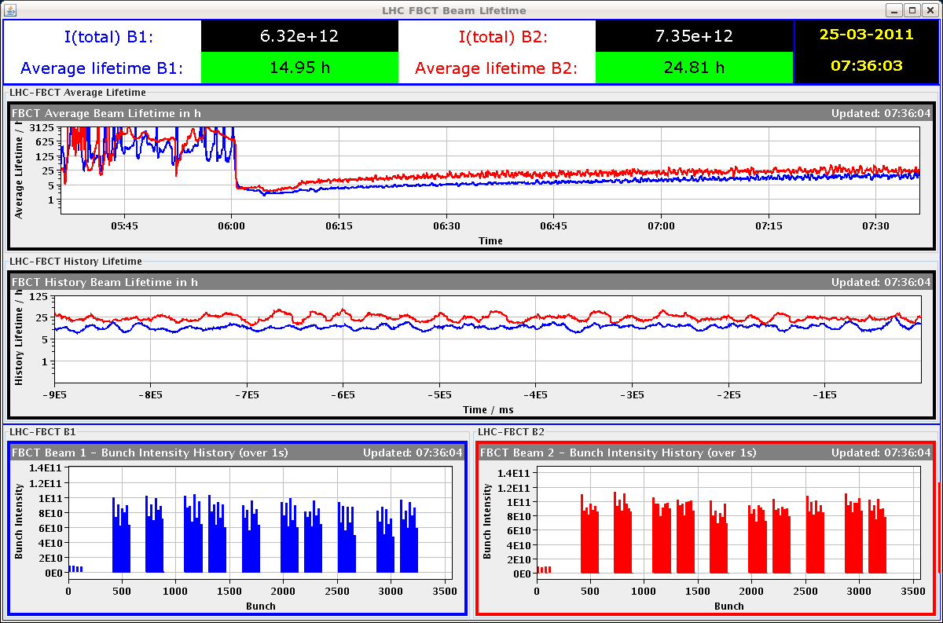
1.38 TeV Lifetimes and Intensity

Slide 4
1.38 TeV Beam Dump

Slide 5
Why the Interlock?
A single bunch with larger loss rates and low intensity is no problem → collimation takes care of it.
Problem comes from BPM for dump protection:
A BPM is used to verify that local IR6 orbit is in allowed range for a beam dump (dump kick depends on offset in quadrupole).
Interlock checks that every bunch is inside orbit specification.
Interlock due to intensity dependence of BPM readings:
In the region of 4-5e10 p per bunch, the BPM reading diverges.
If all bunches have low intensity → no problem, sensitivity range is switched (only possible for all bunches).
If only one or few bunches have low intensity → BPM reading for these bunches becomes artificially large and triggers interlock.
Interlock due to instrumental effects + single bunch logic.
Known but we could live with it so far due small beam-beam effects at 3.5 TeV

Slide 6
Abort Gap Cleaning
D. Valuch
The cleaning is considered operational again. It can be activated/stopped by the sequencer tasks:
Physics -> ALL RF tasks -> Sequence operate abort gap cleaning
Switch on AG cleaning B1
Switch off AG cleaning B1
Switch on AG cleaning B2
Switch off AG cleaning B2
Lack of time: re-commissioned with one bunch in the bucket 1:
Window function:120 x 40MHz buckets (b), aligned with abort gap. 5 b zero, 10 b rising edge, 30 b flat top, 10 b falling edge, rest zero.
The window function needs to be fine tuned in order to minimize impact on bunches in the very last buckets → more time.
New gating delays for VB1: 317, VB2: 3476.

Slide 7
Friday, 25.3.
17h55: Injection.
19h05: Ramp. Tuning at flat top:
Reduce chromaticity from +16 to +5.
Octupoles on.
20h03: Stable beams. Fill #1651.
22h37: Beam dump:
One bunch dropped too much in intensity and gave BPMS interlock (dump protection).
23h31: Trip power converter RB.A78.
No beam, just getting ready for injection.
Active filter problem.
Several accesses: Deactivated bridge B but still not staying on.
Status 09h00: Repair ongoing…

Slide 8
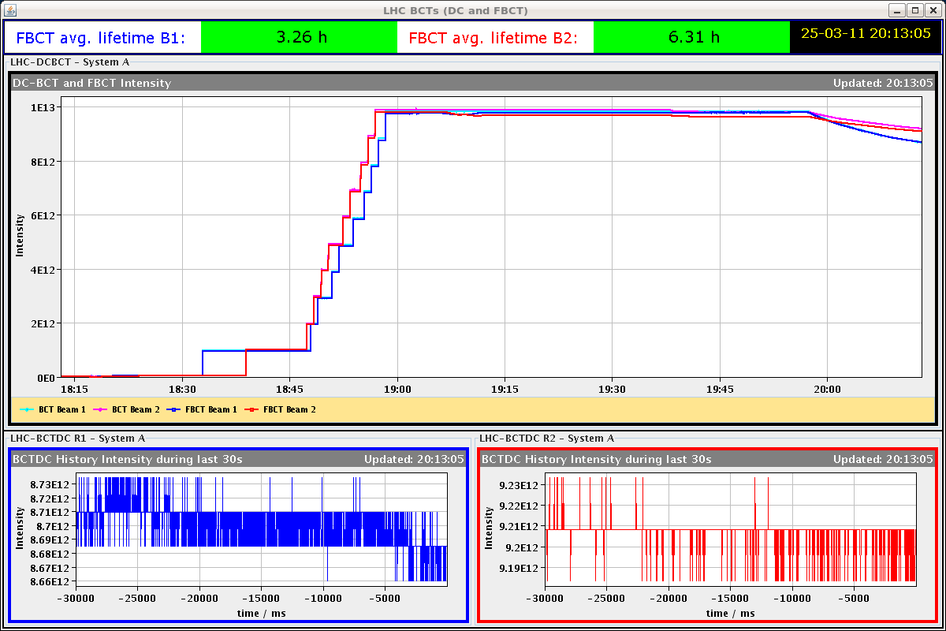
See Effect of Collisions

Slide 9
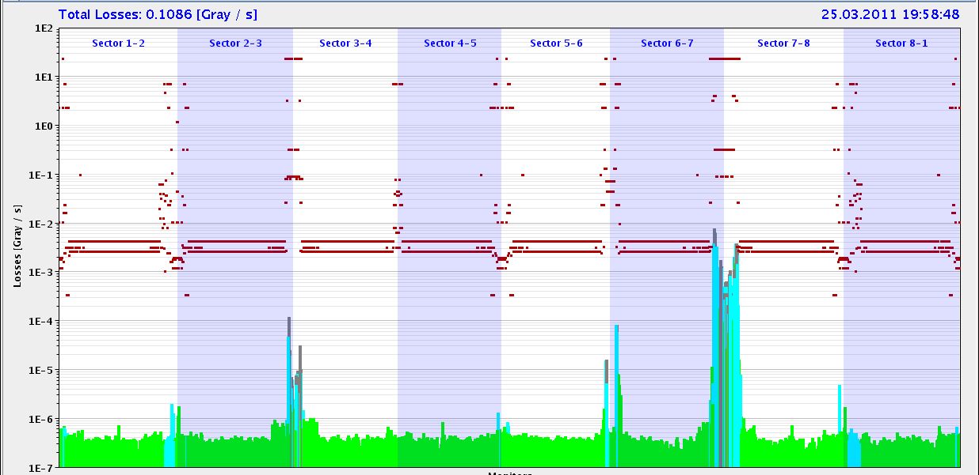
Lifetime and Losses

Slide 10
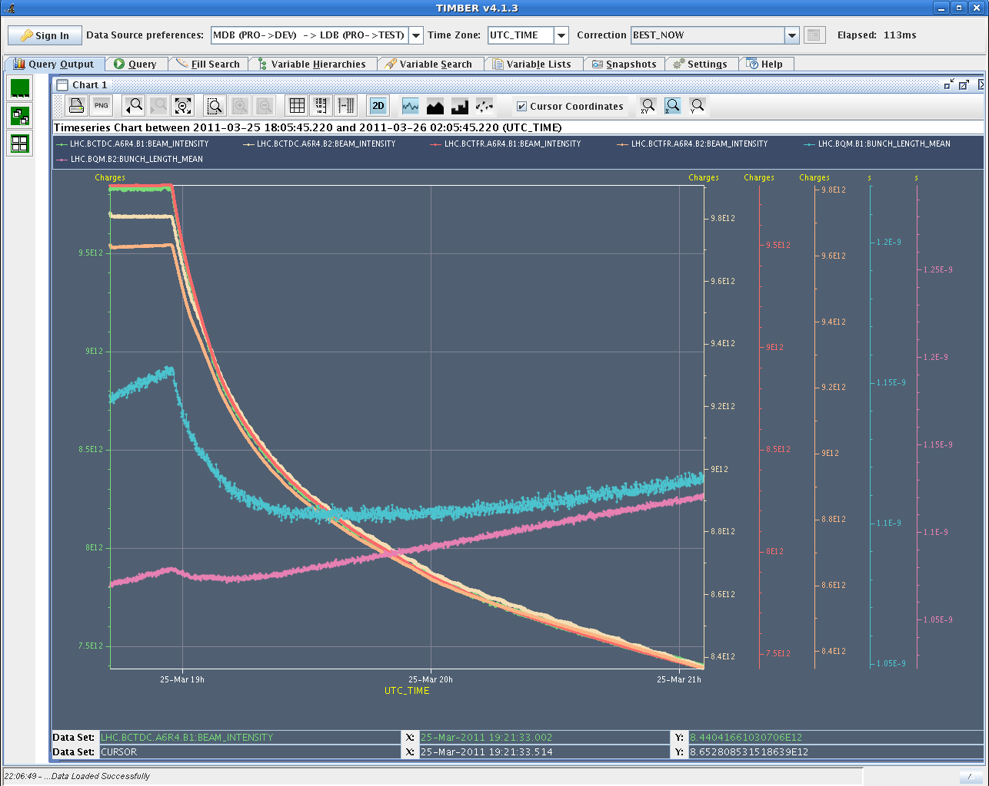
Seen also in Bunch Length (blue, purple)

Slide 11
Incoming
After fix of RB.A78…
Assume that we can change IR6 interlock to get longer fills (checked last evening, not possible for second fill but agreed to look at it today).
Can consider going down in bunch intensity for 1.38 TeV as an option, but this costs time (requalification of orbit, collimation + protection at least to some extent).
Sat + Sun | 1.38 TeV, 1.38 TeV, 1.38 TeV
Mon – Thu | Technical stop
Fri | Back to physics program Scrubbing run delayed: Discussion in LMC

