Slide 1
Friday 18/03
07:15 Test ramp with pilot after the test of dynamic FIDEL correction.
Ramp was OK, but fill was stopped due to the trip of several RQTFs when switching on the radial modulation for chroma measurement with tune feedback on
09:00 New version of the timing deployed but several problems: the telegram was somehow stuck with strange value for the beta star publication and the sector 12 set to access mode.
Revert to the previous version on system B and
10:45 Performed another test ramp with one nominal bunch.
At the beginning of the squeeze, the tune feedback tripped a bunch of RQT
Reverted yesterday's BBQ acquisition change from 5 back to 2.5 Hz
14:10 Ramped 32 nominal bunches, squeeze and collisions without trouble
Tune feedback on, also at beginning of the squeeze
15:05 Stable Beams!
21:00 Dumped & Refill
23:30 Stable Beams
23:35 Beams lost during optimisation: RF Interlock B1
04:00 Start ramp 32 bunches
04:35 Stable Beams

Slide 2
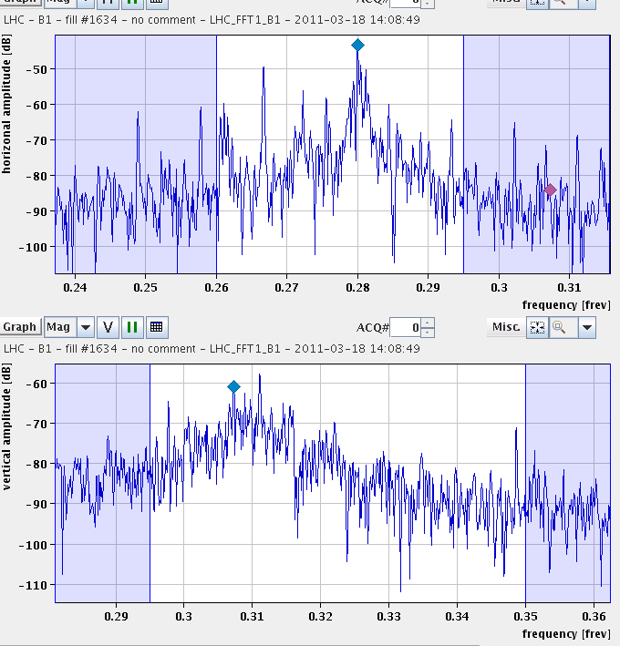
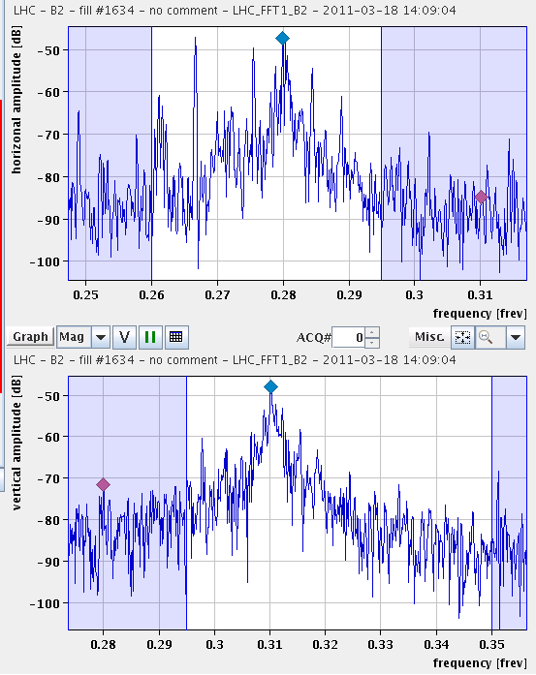
Tune spectra before start of ramp
B1
B2
H
V
Reduce transverse damper gain vertical plain for next ramp -> Indeed better

Slide 3
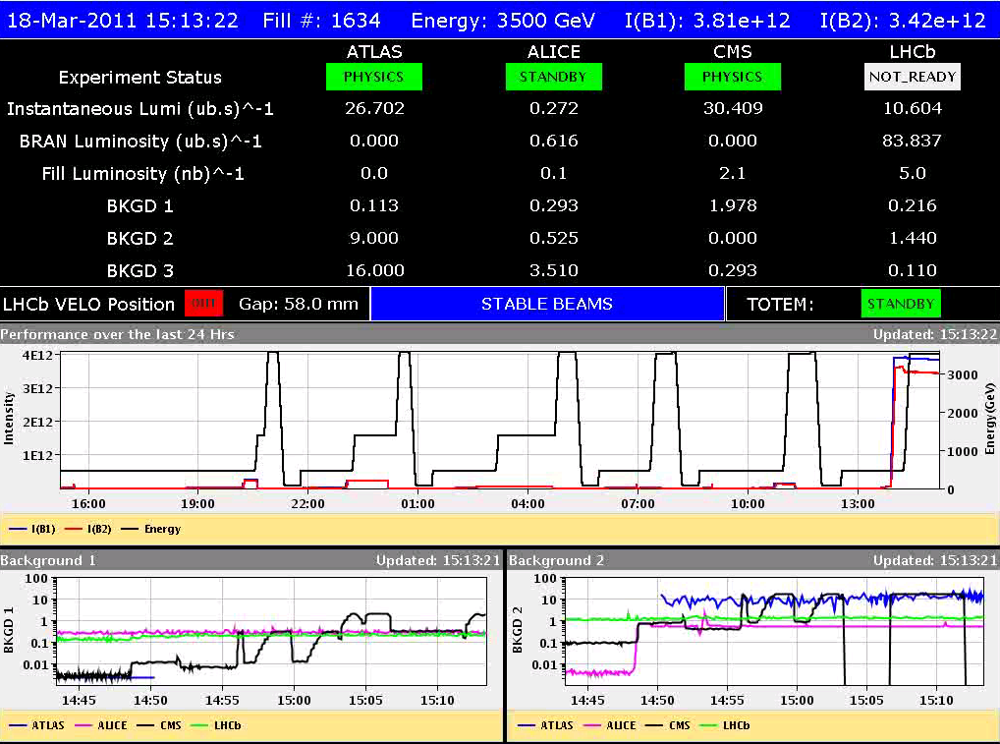
Finally !
Some problems optimising CMS,
Put back same off-set as before: sepH to +- 0.32
Lumi agrees with εn ≈ 2.5 µrad

Slide 4
RF news from Philippe
Capture loss = 0.13 %; identical for both rings (while B1 capture voltage = 6 MV, B2=4.5 MV);
Rather strong dependence of FastBct on bunch length;
Longitudinal Blow-up a bit weak, specially for B1 that ended-up at 1.05 ns (compared to the demanded 1.2 ns). I have increased the gain for next ramp;
Equalization of bunch length with blow-up worked well on B1 but not as well on B2. We end-up with min=1.0 ns, max=1.25 ns. To be followed¿
At flat top, loss and bunch lengthening are both about two times worse on B2 than B1. Compared to last year standard (~15 ps/h), B1 appears a bit better, while B2 is worse. Probably a good idea to make a test with identical voltages on both rings.

Slide 5
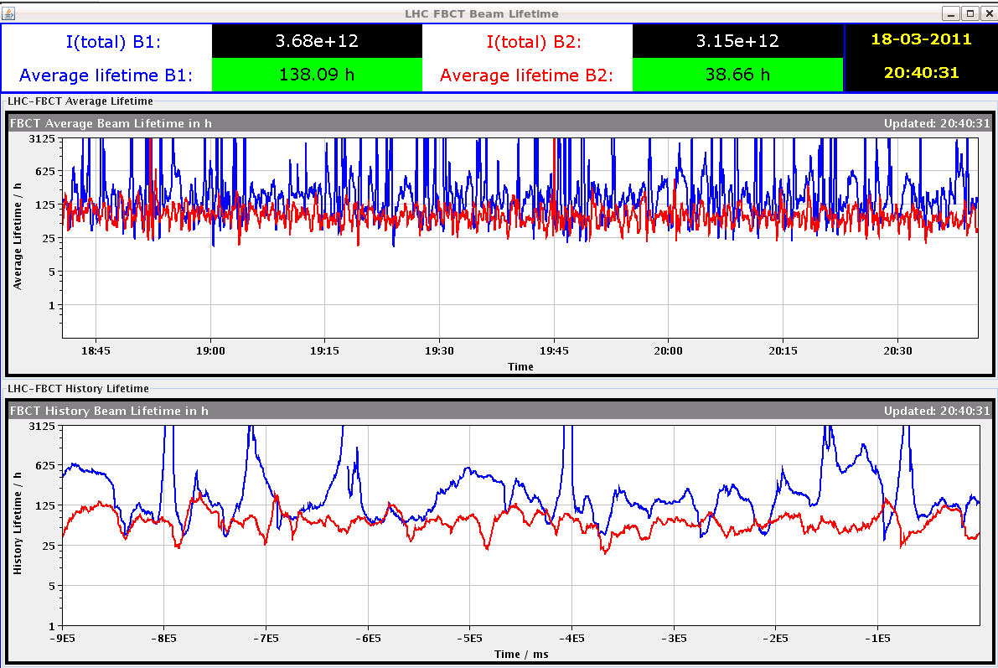
Life time B2 always a bit lower – less Vrf

Slide 6
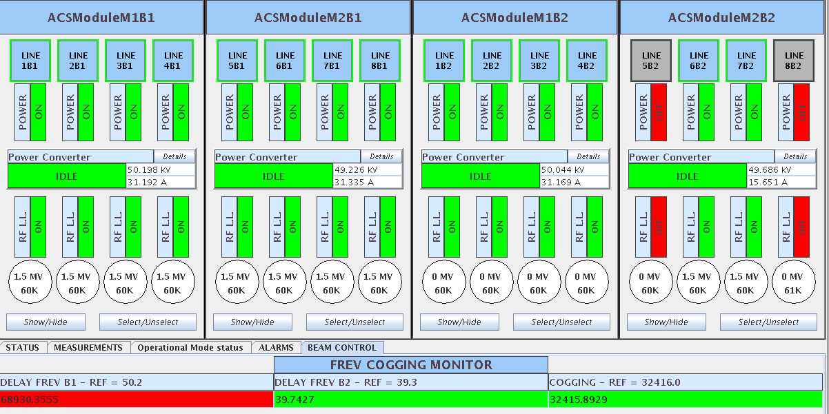
2nd Fill with 32 bunches
23:35 Lost during optimisation due to RF Interlock B1
” we saw all cavities M1B2 with 0 MV and the RF interlock that triggers is B1”
Reset was sent to two RF FGC crates the one of B1 BEAM CONTROL (SR4.BC.B1) and the other to UX45.ACSFCB1.B2. This is not yet understood and S. Page is investigating.

Slide 7
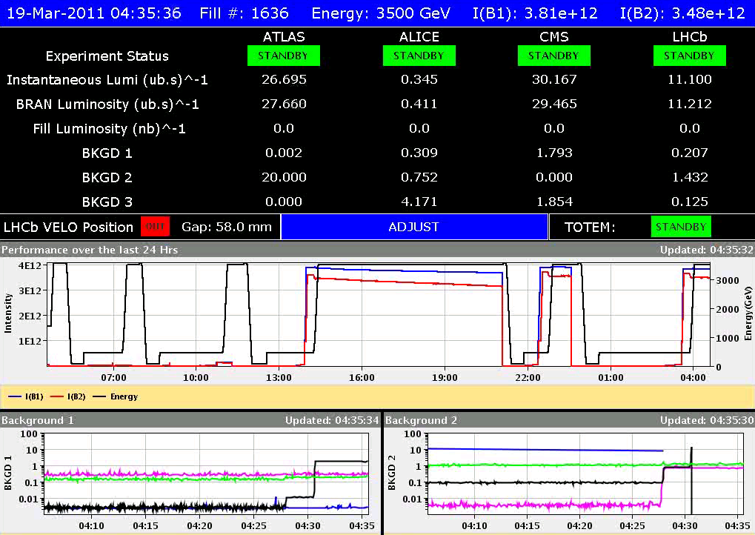
3rd fill 32 bunches

Slide 8
Plans
Dump this fill at 10:30
3 x in stable beams
12 hours in physics
Spectra and tune feedback ok
Non conformaties
Timing distribution
RF FGC reset leading to clean dump
Give time to rMPP to decide if ok to 64 bunches
If OK continue 64 bunches

