Slide 1
Friday 11th morning
8:26 RQTF.A81B2 trip at top of ramp, QPS EE switch open. We were near the end of round-off.
B2H tune fairly large oscillations at this point
1 probe and 2 nominal per beam up ramp and through squeeze without problems
- The setting of the SBF threshold to VERY_RELAXED was tested and used, and it was noted that with two nominal bunches, the RELAXED SBF threshold was not enough to give SBF true (as expected)
12:20 Start collimator setup at 1.5 m, separated beams
14:24 Collimation setup at end of squeeze is done
... now we try to find collisions

Slide 2
IP2 LUMI knob is transfered to the separation knob (in H).
Now offsetting by 4 sigmas the two beams : separation knob increase by 0.16 mm.
Find collisions at IP8. Offset 0.2mm V plane, 0.12mm H plane
Found CMS after restoring the 2010 V offset observed in V from the BPMS. We had to move the beam separation by 800 um in V.
We have transfered the LUMI knob of CMS in V to the separation knob - this makes smaller excursions (by ~ 1 mm) and allows us to keep the same length of collision BP. The collimation team will setup the TCTVs of CMS again.

Slide 3
Collimation set-up
Adriana, Gianluca, Daniel, Florian, Ralph
Set up the 16 TCT's for (1) 1.5m beta* and (2) for collision
Setup performed in ~1.5h for each of theses states, parallel for b1 and b2, parallel for several collimators in one beam (down from ~4h last year)
Adjusted TCDQ to agreed setting
Performed loss maps (hor, vert, off-momentum negative energy error)
Looks all OK. Higher leakage to IR's, as expected for 1.5m beta*. Around 0.05% to 0.5%.
Only direct loss in magnet: Q6.R8 for off-momentum (2.5e-5 leakage).
To be analyzed in detail.

Slide 4
Summary of collimator settings preparation
Stefano Redaelli at 2 o’clock in the morning
Imported new ramp functions for the TCDQ. New functions dry-tested.
Updated TCT settings at the end of the squeeze with the new BB centres
Updated PHYSICS beam process with the new BB centres for moving the TCTs while the separation bumps are collapse
Cleaned up the operational sequences and tested the full cycle without beam.
Collimation sequences are fine for all the cycle - parking to collisions. Ready for loss maps.

Slide 5
Friday evening
False XPOC and IPOC B2. Nicolas Magnin confirmed the necessity of an access to replace a National Instrument ADC board.
We used the new procedure for access and tested immediately after that the arm and dump of LBDS was working fine (got a couple of problems related to local triggering by the experts).
We did a SMP test at injection by switching off the RMSD of both beams and checking the triggering by the FMCM.
AGK tests…

Slide 6
Conclusion on AGK tests
For both beams the last bucket at position 1 from the SPS which can be injected into the LHC is bucket 31181. Bucket 31191 is stopped by the AGK. According to calculations, bucket 31241 was expected as the last bucket, so 5 bunches less.
Trying to inject the two extreme positions, bunches 31181 + ( 31181 + 3110) was difficult from the SPS as the MKE extraction kickers were not properly set up.
When injecting these two beams for B1, there were losses in the transfer line. The dump for these extreme beam positions was clean.
For B2 the MKE kicker was adjusted by 3 us after which both bunches were cleanly injected into the LHC and afterwards cleanly dumped.
Conclusions: The AGK properly protects the LHC abort gap (setting of AGK for bucket 1 was checked and adjusted on 22/02) and beams are cleanly dumped for the extreme positions. However, extraction from the SPS is unsafe for multiple bunches as the MKE delays have not been optimized.
The AGK limit found prohibits 5 additional bunches from being injected into the LHC, compared to expectations. It has to be studied if it can be adjusted (locally), after which tests need to be repeated.

Slide 7
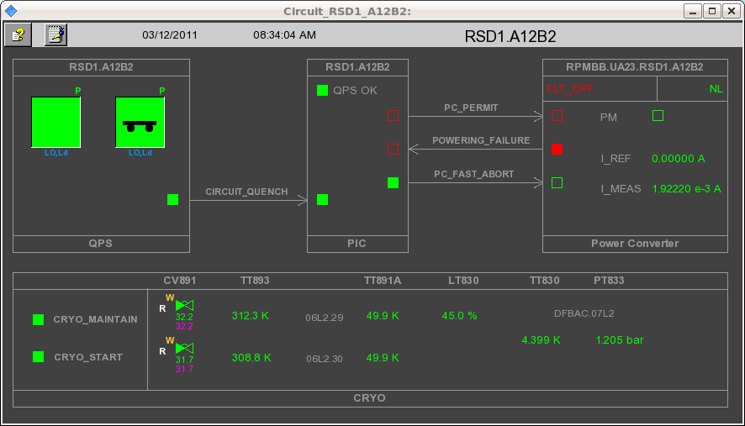
Overnight continued
Loss maps and asynch dump test at 450 GeV
Asynch dump test at flattop.
When we were ready for the next injection and ramp, no more beam was available from the PS.
PSB/PS synchronization…
Beam limped back into LHC around 8:00
Lost SD circuit sector 12

Slide 8
Loss maps
 | Betatron loss maps | + off momentum | - off momentum | async dump
450 GeV | Done | Done | Done | Done
Flat top | Done | Done |  | Done
1.5 m before collisions
Collisions | Done | Done

Slide 9
Incoming
Loss maps
Aperture measurements of dump channel
Wolfgang can come in during the day on Saturday. He will need about 3 hours.
(Beta* revisited) Rogelio & team ready
1.38 TeV tests

