Slide 1
From yesterday
“we believe the reason why the first bunch is more intense than the following 3 is that it's on that one that the SPS RF loops are locked” Philippe & Django
Etienne explained to Jan that the LBDS is reading the energy at three different levels:
The MKD/MKB generators get the energy directly from the BETS – this was fine for the dump this morning.
The IPOC for the MKD and MKB get the energy from the SMP distributed over the timing system - – this was fine for the dump this morning.
The XPOC gets the energy over CMW – this was not ok for the dump yesterday morning.
As the BLMs also get the energy over the SMP / timing system; there should have been no problem with the BLM thresholds yesterday morning.

Slide 2
Thursday 11th November
07h08: RCBXH1.R2 fixed. Board bypassed.
Problems during access:
lights on → ODH alarm, fire brigade in,
patrol dropped by fire brigade (wrong MAD key)
problem in 81, PP60A (earth fault in a 18 Kv cell → PC problem),
lights off → ODH alarm again
16h35: Access finished. Recover and pre-cycle

Slide 3
Thursday evening
18h17: Ready for injection.
18h23: No beam from injectors: LEIR/PS problem. The beam is not extracted. LHC had mastership.
21:00 Beam presence flag problem
BEAM PRESENCE FLAG gives FALSE, there is 9 10^9 in B1 though
rebooted cfv-ua47-bctfra and after we had to reboot the proxy, and then it worked again.
21:30 Timing missing
The 40.08 MHz LHC bunch-crossing clock and 11.246 kHz orbit signals presumably, plus BI prepulses and 400 MHz
Alarm on BST crate – CCC
Andy “there was a flash” Butterworth diagnoses problem - VME power supply – replaced very efficiently by CO piquet.
cfv-ccr-allfo1

Slide 4
Thursday evening
20h08: Injection
pretty ratty, long, big beams, unequal bunch intensities
intermittent problem in LEIR
Note: - we OP disable one BPM in 9L3 B1V because guess the reading is wrong. - we asked Verena to unmask injection oscillation in the IQC as data came back when the RF clock was published again
23:50 Start ramp
00:53 Stable beams 68 on 69

Slide 5
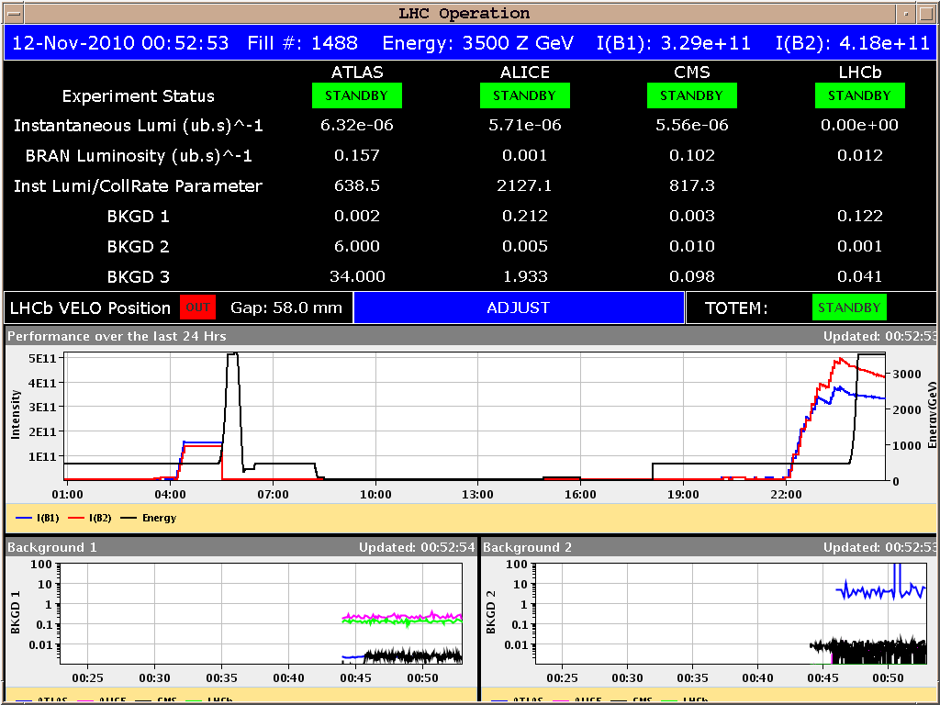
1488

Slide 6
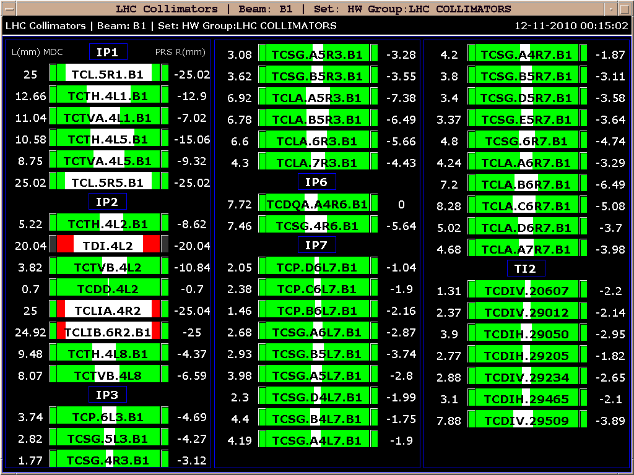
New collimator fixed display

Slide 7
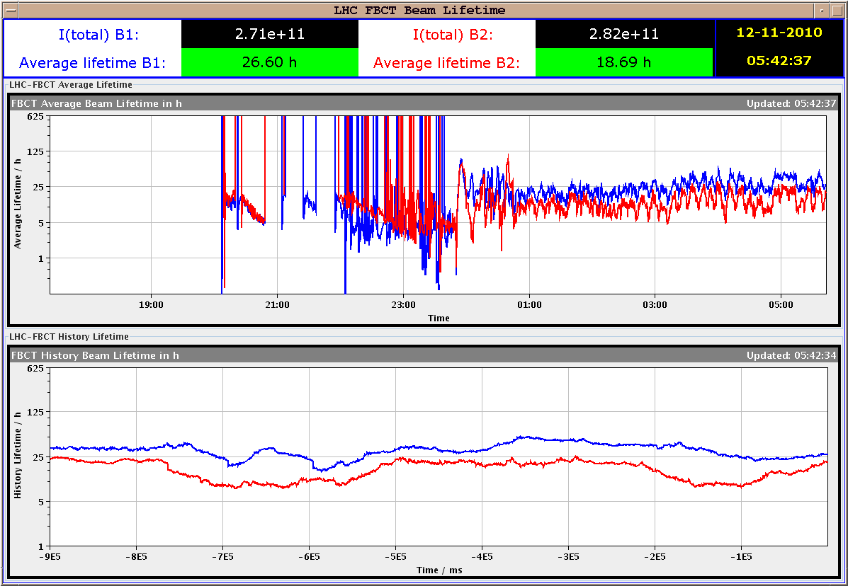
Lifetime in stable beams

Slide 8
This morning
beams lost : trip of RQD.A23
trip of sector 67 when loading the ramp-down start BP.
In the hands of MP3 (Mike & Knud)

Slide 9
Today
RF voltage modulation during injection
Philippe & Delphine 1 – 2 hours
Tidy up injection
check injection oscillations
LEIR
Try for a cleaner 69 on 69

