Slide 1
Tuesday 9th November
10:02 Fill1483 - beams dumped
Offset on the BPMs readings around IR3.
Heating problem in the building were the BPM crates of IR3 are.
The cooling system of SR3 was under maintenance and this inhibited the alarms going to TI (to prevent false alarms)
In the meantime a real alarm "defaut gel" appeared and cut the ventilation of the building.
The site manager switched on the system, the temperature went back to normal and the BPMs readings as well.

Slide 2
Injection
LHCION2 was giving big longitudinal and transverse emittances, ~1.8-2 and 3-4 respectively.
Tuned by SPS
beam presence flag threshold tested by reducing intensity of B1 pilot

Slide 3
Injection
Injected 4 bunches of ions and checked TL trajectory and losses and injection oscillations
B1: Did steering in vertical plane with one corrector and saved new trajectory into the dataset catalog.
B2: had first problems to get BPM acquisition in the ring, changed the reference and steered in the horizontal plane with one corrector, new trajectory saved in the catalog.
Losses in the TL: max losses 1.6 mGy --> OK, no TCDI adjustments needed
Losses in IP2 and IP8 look fine. No IQC latches seen.
Copied settings from LHCION2 to LHCION1.

Slide 4
Tuesday evening
17:30 Inject for test ramp
4 x 500ns
New collision beam process tested without problems
Crossing angles, separation bumps, lumi scan knobs and orbit adjustments
Alice’s crossing angle from +110 to -140 microrad
IP6 interlock thresholds crate B tested
will change BPMSB.B4L6.B2 horizontal, actual reading 1.2 mm
B2 dumped when moving from 1.5 to 1 mm --> OK
will change BPMSB.B4R6.B1 horizontal, actual reading 2.2 mm
B2 dumped when moving from 2.5 to 2 mm --> OK

Slide 5
Tuesday eveing
Bit of trouble injection (tunes, chromaticity)
22:50 Stable beams, fill 1485
500ns 17 bunches 16 colliding pairs/IP
Initial luminosity around 3.5 x 10²⁴ cm⁻²s⁻¹

Slide 6
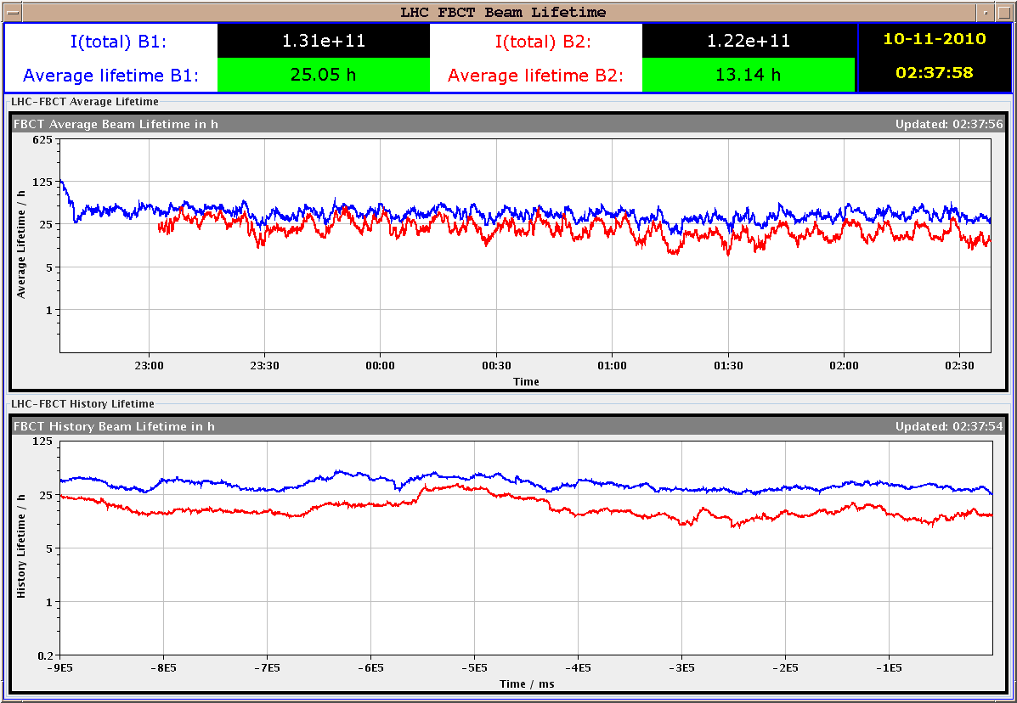
BCT after 4 h

Slide 7
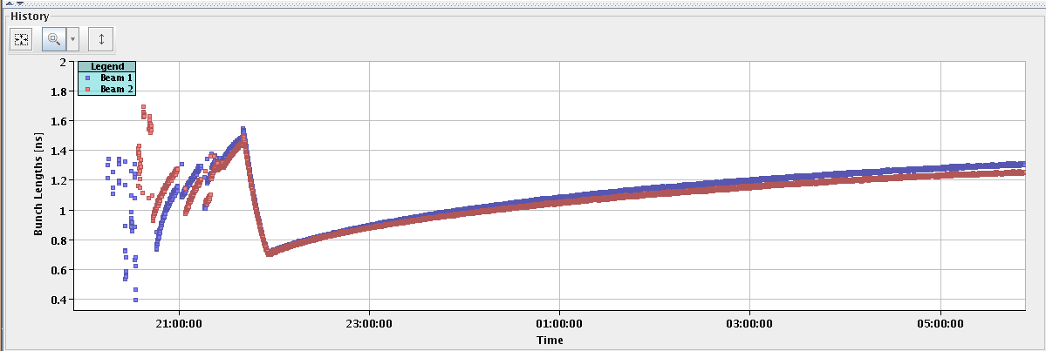
Bunch length

Slide 8
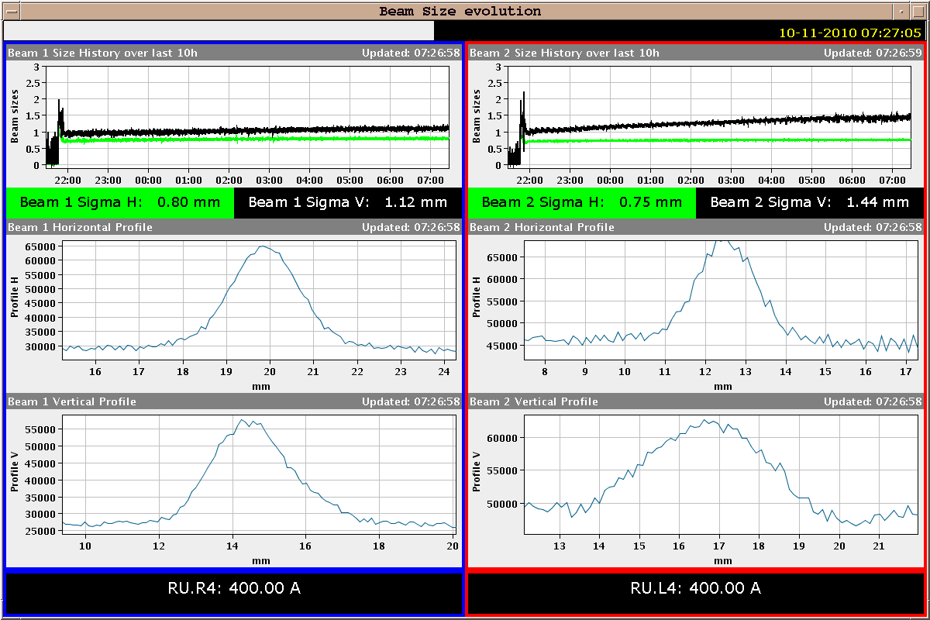
Beam sizes

Slide 9
Today
MD in PS until 14:00
Will keep this fill as long as reasonable
PS RF cavity (80 MHz) will need retuning to go back to ions
Fill for 69 bunches/ring, 66 bunch encounters/revolution for ALICE and 65 for CMS and ATLAS.

