Slide 1
Saturday 06/11
Triplet R8 tripped during ramp for collision setup.
Lost status of access door (YCPS04=Uj56) and patrol in Pt5.
Patrol found the door (slightly ~ 1 cm) open, but contacts were such that LASS saw it closed – until the patrol was lost.
Access to Pt8 to fix triplet PC RQTX.R8.
Triplet finally back in operation around 18:00.
Pre-cycle. Beam delayed by MKI problem and water problem in TT2.
Beam in at 21:30.
BPM interlock test.
Ramp & squeeze.

Slide 2
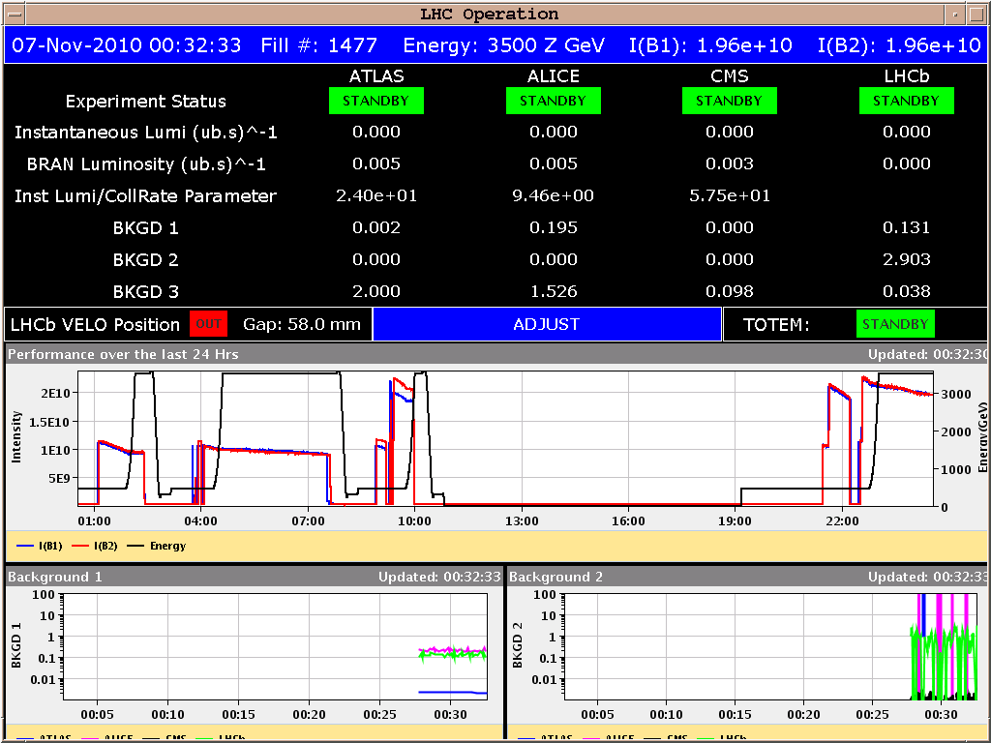
Saturday lat evening
00:30: Colliding in all IPs with TCTs at 25 sigma.
With proton settings for Xing and lumi scan knobs (ALICE separation to 0).

Slide 3
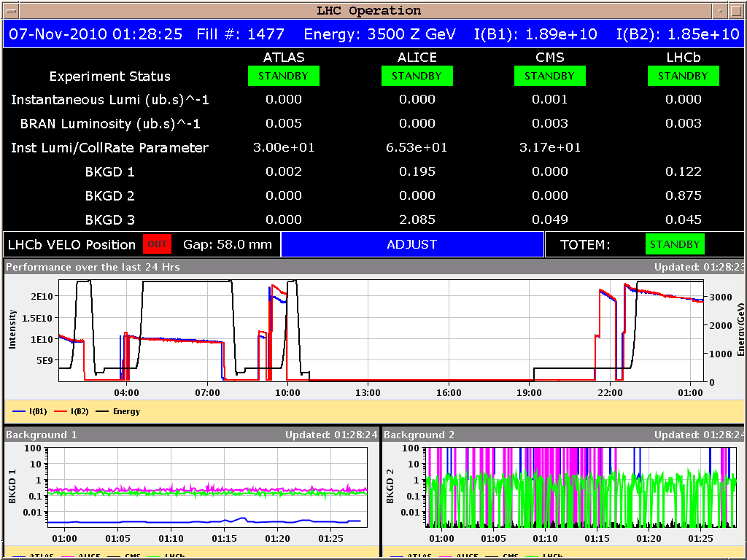
Saturday PM – collision setup
Xing in ATLAS and CMS to 0. Xing in ALICE to 0 effective Xing angle.
External angle -140 urad.
Optimized orbit and beam overlap.

Slide 4
Saturday night
01:45 TCT collimator setup.
04:02 Beam dumped during TCT movement in Pt2.
Triggered while moving in TCTVB.4L2 between 15-20 sigma.
5 TCTs setup in B1, 3 TCTs set up in B2
All TCTH B1, 3 TCTH B2 (miss Pt2), TCTVA.4L5.B1
QPS OK issues on RB.56.
Two issues on the same circuit: heater PS.
Access finishing soon…
Intensity issue on the ion source (factor 2 weaker than in the last few days).
Investigating…

Slide 5
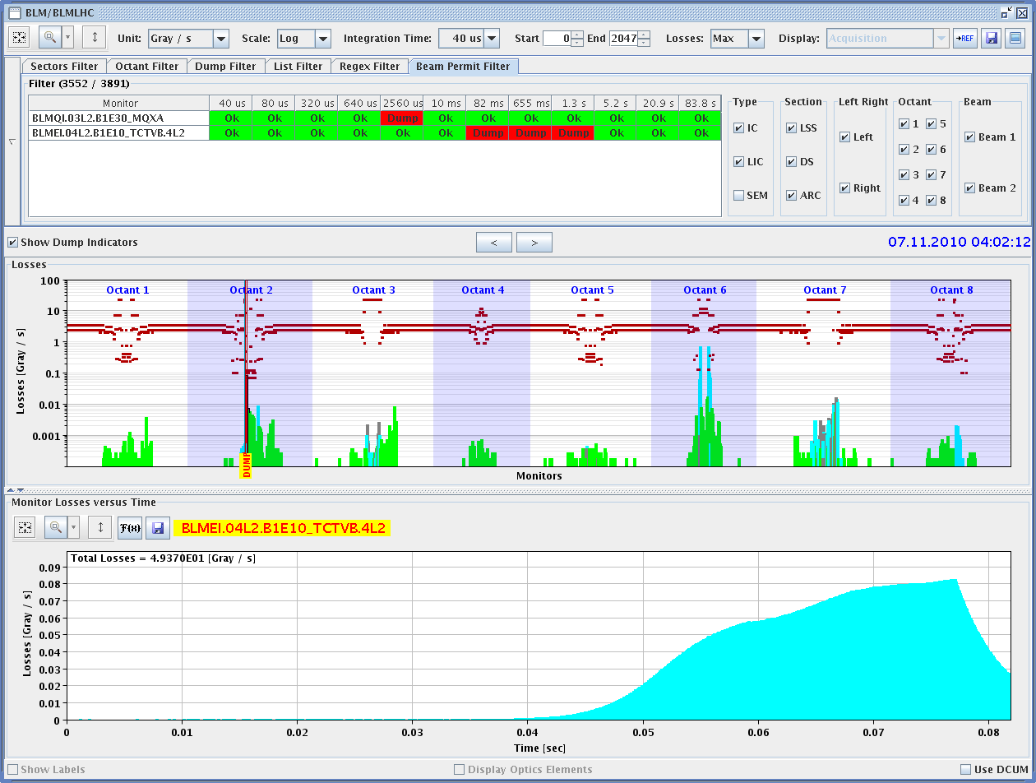
Dump

Slide 6
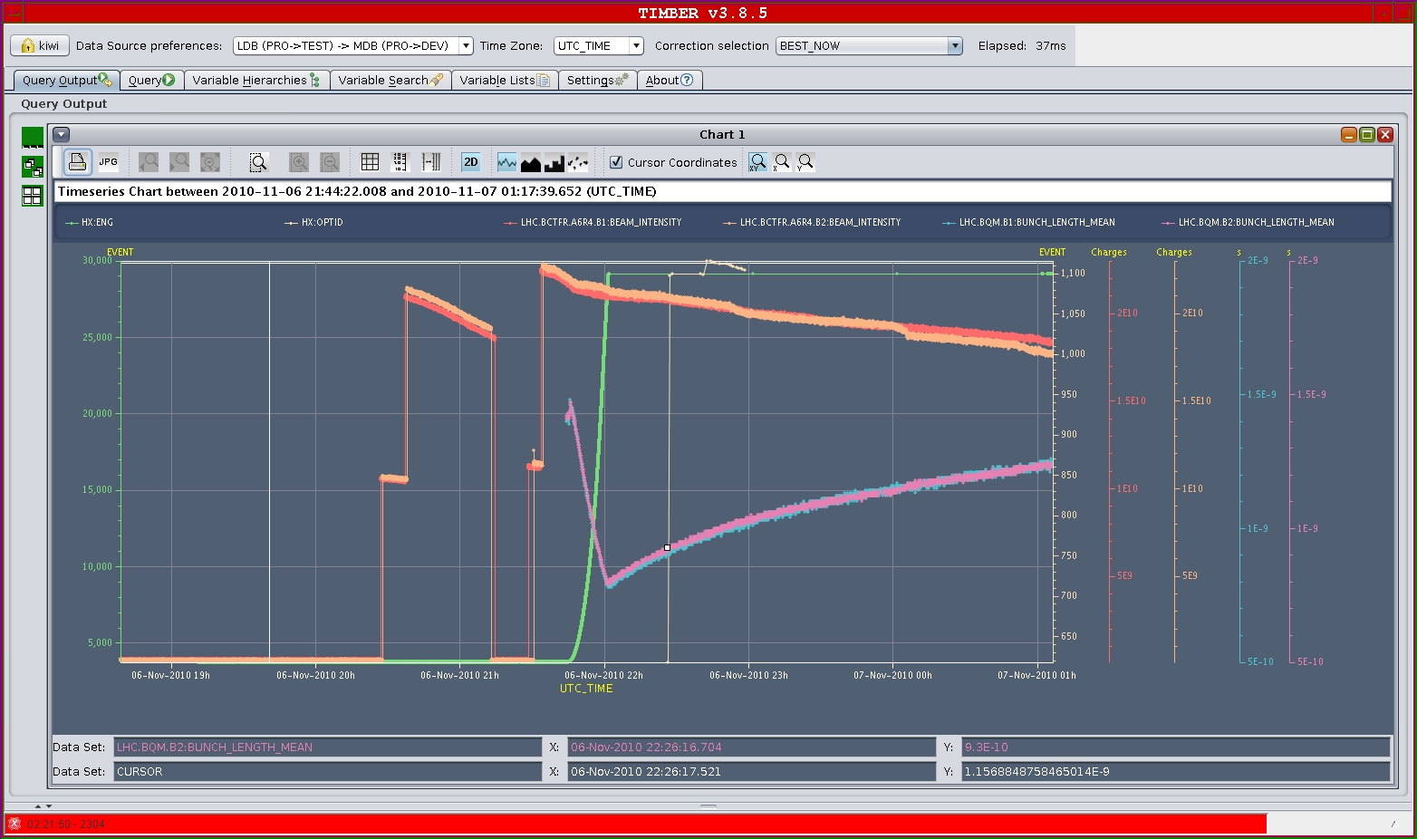
Bunch lengthening

Slide 7
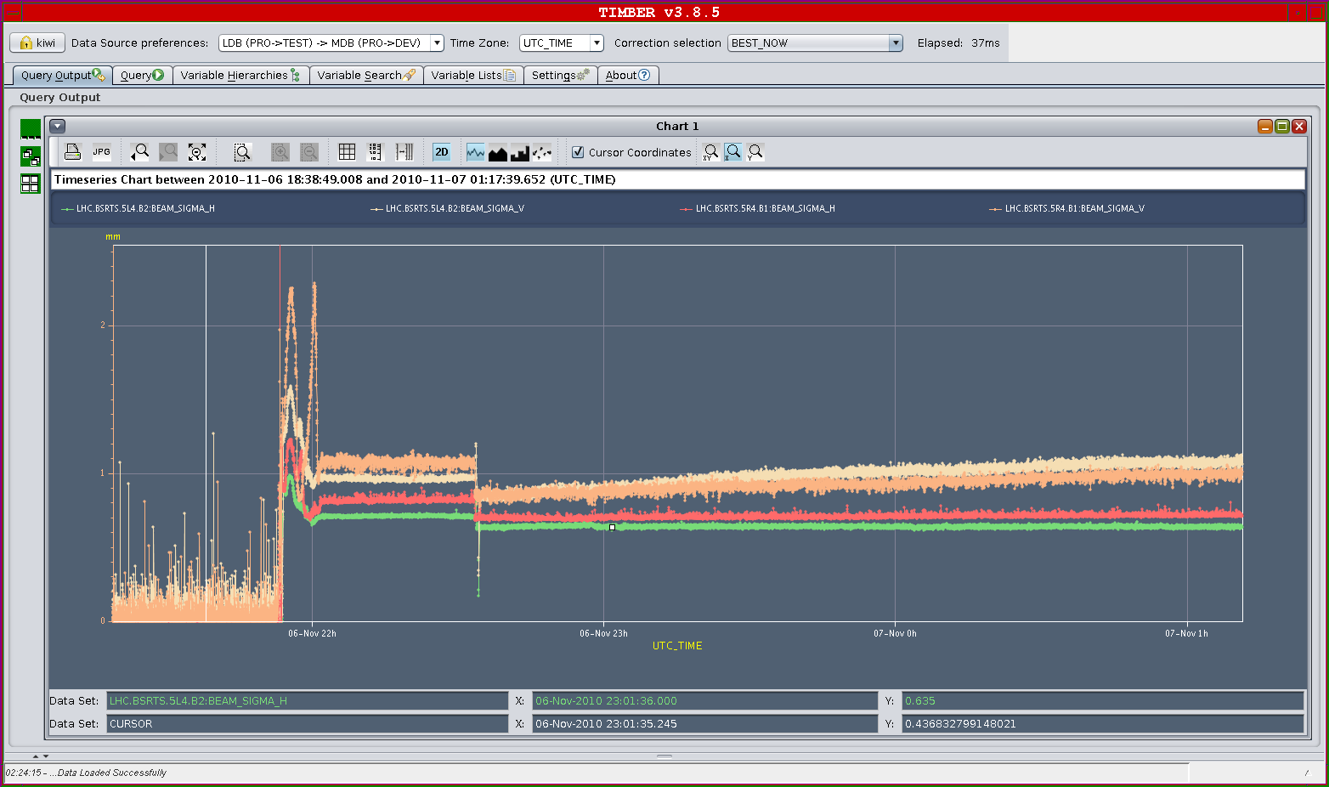
Emittance increase seen by BSRT – V plane

Slide 8
Collimator loss map end of squeeze (b* 3.5 m)
Loss map analysis (R. Assmann):
Leakage IR7 to:
DS: 1-2%
Arc: 0.1-0.3%
IR3: up to 30% (H plane)
Exp. IRs: clean

Slide 9
Plan
Sunday AM | Collimator setup to finish
Sunday PM & Night | Loss maps (betatron & off-momentum) Asynch dump test Stable beams 2x2
Monday++ | 4b cycle and injection Stable beams 17x17, 128x128 etc

