Slide 1
Thursday 04/11 - Morning
Access until ~13:00
Mostly for BI for BPMs and ion changes
ALICE, CMS
Pre-cycle
Proton checks:
BCT calibration with ~15 probe bunches
BPM orbit reference for high sensitivity setting

Slide 2
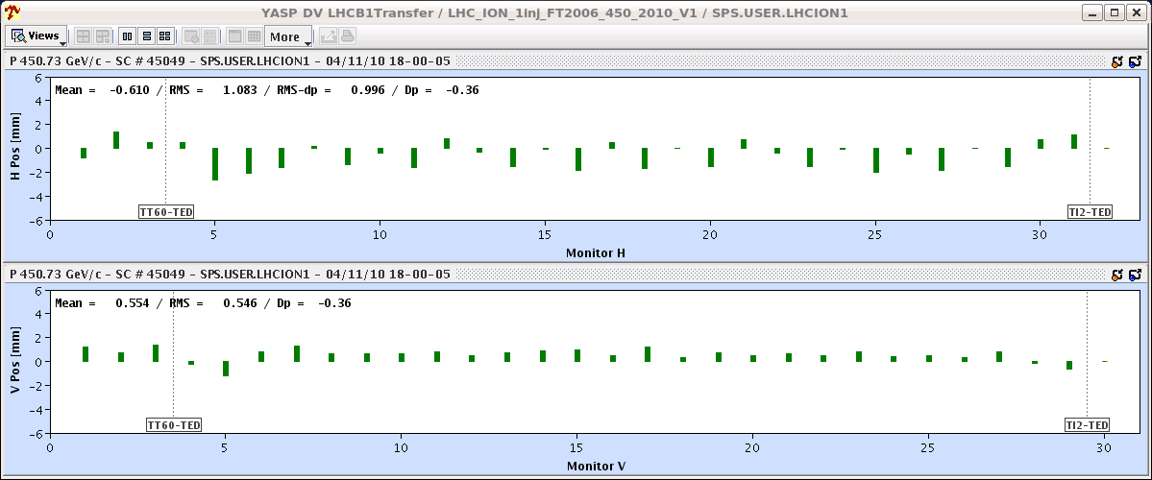
Thursday PM – ions in the lines
18:00 : Ions extracted to TI2/8 TEDs.
A bit of steering of the trajectories. No problems.
B1 in TI2 before correction (wrt proton reference)

Slide 3
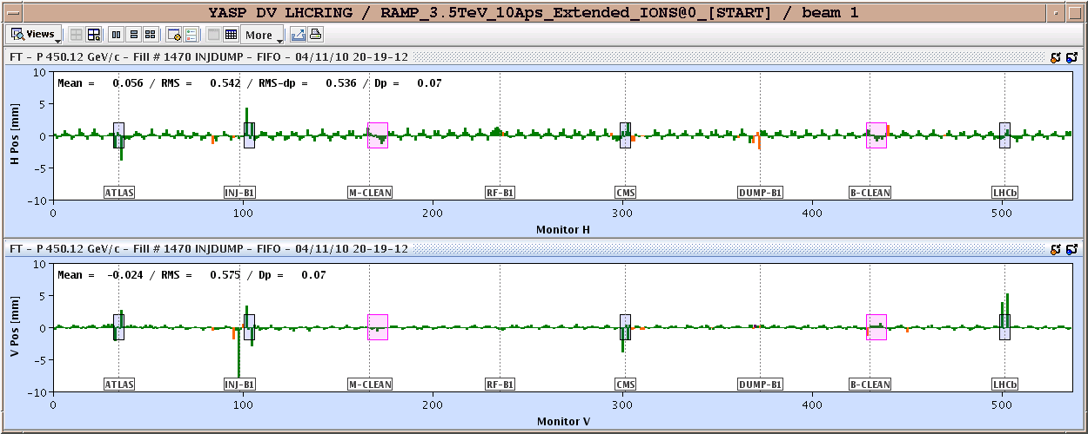
Thursday PM – ions to the LHC
Adjustment of the offsets LHC-SPS to place ions bunch on the MKI of B1.
20:20 First 75+ trajectories in the LHC.
B1 turn 1 compared to proton closed orbit – not bad !!

Slide 4
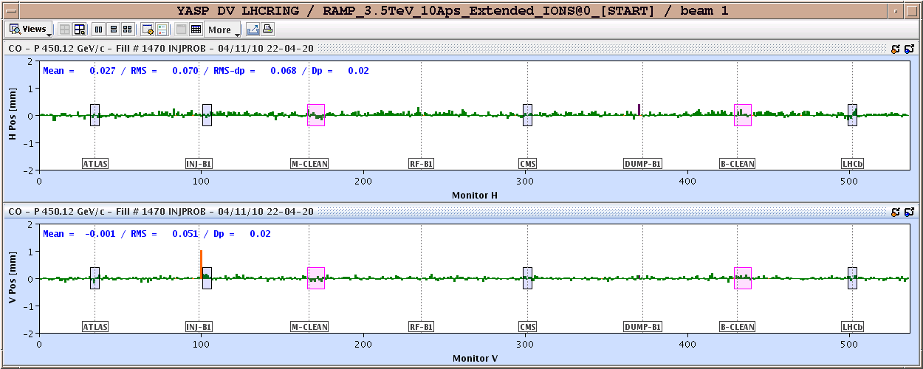
Circulating B1
20:30-22:00 RF : placing bunch into correct bucket.
BLM thresholds on IR2 triplet magnets set back to 0.1 (were reduced to 0.03) to avoid unnecessary PMs from beam to TDI.
22:00 B1 captured and circulating for many seconds.
B1 ion orbit compared to proton orbit – no steering !

Slide 5
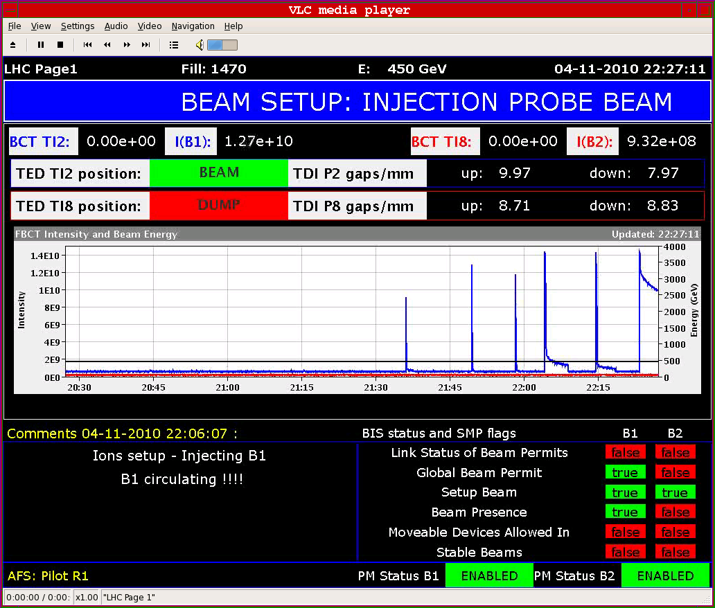
B1 progress

Slide 6
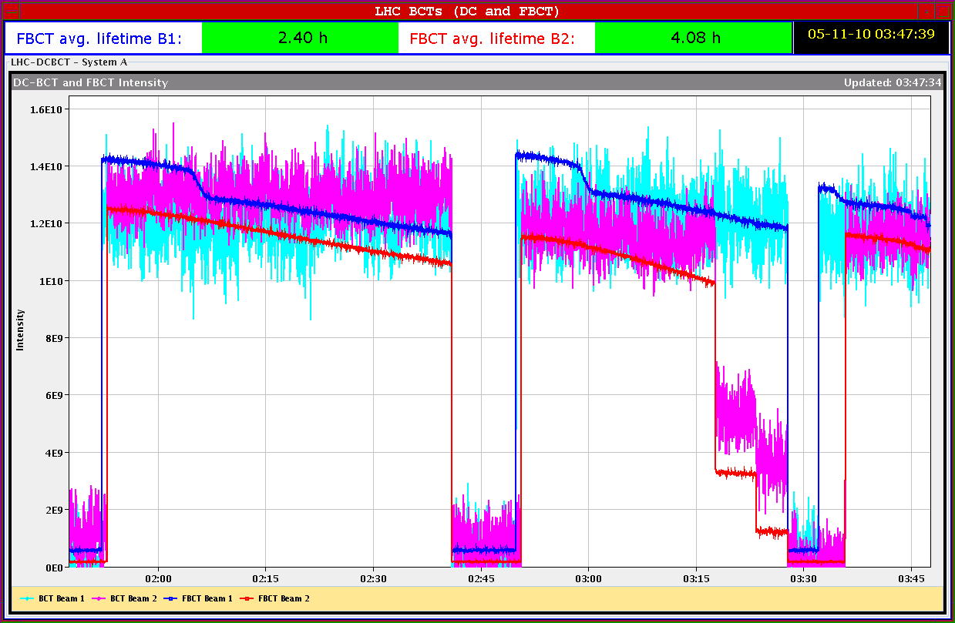
Beam2
01:00: Beam2 injected OK.
01:50: Both beams circulating.
Lifetimes around 10-20 hours.
Stepwise losses on B1.

Slide 7
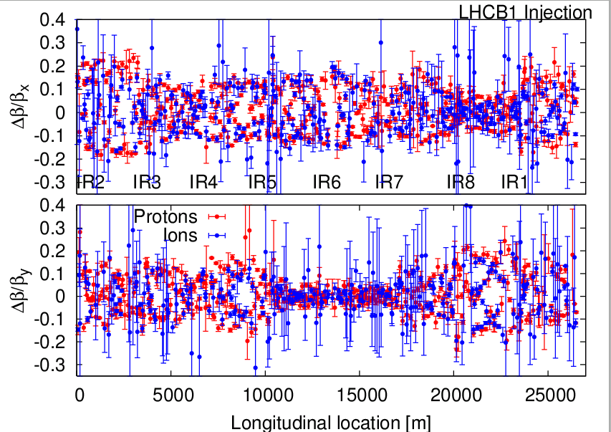
Optics measurements
Initially some problems with AC dipole in H, solved by kicker expert – arming issue.
Q-kicker used.
Optics in good agreement with protons.
Many BPMs do not trigger in capture mode.

Slide 8
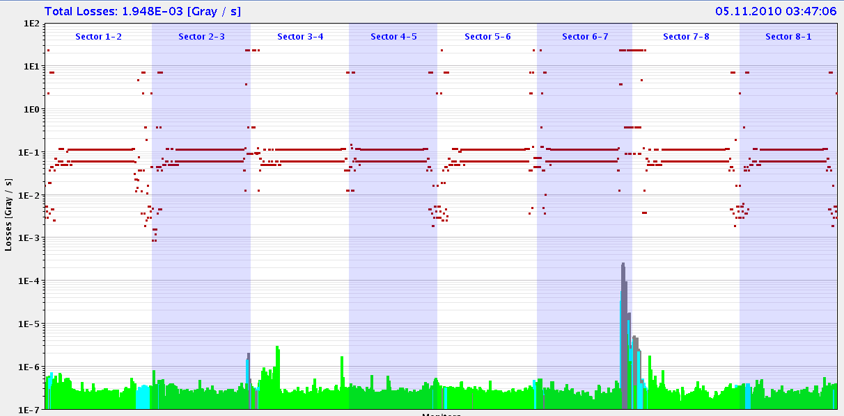
Losses with kicks

Slide 9
Beam parameters
Intensity:
Around 1-1.2E10 – sometimes even too high to be a probe beam cannot inject into empty ring).
Emittance:
Both beams around 1.0-1.2 um just after injection (! with Pb gamma) – nominal. Proton equiv. emittance 2.5-3 um.
Beam is blowing up quickly to 3-4 um.
Energy calibration: from RF frequencies of protons and Pb:
fRF[p] = 400.788876 MHz
fRF[Pb208]=400.784230 MHz
>> Energy[p] = ~450.0 GeV – prel. error around 0.4 GeV

Slide 10
Plans
Friday 5/11 – AM | Collimation 450 GeV, loss maps BI, RF
Friday 5/11 – PM | First ramp, collimation checks, possibly squeeze.
Friday night – Saturday | Collimation on flat top, squeeze etc

