Slide 1
Ion Commissioning: Thursday & Friday
Optics Checks BI Checks Collimation Checks
First Ramp Collimation Checks Squeeze
B1 Inj., Circ. & Capture
B2 Inj., Circ. & Capture

Slide 2
Debunching at injection

Slide 3
Friday Morning: Collimation checks at 450 Z GeV
Check collimator alignment
Gap centers checked for 11 collimators per beam. Reproducibility from proton to ion at 0.4mm level. OK for injection nominal settings and probably for intermediate settings as used at 3.5TeV.
Loss maps: Betatron cleaning inefficiency:
Leakage to dispersion suppressor: 0.5% - 2%
Experimental IR's: clean
Arcs: 0.1%
RF: clean
Loss maps: Momentum cleaning inefficiency:
Leakage to dispersion suppressor: 0.5% - 4%
Experimental IR's: 10% (TCTH in IR1, b2), 1% (TCTH in IR5, b1)
Arcs: 0.3%
RF insertion: 0.5%

Slide 4
Conclusions from Ralph A.: collimation @ 450 GeV
Loose about factor 50-100 in cleaning efficiency for ions, compared to protons. This is expected (ion fragmentation and dissociation)
Main losses in predicted locations, namely the dispersion suppressor magnets. Maybe losses occur somewhat earlier in space than expected
We see a large 10% leakage into IR1 from IR3 losses for beam 2. It is not clear what ion species escapes IR3 and travels to IR1. To be analyzed in detail
OK for injection and ramp to 3.5 TeV
As ion species form independent "beams" we worry about potential high energy losses into IR1. Therefore request of full set of loss maps at 3.5TeV before a squeeze is performed
DONE

Slide 5
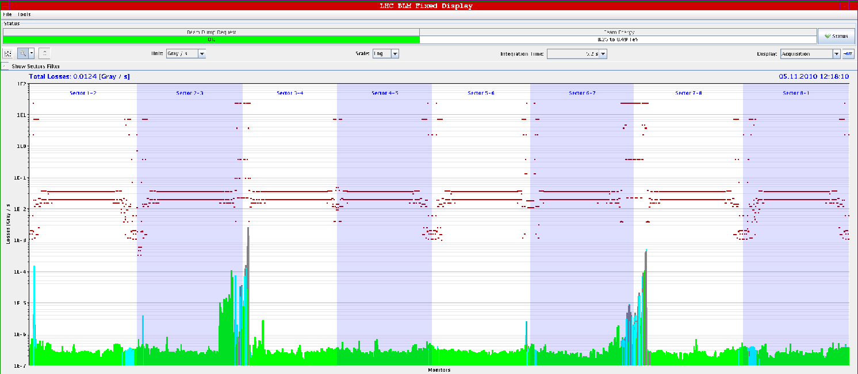
141 BLM screen dumps in 1.5 hours !
Momentum losses B1 -1000Hz
Momentum losses B2 -1000Hz

Slide 6
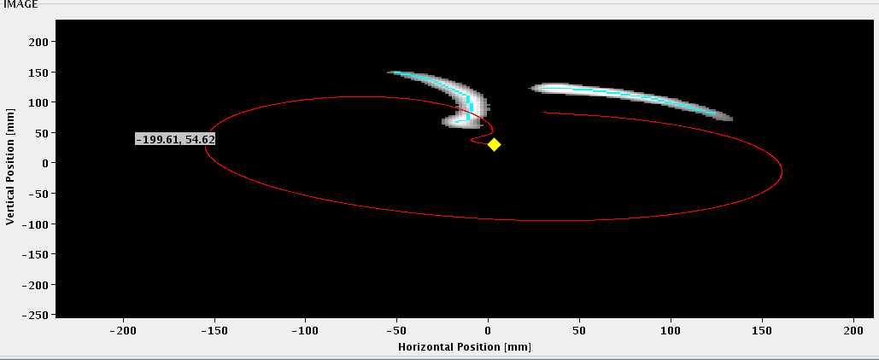
Asynchronous Beam Dumps at injection
Dump protection OK: There was essentially no leakage to the TCTs during the async. dump of both beams, so I think everything is fine! Chiara Bracco

Slide 7
BGI:
not uniform signal strength, in general better for vertical BGIs.

Slide 8
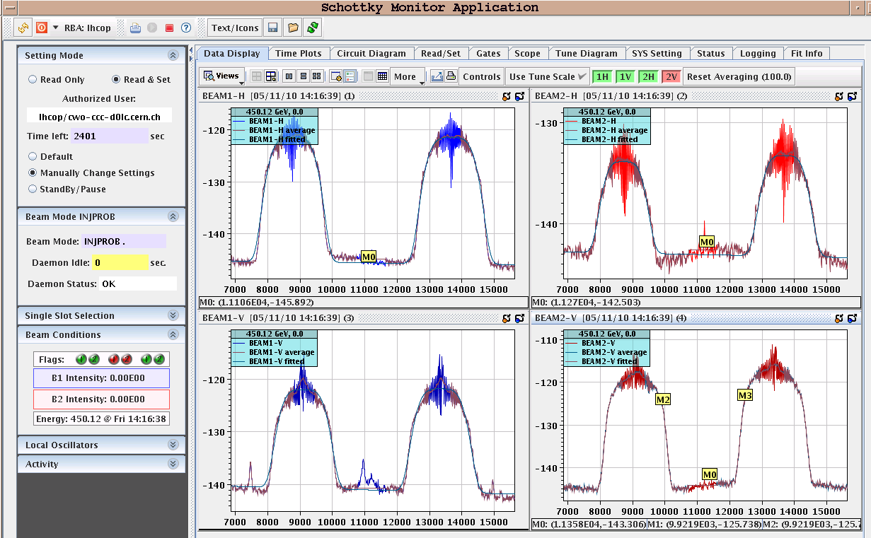
Schottky data – Ralph Steinhagen
Plus: Re-verified FB operation - FB's OK

Slide 9
16:25 start first ramp – no beam losses
There is light a bit above 0.5 Z TeV
Emittances on flat top: B1; H=5.5 , V=5.6 B2; H=5.8 , V=8.7
Bunch length up at injection, down during the ramp

Slide 10
More loss-maps at 3.5 Z TeV – ok-ish
negative frequency trim of -1000Hz for negative off momentum loss map

Slide 11
22:15: first squeeze finished: perfect trajectory
Wirescans @ injection: B1-H: 4.5 B1-V: 3.1 B2-H: 5.1 B2-V: 4.5
Wirescans afer squeeze: B1-H: 7.1 B1-V: 6.5 B2-H: 6.8 B2-V: 10.1

Slide 12
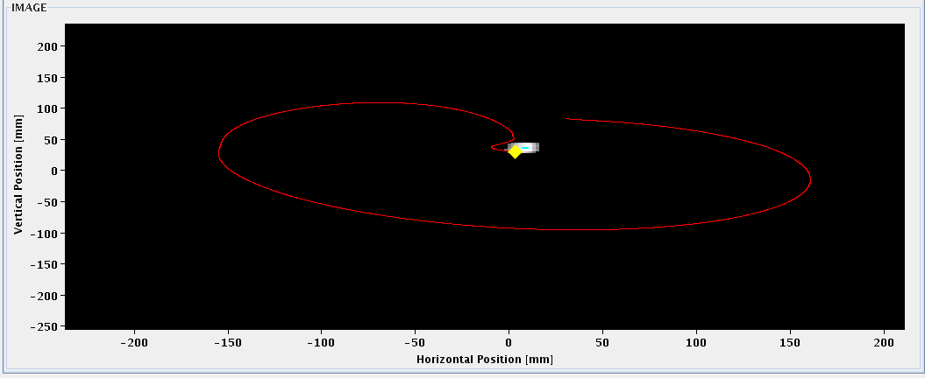
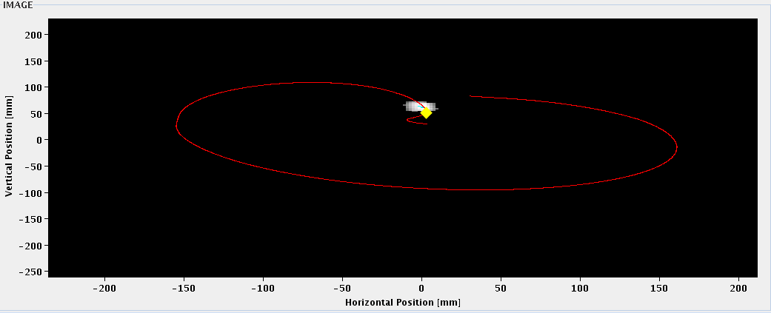
First programmed dump at 3.5 TeV
No surprises for dump of a bunched beam at 3.5 TeV
B1
B2

Slide 13
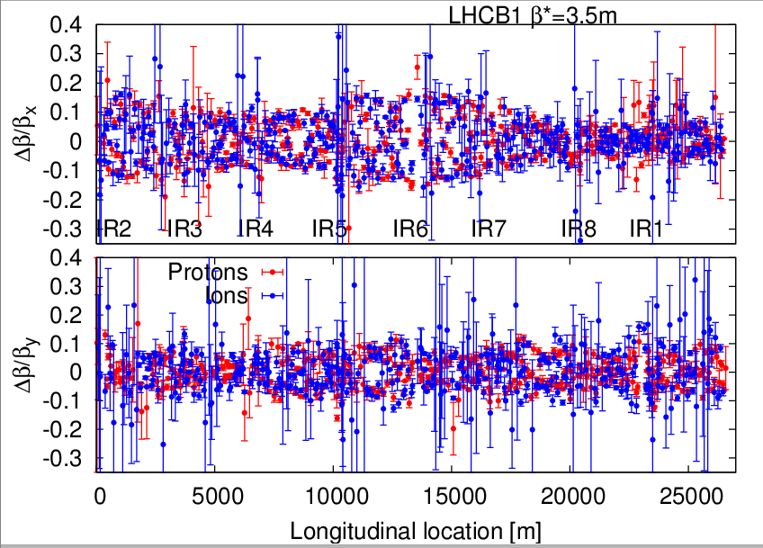
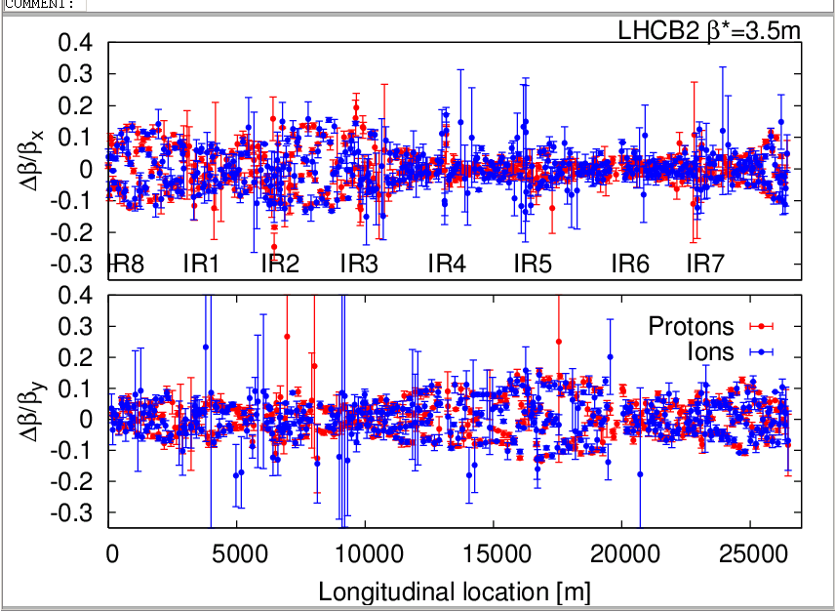
Beta Beat Checks at 3.5 Z TeV, squeezed
AC-dipole fixed from last night: reboot controls
Looks very similar to protons
Rogelio

Slide 14
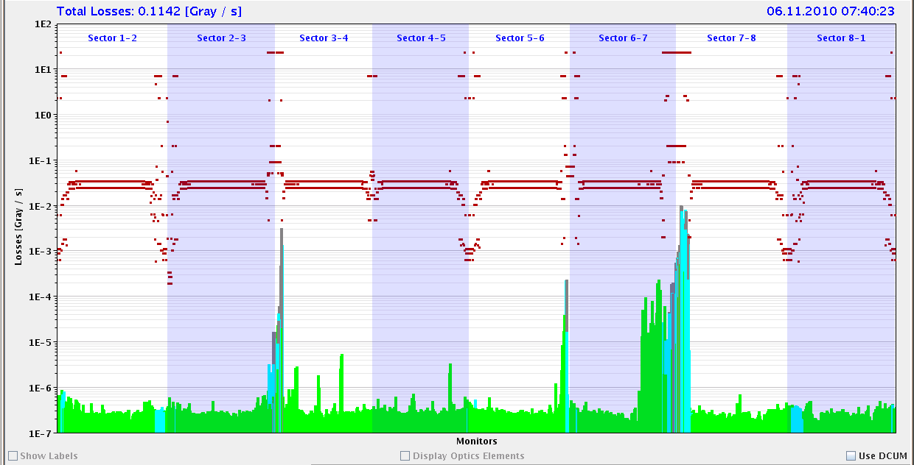
Work over night
Asynch dump tests at flat top
to be analysed in detail but looks ok
Next ramp: loss maps after the squeeze
To be analysed in detail
B2: Q_H trimmed to 0.34

Slide 15
Chromaticity through the ramp

Slide 16
Plans
Saturday | Find collisions 2 x 2 bunches Collimation – loss maps Asynchronous dump Stable beams 2 x 2 bunches
Sunday | Stable beams, increase # bunches 2 x 17, 2 x 128 bunches

