Slide 1
OP summary of week 37
Goal of the week:
Stable beams with bunch trains
… not quite achieved !
M. Lamont & J. Wenninger

Slide 2
Cycle configuration
Machine configuration for operation with bunch trains.
Crossing angles of 170 microrad in all IRs at injection, constant through the ramp.
The crossing angles are reduced to 100 microrad (IR1,5,8) and 110 microrad (IR2) in the first 110 seconds of the squeeze – almost no β* change (IR2 at 9.8 m).
The ramp has been extended by ~5 minutes to be able to feed-forward decay of Q and Q’ (not done yet).
Tune and chromaticity changes in the ramp and squeeze have not been fed-forward.
One attempt of FF on the ramp (Q’) failed on Friday – rolled back.

Slide 3
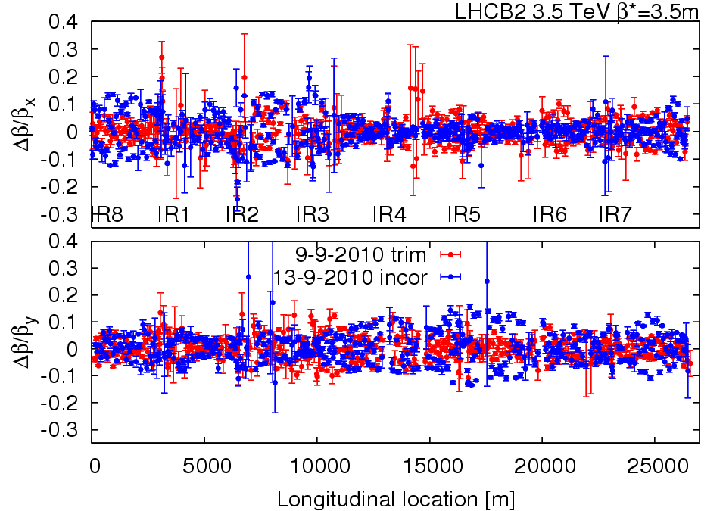
Beta-beat at 3.5 TeV
Beta-beat 10% in collision

Slide 4
Orbit
Reference orbit established (after many iterations).
One orbit at injection, kept until crossing angle reduction.
One orbit after crossing angle reduction, beams separated.
One orbit for collisions (with lumi scan settings).
The 3 orbits differ in IR1/2/5/8. Everywhere else the difference is kept as small as possible (better than 100 microns rms).
Orbit feedback on from start ramp to end of the squeeze.
Operates with injection orbit reference up to flat top.
Before start of squeeze:
Disable BPMs in crossing bump.
Set new reference with reduced crossing angles.
After 110 seconds in squeeze, re-enable BPMs in crossing bump.
Feed-forward of real-time trims was done systematically – corrections are very small.
The last few cycles have been nicely reproducible.

Slide 5
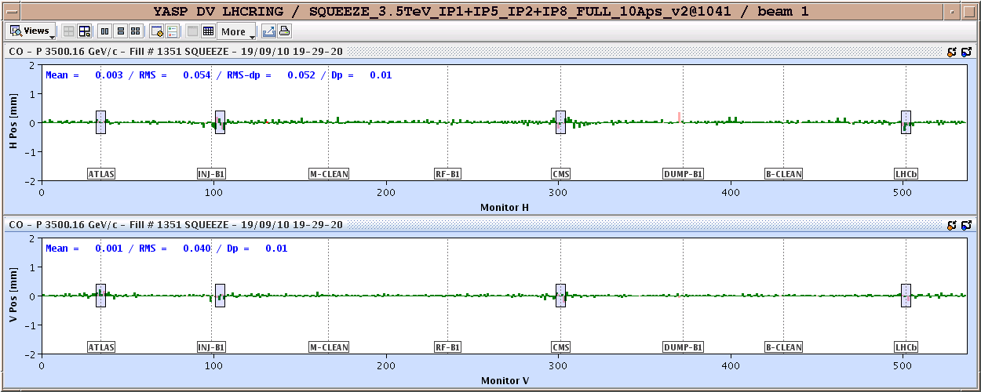
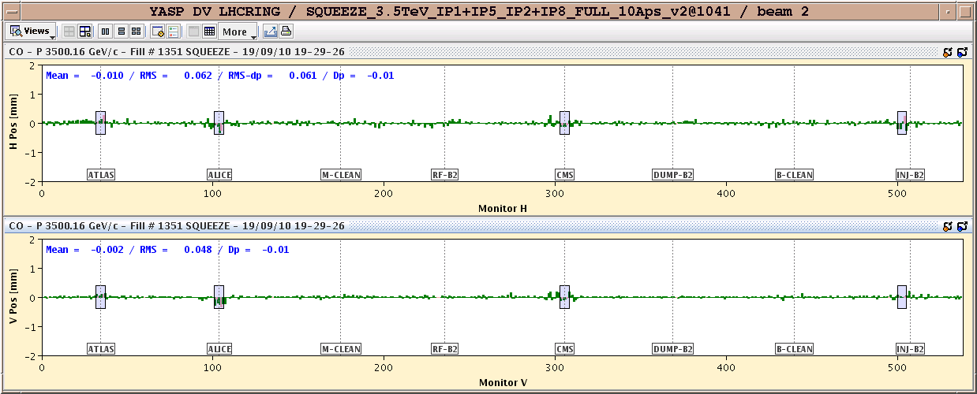
Orbit in the squeeze
Orbit change 3.5 m versus point at 110 s (Xing reduced)
~50 μm rms
Some ‘structures’ in IR2, 5 and 8
(cannot be improved without common correctors – MCBX)

Slide 6
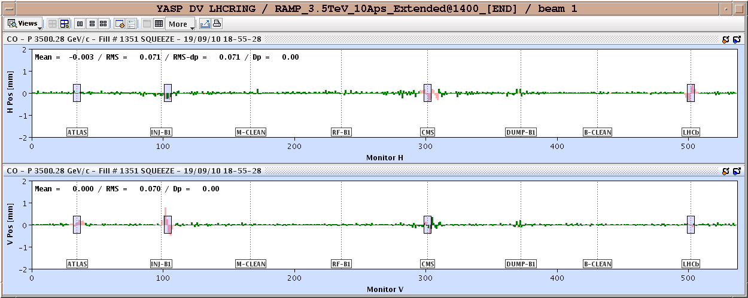
Some transients
During the ramping down of the Xing, the OFB introduces small structures in the IRs where the BPMs are masked out (pink) due to missing constraints.
They disappear as soon as the BPMs are re-enabled.

Slide 7
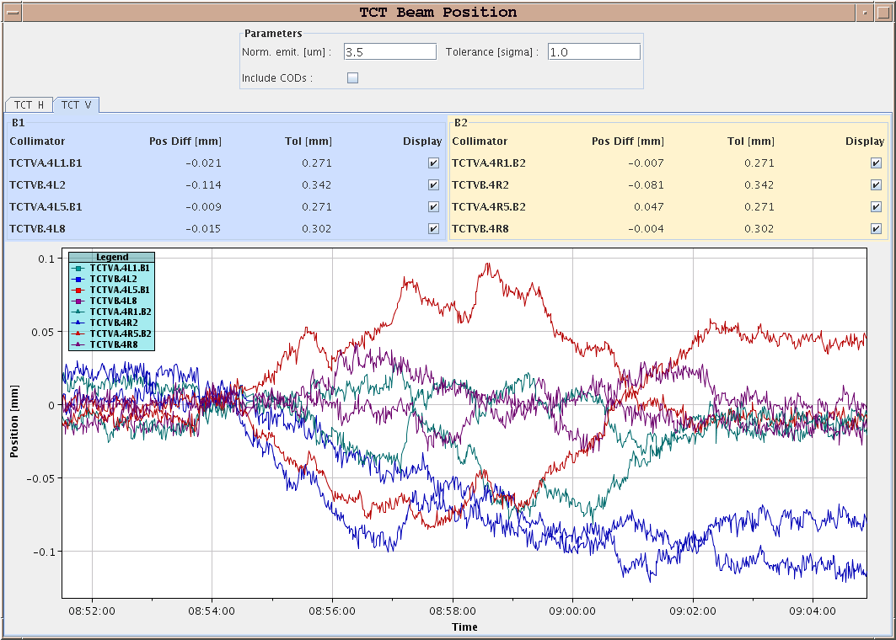
Beam positions at TCTV 7 m → 3.5 m
Beam position at TCTs stable to 0.1 mm during squeeze

Slide 8
Collimation – a lot of work !!!
TCTs were aligned at 3.5 TeV:
Crossing angle 170 microrad.
Crossing angle 100/110 microrad (point 110 sec).
Collisions.
Off-momentum (IR3) collimators for B2 were re-aligned.
TCSGs in IR6 were checked.
B1 TCSG centre was corrected by 0.4 mm.
Collimator ramp and squeeze settings and functions have been updated/re-generated.
Collimation loss maps – very lengthy:
3.5 TeV Crossing angle 170 microrad.
3.5 TeV Crossing angle 100/110 microrad, β* 11/10 m.
3.5 TeV Crossing angle 100/110 microrad, β* 3.5 m.
Collisions.

Slide 9
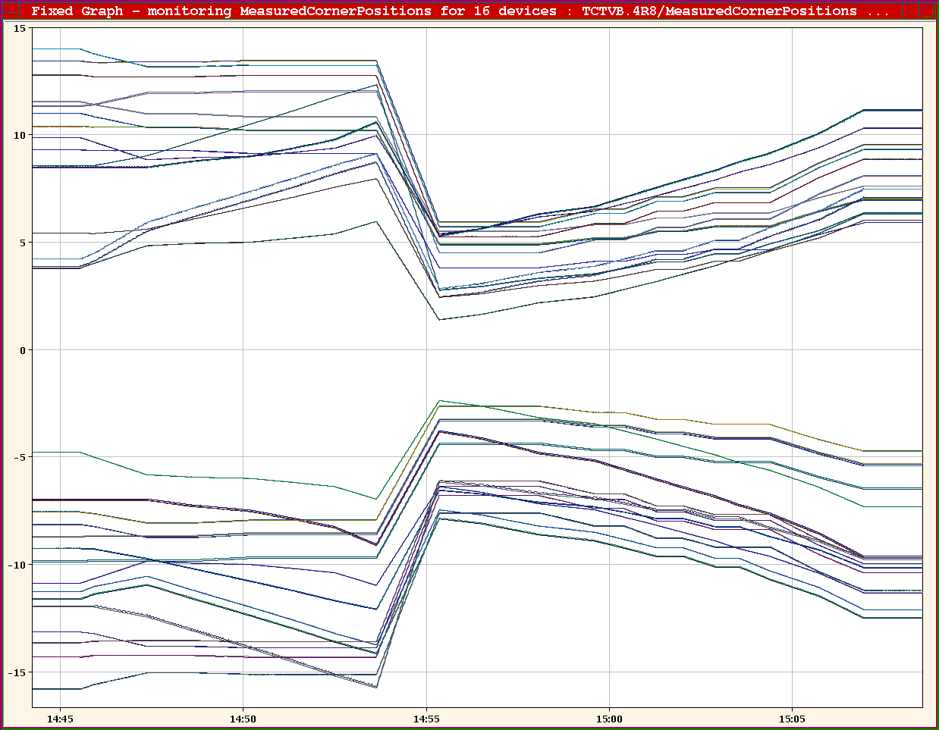
Collimator functions (TCTs) in squeeze

Slide 10
Qualification - status
End ramp | Betatron OK Both off-momentum OK Asynch dump test OK
Reduced crossing angle | Betatron OK Both off-momentum OK Asynch dump test to do
3.5 m separation bump off | Betatron OK Positive off-momentum to do Asynch dump test to do
Collisions | Betatron OK Negative off-momentum OK Positive off-momentum not OK B2 Asynch dump test OK
! Some loss maps must still be analyzed !

Slide 11
Incorrect B2 hierarchy in collisions

Slide 12
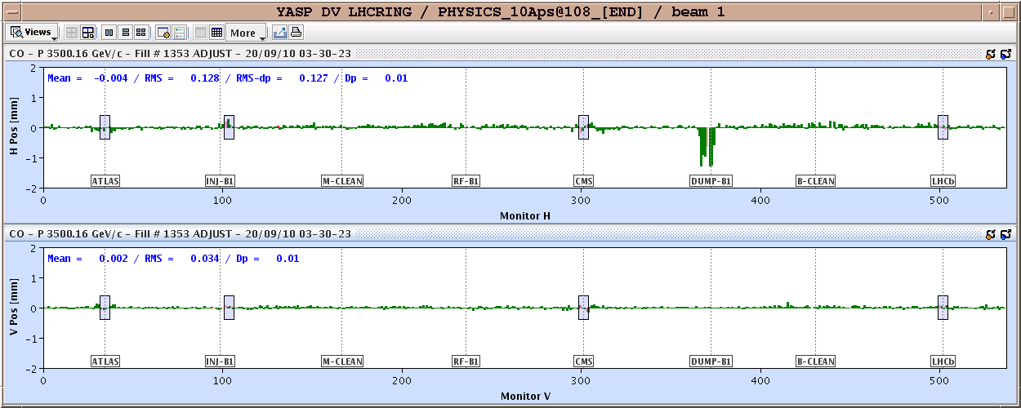
Asynch. dump tests
Tests are performed with a 1.7 sigma/1.2 mm offset corresponding to the limit of the position interlock (SIS)

Slide 13
Injection
Due to a mistake during settings copy, the SPS LHC3 cycle used for the 150 ns beam had a momentum slope on the flat top.
Resulted in a 0.1 permill energy difference with respect to the nominal setting (and to the other cycles). The error was corrected, TI2 and TI8 had to be re-steered. Loss levels could be restored.
SPS H scrapper broken on Sunday.
Access. Problem with a cable – fixed.

Slide 14
Injection protection qualification
Injection protection was qualified by launching trajectory oscillations down TI2 and TI8 towards the LHC.
Validate protection settings of the TCDI (TL), TDI and TCLI (LHC ring) collimators/absorbers.
Both ALICE and LHCb BCMs triggered during those exercises.
During the protection qualification exercises QPS crates lost communication on TI2 (MB.A9L2) and TI8 side (MB.A8R8 – happened twice), correlated with ‘larger’ losses on TL collimators.
Hard reset in tunnel required.
New firmware prepared, but not deployed (tests during access on Thursday not successful).
Cables have been re-routed (coupling with BLMs) – assuming the issue is EMC.

Slide 15
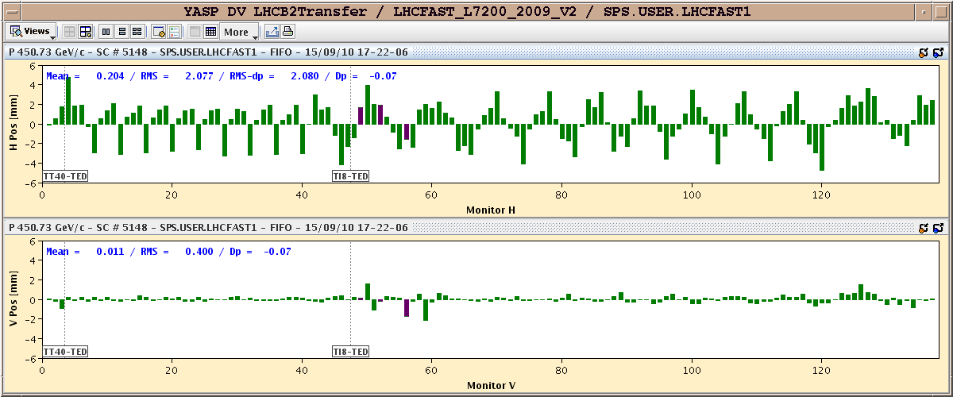
Protection validation - example
Example of a 4 sigma amplitude oscillation through TI8.
Must scan all phases

Slide 16
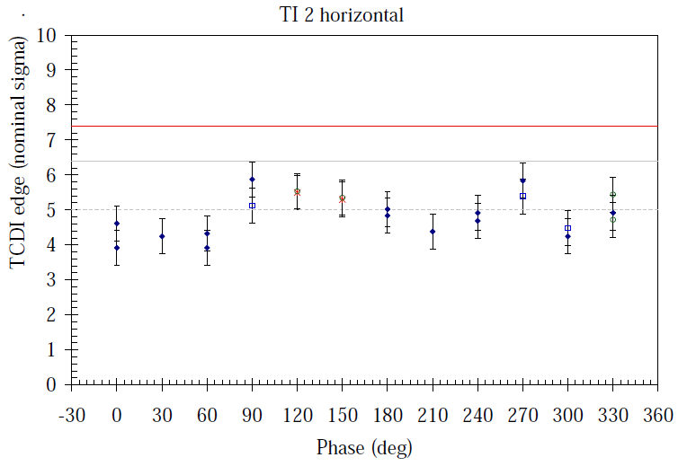
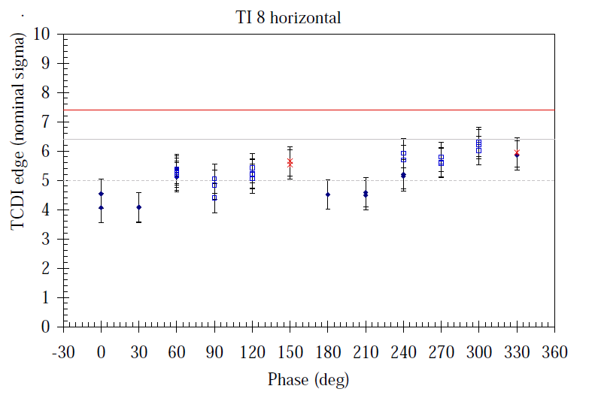
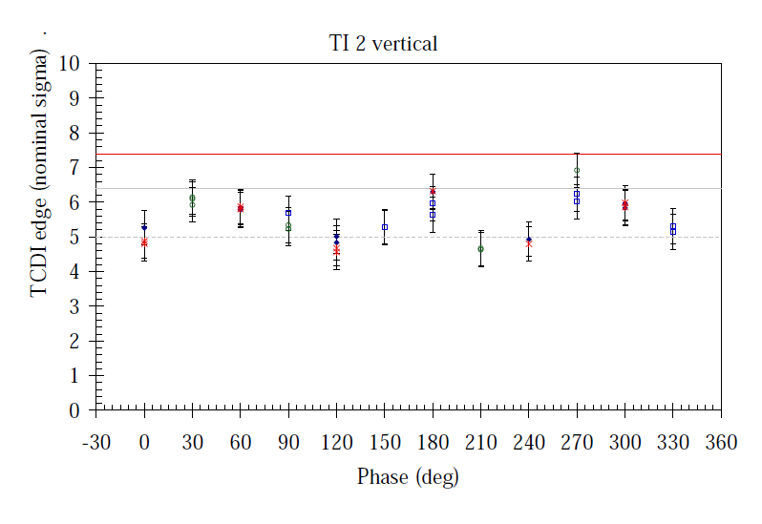
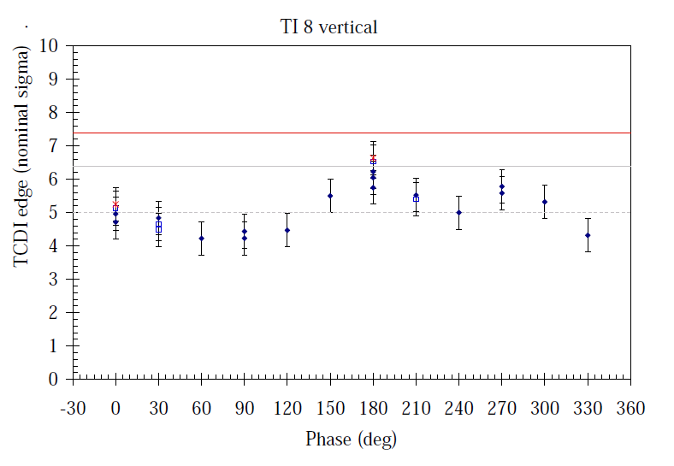
Injection protection results

Slide 17
Quench test
A quench test at injection was performed late night on Saturday. Aim was to observe the onset of the quench with nQPS (without triggering the QPS).
Beam was bumped (inwards as B1 on inside) at quadrupole 14R2.B1, up to approx. -24 mm.
Beam was in inject and dump mode.
No quench was induced, even with ~8E9 p/bunch.
The test had to be stopped when the QPS controller (DQAMC.C14R2 controller) in the area lost communication. An access had to be given to reset the crate.
A contact dose of 20 uSv/h was measured at MB.C14.R2. SEU?

Slide 18
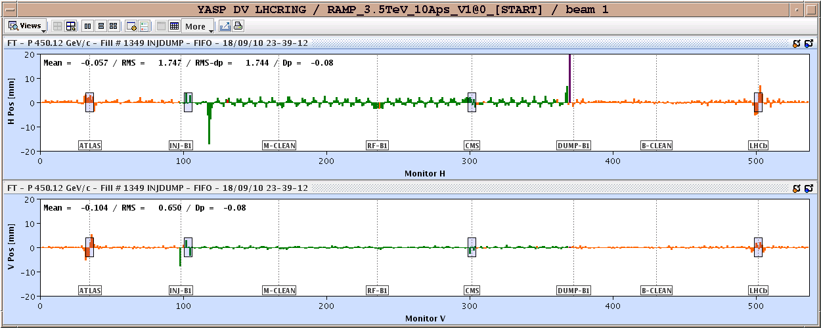
Trajectory -18 mm @ 14R2.B1

Slide 19
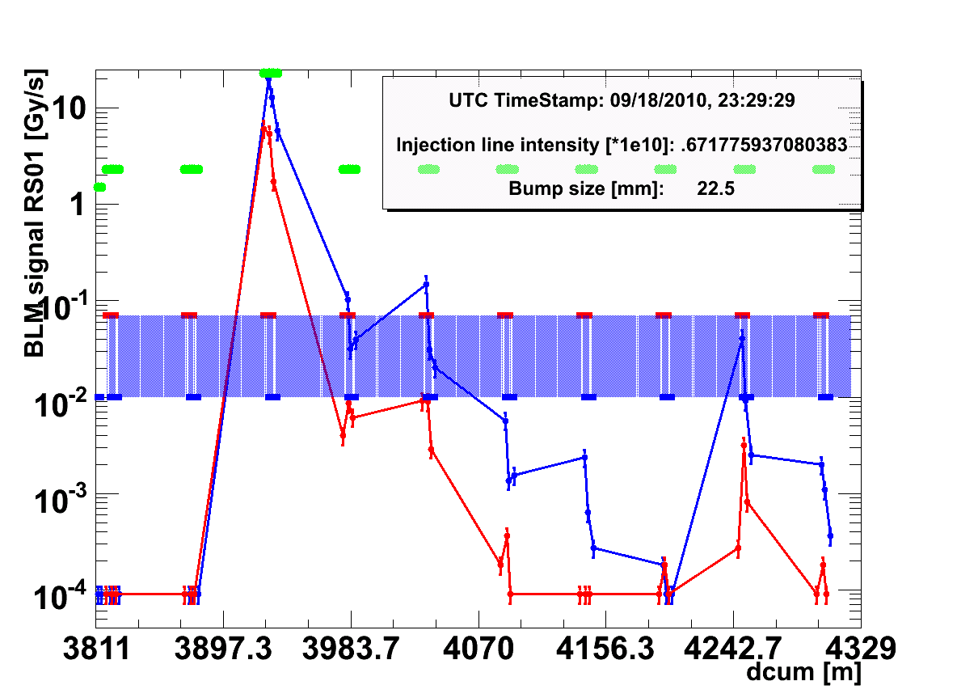
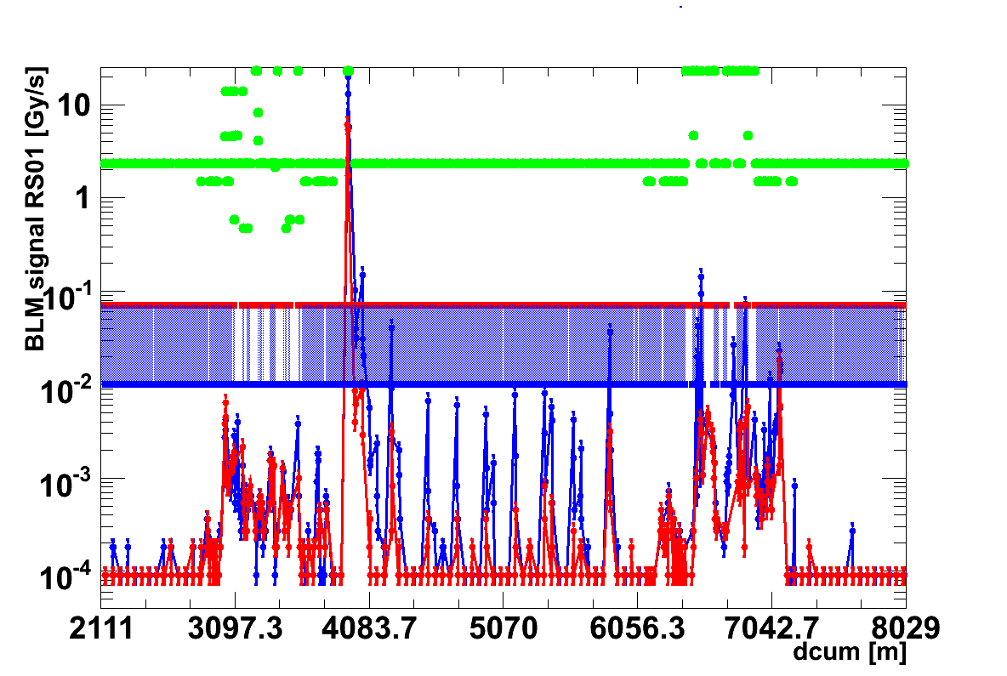
Quench test
The plots show one of the highest registered losses (transient losses). The values on the first and the second monitor on MQ is up to factor 3 above calculated quench level.

Slide 20
Interlock systems
On Monday a beam was lost due to a redundancy problem on the ‘OP buttons’ input to the BIS
Redundant signals were inconsistent.
Preventive replacement of a power supply by BIS team.
Thursday afternoon a problem was observed on the PIC in sector 81.
Finally a ANYBUS module had to be exchanged.
A requalification of the PIC tests was performed successfully on Friday afternoon.
Global Protection Mechanism.
PIC2_QPS_OK on all circuits.
PIC2_POWERING_FAILURE test on all main circuits.

Slide 21
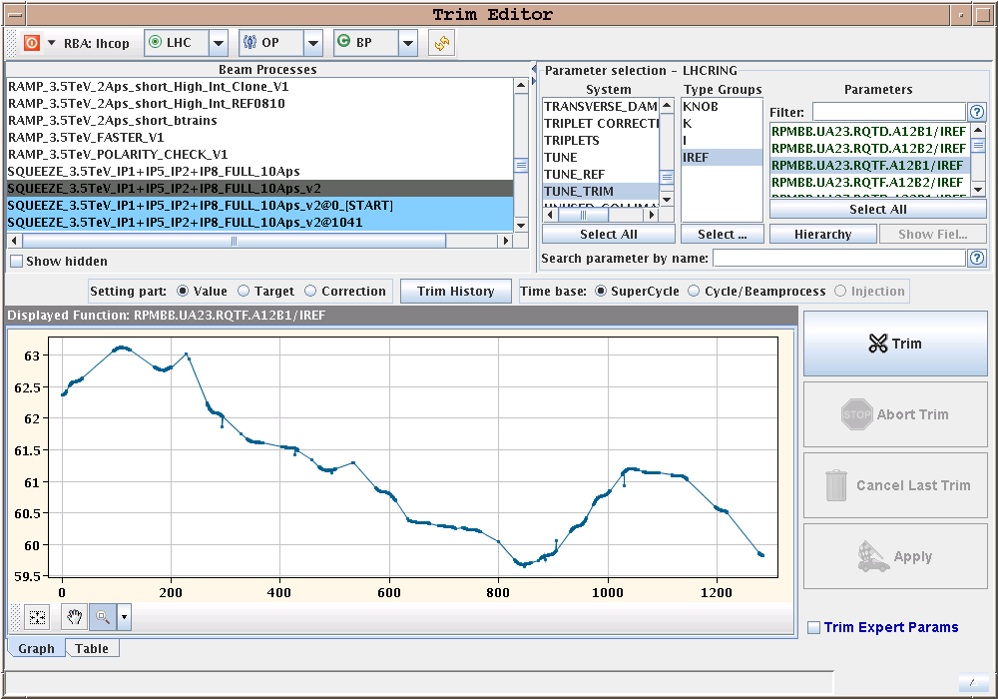
Settings and QPS
In past 3 days we were struck again twice by QPS false quench triggers due to discontinuities in converter functions:
RCBX corrector – fixed (issue with incorporation and trim).
RQTF : spikes introduced by feed-forward correction, most likely combined with QFB action. Spikes removed by hand for RQTF/D.

Slide 22
Program for today
Beam-based alignment of TOTEM RPs.
TOTEM BLM thresholds increased factor 10 for alignment
Final asynch. dump tests.
Next day(s):
Stable beams with 24 bunches, followed by an increase to 48 bunches if everything is smooth.
Consolidation of train operation.
Abort gap cleaning tests (MP external review follow up).

Slide 23
Intensity increase
From the moment we reach 48 bunches:
Intensity steps ~ 48 bunches.
At a given intensity step at least 3 fills and around 20 hours (or more) of Stable beams are required.
Intensity increase possible if no problems are encountered on the MP side (checklist).

