Slide 1
Yesterday
08:33 lost sector 12, 23 and 34. Lost patrol box YZBPC01=PM25 in sector 1 of PM25 at 8:32.
Access prepared at PM25
site manager of P1 will perform the security patrol
S. di Luca to PM25
10:24 machine closed
11:45 beam back
finished off the resetting up of the TCDIs with LHC3, injection each time 4 150ns bunches.

Slide 2
Injection setup - summary
Checked alignment of one TCDIV in each of TI2 and TI8 - again look consistent with the settings from before the corrections yesterday. -> Left all the TCDI centres unchanged.
- Opened all TCDIs to +/-5 sigma for injection protection tests, and put the TCPs closed in both P3 and P7 for measurement.
- Started measurement of transmission with 7.5 sigma trajectory from TI 8 with 7e9 p+

Slide 3
QPS & injection losses
Beam lost on TCDIs as planned - however, this caused a loss of QPS OK exactly correlated with the injection, and again the crate has lost communication and needs an access to reset or fix, as happened already a couple of weeks ago (SEU or EMC??).
Unable to continue the validation tests with this method until this issue with QPS and beam losses is resolved!
Access required

Slide 4
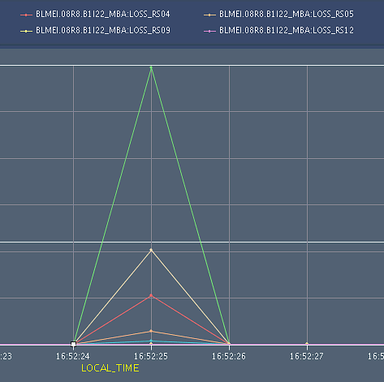
From MP3:
The data acquisition of the QPS system, gave a false trigger ( heaters not discharged) and this was coincident with the beam losses (see attachment of BLM losses at the A8R8). This may be a second case of a single event upset (same as a false trigger that happened on the same crate with the same order of beam loss ( this happened ~two weeks ago))

Slide 5
MP3
CIRCUIT :RB.A81
Lost communication with old QPS crate MB.A8R8. Coincided with injection losses. One PM file created at 165224.680 but seems rubish. The crate can not be remotely reset so access is being prepared to power cycle the crate and change both boards. NB.It is the same crate and loss as the last time.
Hard reset on A8R8 successfully performed by Vincent. No indication for hardware faults. Rack moved slighly towards passage. Meanwhile all available data for dipole A8R8 checked (oQPS and nQPS) no indicaction of "quenchino" or othe problems. BLM data confirm radiation losses.
Nuria
Reiner

Slide 6
Evening
Recover, setup and ramp of 2*1 nominal bunches for collimator setup
establish reference orbit
Finished the "squeeze" up to 110s, with the variation of the crossing angle. Also note that IP2 is now at 9.82 m! The other IPs are at the ususal 11/11/10 m.
local steering at IR3 & 7 – reference established
In night - Lost communication to the collimators in P3. Usual problem with CMW. This problem occurred when we launched the collimator tasks from the sequencer (the B1 task was the one that failed).
Lost beam at 3.5 TeV to interlock problem on MQKA

Slide 7
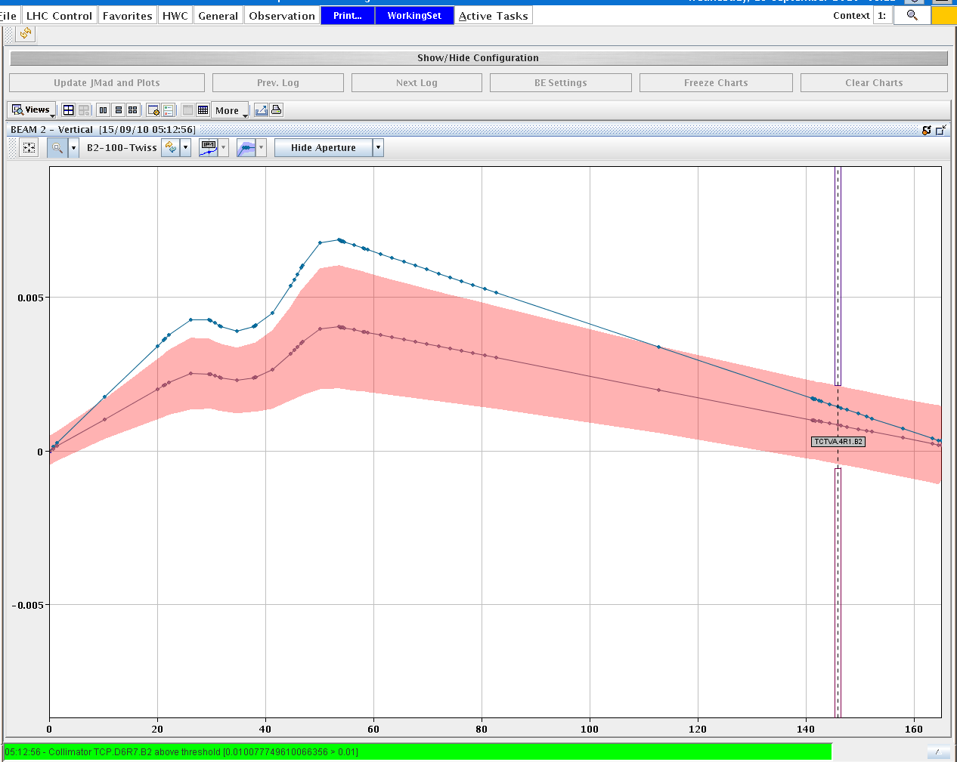
TCT setup

Slide 8
Summary collimation setup, 3.5 TeV, beta*=11/9.82/11/10
Established new reference orbit and saved to MD catalog. all TCTs in crossing plane recentered for 100 urad crossing angle (horizontal in IR5 and IR8, vertical in IR1 and IR2) - in total 4 TCTs per beam. Re-checked 1 TCT per beam in the separation plane - center found consistent with previous setup. Found settings imported to beam process CollimatorBP-450GeV_V1@60_[END]. Settings for the other collimtors as defined in previous entry about loss map conditions are also imported in the same BP. This provides a complete set for loss map validation for this machine configuration.
Stefano Redaelli & team

Slide 9
Recentered TCSG in IR6 both beams - found 670 micron offset of center in B1 w.r.t. previous setup. This is consistent with the measured orbits. Re-aligned TCDQ in both beams after defining the beam edge with the TCSG in IR6. Data should be checked by beam dump team before further action. Loss map B2 V carried out but caused dump of both beams, due to the usual unmaskable BLM at the MBW in IP7. This issue should be sorted out soon otherwise it will be difficult to perform loss maps. Next: TCT setup after establishment of collision conditions.

Slide 10
To do
Injection protection |  | Ongoing
Collimator setup (TCT) | beam 1 & 2 | Flat top | done
Collimator setup (TCT) | beam 1 & 2 | reduced crossing angles | done
Collimator setup (TCT) | beam 1 & 2 | reduced crossing angles 3.5 m
Collimator setup (TCT) | beam 1 & 2 | separation bumps off | tomorrow
TCSG/TCDQ setup in IR6 | beam 1 & 2 | flat top [valid elsewhere] | check
Loss maps | beam 1 & 2 | Flat top | mom. to do
Loss maps | beam 1 & 2 | reduced crossing angle | started
Loss maps | beam 1 & 2 | Colliding beams
Async. dump | beam 1 & 2 | everywhere
Ramp, squeeze & collide | beam 1 & 2 | everywhere

Slide 11
Outlook
Sun | A | 8 | Collimation set up at 3.5TeV (IR3 and TCTs)
Sun | N | 8 | Loss maps at 3.5TeV (end of ramp)
Mon | M | 8 | Injection protection qualification for injection of unsafe beam part 1
Mon | A | 8 | Loss maps at 3.5TeV (end of ramp)
Mon | N | 8 | Collimation set up at 3.5TeV (TCTs at end of ramp and with reduced Xing)
Tue | M | 8 | Access system problem - recovery
Tue | A | 8 | Injection protection
Tue | N | 8 | Collimation set up at 3.5TeV
Wed | M | 8 | Squeeze and collision – sequence test
Wed | A | 8 | Injection qualification
Wed | N | 8 | Loss maps at 3.5TeV (collision)
Thu | M | 8 | Collimator set-up at 3.5 TeV – separation off
Thu | A | 8 | Loss-maps
Thu | N | 8 | Loss-maps
Fri | A | 8 | ….
 |  |  | Collimation integration into sequencer and tests
 |  |  | Ramp and squeeze bunch trains - collisions with 3 trains of 8
 |  |  | Quench test at 450 GeV

