Slide 1
08:08 ramp (for squeeze) started
Q-FB on & off a few times
Orbit FB switched off; we noticed a step in the RMS and max position plots
09:44 beams lost
redundancy problem on the channel "OP button".
11:07 B.Puccio preventively changed a power supply in the electronics managing the OP button logic and finished checking the 4 OP buttons by activating them individually - all behave correctly.
No beam from injectors – 9:30 scheduled
10:38 Electrical problem in SPS: a AUG button was pressed and several chains went down.
PS still in access.- truculent RF problem

Slide 2
11:57 S78 tripped.
Jean-Philippe and Reiner concluded that the problem in sector 78 was due to a noisy board, where the coefficients calibration was done long time ago and some drift occured.
14:00 beam back in
14:12 ATLAS toroid & solenoid tripped – off for 4 days

Slide 3
Injection protection – stage one
From the trajectories we have a bit more than 0.1 per mil momentum offset now in the TLs.
The losses on the TCDIs are a factor 2-4 higher than after our (time consuming) setting up last week, which indicates that the trajectory has indeed changed significantly at some of the TCDIs.
This is a result of the changes made this weekend in the SPS to the LHC3 cycle (which increased the extraction momentum by an estimated 0.04 GeV/c).
Looks like we will have to resteer the lines, then check the setting up of the TCDIs, before we can start with the protection validation.
Still not clear what has changed since Saturday when the injection after the LHC energy matching was tested.

Slide 4
Beam available at ~3:45 pm - spent our 3 hours checking effects of changes made over the w/e
Checked trajectories in TLs with LHC3 cycle - differences wrt last week compatible with the momentum change made to the SPS on Saturday for this cycle.
Beam losses at TCDIs 2-4x worse - real changes at collimators
Resteered TI 2 and TI 8 to the setup references and re-corrected the injection oscillations - beam losses at TCDIs came down to roughly the levels we had last week.
Started checking the centering of the most critical TCDIs (large D/beta).
Check centre of TCDIH.87441 and TCDIH.29050 by moving left and right jaw (one at the time) by +/-0.5 sigma and +/-1sigma. We found the same centres as last week within 10um (sse attached plots) ==> we assume that old values are still valid!
Should be able to start the injection protection validation checks tomorrow after checking 2 more TCDI centres

Slide 5
Squeeze commissioning
Reduce crossing angle from 170 to 100/110 microrad during first 110 seconds of squeeze
disable BPMs concerned for the exercise
Successful squeeze to 3.5 m
Xing angles after first stage of squeeze were measured to be within 10%
At 7m, the unusual structure that was observed on the previous ramps was again observed, but was eventually traced to "huge and crazy corrections at 7m" that were due to a bad incorporation from last week.
This was cleaned up using SVD on bare on the difference.
The orbit clean up also seemed to cure the growth in coupling.
Ralph Steinhagen in attendance for adjustments of tune fitter setting/coupling measurement issues
We needed to set the coupling to less than 0.003 to avoid the QFB from stopping..

Slide 6
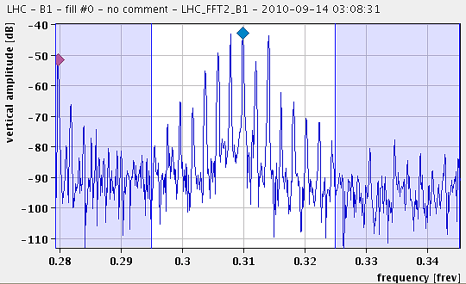
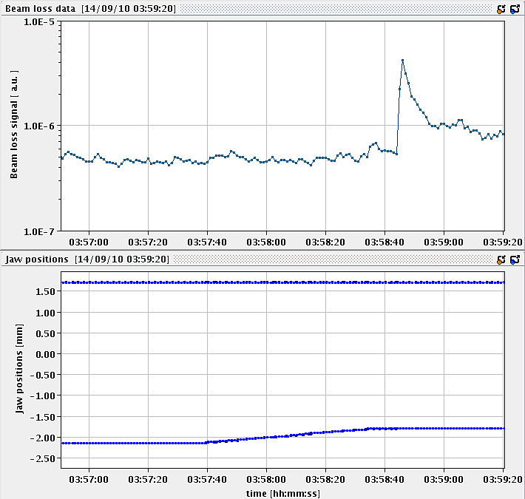
Collimator set-up
02:54 Single nominal bunch at flat-top
longitudinal blow-up in ramp looks better (PB/AB)
bad B1 lifetime – octupoles were off (?)

Slide 7
Collimator setup…
We continued the check of B2 momentum cleaning and setup the H tertiary collimators. Setup started at about 4h and we made the alignment for 11 collimators. This completes the setup with 170 urad.
The beam conditions were much better than yesterday. On the other hand, we could not achieve a very good orbit (also note that high intensity reference is not yet well established). Same accuracy as yesterday.
We performed loss maps of the B2-H. We saw a peak at the MQX-R1 that required more investigation (further check of the BLM measurements and of the settings used). Note that the beam was dumped during the loss maps so the measurement might not be clean.
Collimator setting for B2 are stored in the same collimator BP as yesterday: "CollimatorBP-450GeV_V1@2".
Stefano Redaelli & co

Slide 8
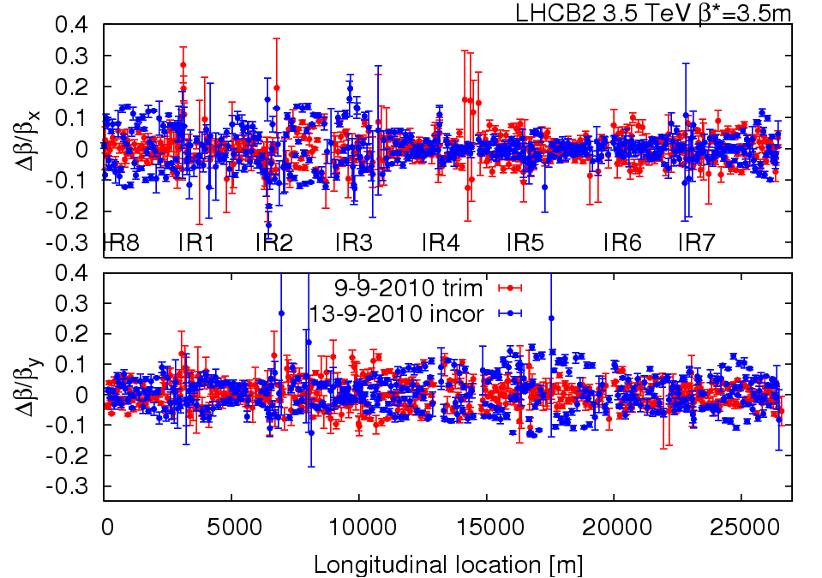
Beam2 beta-beating with on-oline trimmed global knob correction and with incorporated global knob correction.

Slide 9
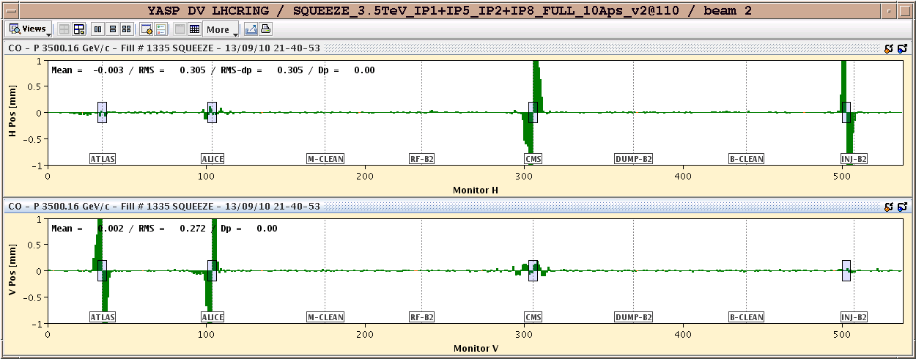

Slide 10
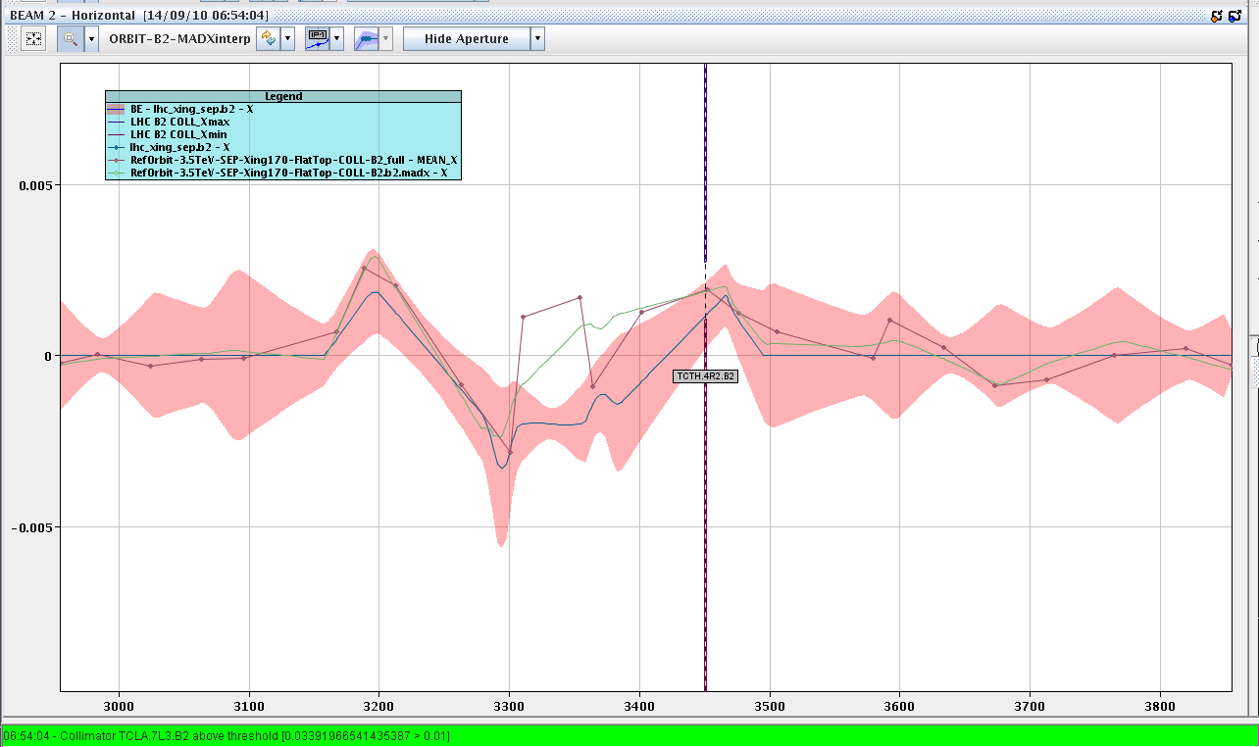
Tertiary setup

Slide 11
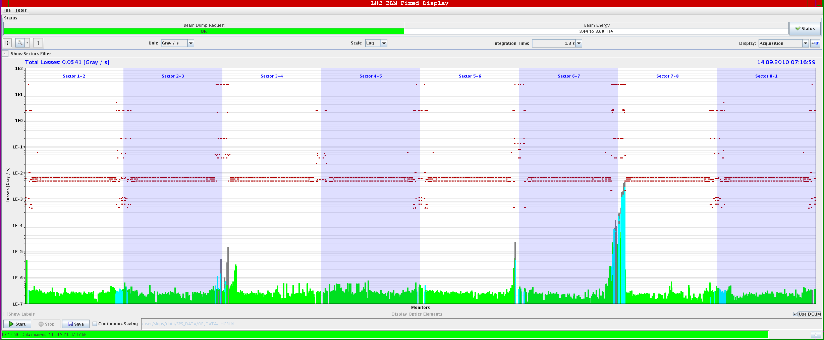
Loss maps
Horizontal loss maps for B2. Seen TCTH.4R5.B2 at 5e-5 level. Also see a peak at the MQX-R1 at 10-3 level. This needs further investigation.

Slide 12
Outlook
Sun | M | 8 | Ramp commissioning, longitudinal blowup, ramp nominal
Sun | A | 8 | Collimation set up at 3.5TeV (IR3 and TCTs)
Sun | N | 8 | Loss maps at 3.5TeV (end of ramp)
Mon | M | 8 | Injection protection qualification for injection of unsafe beam part 1
Mon | A | 8 | Loss maps at 3.5TeV (end of ramp)
Mon | N | 8 | Collimation set up at 3.5TeV (TCTs at end of ramp and with reduced Xing)
Tue | M | 8 | Injection protection qualification for injection of unsafe beam part 2
Tue | A | 8 | RF set up with multibuch injection, transverse feedback
Tue | N | 8 | Collimation set up at 3.5TeV (TCTs at end of squeeze and collision)
Wed | M | 8 | Loss maps at 3.5TeV (end of squeeze)
Wed | A | 8 | Ramp and squeeze bunch trains
Wed | N | 8 | Loss maps at 3.5TeV (collision)
Thu | M | 8 | Collimation integration into sequencer and tests
Thu | A | 8 | Ramp and squeeze bunch trains - collisions with 3 trains of 8
Thu | N | 8

