Slide 1
Restart Sept 2010
P. Baudrenghien, A. Butterworth BE-RF

Slide 2
Old ramp vs. new ramp
2 A/s ramp (~ 45 min long)
Longitudinal Blow-up in SPS: ~ 1.5 ns, 0.5 eVs
Capture with matched voltage 3.5 MV
Voltage rise from 3.5 MV to 5.5 MV in parabolic part of ramp, then constant 5.5 MV
Only 4 lines per beam
10 A/s ramp (1020 s long)
Longitudinal Blow-up in SPS: 1.5 ns, 0.5 eVs
Capture with matched 3.5 MV
Voltage rise from 3.5 MV to 8 MV from start ramp to end ramp. 8 MV in physics
8 lines per beam
RF bucket at 450 GeV unchanged:
Bucket area 0.94 eVs
Bucket Half Height Δp/p 6.6E-4
Synchrotron freq: 42 Hz

Slide 3
Old bucket vs. new bucket @ 3.5 TeV
5.5 MV
Bucket area 3.3 eVs
Bucket half height Δp/p: 3E-4
Synchrotron freq: 19 Hz
8 MV
Bucket area 4.0 eVs
Bucket half height Δp/p: 3.6E-4
Synchrotron freq: 23 Hz
Motivation:
Higher voltage to reduce losses during physics. Would go to 12 MV in 2010. Design value is 16 MV
Linear voltage rise makes bunch length control easier
No cavity left idling without feedback to prepare for high intensity

Slide 4
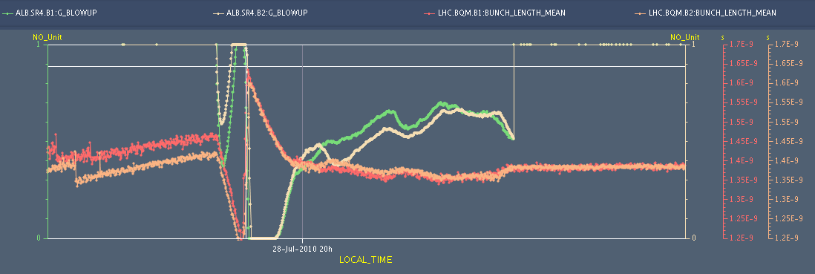
Longitudinal blow-up
Previous target: 1.4 ns
New target: 1.2 ns (design report value). Presently 1.3 ns
Blow-up with old 2A/s ramp

Slide 5
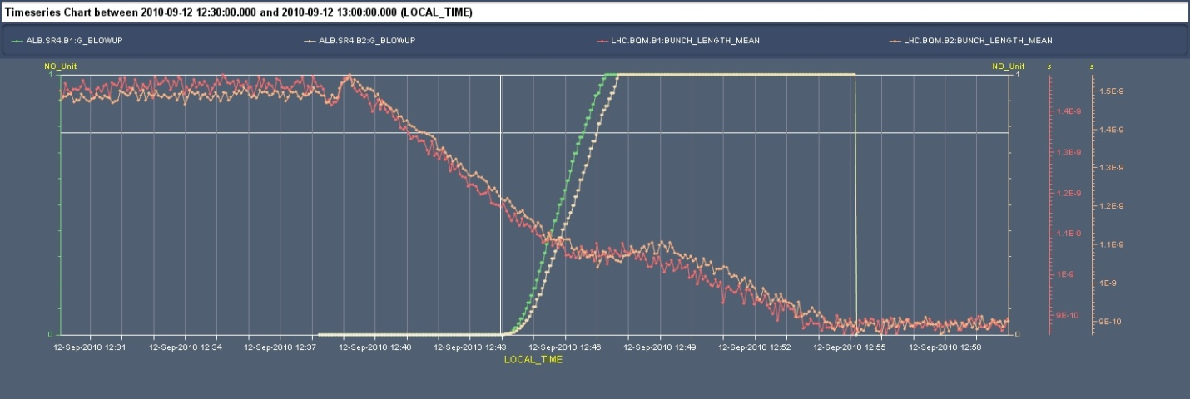
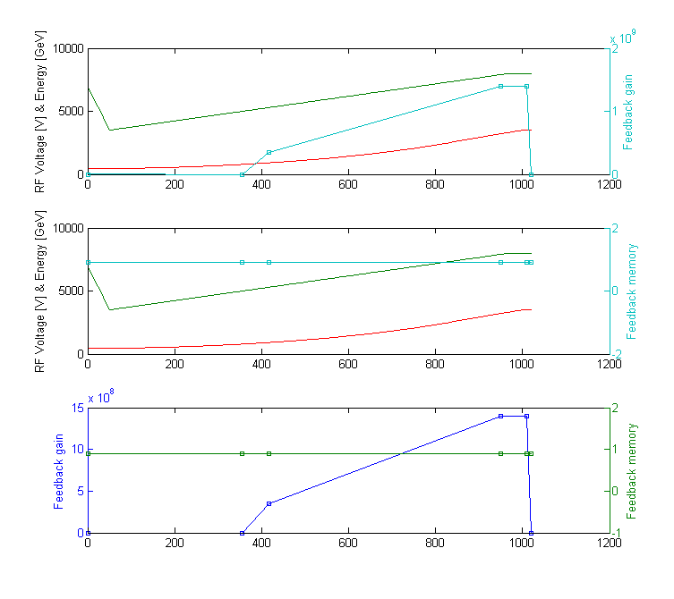
Longitudinal blow-up with new ramp (1)
Ramp 1: Sept 12, early afternoon
Blow-up too weak:
we end-up with 0.9 ns long bunches
Blow-up settings

Slide 6
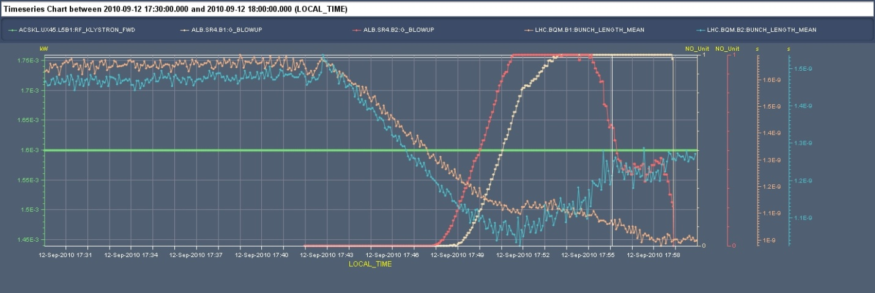
Longitudinal blow-up with new ramp (2)
Ramp 2: Sept 12, late afternoon
Blow-up B2 OK: ends-up with 1.33 ns
B1 too short (1.01 ns) but Cavity5B1 tripped before ramp
Blow-up settings identical to previous ramp

Slide 7
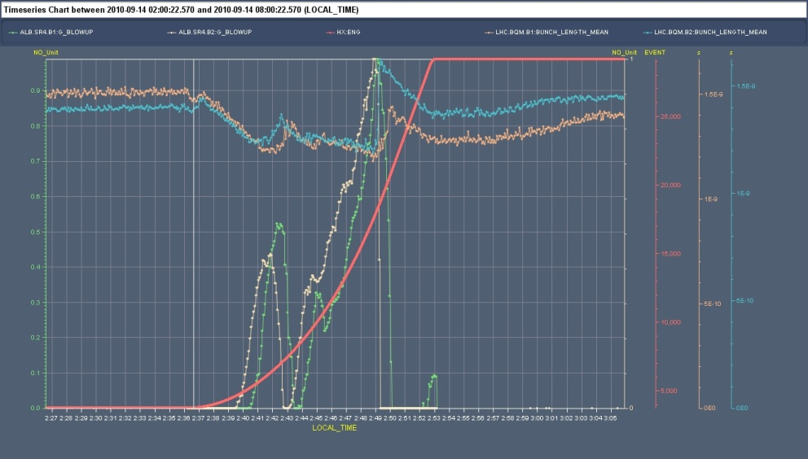
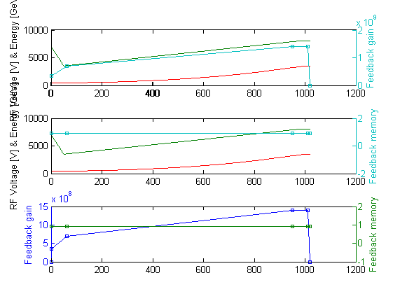
Longitudinal blow-up with new ramp (3)
Ramp 3: Sept 14, early morning
Blow-up a bit too strong: in the last third of ramp
But we end-up with correct 1.3 ns long bunches
Blow-up settings

Slide 8
Left to be done…
Fine-adjust blow-up. Waiting for another ramp…
Test flat bottom with fixed 7 MV and adiabatic voltage reduction for few seconds at each injection

