Slide 1
Global aperture measurements at 450 GeV with 170 μrad crossing angle
R. Assmann, R. Giachino, M. Giovannozzi, D. Jacquet, L. Ponce, S. Redaelli, J. Wenninger
Acknowledgements: G. Müller

Slide 2
Method
Global aperture measurement
Open collimators
Measure loss map (crossing 1/3 resonance) to determine minimum aperture in the ring.
Close primary collimator until the largest loss peak is onto the collimator.
Repeat for both beams and planes.
Off-momentum aperture performed
RF frequency changed to get 1.5×10⁻³ Δp/p (compatible with n1 computations).
Repeat excitation on resonance.

Slide 3
Results
On-momentum aperture (expressed in terms of nominal sigmas)
Aperture bottlenecks:
Off-momentum contribution:
Beam 1 (H): reduction by 1.5 sigma
Beam 2 (H): reduction by less than 1 sigma
 | Horizontal | Vertical
Beam 1 | 12.5 | 13.5
Beam 2 | 14.0 | 13.0
 | Horizontal | Vertical
Beam 1 | Q6.R2 | Q4.L6
Beam 2 | Q5.R6 | Q4.R6

Slide 4
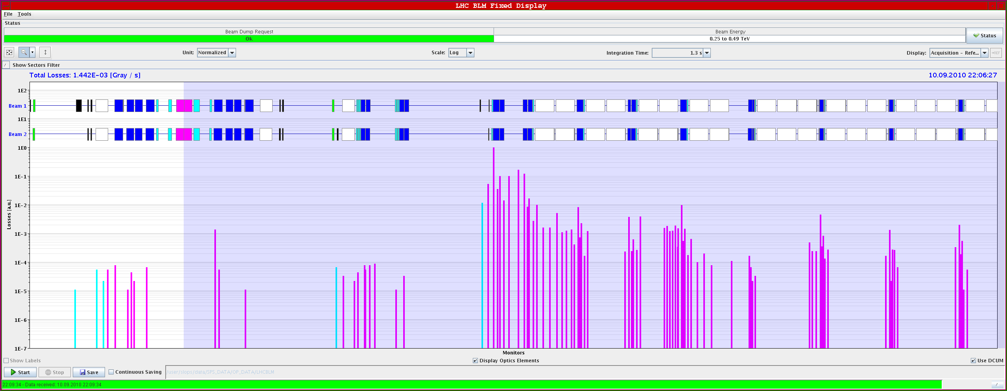
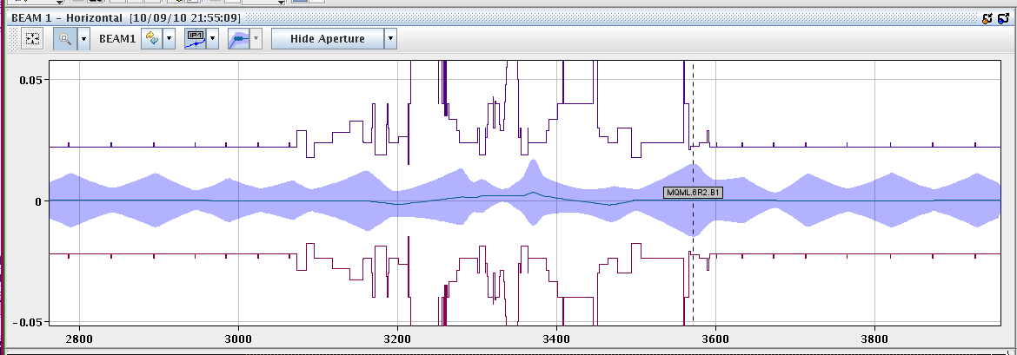
Few images – IR2

Slide 5
Comments
Standard question
n1=7 sigma gives an aperture of 7×1.2=8.4 sigma: what is the reason for the discrepancy?
Tolerances used for the computation of n1:
Beta-beating -> 20%: it seems in good agreement with measurements.
CO budget -> 4 mm (radial): it seems rather pessimistic (see later).
Mechanical -> fixed tolerances with cold bore measured profiles: might be pessimistic.
We should not forget about the factor 1.2 to translate from n1 to apertures: is it still adequate?

Slide 6
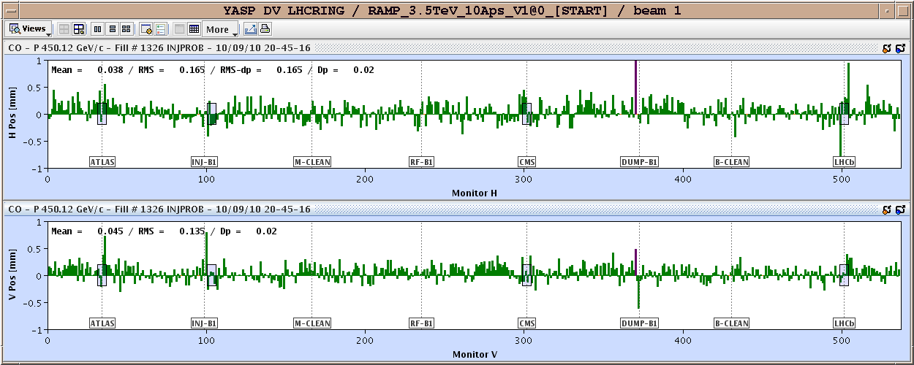
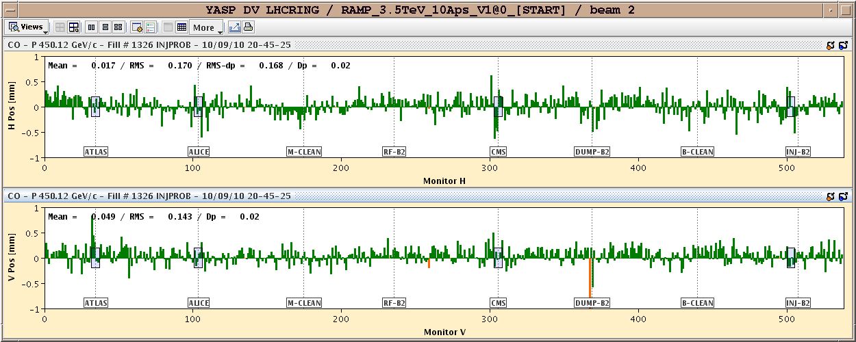
Measured CO
Difference between reference and actual CO.
Actual orbit excursion (3sigma) around 1-1.5 mm

Slide 7
N1 vs. CO budget

Slide 8
Conclusions
Change from initial expectation (thanks to the outstanding machine quality): no many distributed bottlenecks all around the arcs.
Also at injection, we have isolated bottlenecks in the IRs (seen already in sector test measurements).
Implications on machine protection to be carefully evaluated.
No bottleneck in the triplet was found. The 170 μrad crossing angle can be used in operation at injection (in terms of aperture).
It would be nice to be allowed to measure aperture at top energy! To be seen how to extrapolate at top energy these results (min β*)…

