Slide 1
14.12.2009
-07:00: recovered from cryo fault but still struggling with QPS system
-18:30: finally solved QPS issues and finished pre-cylces
-19:15: inject beam and adjust tune and Q’
-20:30: tripped sector 12 due loss in cryo maintain due to faulty temperature
reading ➔ need to recycle
-22:15: ready to re-inject again
-22:40: start ramp
-22:45: lost Beam2 at 800 GeV triggered by BPM interlock even though it was
masked in the BIC ➔ Caused by problem of the BCT
Continue measurements on Beam1:
-chromaticity and tune; orbit; beta-beat; dispersion; RF loop for online
Q’ measurement; beam dump for Beam1
-00:40: Try second ramp

Slide 2
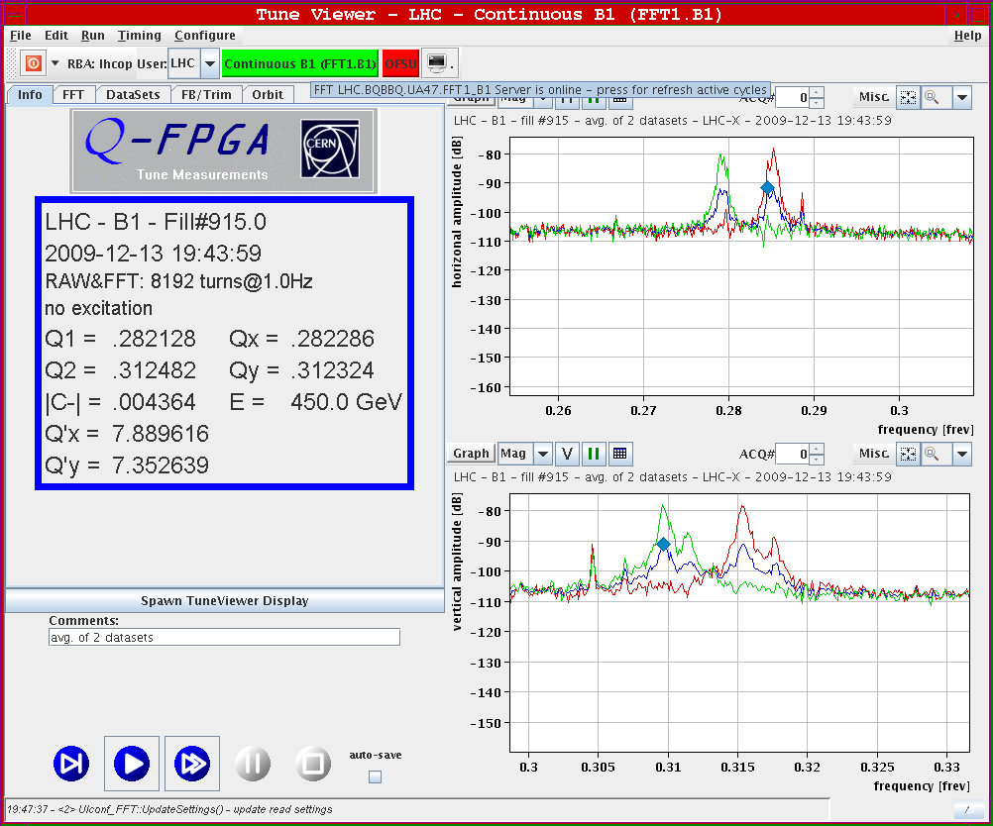
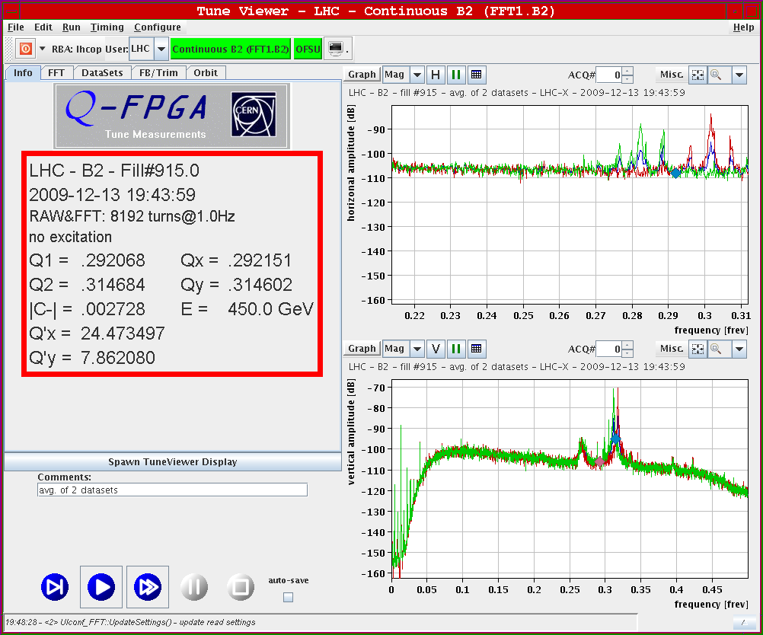
14.12.2009: Q & Q’ after correction before ramp
Beam1:
Horizontal Q‘ for Beam2
required trim of -15!
Beam2:

Slide 3
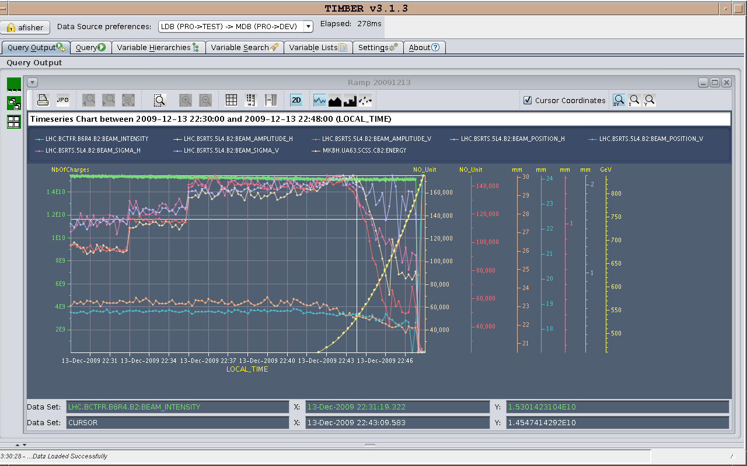
14.12.2009: Synchrotron light monito
Beam2:

Slide 4
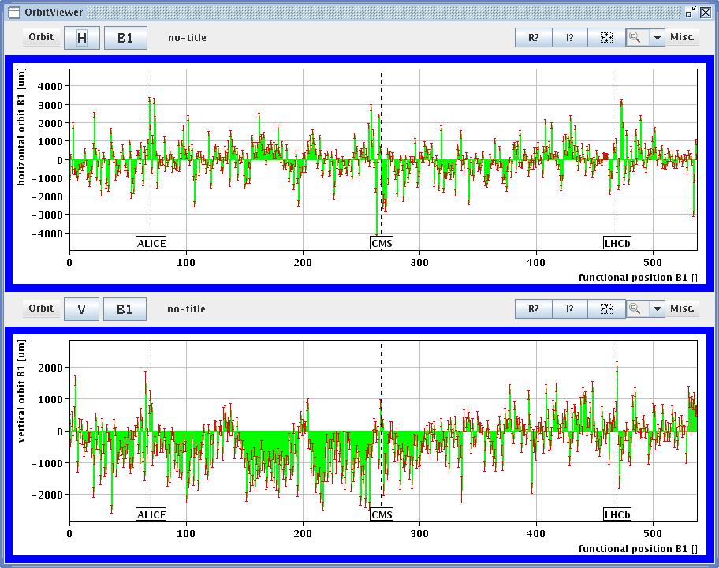
14.12.2009: Raw orbit at end of ramp
Beam1:

Slide 5
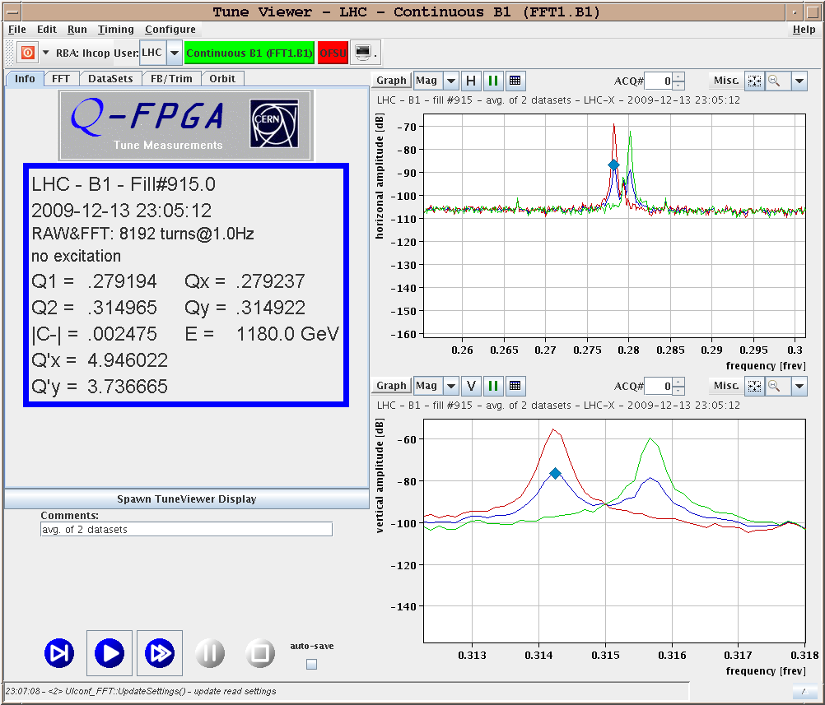
14.12.2009: Q and Q’ at end of ramp
Beam1:
Beam2 Chromaticities
trimmed by of -13 / +12!
Beam2:

Slide 6
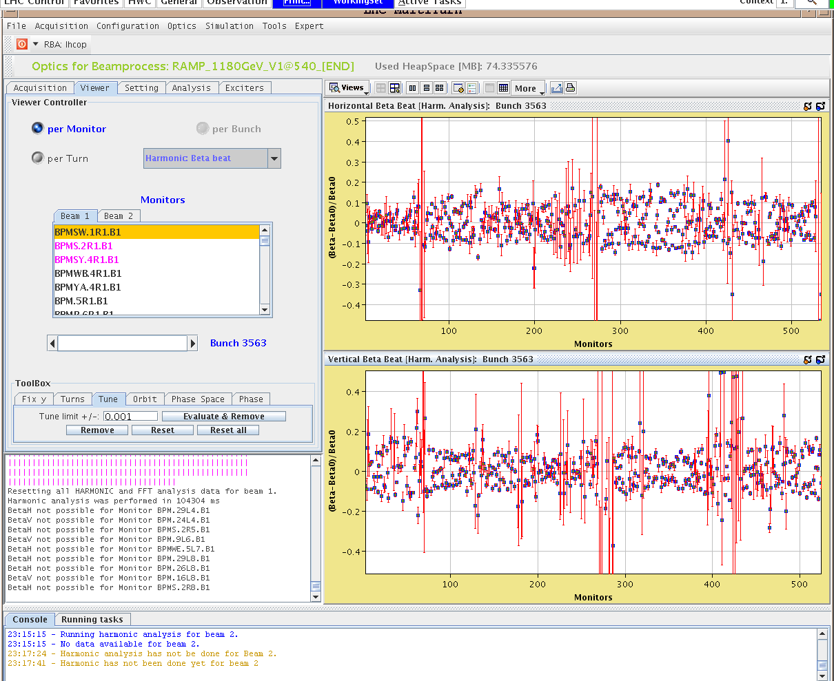
14.12.2009: beta-beat at end of ramp
Beam1:
beta-beat
within 20%

Slide 7
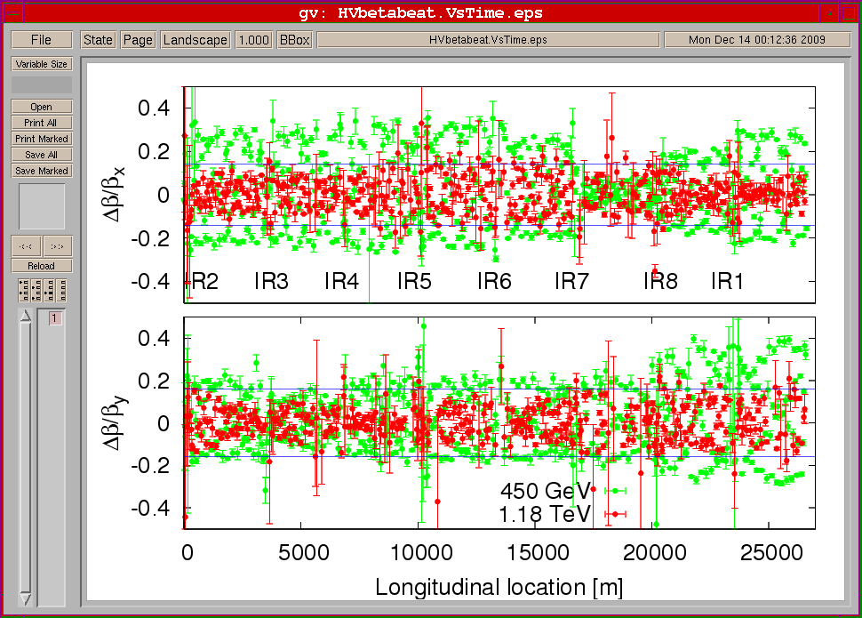
14.12.2009: beta-beat comparison 450 GeV to end of ramp

Slide 8
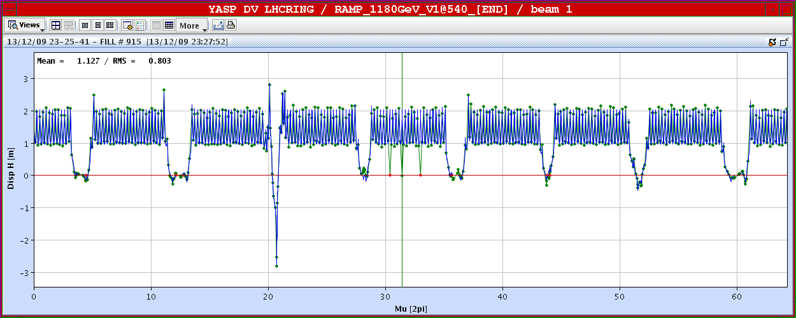
14.12.2009: dispersion at end of ramp
Beam1:
Beam2:

Slide 9
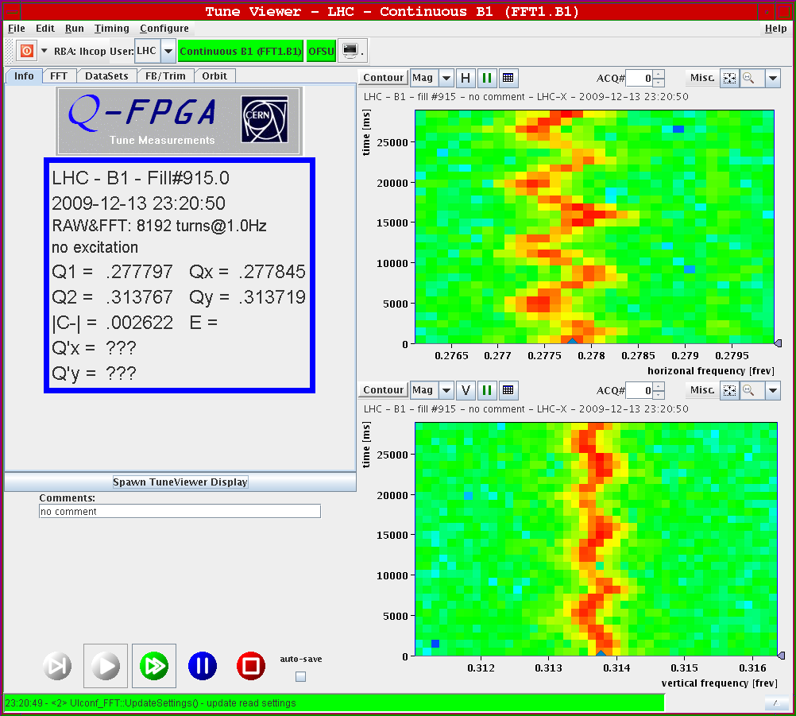
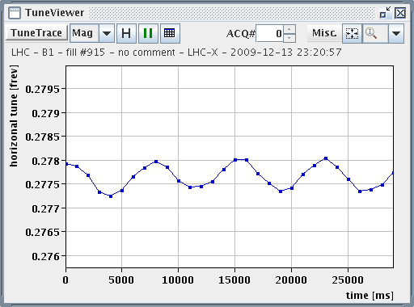
14.12.2009: Radial modulation for Q’ measurement
Beam1:

Slide 10
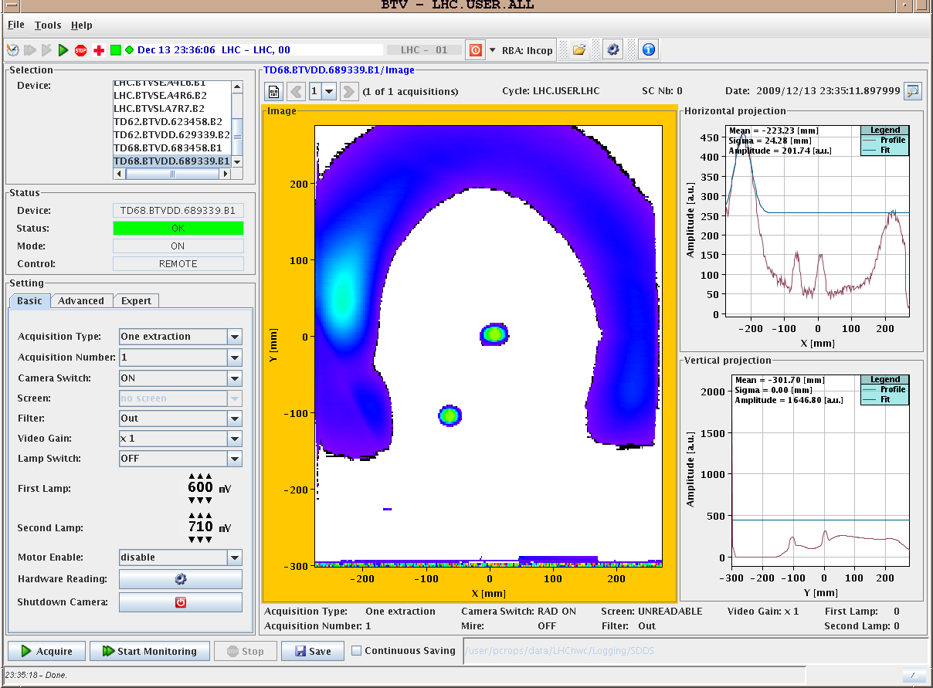
14.12.2009: Beam dump
Beam1:

Slide 11
14.12.2009
-00:40: Communication problems with RF at end of pre-cylce
finished pre-cycle and ready for next ramp:
-02:00: Preparing new fill:
some collimators were in park position after cycle
-02:20: Start new fill:
switched Q-FB on for both beams, references: B1: Qx = 0.280; Qv = 0.315 B2: Qx = 0.280; Qv = 0.310
-02:40: Both beams at top energy with excellent lifetimes
measurements
-04:00: Declaring quiet beams
-06:00: Dump both beams
➔ all sectors tripped

Slide 12
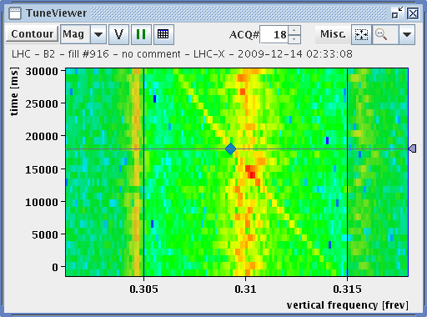
14.12.2009: Tune second ramp
Beam2:

Slide 13
14.12.2009: Second ramp

Slide 14
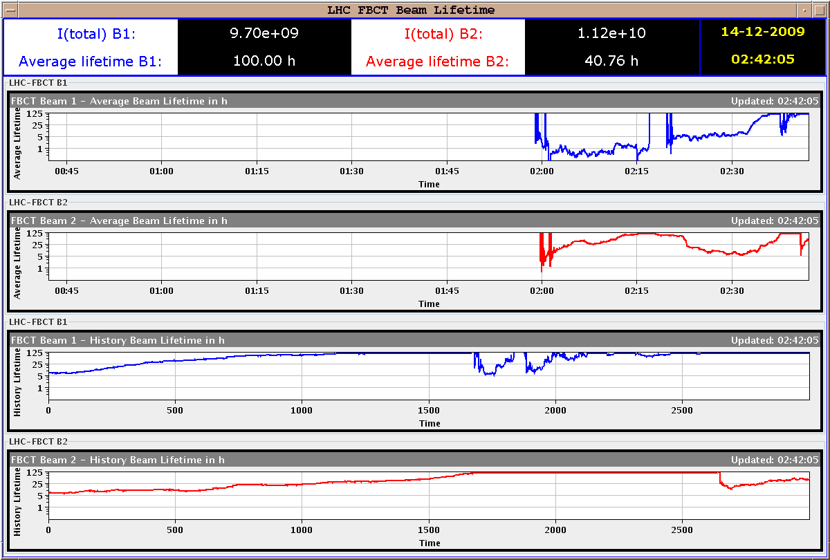
14.12.2009: Second ramp

Slide 15
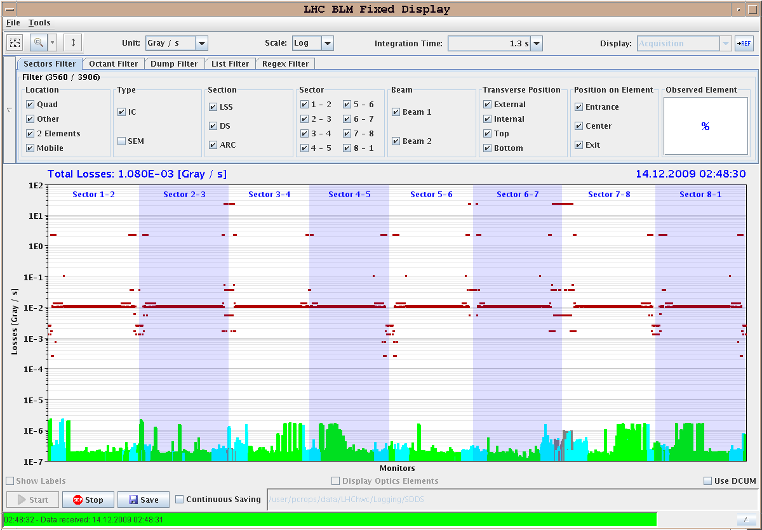
14.12.2009: Second ramp BLMs

Slide 16
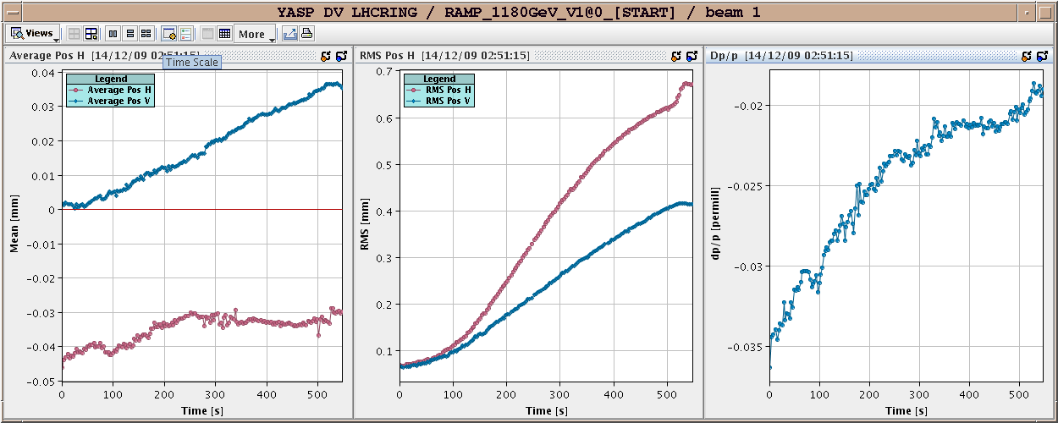
14.12.2009: Second ramp Orbit movement

Slide 17
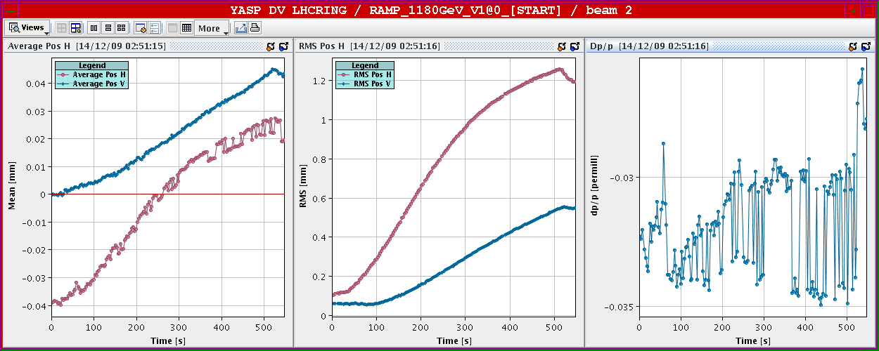
14.12.2009: Second ramp Orbit movement

Slide 18
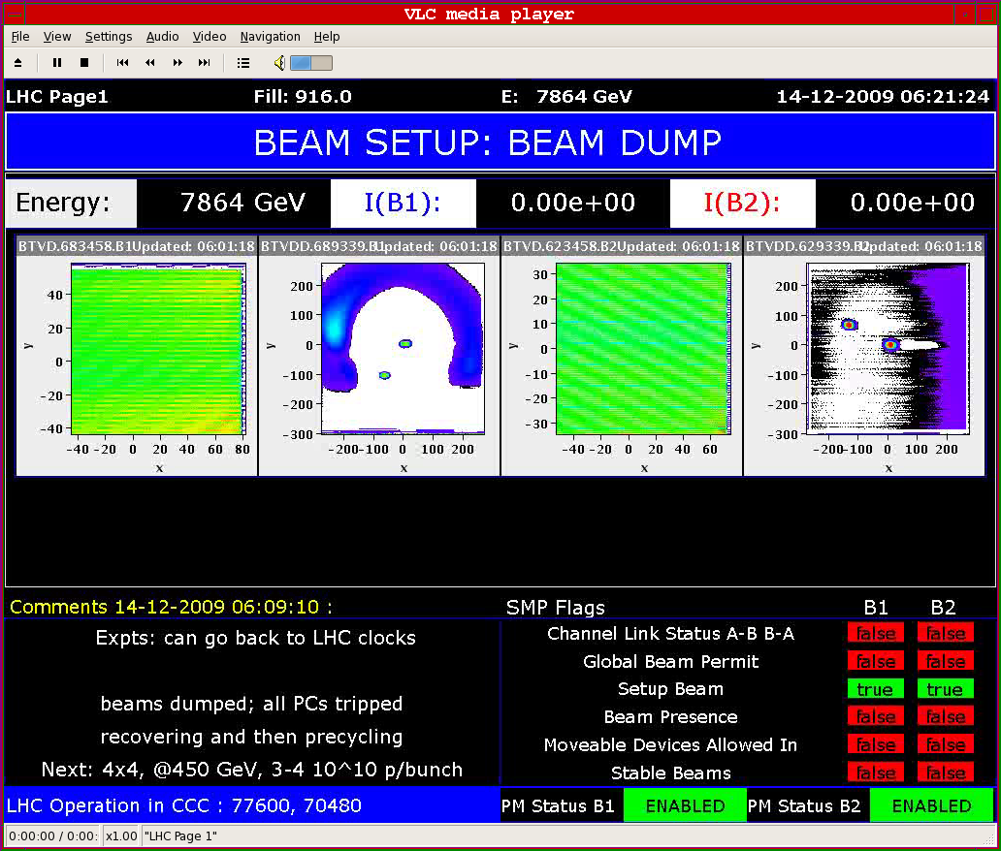
14.12.2009: Second ramp dump

Slide 19
14.12.2009: Plans for rest of year:
-MPS and beam dumping system at 1.1 TeV (end of ramp?)
-Protection devices and collimation system setup at 1.1 TeV
-intermediate energy dumps
-Finish luminosity production at 450 GeV with 16 on 16 bunches
bumps at TOTEM Roman Pots at end of fill
-Turn separation bumps on at IPs
-High intensity at 450 GeV: 16 x 5 10¹⁰ per beam
-abort gap cleaner commissioning
-Orbit bumps at synchrotron light monitor (end of fill)
-test β* knobs and squeeze at 450 GeV

Slide 20
14.12.2009: Plan for the weekend:
-ATLAS aperture re-check in horizontal plane
Other miscellaneous work:
-finish circuit polarity checks
-finish kick response measurements
-orbit feedback commissioning
-nQPS quench threshold test with beam (bunch intensity < 2 10⁹)

