Slide 1
Yesterday
Power back around lunchtime
Access until 12:30
Totem winkled out last
QPS tests on sector 12
Pre-cycling interruptus by re-energization of SVCs around the ring
Access (6 & 4) again for beam dump in the shadow
20:15 Pre-cycle again
22:15 Beam circulating again

Slide 2
Overnight
Aperture checks in IR8
Loss cyro instrumentation ROFA45.B2
temperature monitoring – masked, to be superlocked
force cryo start cryo maintain
Beating team started, finished at 8:15
Collimators in coarse, BLMs in 3 & 7 unmasked
Number of problems with LBDS
sync problem with BETS
XPOC failure
IPOC – retriggering
LBDS be woken up all night
similar problems this morning

Slide 3
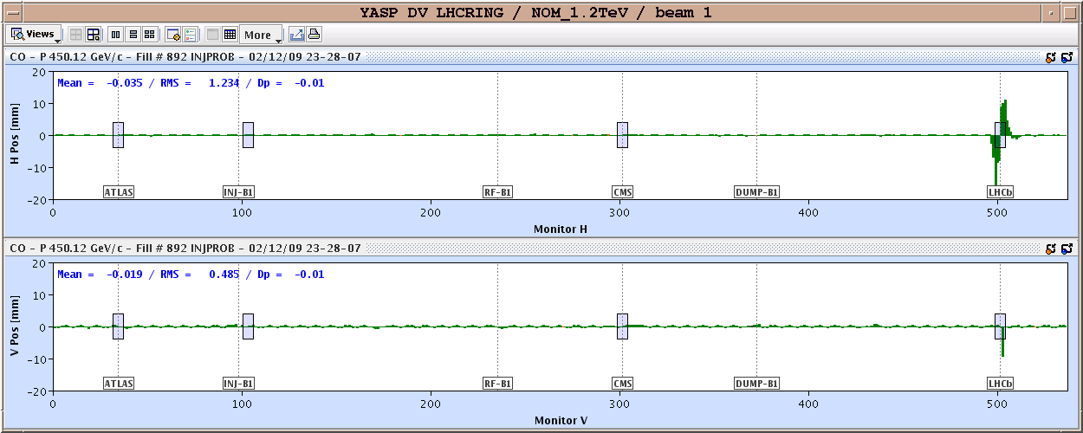
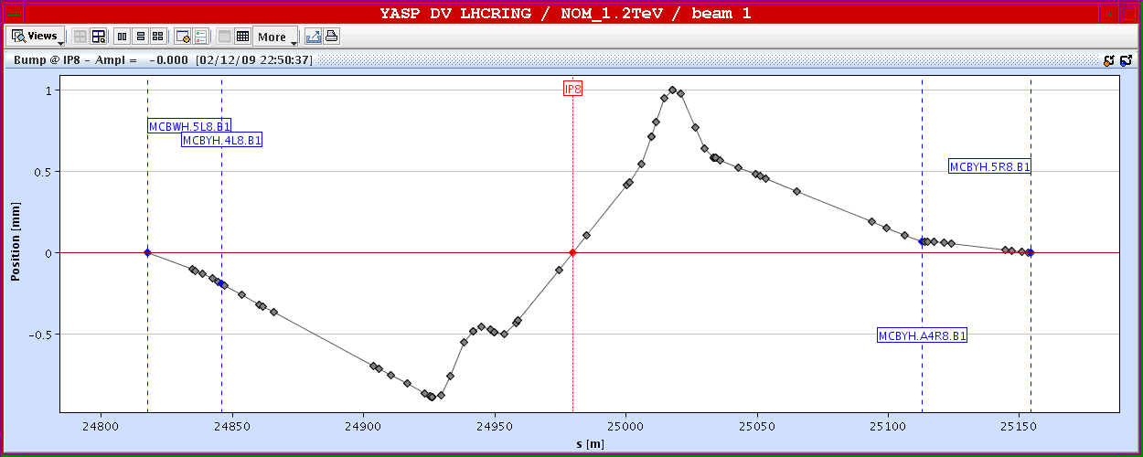
aperture IR8

Slide 4
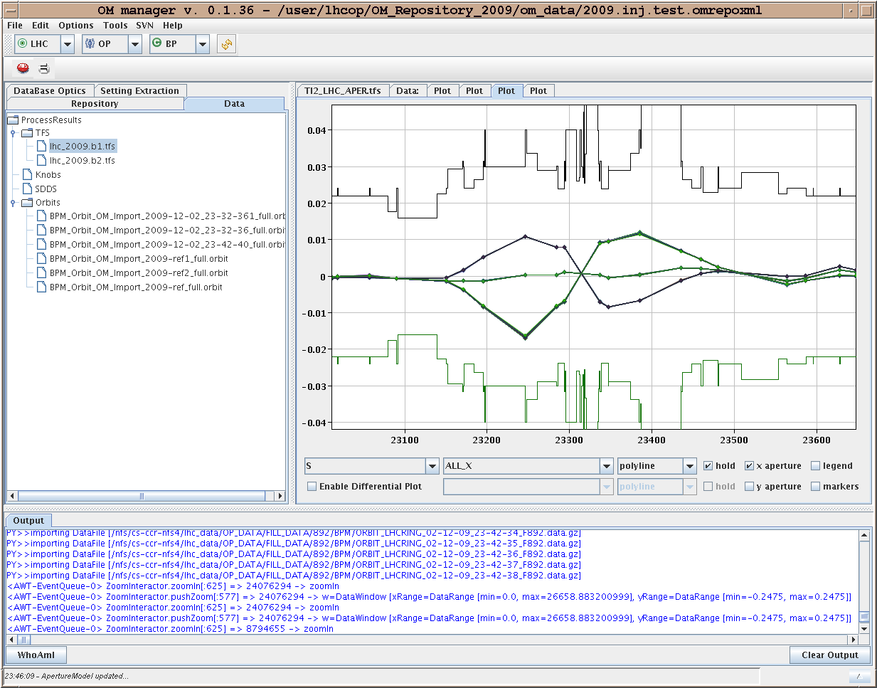
Example

Slide 5
Beating
Beta-beating experiment finished for now... 1. Beam 1 has a positive effect from the corrections applied. 2. Need to understand IR7 results more carefully for Beam 2. All trims and tunes reset to initial settings.
Off line analysis to follow
Capture not used

