Slide 1
Summary of Week 4 pPb physics
Machine Coordination:
Mike Lamont & Jan Uythoven
Ion coordination: John Jowett

Slide 2
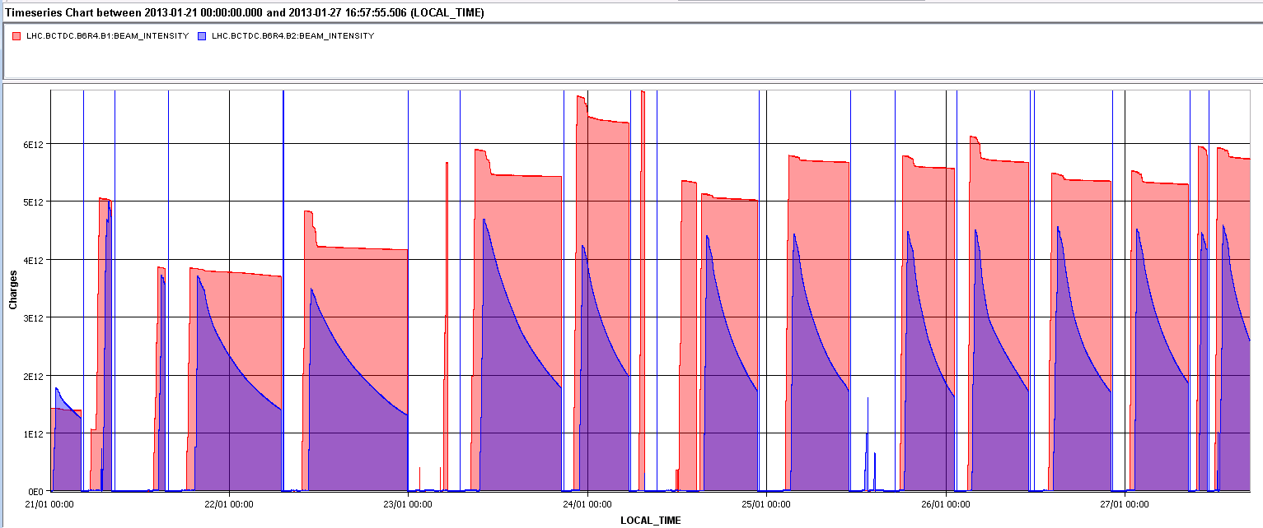
The week in beam currents
Pb: large burn off
Protons no burn off in collision
5e12 charges
BPMS limit
Dumps RF manip
Pb 248 bunches
Back to 338 bunches, all dumps by BPMS low intensity limit ions
Access
SPS problems
UFO ALICE ?
Struggle with beam SPS and QPS problem
PS POPS

Slide 3
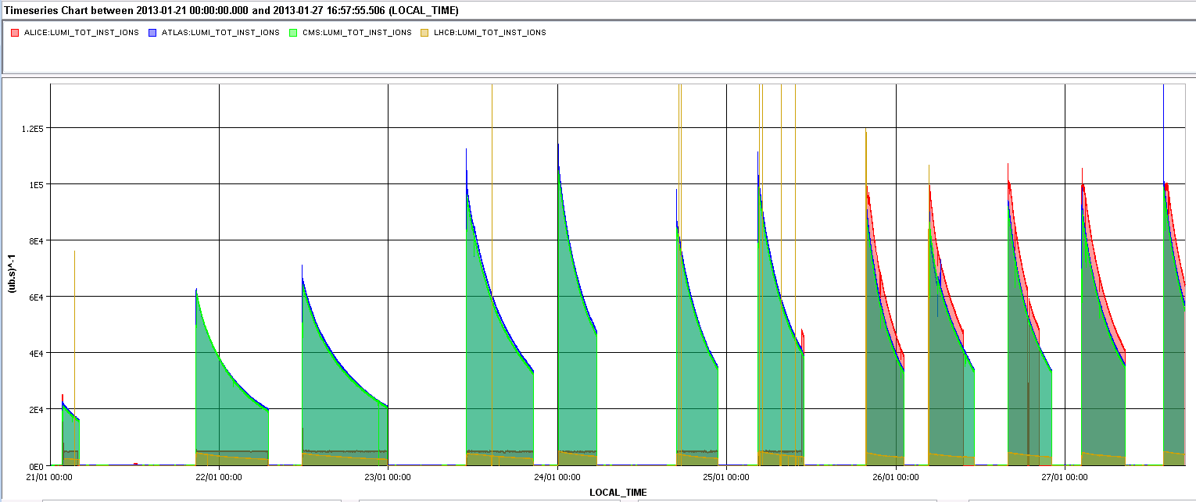
Lumi’s over the week
ATLAS & CMS
1e29 cm-2s-1
ALICE finished low-bias data taking on Thursday
LHCb

Slide 4
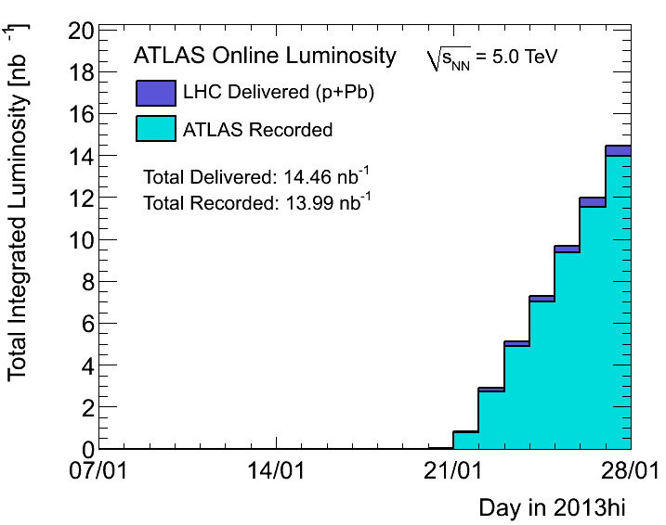
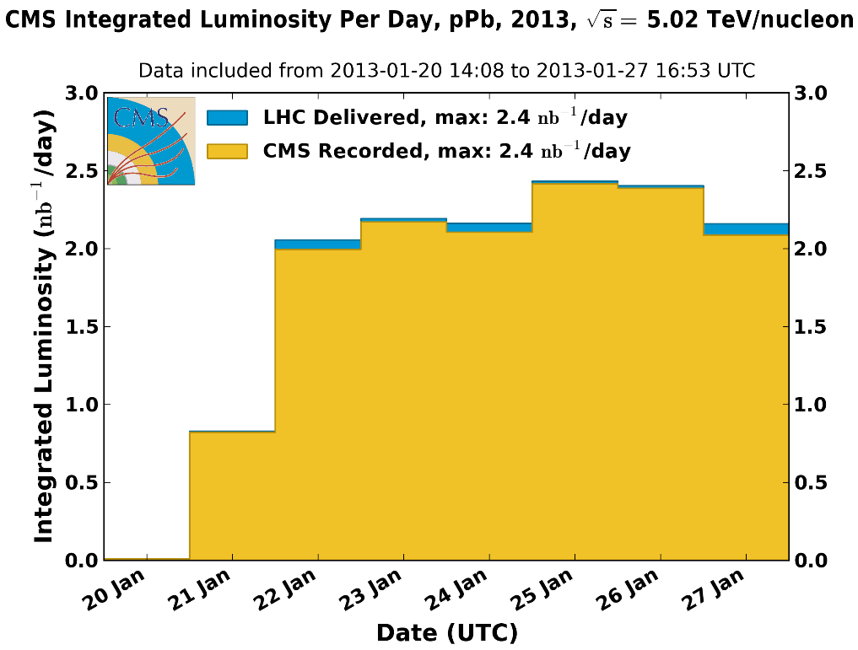
Production of 2 nb-1 / day

Slide 5
Fill statistics – ALL fills
Fill | Day | Peak L [cm-2s-1] | Stable beam [h] | Int L [nb-1] | Dump
3479 | 21/01/2013 | - | - |  | RF cogging
3480 | 21/01/2013 | - | - |  | RF cogging
3481 | 21/01/2013 | 6.10E+28 | 10:11 | 1.2 | Operator
3482 | 22/01/2013 | 6.40E+28 | 11:55 | 1.5 | BPMSA.B4R6.B2
3485 | 23/01/2013 | 1.00E+29 | 09:23 | 1.9 | BPMSA.B4R6.B2
3486 | 24/01/2013 | 1.10E+29 | 05:27 | 1.35 | BPMSA.B4R6.B2
3489 | 24/01/2013 | 8.44E+28 | 05:59 | 1.1 | BPMSB.B4L6.B2
3490 | 25/01/2013 | 1.00E+29 | 06:29 | 1.4 | BPMSB.B4L6.B2
3493 | 25/01/2013 | 9.50E+28 | 05:17 | 1.1 | BPMSB.B4L6.B2
3494 | 26/01/2013 | 8.50E+28 | 06:21 | 1.1 | BPMSB.B4L6.B2
3495 | 26/01/2013 | 9.50E+28 | 06:11 | 1.2 | BPMSB.B4L6.B2
3496 | 27/01/2013 | 9.00E+28 | 06:02 | 1.2 | BPMSB.B4L6.B2
3497 | 27/01/2013 | - | - |  | UFO ALICE?
3498 | 27/01/2013 | 1.00E+29 | 06:11 | 1.4 | Operator
 | Polarity change
47 % in Stable Beams, Total Lumi 14.4 nb-1

Slide 6
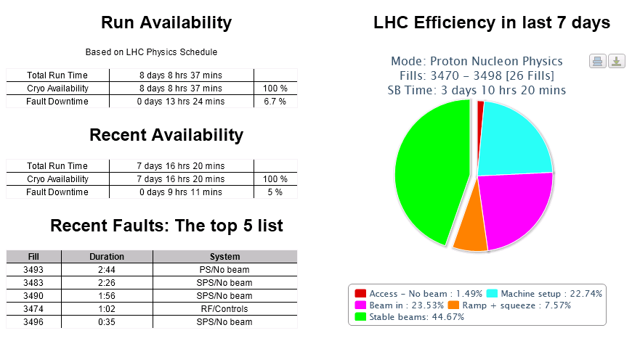
Excellent availability – stats pages

Slide 7
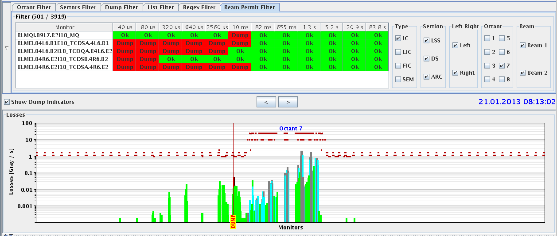
RF cogging / BLM thresholds
First fills of the week beams dumped on BLM losses 9L7.B2 at moment of frequency change to bring proton and ions beams on the same RF frequency.
BLM thresholds pushed up at quads 7, 9, 11 R&L at 7
B2
Shower from primary collimator

Slide 8
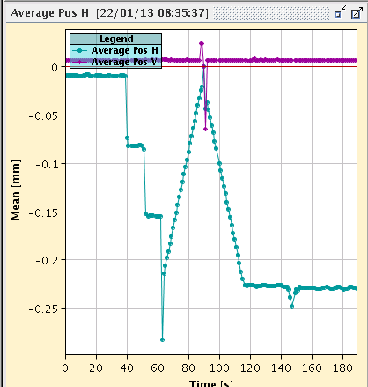
… source of the problem: understood
Protons and ions injected at their central frequency
Moving frequencies to ‘common’ mean value at 4 TeV, so later on one can make collisions
This moving of the frequencies is done in steps
command "lock both frequencies on beam 1" was executed while the frequency trim was still on going.
A pause was added and no overshoot anymore
Overshoot in mean orbit
Orbit evolution during cogging and re-phasing.

Slide 9
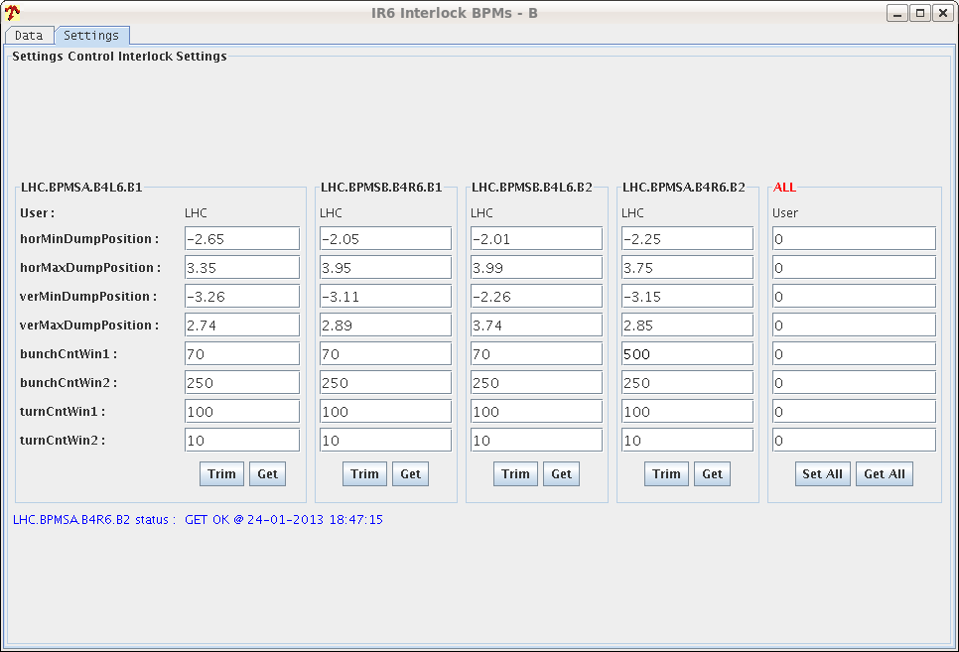
BPMS interlock
BPMSs are interlocked BPMs at point 6 which check that the orbit is such that the dumped beam will pass through the dump channel
Interlock set at +/- 3 mm
4 BPMSs for each beam at either side of IP6
For low (ion) intensity the signals become noisy and bunches are seen outside the window
Happens between 3 – 4 e9 charges for the ion beam
Interlock per ‘window’
100 turn window increased count 70 -> 500 -> 2000 false counts on one BPMS
After this change this specific BPMS did not trigger anymore but the next one did…

Slide 10
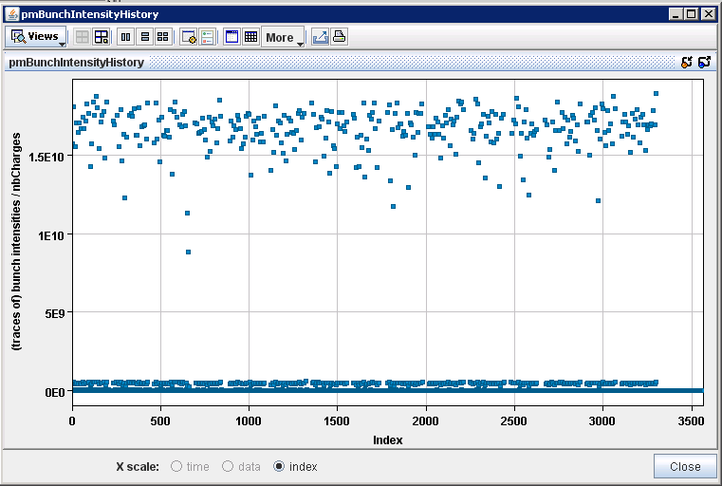
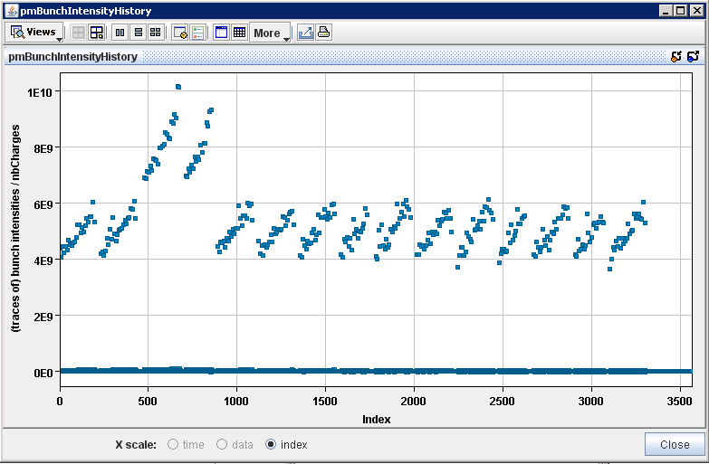
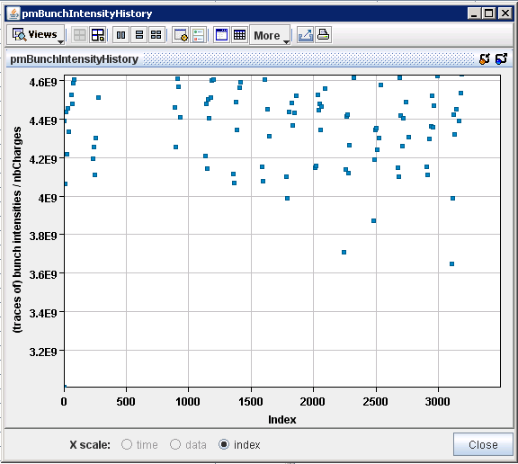
23/1/2013 @ 20:30:38 IR6 BPMs analysis
B1 and B2 bunch charges
B1
Eva Calvo
Zooming vertical axis
B2
3.65p/bunch
25-10-2013
LHC status

Slide 11
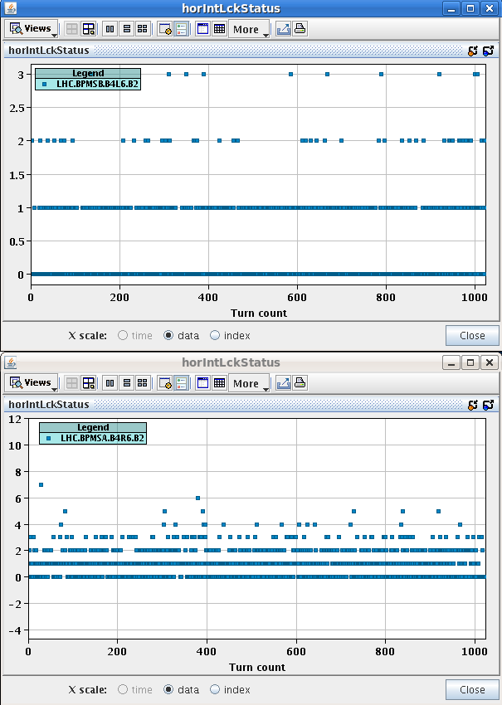
Dump of fill 3494
This BPMS dumped
BPMSB.B4L6.B2 70/100
Would have dumped if window not changed
BPMSA.B4R6.B2 2000/100

Slide 12
Roman Pots – moved in
Modified sequence for moving in the pots tested with the specialist: OK
Since then both TOTEM and ALFA moved in at the beginning of the fill by the operation crew
Vertical only at 13 σ
Proton side only
Loss maps made with pots in
No problems so far

Slide 13
Longitudinal blow-up at injection
At injection, to reduce increase of transverse emittance
1.4 ns target
Worked after some testing during injection steering
Observables
Initial lumi: does not seem to be match larger. Not really gained.
BSRT / BGI: needs further analysis, no absolute calibration

Slide 14
ALICE UFO (?) / BPMS / Polarity reversal

Slide 15
ALICE polarity change: last night
ALICE spectrometer polarity change.
External crossing angle changes in collision: needs set-up of collimators at IP2 (TCTs).
First cycle:
No beam: change polarity, change target external Xing in physics.
Inject. Correct H orbit by hand, incorporate into ramp GRADUAL_OUT (~almost like 1/E).
Run through the cycle with a few bunches up to end of squeeze. Orbit FB will take care of any residual error up to end of squeeze.
3 minute test on FT to calibrate the BPM scale with RF frequency trims (for energy calibration).
Run collision BP, TCTs in IR2 to be handled separately, I recommend opening the TCPs temporarily to 6 sigma to avoid losses from the orbit change. The H orbit in physics will require a correction. Find collisions in IR2 (if needed). Incorporate back orbit trims (! rule).
Align the TCTs around the new orbit in IR2. Perform loss maps etc
Offline:
Prepare new TCT functions for IR2 (collision BP).
Update all orbit and COD interlocks (SIS+Kajetan).
Feed-forward orbit RT trims (if worthwhile).
Second cycle:
Validation of corrections and TCT functions. Test on FT.
Jorg and collimation team

Slide 16
Last Night
20:10 Operator dump
22:47 Ramp for collimator set-up, orbit, lumi, TCTs
Took 15 mins to align 4 IP2 TCTs
01:30 Loss maps
Full set of betatron loss maps performed (preliminary analysis: all OK), as well as negative off-momentum loss map
02:39 Beams dumped by negative off-momentum loss maps
03:33 Lost RB.A12 power converter fault
04:15 Cycling
05:25 Water circuit problem affects the booster, no protons
07:23 Beam back
07:57 Ramp started
Now
Another low intensity ramp for IP2 collimator validation and positive off momentum loss map
Followed by preparation for VdM scans

Slide 17
The Plan
Shorter term plan
Polarity change – done
Verification fill with low intensity and loss map: on now
V/d Meer scans = today
Ion source refill – Wednesday
pPb to Pbp change – about Thursday / Friday
Between ion source refill and quench tests in 2 weeks:
pPb physics ! Possibly pp intermediate energy run
ADT set-up for quench test preparation: 4 – 6 hours
BSRT tests at 450 GeV few hours with few trains of 1.4e11 bunches
In parallel dump B1 at injection with high intensity trains for pick-up test
Real time squeeze test (beta* levelling) – 4 hours
Longitudinal damper tests, at injection, 1 beam only, 2 – 4 hours
Mon 11th Feb: quench tests for 48 hours
Bye-bye-beam

Slide 18
Access
Access requests:
Wire scanner, J.Emery, point 4, 2 hours.
Collimators UJ33, test position sensors, M. di Castro, A.Masi, 20 minutes.
“Train”, B.Feral, D. Paulic, PM56/UL55, 1 h during working hours
BGI, M.Sapinski, R4, ½ h
LHCf has a problem in a part of the frontend electronics placed in the tunnel, we would like to ask a two hours access at the next opportunity in the shadow of the other activity. Takashi Sako
Quench Test on Q6.L8 – the scope is not yet in place, 1h in the UA. Mateusz Bednarek
CMS cryogenics – filter to be cleaned
Ludovic Mourier 165232 Restore pump for QRL insulation vacuum in sector 45 (which has a leak)
LHCb – 3 hours
ODH detector is in ALARM in UJ1
Up to the next coordinators: Bernhard Holzer, Jorg Wenninger
After V/d Meer

