Slide 1
Wednesday 23rd January & night
07:05 Injecting probes
11:00 stable beams fill 3485
initial lumi in ATLAS and CMS ~1e29 cm-2s-1 !
ALFA and TOTEM Roman Pots moved in
20:30 Beams dumped due to low intensity B2 bunches resulting in BPMS interlock. Integrated lumi 1.9 nb-1 in 9h23m.
21:00 Test of TOTEM RP sequences by Mario: OK
22:00 Injecting for physics
22:27 FBCT B1 lost the phasing, David coming.
Quick and dirty fix, to be followed up today
00:06 Stable Beams – turn around of 3h36m
Initial lumi 1.1e29 cm-2s-1
00:11 ALFA moved in
05:34 Beams dumped due to BPMS B2, again
1.35 nb-1 in 5h329m
06:48 Injecting for physics
07:40 QPS triggered on RQX.L8; beams dumped, expert checking

Slide 2
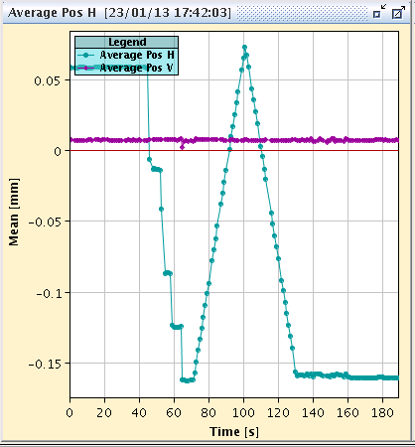
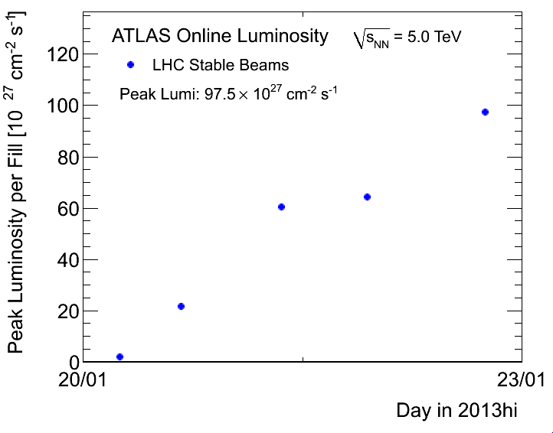
Fill 3485
No overshoot anymore in frequency shift exercise at flat top
New record lumi’s with nominal filling scheme of 338 bunches: 1e29 cm-2s-1 !

Slide 3
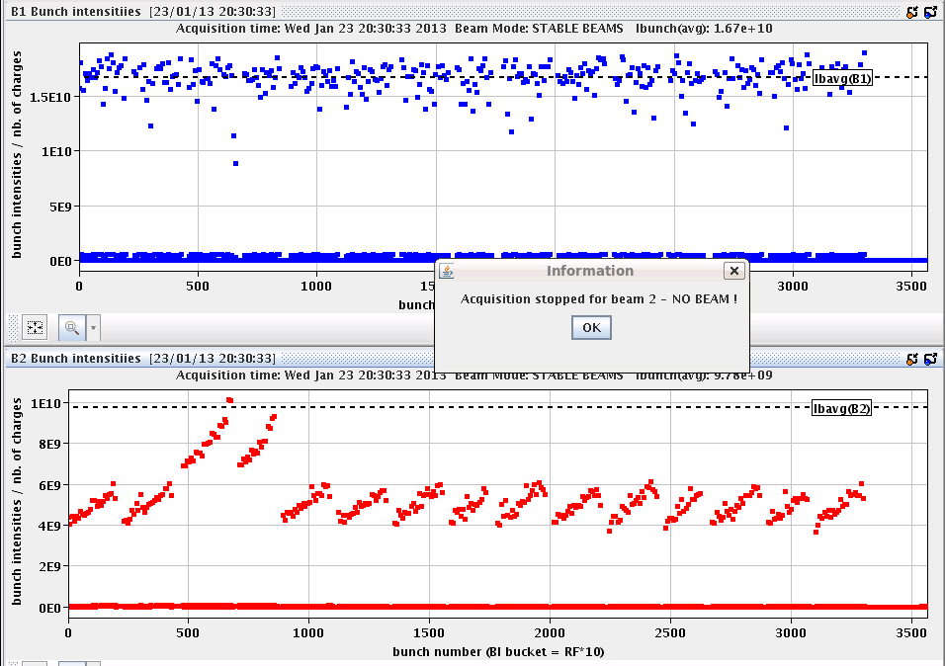
BPMS point 6
After attenuator intervention in TS4, the expected minimum bunch intensity was around 0.8-1 e9p/bunch
However, we seem to have dump just below 4e9 charges/bunch
Yesterday seemed to be around 3e9 charges/bunch
Under investigation by the experts

Slide 4
Various
Get better understanding of BPMS B2 interlocks at higher bunch intensities than expected
Wire scanners not to be used until checked in tunnel
V/d Meer scans next week Mon/Tue
Access requests:
Wire scanner, J.Emery, point 4, 2 hours.
Collimators UJ33, test position sensors, M. di Castro, A.Masi, 20 minutes.
“Train”, B.Feral, D. Paulic, PM56/UL55, 1 h during working hours
BGI, M.Sapinski, R4, ½ h

