Slide 1
Monday 21st January & night
05:20 Injecting 338 bunches/beam fill 3479
08:13 Dump on BLM losses 9L7.B2, during change of RF frequency at flat top to common RF frequency.
09:00 Access for LHCb who can't take data.
11:20 Cycling.
14:00 Filling for physics 200ns_270p_248Pb_15inj24bpi.
15:21 Second dump due to losses on BLM 9L7.B2 during RF frequency change. Increase BLM thresholds.
18:15 Injecting physics beam
20:47 Stable beams fill #3481
06:58 Beam dumped by operator
Filling for the same again, proton intensity bit larger (2e10)

Slide 2
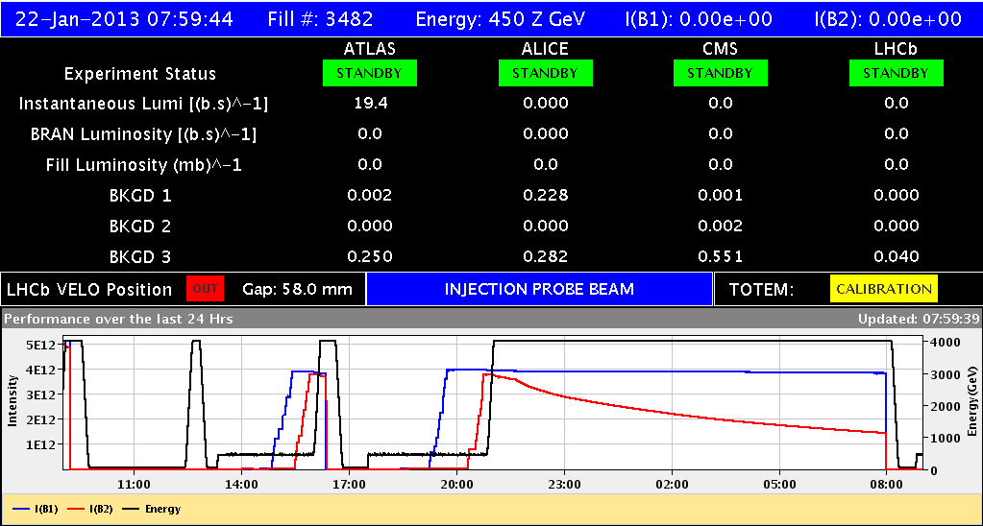
Finally …
Vistar time stamp 1 h out

Slide 3
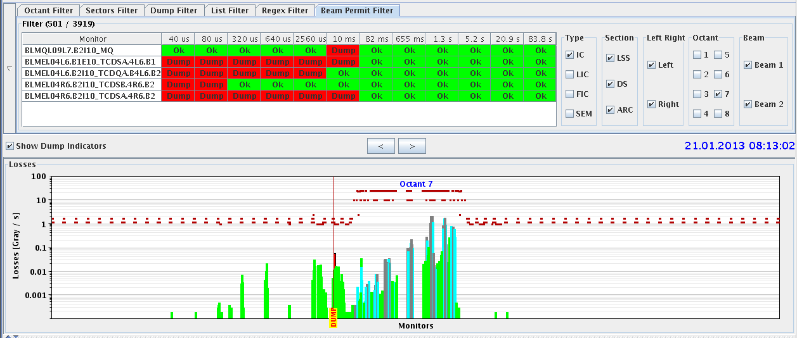
Fill #3479
Beams dumped on BLM losses 9L7.B2 at moment of frequency change to bring proton and ions beams on the same RF frequency.

Slide 4
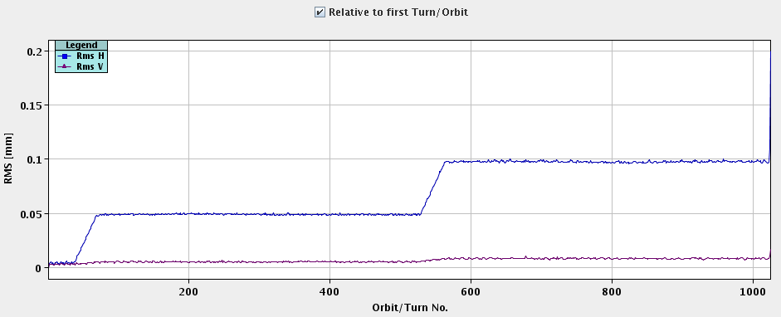
Fill #3480
Changes:
RF frequency changes in 3 steps with pause of 10 s in between
Rate of change slowed down by factor 4
Changed filling scheme to 200ns_270p_248Pb_15inj24bpi
extrapolating from fill o-night should not reach dump threshold
Dumped again on same BLM on third frequency step
1 unit = 20 ms

Slide 5
Fill #3481
Increased BLM threshold (monitor factor) factor 3
- BLMQI.09L7.B2I10_MQ (0.1 -> 0.3) - BLMQI.11L7.B2I10_MQ (0.1 -> 0.3)
Some scraping of beam in the SPS
It passed… just:
Before dumped on RS 10 ms

Slide 6
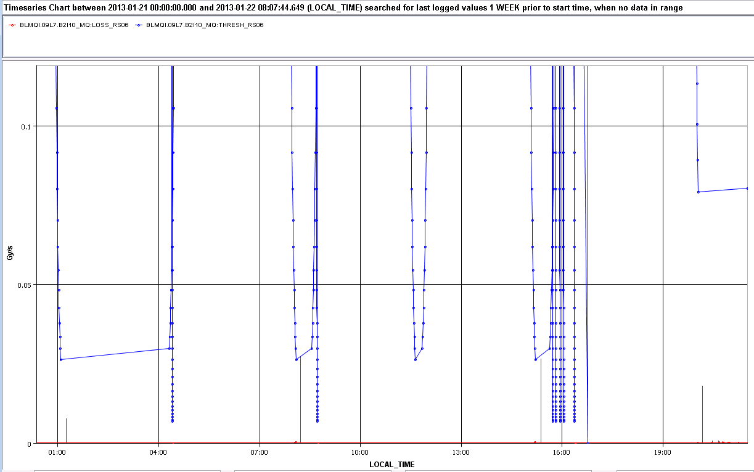
The Plan – needed to increase #bunches
Increase the limits of the other BLMs in the same way
Q15, Q17, …
Further slow down frequency trim – split third step ?
Move orbit and/or collimators slightly at the primary ?
120 Pb
338 Pb
248 Pb
248 Pb
BLM limit
BLM loss

Slide 7
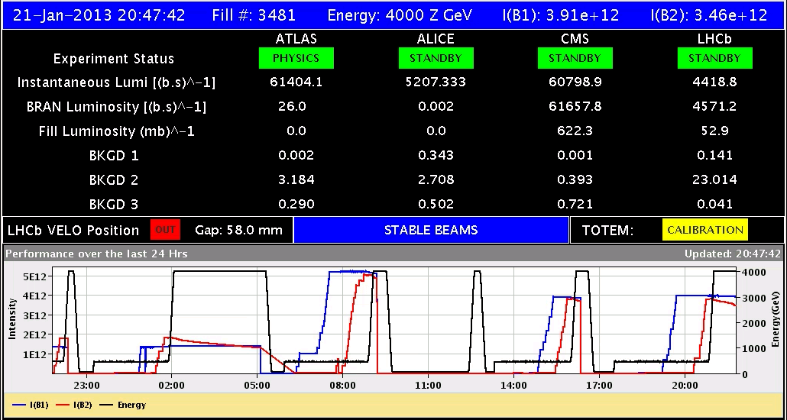
Stable beams
Alice came in too high – adjusted for next fill
incorporated +10 um in the separation for ALICE
ALICE luminosity signal for leveling is quite noisy ….

Slide 8
Various
Wire scanners not to be used until checked in tunnel
Preparing for moving in Roman Pot during physics
V/d Meer scans next week Mon/Tue
Access requests:
Wire scanner, J.Emery, point 4, 2 hours.
Collimators UJ33, test position sensors, M. di Castro, A.Masi, 20 minutes.
“Train”, B.Feral, D. Paulic, PM56/UL55, 1 h during working hours
BGI, M.Sapinski, R4, ½ h

