Slide 1
Summary of Week 49
Machine coordination:
Jorg Wenninger & Jan Uythoven
Scrubbing coordination:
G. Arduini, H. Bartosik, G. Iadarola, G. Rumolo

Slide 2
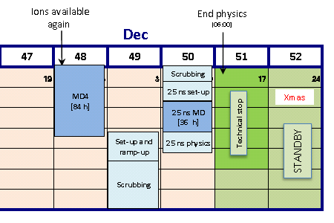
Physics and Scrubbing
Week 49
3 days of physics: 50 ns bunch spacing
4 days of scrubbing with 25 ns bunch spacing

Slide 3
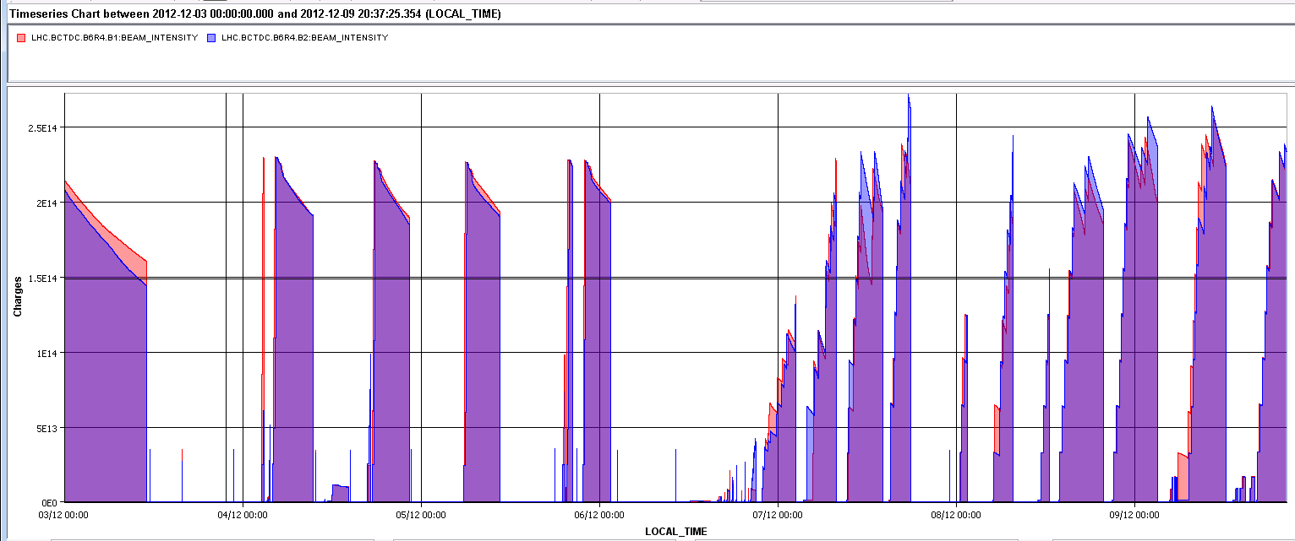
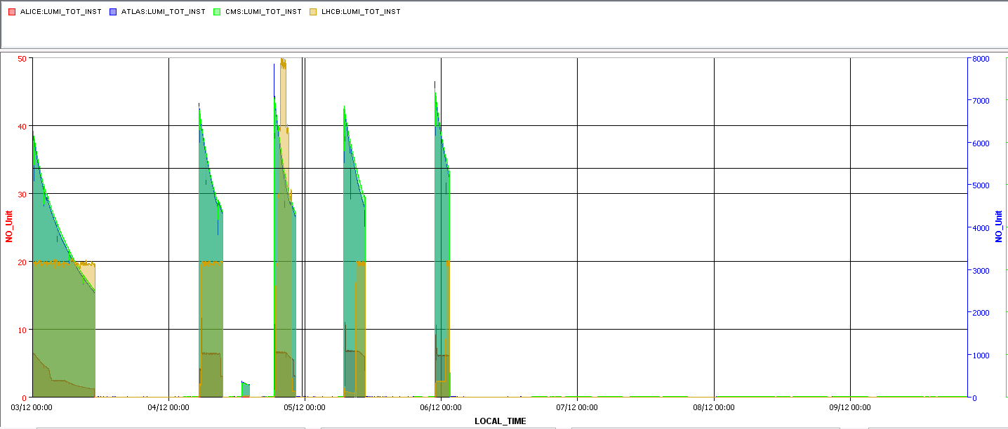
Beam currents and luminosity
2.5e14
2e14
TDI HB RF TED
ATLAS & CMS 7e33 cm-2s-1
LHCb 1e33 cm-2s-1: all holding !
ALICE peak at 10e30 cm-2s-1, level at about 6.5

Slide 4
Fills of the week
Fill | Day | Peak L [cm-2s-1] | Stable beam [h] | Int L [pb-1] | Dump
3363 | 02/12/2012 | 7.00E+33 | 11:36 | 167 | Operator
3370 | 04/12/2012 | 6.80E+33 | 4:02 | 77 | SIS communication
3372 | 04/12/2012 | 3.40E+32 | 1:15 | 1.2 | Operator
3374 | 04/12/2012 | 7.00E+33 | 3:42 | 70 | RF
3375 | 05/12/2012 | 6.80E+33 | 3:39 | 72 | RD2.R5
3378 | 05/12/2012 | 7.20E+33 | 2:31 | 55 | QPS RB.A81
Total |  |  |  | 442
442 pb-1 in about ½ week is below the average 1 fb-1 per week.
Explained by problems with TI2 TED and TDI

Slide 5
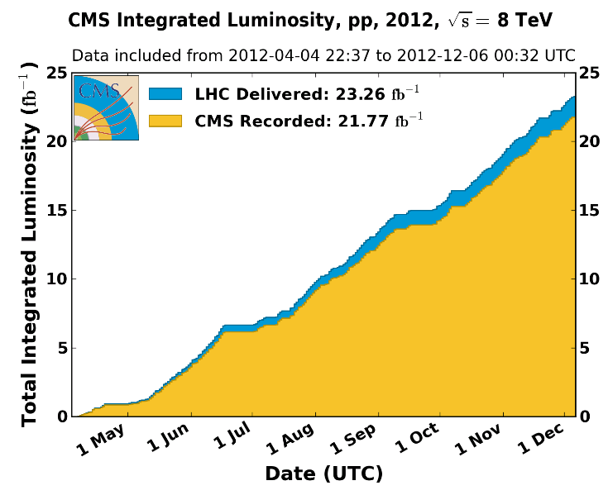
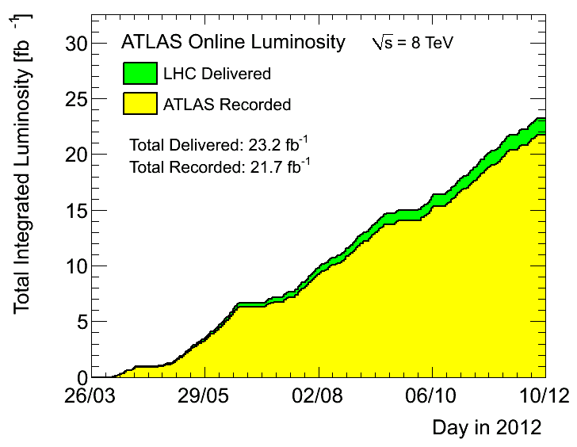
Total Lumi’s 2012 (so far?)

Slide 6
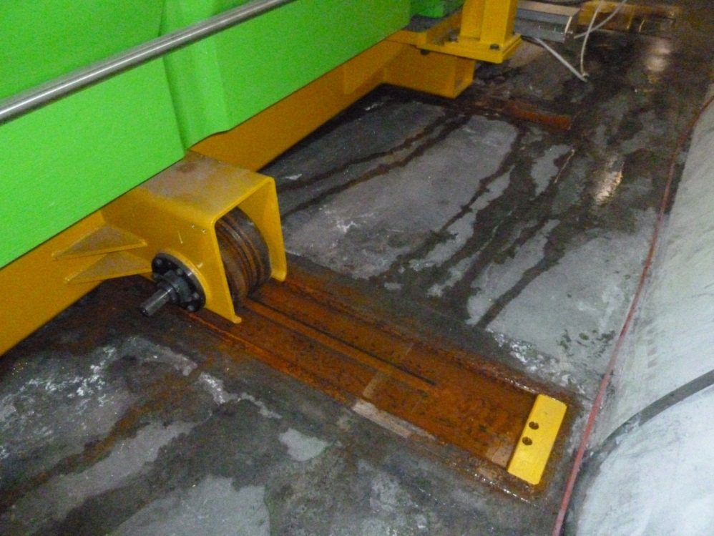
TI2 Beam DUMP (TED)
Is ‘rolled’ in/out of the beam when required
Saturday 1st December: motor can’t move it anymore
Special procedure in place to give access to the LHC as the TED is one of the three “Element Important de Sécurité” (EIS).
About 4 hours overhead to give access
Fixed on Wednesday
Took away the torque delimiter and the rust
OK since

Slide 7
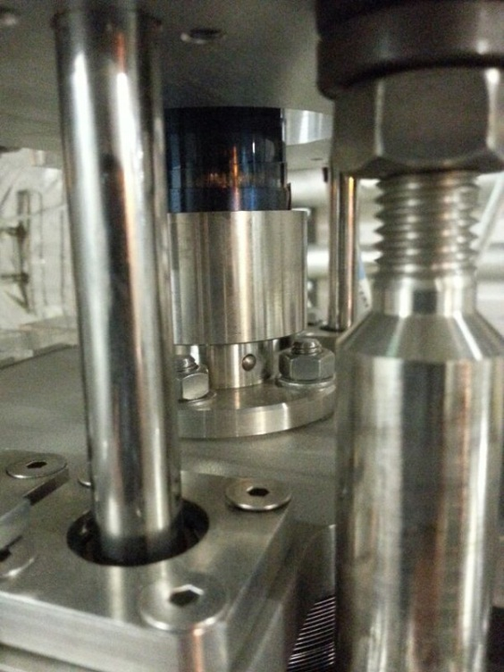
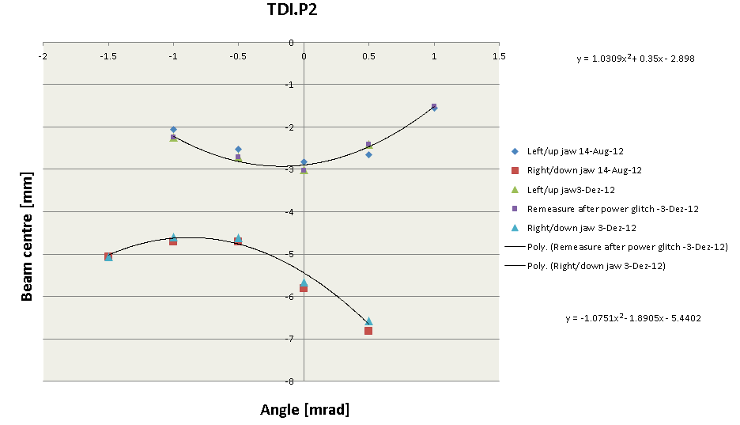
TI2 injection absorber TDI
Pin?
On Monday moving from parking to injection the upper jaw, upstream part literally fell into the beam aperture
Pin got loose
Pin relatively easily put back & scotched
Needed a late night of injection team to check alignment with beam
Found back position and angle from last summer
All ok again (largest error of single measurement 0.25 mm)
On Wednesday pins professionally secured
In point 2 and point 8

Slide 8
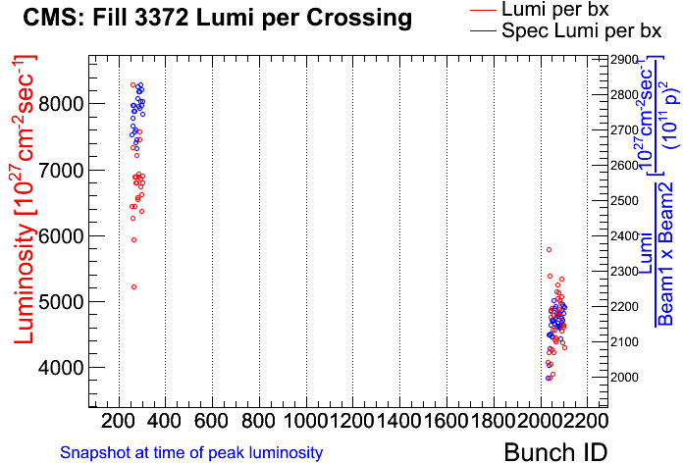
Injector High Brightness Beams (or BCMS)
About 30 % gain in specific luminosity !
High brightness beams from the injector chain
Very interesting option for 2015 operation, both 50 ns and 25 ns beam spacing
Fill with one batch HB and 1 batch ‘standard’ 50 ns
Emittance for HB beam ~ 1-1.2 um, standard 1.4-1.6 um.

Slide 9
Scrubbing
Week 49
3 days of physics: 50 ns bunch spacing
4 days of scrubbing with 25 ns bunch spacing
Week 50 coordinators
Bernhard Holzer, Mike Lamont & 25 ns team
Access now:
Semi-urgent access for ATLAS & QPS, TDI.R8 stuck when to parking

