Slide 1
Wednesday 21st November
Access in PM76 to recuperate chopped up cable bits....(EN-EL)
Opening PM76 again - RP need a short access.
12 V survey on the LBDS system is working correctly now. No access needed. (Etienne Carlier)
RF testing for the pPb MD – Daniel Valuch
Investigation of RB.A23 event following trip the previous night:
Result for device RPTE.UA27.RB.A23 : ACT :FREE WHEEL THYRISTOR ON :FAULT : : several old QPS have the quench heaters discharged

Slide 2
Summary of the current status of RB.A23:
QPS SUMMARY:
QPS reaction last night RB.A23: Due to some perturbations well visible in V_MEAS, the thresholds of some QPS detectors were exceeded. As a result 6 dipole magnets have got fired heaters (A18;B11;A17;B26;B20;C13)R2.
DS buffers from nQPS units(10,11,13,17,18,27) R2 have been successfully read at 09:09h.
PO SUMMARY: Unable to reproduce the conditions of last night. Nothing unusual found at the level of the converter. Until we get beam back, RB.A23 is doing a cycle ramping to injection, staying 10', going back to STND BY, waiting there 10', and then going back to injection etc.

Slide 3
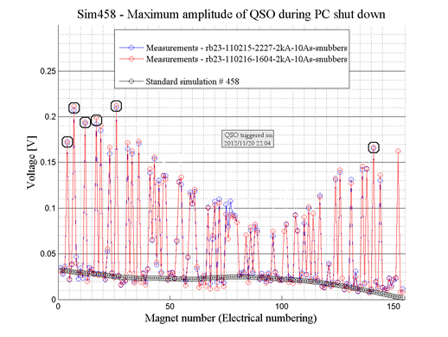
There was an oscillation observed of the current measured at the power converter. From previous studies in 2011 we know what magnets in the chain are most sensitive to such oscillations. For these magnets are the signal was above threshold and they quenched (see in the figure),

Slide 4
Summary of BPM test yesterday afternoon
The vertical electrodes of channel BPMSA.A4L6.B1-Vertical were disconnected, in order to connect a signal generator, and measure the level and location of possible reflections.
And the end of the measures, the monitor was connected back again, without any kind of change in the acquisition chain.
A small reflection was found where the CMC50 cables arrive to the rack, where the attenuators are mounted. The levels should still be further analysed.
In order to validate the system before normal operation it would be enough to make a bump close to this BPM and check the sign of the position measured (what will prove that the cables are correctly connected and polarity was not inverted).
E. Calvo.

Slide 5
Mean while in SPS
12:35 beam back in SPS…
13:40 SPS MKD switch need to be changed.. no beam before 17h
19:10 conditioning of MKD was terminated
19:15 Beam back in SPS
21:00 we call Thomas because we have a problem with the BQM. the error written on the BQM is No beam or not enough dyn range out of acq window (ftop)
22:40 After analysis Thomas reboot rephasing server. After that the rephasing work correctly one out of three times.
This situation was not sufficient for the night so he decide to recall Andrei.
Andrei Pashnin make an upgrade on rephasing software this afternoon which do not work correctly (prep. for ions).
Thomas ask him to return at the previous version and after his new intervention the BQM is working well.

Slide 6
Back in the LHC
16:10 RB.A23 flt OFF (NO_PC_PERMIT VS_FAULT)
18:10 RB.A23 active filter has been exchanged; will close and precycle
We have tested the RB.A23 over ten cycles of going to standby and back to injection level. No fault observed. The exchange of the active filter is validated. (HUGUES, THIESEN)
19:15 Cycling
22:00 Pilots in – SPS wrestling with BQM problem
Test of BPMS.A4L6.B1
Midnight – 3 indivs on flat top
02:00 adjustments finished, ref orbit established, all point optimized
Some difficulties to find collisions in LHCb, no signal from BRAN.

Slide 7
Thursday 22nd November morning
02:07 Starting TCT alignment
03:17 Collimator set-up finished
TCPs to 5,3 sigma.
Loss maps…
Overnight: Jorg, Laurette, Guy, Belen, Gianluca, Stefano

Slide 8
Summary of collimator alignment and loss maps
At flat top, TCTHs in IR8 opened to symmetric settings.
All TCTs aligned in 1 hr 10 minutes, set at 26 sigmas around new centers.
IR7 TCPs set at 5.3 sigmas, position limits set at 0.3 mm around the jaw positions of TCTs. TCP position limits loaded from beam process.
Loss maps performed (tune resonance crossing, B1 & B2, H & V) + negative off-momentum loss map (+500 Hz).
Belen Salvachua, Gianluca Valentino

Slide 9
Loss maps - Preliminary results:
B1 V: No losses at TCTs, hierarchy breakdown in IR7 (same as last VdM scan loss map), however only 1 sigma retraction between TCPs (5.3 sigmas) and TCSGs (6.3 sigmas).
B1 H: No losses at TCTs, better IR7 hierarchy
B2 V: No losses at TCTs, good IR7 hierarchy
B2 H: Loss in TCTH.4R5.B2 (similar to previous VdM scan), good IR7 hierarchy
B1+B2 neg off-momentum: losses in IR2 and IR8, similar to the last VdM scan loss map.
Belen and Gianluca

Slide 10
Thursday 22nd November morning
04:35 Beams dumped
Problems resetting post mortem
SIS channel post_mortem_machine_protection latched
Vito, on request from EiC resetted the PM_OK
Fill for the next ramp, for validation of TCT functions and to complete loss maps and asynchronous dump test.
08:00 Stable beams (3 bunches) without issue
08:10 Back to adjust
Off set scan as test
Now – async dump and re-fill for Van der Meer scans

