Slide 1
Thu 15/11 – Fri 16/11
06:58 Stable beams fill 3288. Initial luminosity ~6.6x10³³ cm⁻²s⁻¹
2 fb⁻¹ delivered to LHCb

Slide 2
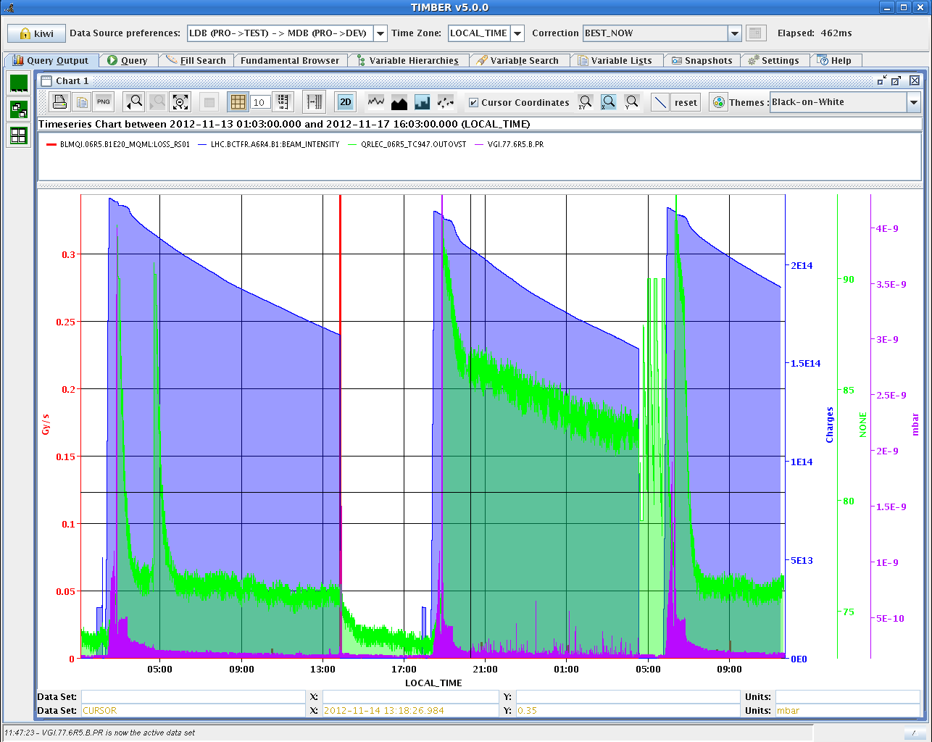
Q6R5 beam screen
Correlation roman pot movement and increased heat load on the beam screen Q6.R5? Dust? Cryo-condensation resulting from gas release?
S. Claudet

Slide 3
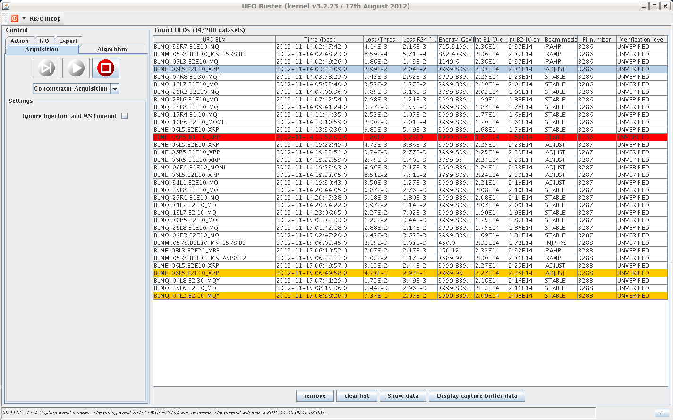
Persistent UFO activity in the area of the Roman Pot ➔ no movement of the roman pot 56-220-N-H that produced the dump yesterday until further understanding

Slide 4
Fill 3288
At the end of fill 3288 another roman pot test moving all the roman pots with the exception of 56-220-N-H
18:47-20:00: beams separated in CMS by 4 sigma and roman pot movement. OK down to allowed position of 14 sigma
20:02 OP dump 176 (ATLAS) / 170 (CMS) pb⁻¹ in 13 h. More than 21 fb⁻¹ delivered to ATLAS/CMS

Slide 5
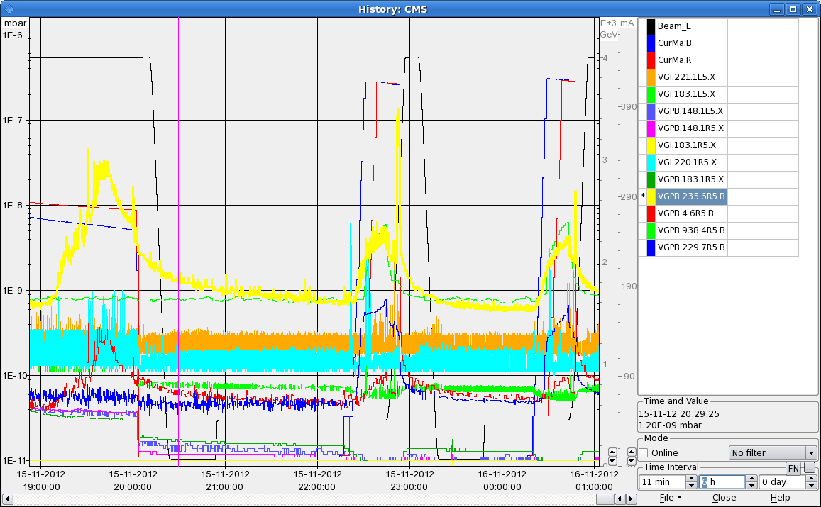
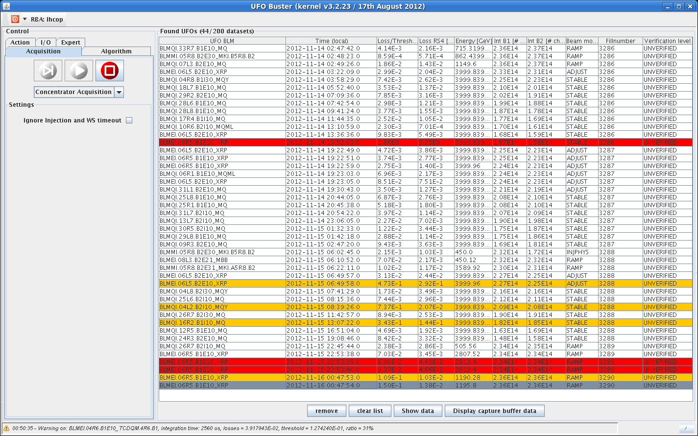
Fill 3289-3290
Fill 3289-3290. Batch-by-batch longitudinal blow-up target value to 1.1 ns (essentially OFF)
Both dumped by BLM (running sums 5.6 s and 1.3 s respectively) in Q6R5 at Roman Pots during the ramp (2.8 TeV/1.2 TeV).

Slide 6
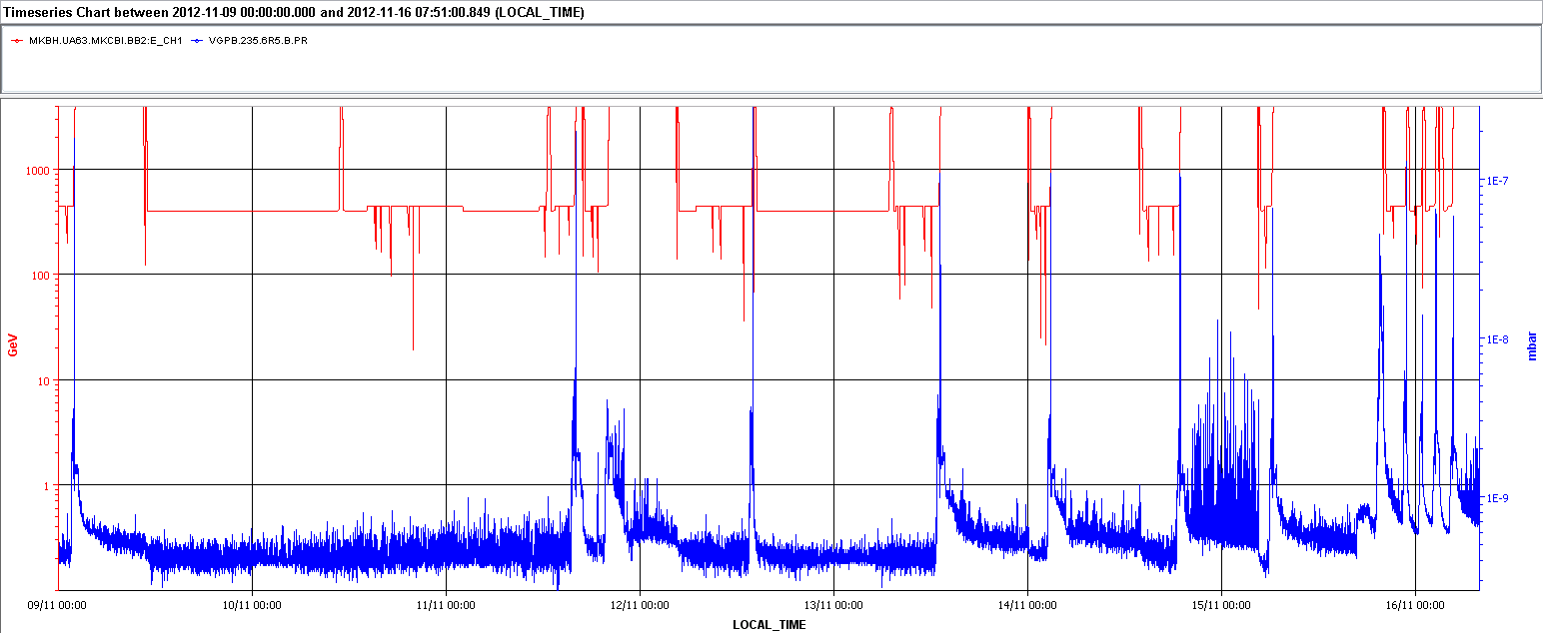
Both correlated with higher activity on beam screen Q6R5

Slide 7
Fill 3291/3292
Reduced bunch intensity to ~1.6x10¹¹ p and longitudinal blow-up to 1.4 ns
02:58 Dumped by BLM (this could be a UFO, faster time scale) in Q6L5 at Roman Pots this time
Following fill 3292 with the same conditions. This time made it through although again UFO at 2% of dump threshold during stable beams
05:16 STABLE BEAMS #3292. 6.3x1033 cm-2s-1.
First conclusion: we are not going to move the roman pots until we do not understand better the observations.

Slide 8
Plan
Physics:
Propose to postpone repositioning of the 6 bunches (B1/B2)
Parameters being scanned (one at a time):
Damper gain during the ramp to try and minimize blow-up now that gated BBQ is operational
Tune split during the squeeze to get rid of instability at the end of the squeeze
Pending access:
PM32 : CV to check / remove sand.
Access system
CMS (Hadronic Forward Calorimeter) > 1 h
BI: wall current monitor (1 h – point 4 RF zone)

Slide 9
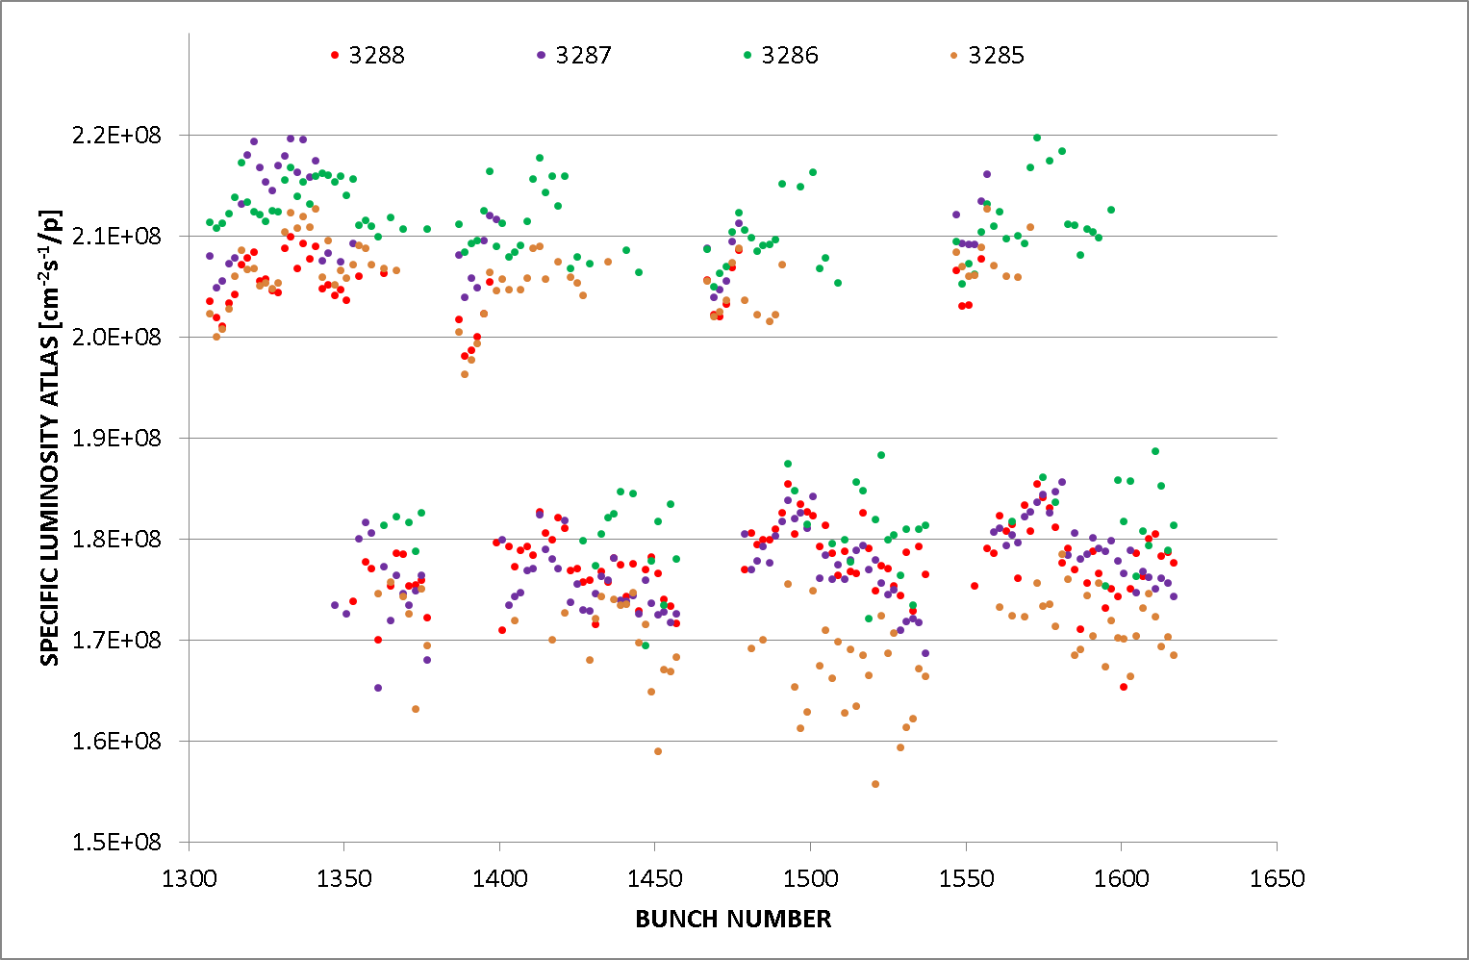
Comparison recent fills
Specific luminosity (ATLAS) at beginning of fill. In fill 3287 batch-by-batch longitudinal blow-up and suppression of tune split.
Fill 3288 re-establish tune split during the squeeze

Slide 10
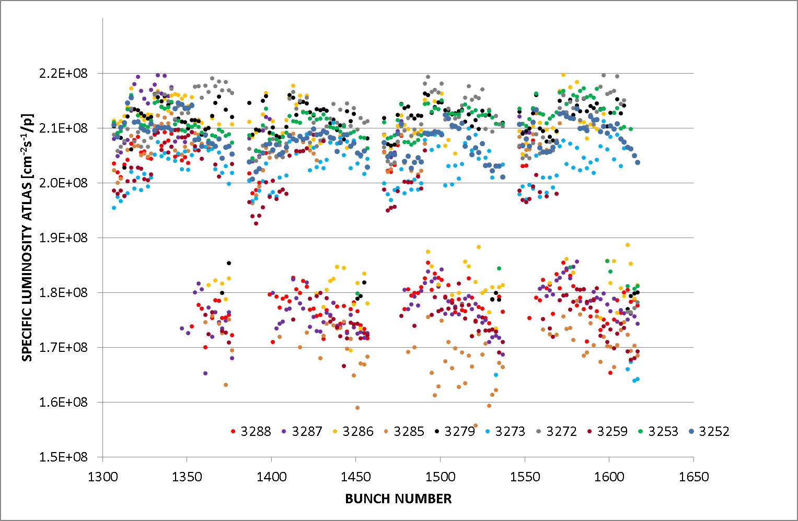

Slide 11
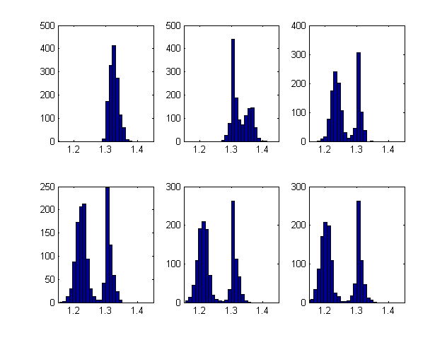
Bunch length evolution
Bunch length evolution during physics fill (B1, not observed for B2) in increments of about 2 hours. Once the bunches separate into two groups, the distribution is more or less unaffected.
The bunches with longer bunch lengths are at the beginning of each PS batch (36 bunches), slightly more on the leading one of the four. Any action from the LHC RF is on the 144 batch level.
T. Mastoridis

