Slide 1
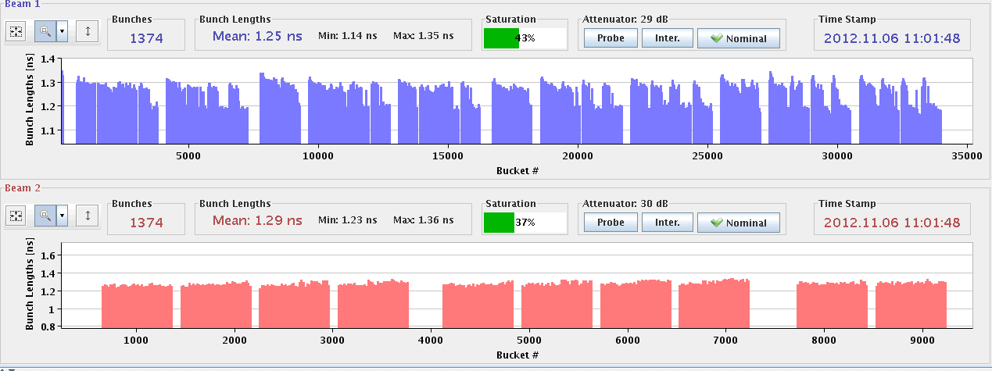
Tuesday morning
Smooth stable beams... Intriguing bunch lengths.

Slide 2
Tuesday afternoon - night
14:30: Beam dumped, spurious signal on QPS of Q9.L2.
Just short of 200 pb-1, over 16 hours of stable beams.
Access and power cycle to reset.
15:30 Access in PM85 and PM25, experiments, RF…
20:00 LHC closed, pre-cycle.
21:00 LHC at injection.
SPS wire scanners and magnets OK, but now RF power problem. And issues in the PS (PFW) and booster (RF).
01:00 ish: Problem with XPOC, energy always -1.
Resolved eventually by V. Baggiolini by restarting timing related servers.

Slide 3
Night
03:40: Yet Another Trip of RB.67.
Spurious opening of the EE system.
Apparently the same issue as last Saturday. Piquet recommends to replace the entire switch cabinet next time.
06:00 Pilot injection.

Slide 4
Beam tests
Loss maps (periodic).
TCL opening early in the fill.
TOTEM test (again).
Heating test at 450 GeV.
TCP IR3 more closed (end of fill).

