Slide 1
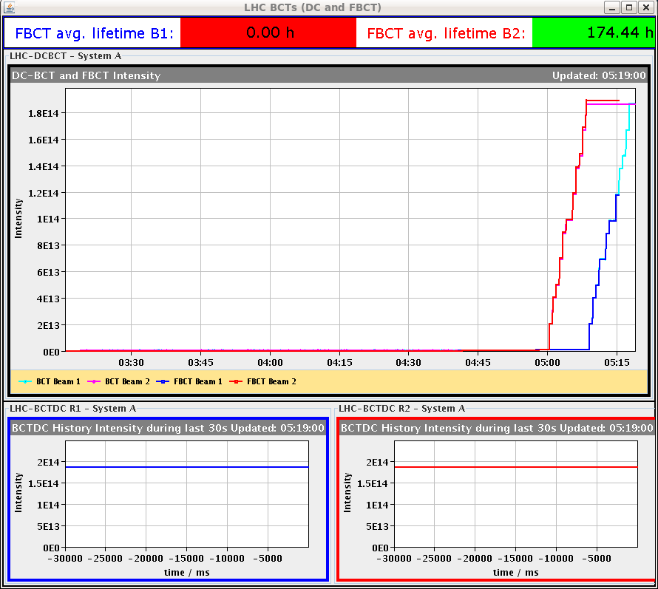
LHC Status Sunday Morning 30-Sep
Bernhard Holzer, Joerg Wenninger
05:00h injection ... 1374 x 1374
with reduced bunch intensity N_{p} = 1.4*10¹¹
06:30h stable beams
06:30h beam dump: Electrical glitch affecting UPS in Sectors 78 and 81
... lengthy repair ... including support from the UPS company piquet

Slide 2
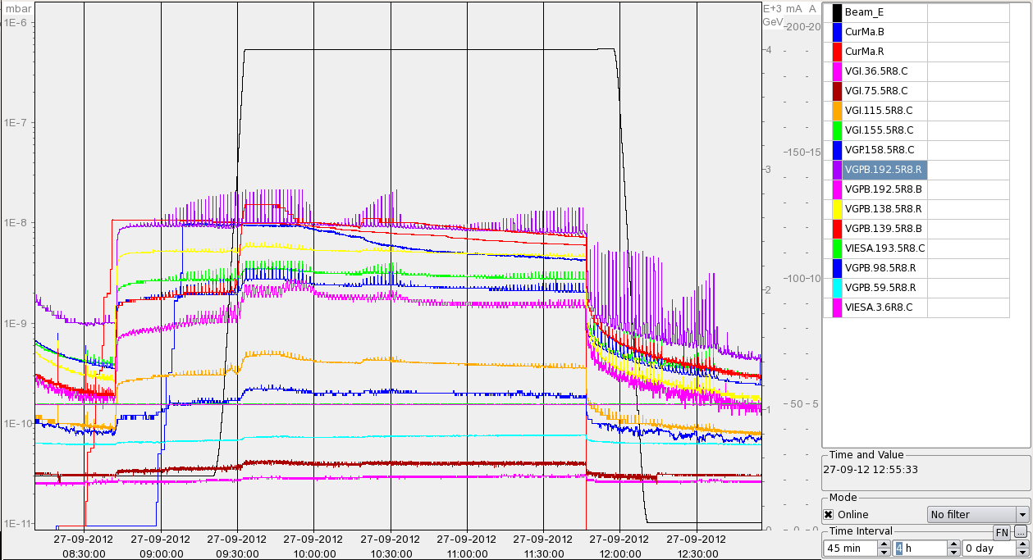
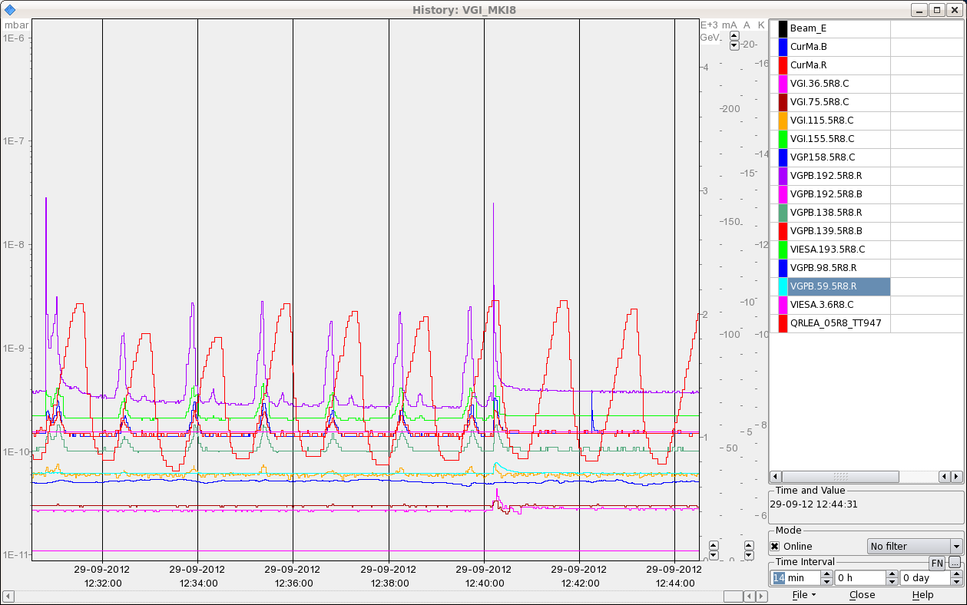
Sat Morning
in parallel to the UPS repair ...
try to improve the spiky situation at MKI8_D:
Vacuum at MKI8_D
seems to be a true vacuum measurement:
several other gauges show the same behavior,
but smaller in amplitude
1E-8
1E-9
1E-10

Slide 3
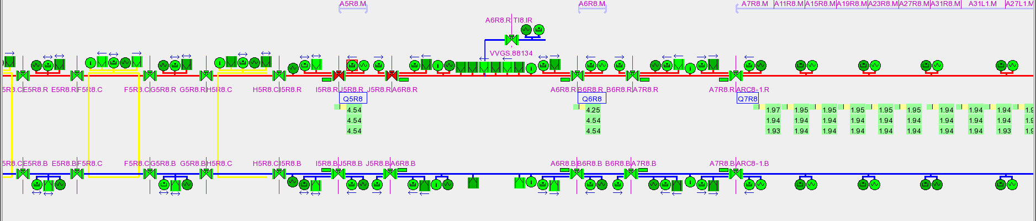
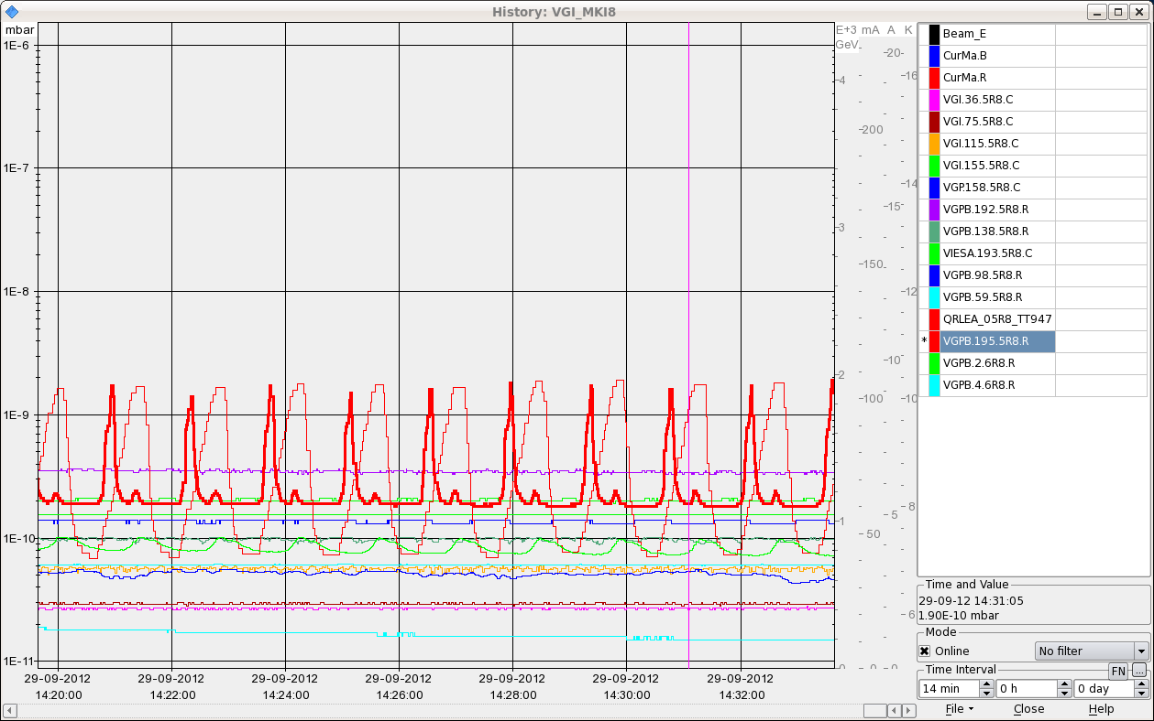
Sat Morning
isolating the section:
and correlating with beam screen temperature that varies with the same
time scale between 5 and 15K.
After consultation with Vincent B. and Udo we decide to close the valves around
Q5 and perform a thermal cycle to 40K of the beam-screen to release gas
from the beamscreen

Slide 4
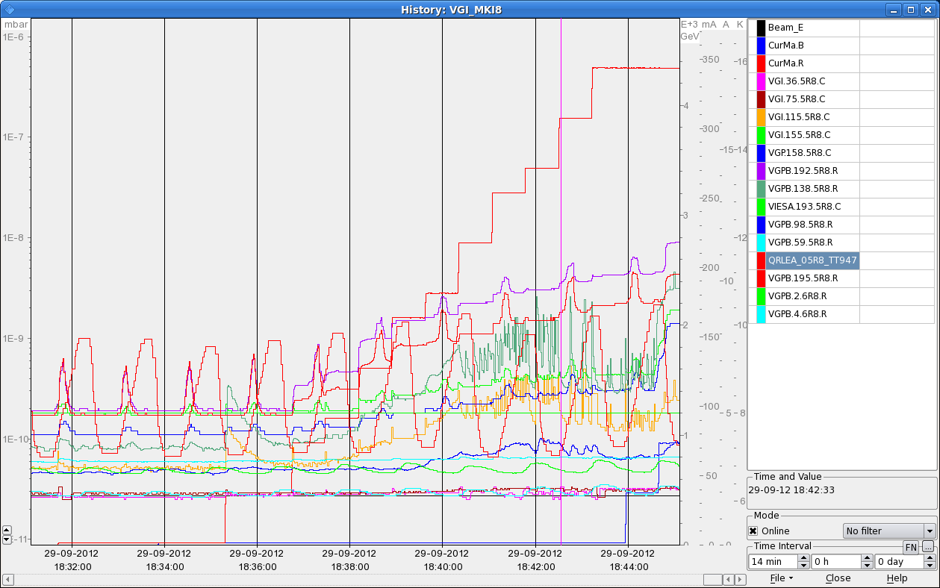
Sat Morning / Late
in parallel: intervention on the water leak on the dump resistors in point 1
16:30h UPS problem fixed, restart LHC
18:10h injection probes
18:30h injection physics: 1374 x 1374
... nota bene
* pressure oscillations still observed, beyond SIS the threshold
* lost again FBCT ...
5e-9

Slide 5
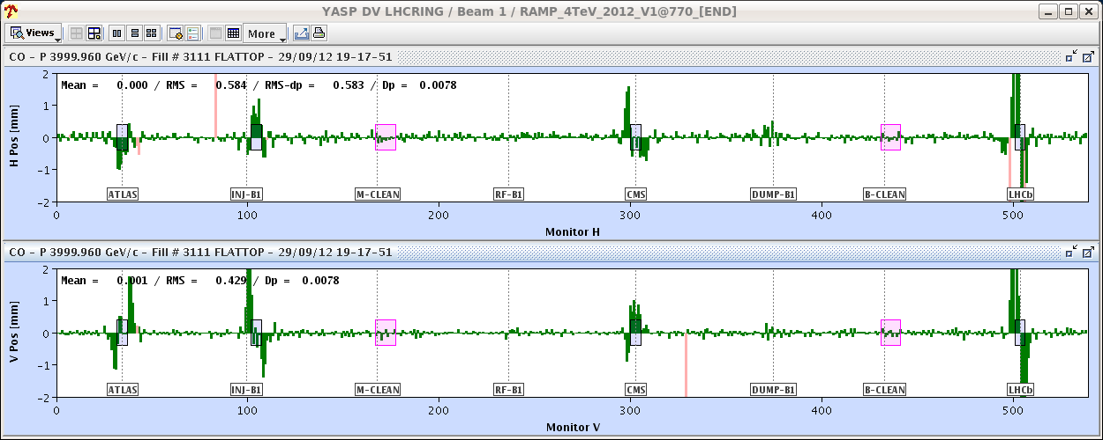
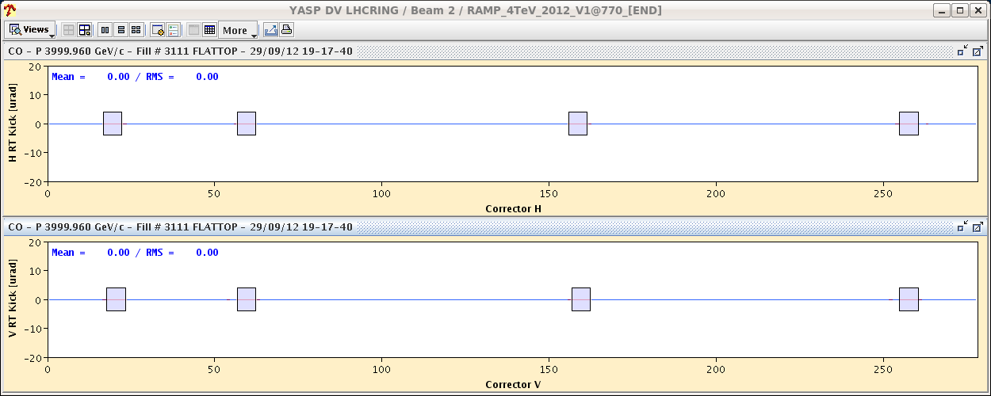
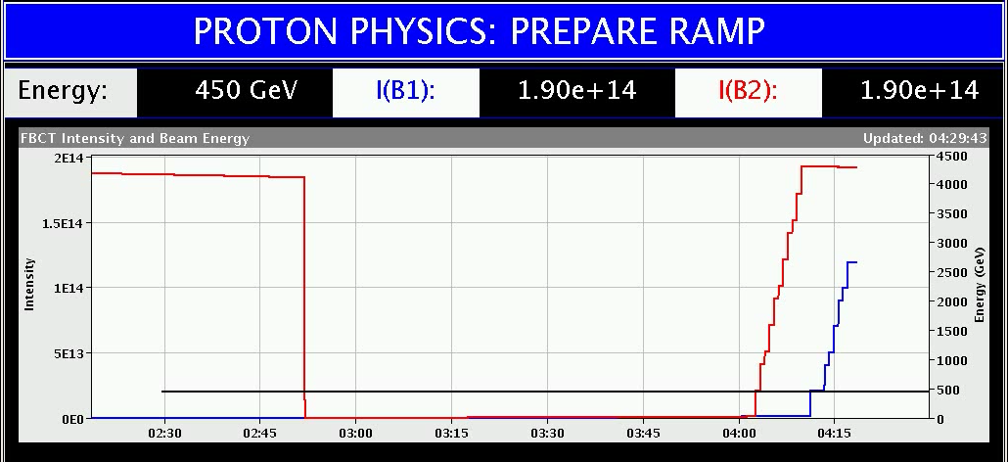
Sat Late
19:00h ramp
19:15h OFC crashed → dump by operation
mismatch between the RT trims in the hardware and what the orbit feedback thinks it put in
22:00h restart
22:30h injection probes ...
problem in TI2, power converter down
00:53h injection physics beam (b2)
03:40h injection physics beam (b1)
... again crash of FBCT !

Slide 6
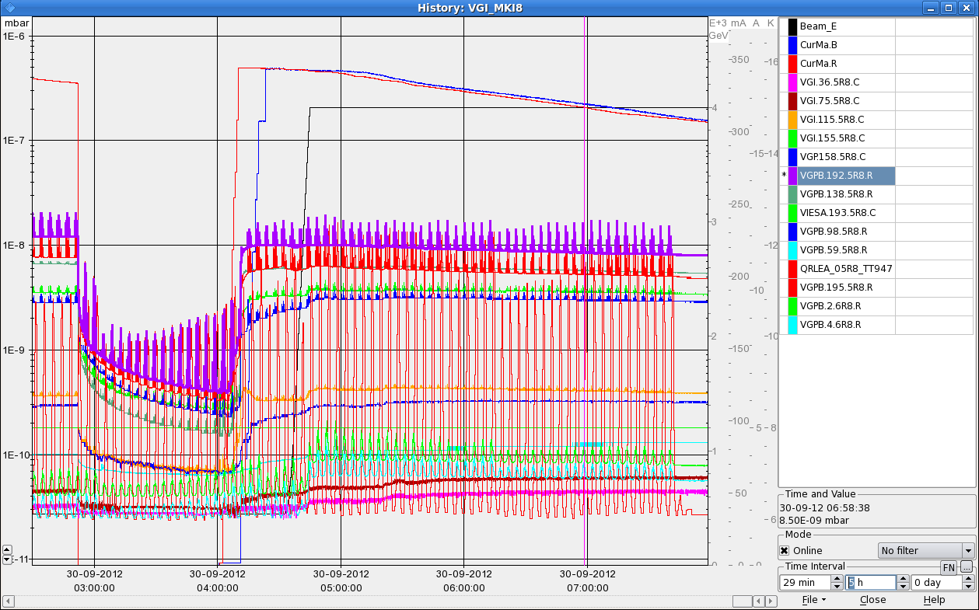
Sat Night
04:32h ramp, squeeze, adjust
05:22h stable beams
07:30h the definitively last picture of the MKI8_D kicker vacuum
... promised !
improved beam screen temperature tuning

