Slide 1
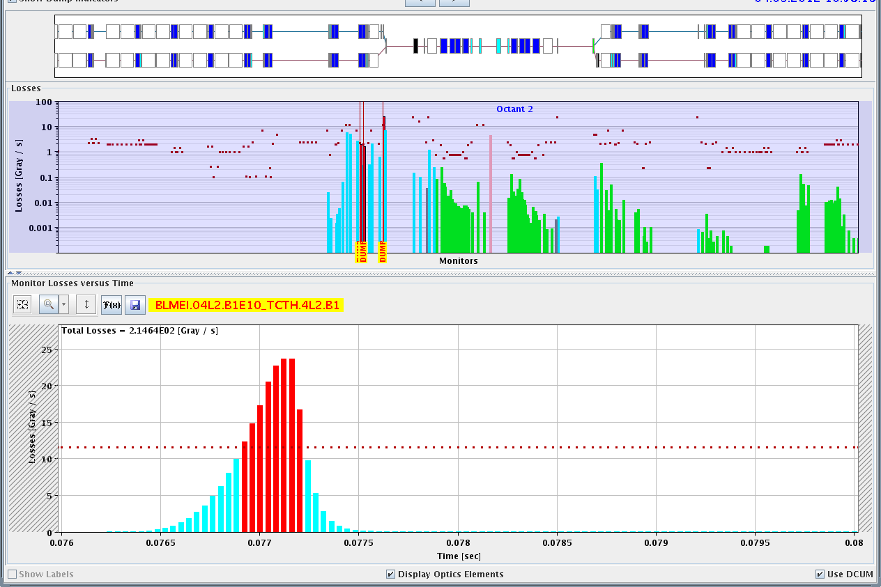
LHC Status Wed Morning 5-Sep
Bernhard Holzer, Mike Lamont
6:00h beam dump:
9:00h injection: filled first beam 1 and then beam 2 (test for Alice)
10:15h ramp, squeeze
11:00h adjust ... & ... beam dump: UFO
pre-cycle
12:50h new injection: again first beam 1.
QPS trigger, lost sector 23 due to the trip of RQD/F.

Slide 2
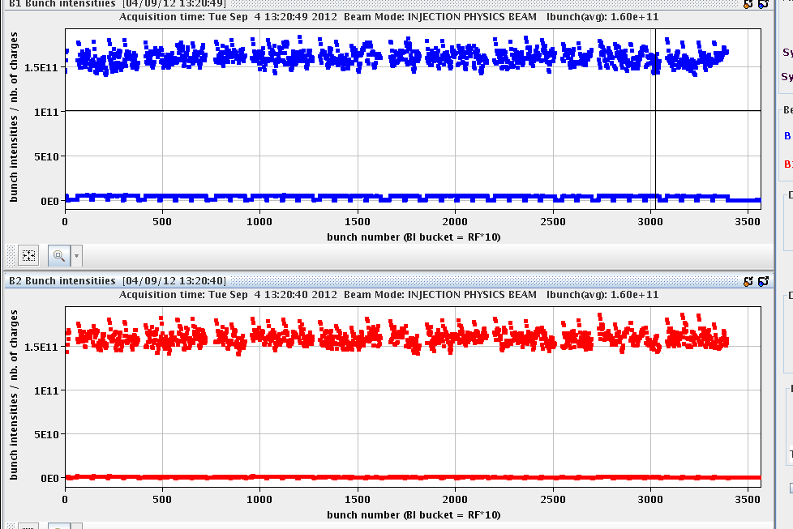
Tue Morning
1.5E11
14:00h adjust & stable beams
some problems during adjust !!
* lumi far off in IP1 & IP5
** optimisation procedure gets crazy
→ manual optimisation by operators ... and then switch back to automatics

Slide 3
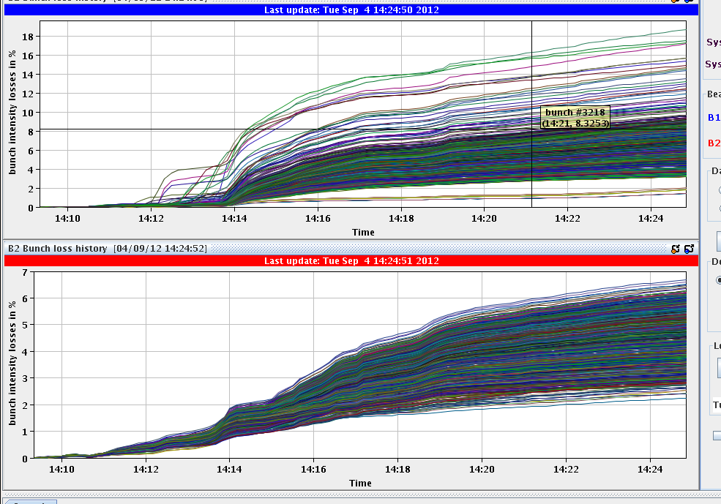
Tue Morning
accordingly: considerable losses (beam 1)
during adjust
L₀ = 6.5E33
16%
6%

Slide 4
Tue Morning
14:30h “the usual trimming of octupoles
and chroma” ... leads this time
to interesting effects ...
strong losses on bunch 20 & 22
(private IP8 bunches)
15:30h beam dump: BLM
faulty optical link of the BLM system ... problem with an optical link in SR5
... and some minutes later:
QPS problem in A67 RQF/RQD an access is needed

Slide 5
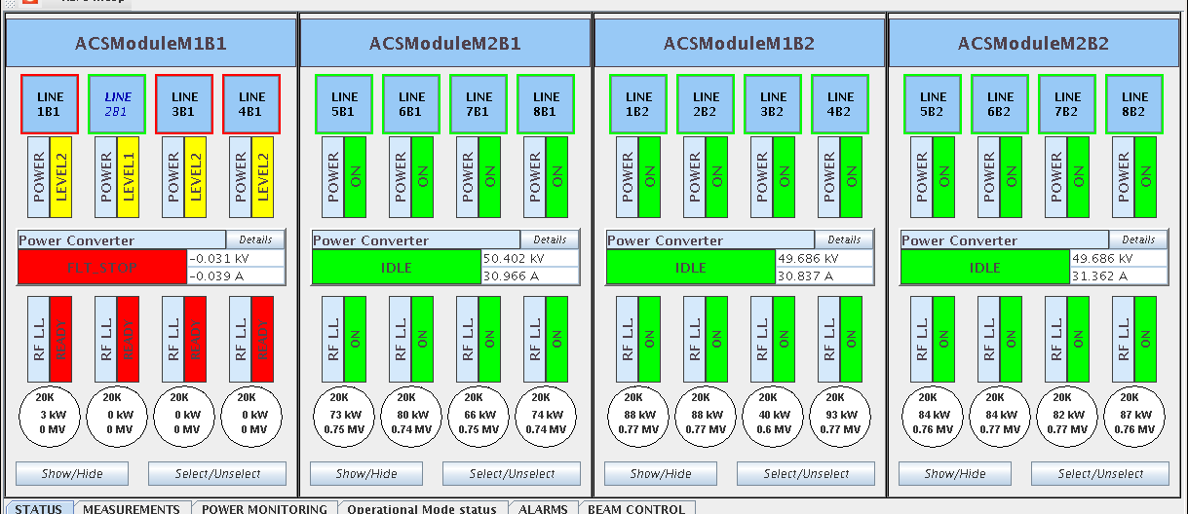
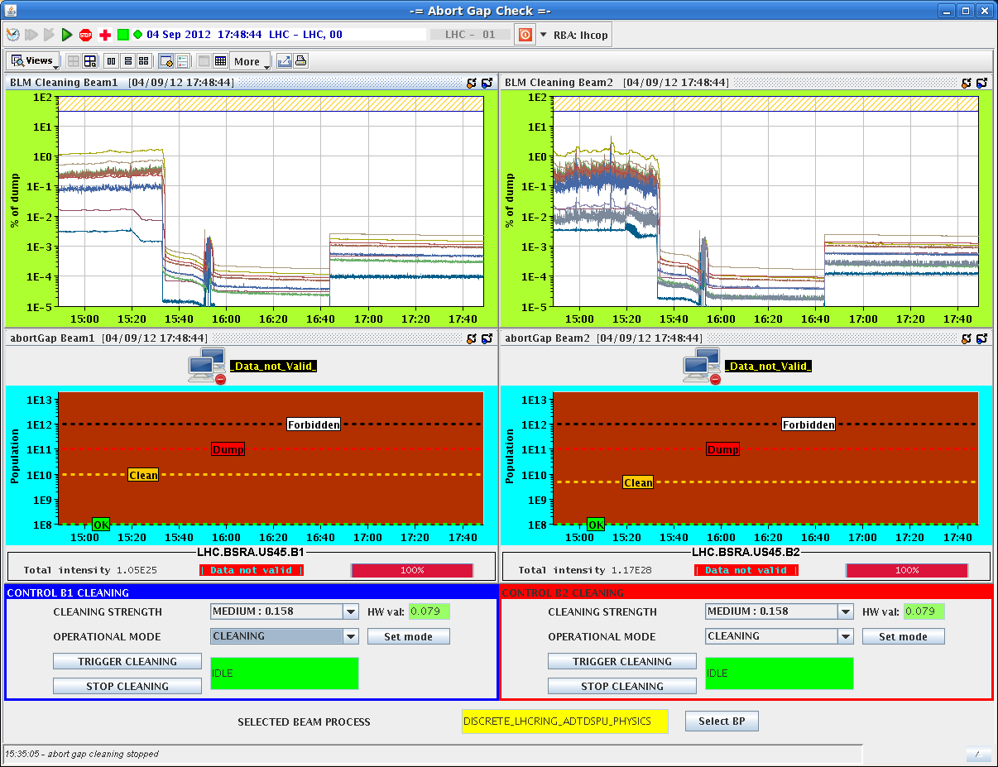
Tue Late
17:00h RF trip M1-B1
filament error -> reset
... in the shadow of all that:
new feature in the agc system:
“population check”
to be tried out for the next fill
20:15h injection for physics
.. and beam dump at injection:
SW interlock on BLM monitoring SR5_R, error on all
voltages, suspected communication error
22:15h injection for physics
Daniel, Delphine, Michael, Jan

Slide 6
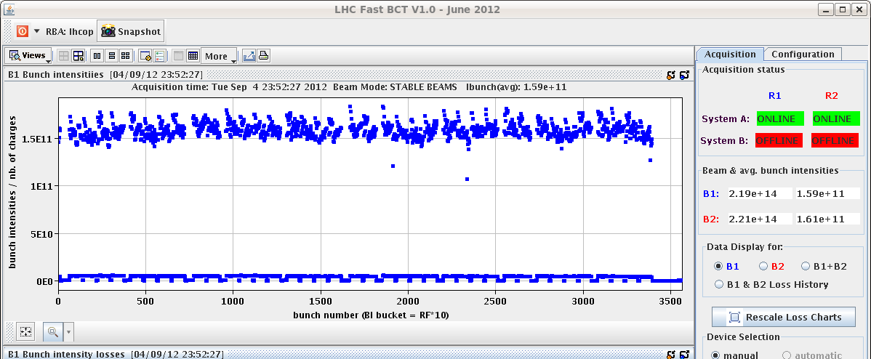
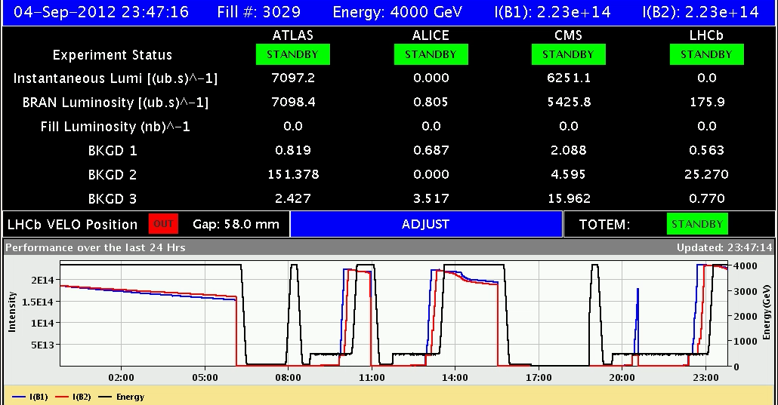
Tue Night
23:00h ramp, squeeze, adjust
23:49h stable beams

Slide 7
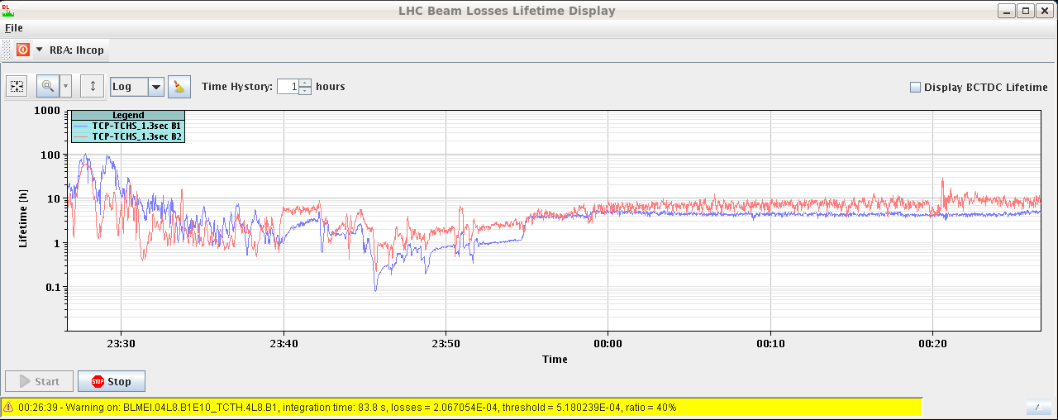
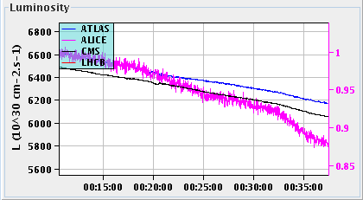
Tue Night
00:20h tests with the agc population check
06:45h beam dump EDF
beam lifetime
luminosity

Slide 8
Tue summary
UFO
BLM communication
BLM communication

