Slide 1
Wednesday 29th August & night
AM intervention to remove mirror and arm BSRT B2 at IP4
The intervention of removal of the mirror and its support was successfully completed by the colleagues from BI: the support fingers of the mirror were found deformed and the mirror just fell in a safe area while removing it. A flange was put in place with a gasket; the pumping is ongoing and a first leak detection indicates a good tightness.
Estimate in the afternoon was that vacuum will be ok Thursday noon. Get vacuum equipment out Thursday morning
BSRT B1 also blocked out as a preventive measure
Both undulators stopped
Compensatory measures to run without abort gap monitoring
Regular abort gap cleaning exercises
Monitor losses at the collimators

Slide 2
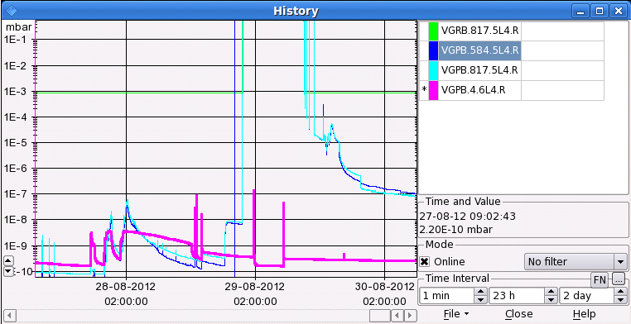
Present vacuum status 5L4

Slide 3
Other
13:21 Compensator in Point 2 down
21:32 A first attempt to connect the SR2 TCR compensator caused the trip of the filter and consequently of the IP2 cold compressor.
Also problems RB12 and RB23
01:00 Cryo Start back
01:29 LHCb dipole tripped due to electrical perturbation
OK for restart…
02:46 POPS back in the PS

Slide 4
The Plan
This morning
Compensator IP2 and RB12, RB23 to be sorted out
Ramp ALICE
LHCb dipole
Recover vacuum @ BSRT
Get equipment out
Open valves – to be confirmed
Finish LHCb polarity change
Fill 2 x 6 bunches to check head-on collisions on all IPs
Physics
On the waiting list
Totem in at end of fill
RF batch-by-batch blow-up

