Slide 1
LHC Status Week 34
Bernhard Holzer, Joerg Wenninger

Slide 2
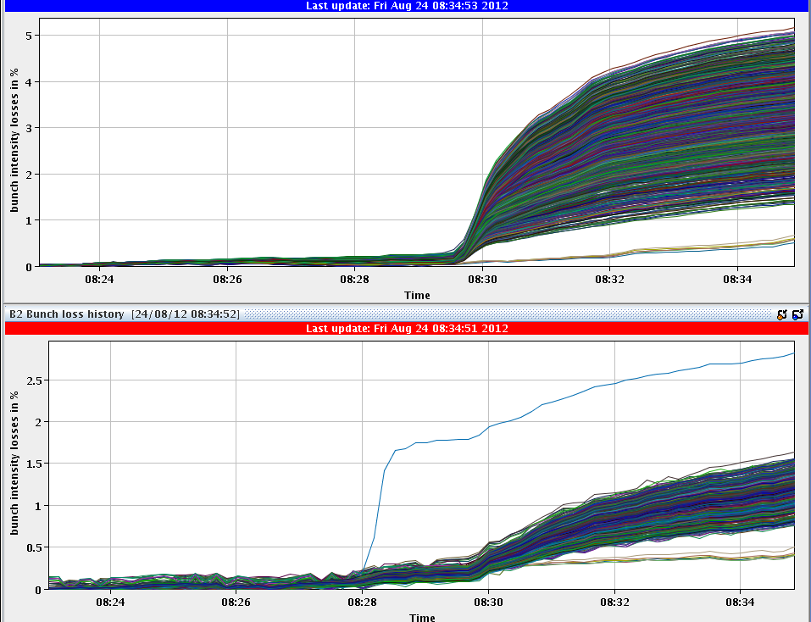
Fri Morning
since 8:30h stable beams
5%
bunch intensities ≈1.6E11
2%

Slide 3
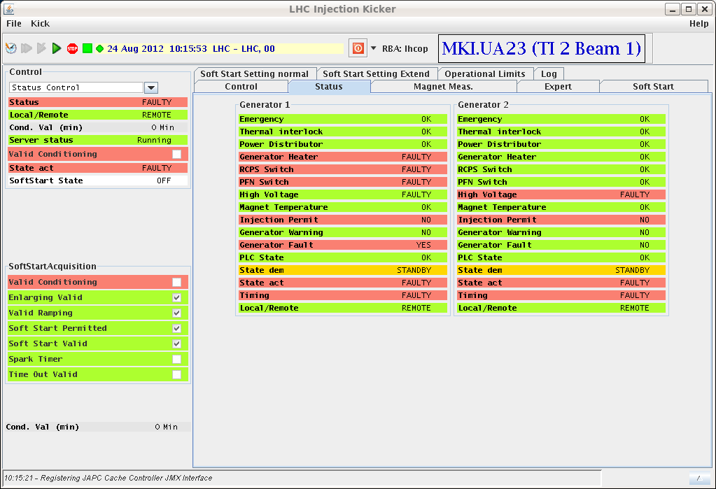
Fri Morning
since 10:15h ... again Injection
Kicker Problem in TI2
16:00h beam dump:
FMCM triggered interlock –
dump was clean.
No electrical disturbance noted by TI ... FMCM_RD1.LR1
preparing LHC or access:
Access for: MKI2,
CMS RPC,
ALICE Muons,
ATLAS RPC,
Current Lead on DFB in pt5 (RQ9.L5)
DFB: regulation module replaced
MKI2 intervention ... no source of fault found but heater module replaced
TDI at Pt 2: the thresholds on the inner gaps (up and downstream) were relaxed by 100 um.

Slide 4
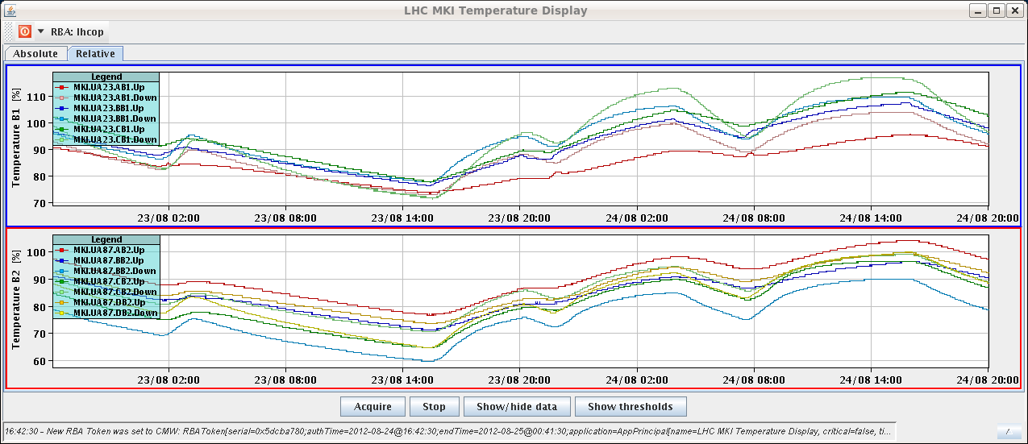
Fri Late
18:00h restart after access: pre-cycle
20:00h LHC ready for injection ... but:
MKI2-C temperature limit: 103 %
tolerance increased by 1 degree (i.e. 43.5ºC)

Slide 5
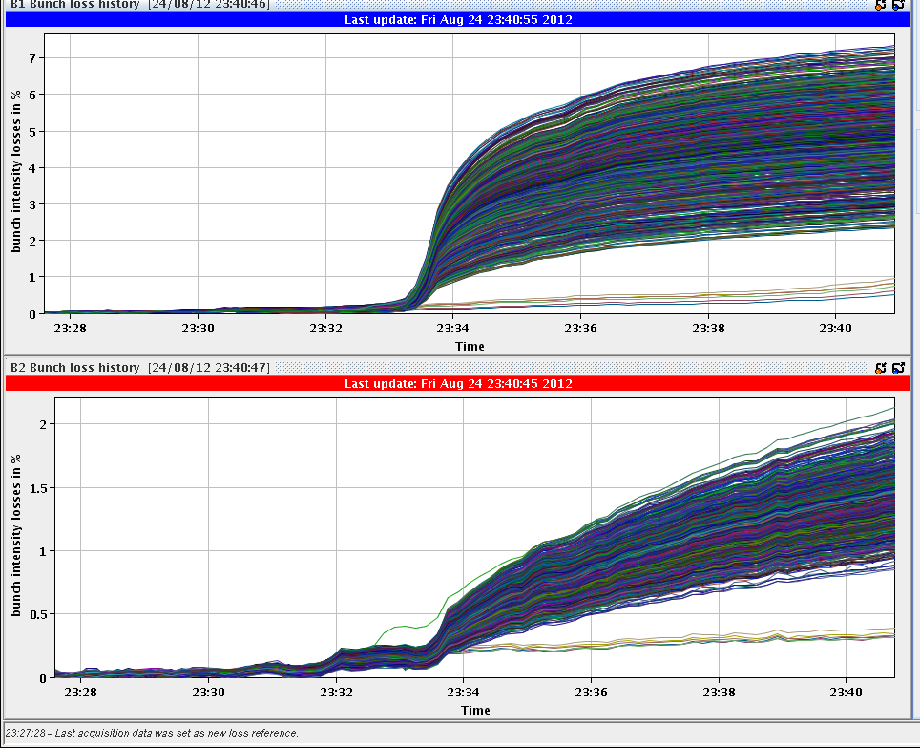
Fri Late
22:00h injection for physics
22:41h squeeze & adjust
... the usual smooth procedure
23:35h stable beams
L₀=7.3 E33
6%
2%

Slide 6
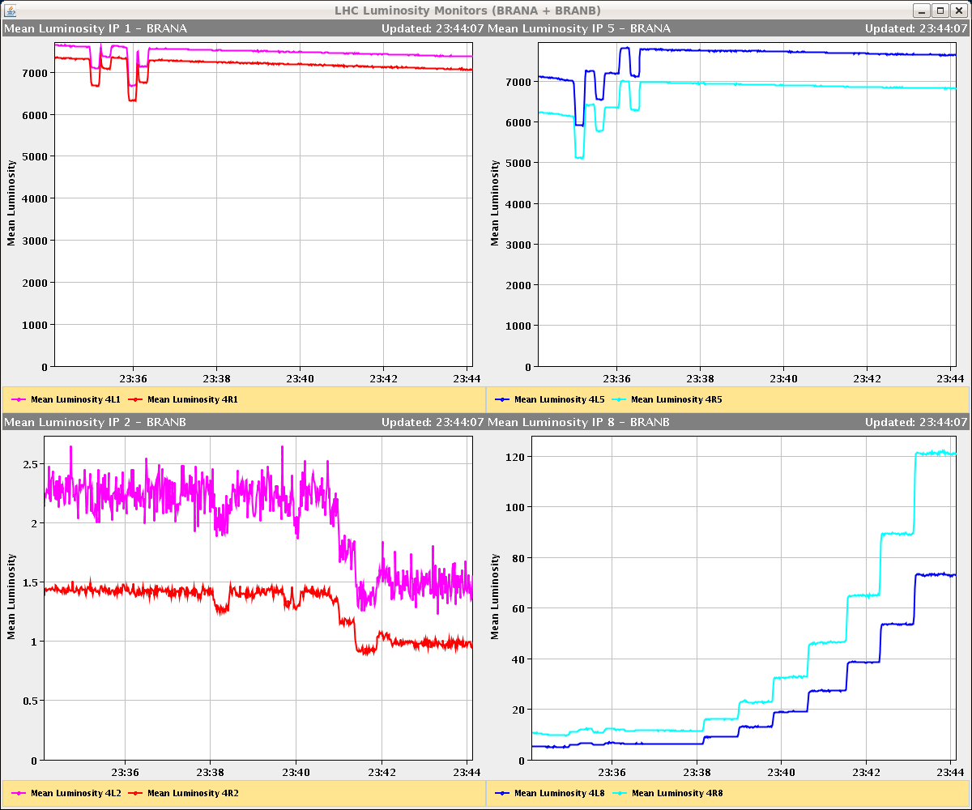
Fri Night
and not to forget: ALICE
IP1
IP5
IP8
IP2

Slide 7
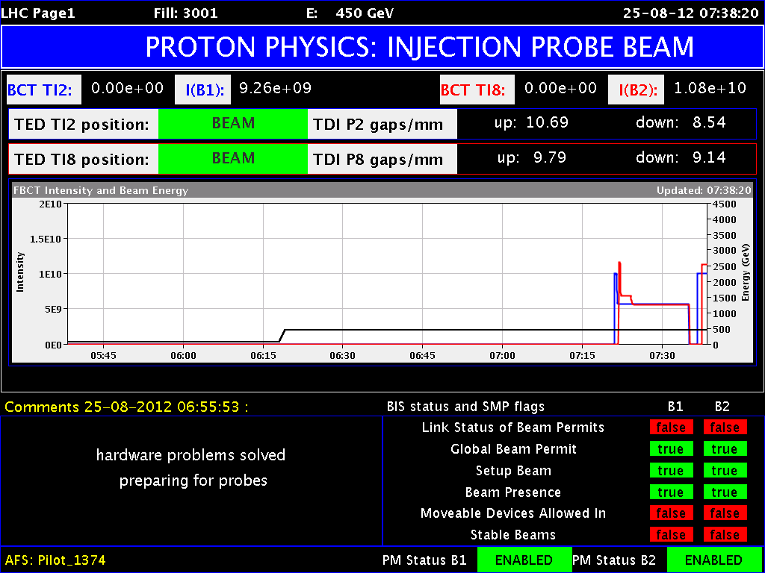
Fri Night
02:00h beam dump: BLM trigger
Electrical distribution of UPS tripped in pt 4, BLM
system not powered anymore → dump.
BLM crate power supply had to be exchanged (Christos)
in addition: 2 power supplies broken in Pt4 in BPM system
07:00h machine ready for injection,
injection probe beam
(nota bene: one BPM erratic
→ disabled)

Slide 8
Saturday
09:30 Stable beams fill 3002, L ~7.2E33 cm-2s-1.
22:12 Beam dumped, trip of Q4.L1 (#3), 178 pb-1.
MKI temperature not too bad.
Q4.L1 trip looks like previous ones.
00:00 Injecting.
High losses on fast RS for B2 (> 30%) 72b.
RF phase noise warnings, but spectrum OK.
01:50 Stable beams fill 3003, L ~7.3E33 cm-2s-1.
02:30 Beam dumped, B1 vac. valves closed in IR7.
03:00 Piquet reopened valves, spike above 2E-6.

Slide 9
Sat Night
Vacuum Problem in IR7
keep it in mind
... it will come again

Slide 10
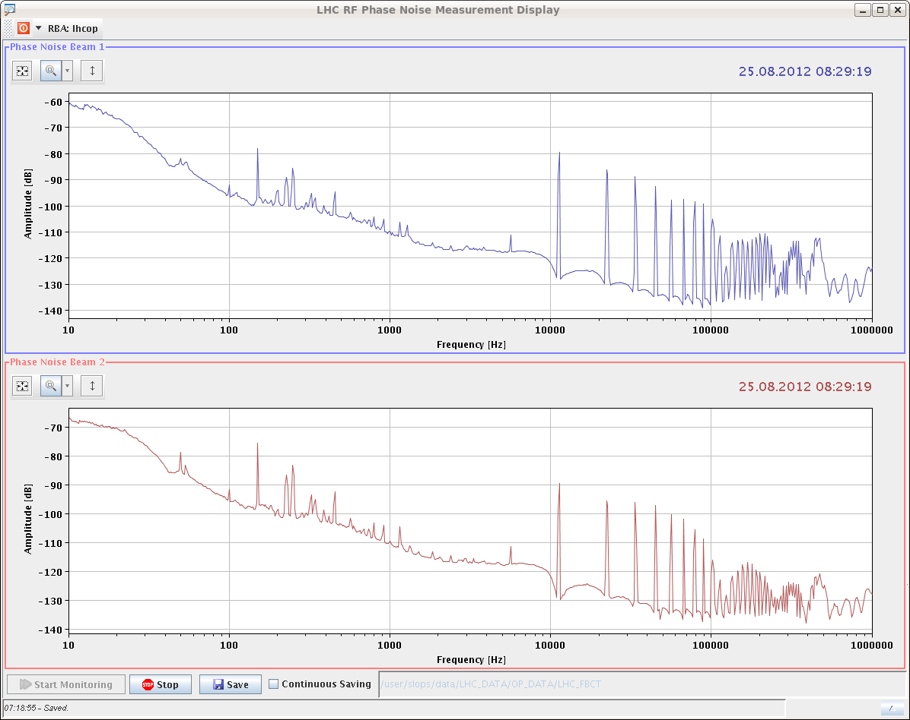
Sunday
04:30 MKI’s ready for injection.
RCBV24.B2R6 tripped again during ramp down (see Friday).
Again noticeable fast ring losses at injection (IR7) for B2 72b injections.
Again RF phase noise warnings
06:30 Dump during the squeeze, ROF.A56B2 trip (PIC).
07:30 Filling again.
Again RF phase noise warnings (4B1), but spectrum OK.

Slide 11
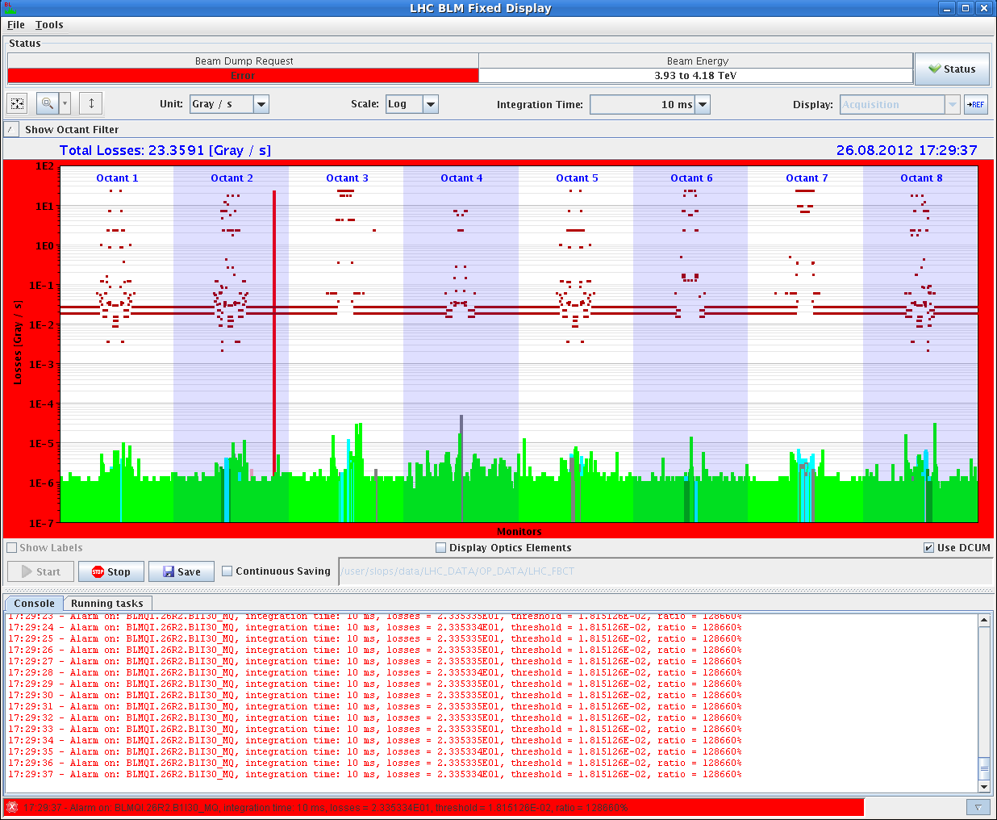
Sun Morning
7:34h injection, ramp, squeeze ... comme il fault.
RF phase noise at injection traced to cavity 4B1 in Big Sister.
9:00h stable beams
L₀ = 7.6 E33 (ATLAS)
17:20h beam dump
Suspected SEU on BLMQI.26R2.B1I30_MQ
128660%

Slide 12
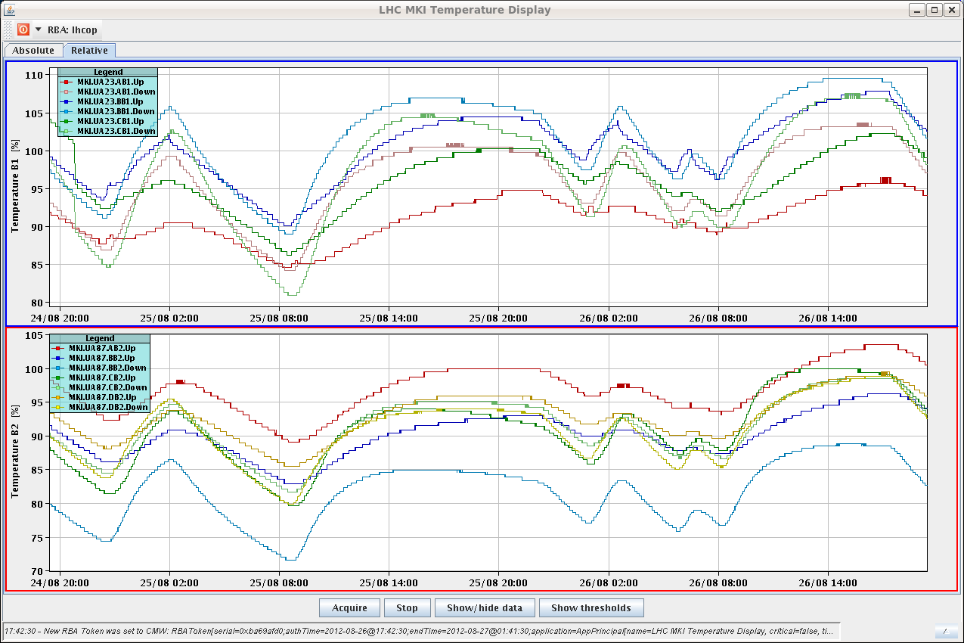
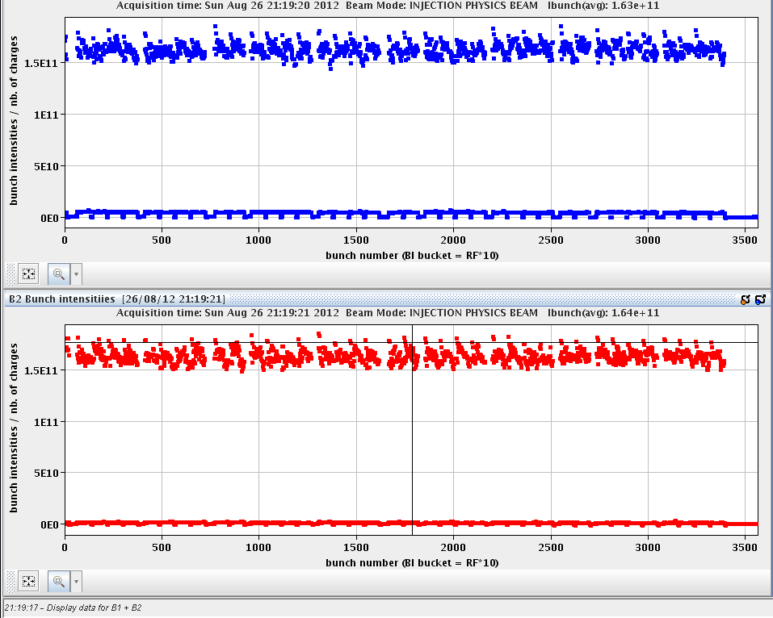
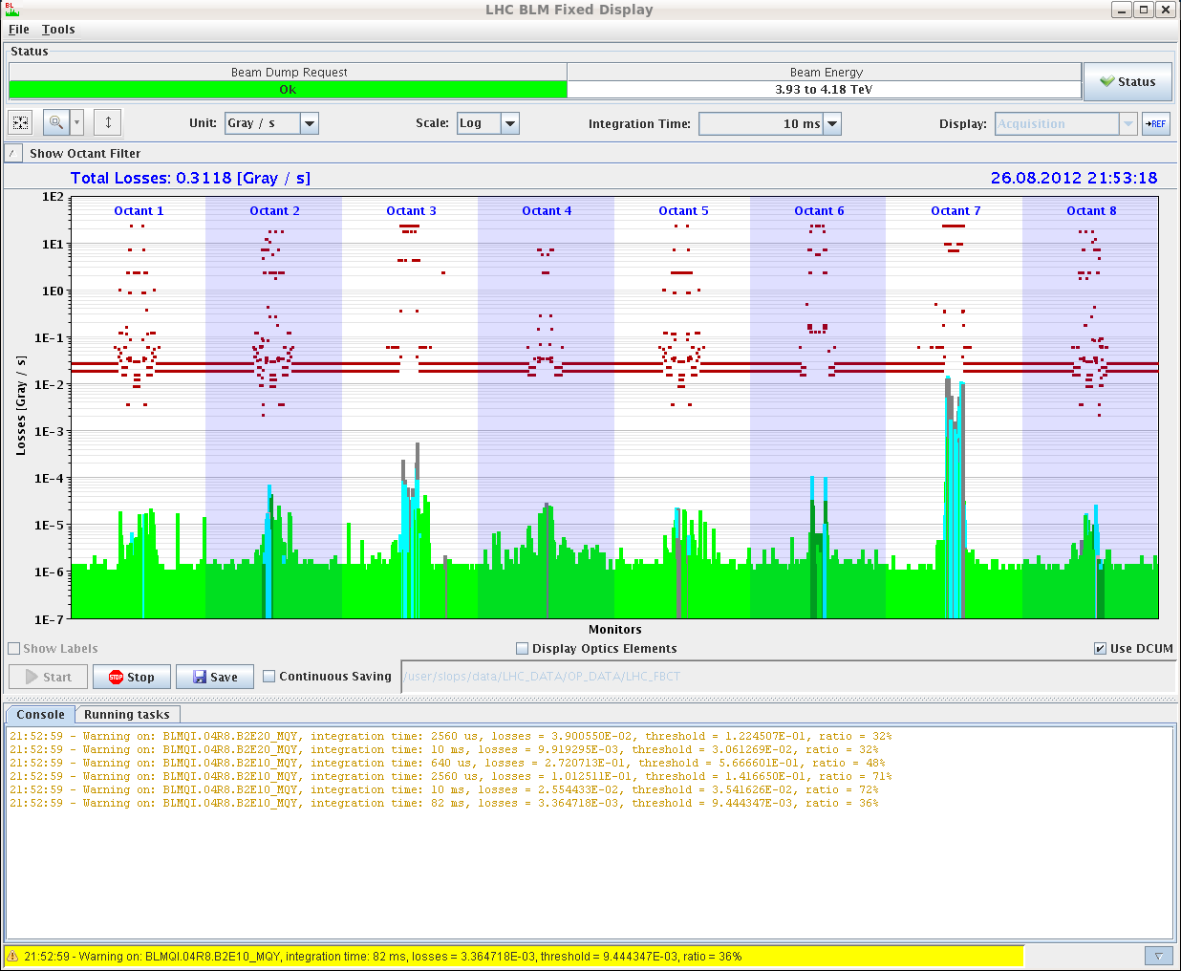
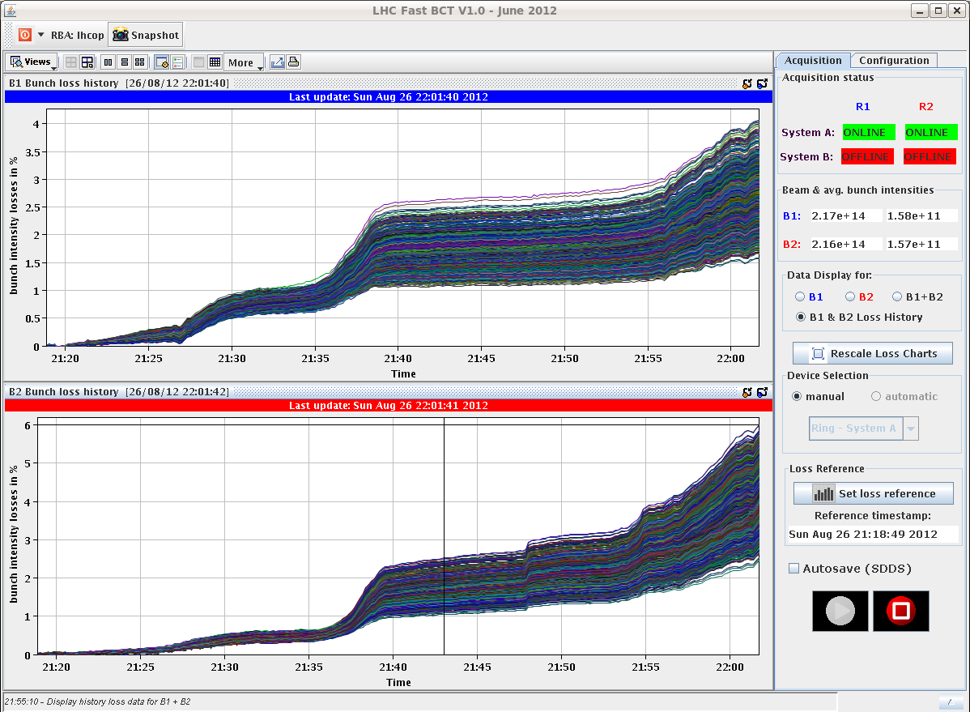
Sun Late
waiting for injection kickers
(note: MKI2-C is no longer top candidate)
20:43h injection, ramp, etc
again ... somehow unequal bunch intensties
21:47h squeeze ... with a bit increased warnings:
71% (routine ≈ 60%)
all in all:
losses = 4-6%
4%
6%

Slide 13
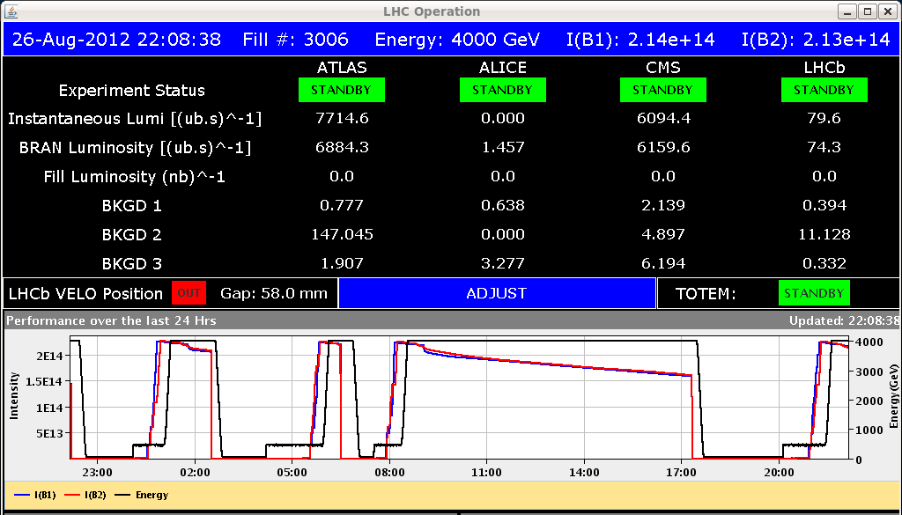
Sun Late
22:08h stable beams, L₀ = 7.7 E33
(ATLAS)
lumi decaying quite fast in the first minutes
L₀ = 2.5 (ALICE) ... levelled down to 1.0
integrated luminosity: in 21 minutes ( ! )

Slide 14
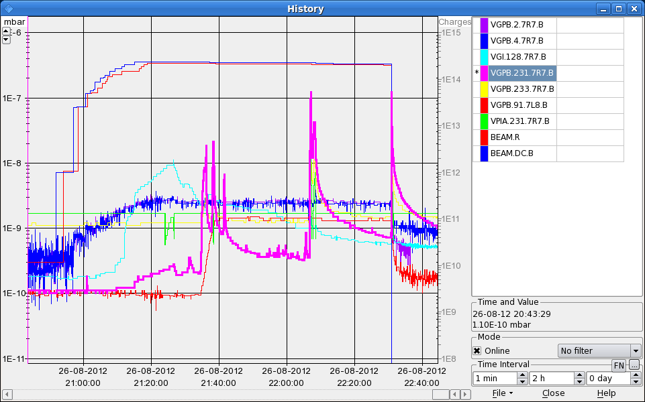
Sun Late
17:20h beam dump
Vacuum system trigger
Vacuum interlock in the same place as last night. Again the valves in 7R7 of B1 triggered, gauge with most activity was VGPB.231.7R7B

Slide 15
Sun Night
23:23h injection probes
00:53h stable beams, , L₀ = 6.9 E33
03:41h beam dump: operators, Cryo operator informs us that the compressors in pt 4 are stopped

Slide 16
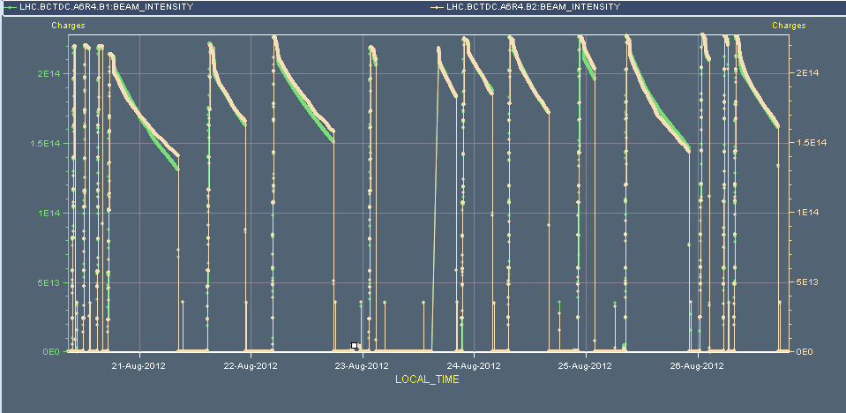
The Week 34
14 fills

Slide 17
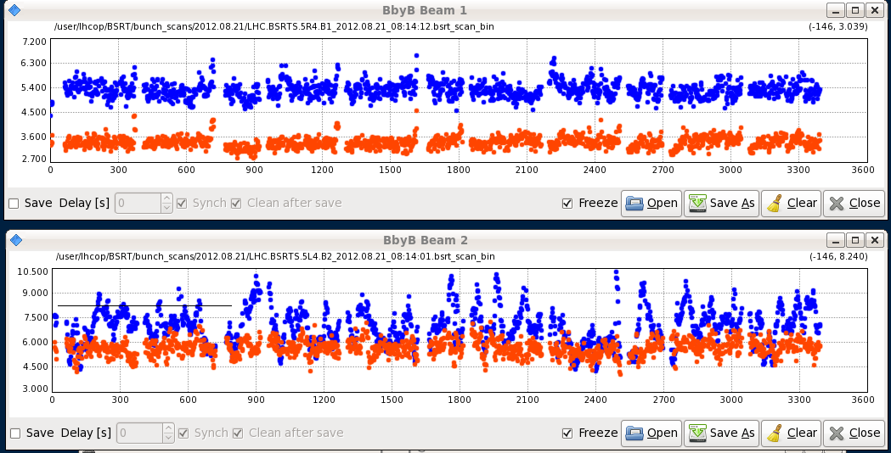
Tue Morning
08:24h beam dump:
Access needed for LHCb water leak
good news:
emittances at fill end ...

Slide 18
Tue Morning
12:07h beam dump: SIS problem,
“See glitches on SIS, on squeeze factors, currents and states of PCs in different sectors etc etc.”
Also the squeeze factor interlock came back - it'd have dumped, had we had beam.Example of exceptions:12:43:26 - 2012-08-21 12:43:25,706 [JapcExecutor-thread-11] ERROR JapcDispatcherImpl +==> Exception occured for parameter id [RPHGA.RR13.RQ8.L1B1_DATA] name [RPHGA.RR13.RQ8.L1B1/SUB_51]asynchronous operation on RPHGA.RR13.RQ8.L1B1/SUB_51@ failedcern.japc.ParameterException: Lost-Updates: Server overloaded and not able to handle all new updates ==> it will loose updates.
at cern.japc.ext.cmwrda.DataTranslator.createParameterException(DataTranslator.java:275)
at cern.japc.ext.cmwrda.RDAReplyHandler.handleError(RDAReplyHandler.java:115)
at cern.cmw.rda.client.ReplyAdapter.handleException(ReplyAdapter.java:103)
at cern.cmw.rda.client.ServerConnection.dispatchLostUpdates(ServerConnection.jav
a:2566)
at cern.cmw.rda.client.ServerConnection.handleReply(ServerConnection.java:2349)
at cern.cmw.corba.rda.ReplyHandlerPOA._invoke(ReplyHandlerPOA.java:45)
at org.jacorb.poa.RequestProcessor.invokeOperation(RequestProcessor.java:297)
at org.jacorb.poa.RequestProcessor.process(RequestProcessor.java:591)
at org.jacorb.poa.RequestProcessor.run(RequestProcessor.java:734)Caused by: cern.cmw.LostUpdates: Lost-Updates: Server overloaded and not able to handle all new updates ==> it will loose updates.
at cern.cmw.rda.client.ServerConnection.dispatchLostUpdates(ServerConnection.java:2562) ... 5 more
my translation: programs running in parasitically were blocking the operation servers
some users caused delays and data packet losses.
-> users identified, processes stopped, SIS reset by the experts ... and ok

Slide 19
Tue
14:14h injection physics beam
... CMS solenoid ramping down ... temperature problem
15:35h OFSU crashed before launching the squeeze.
Need to fetch optics and re-calculate it
Wed
17:51h beam dump, QPS trigger Q4.L1
...” 50 Hz noise on beam 1”. Cryo loss of matching section
during ramp down : RD2.R2 tripped ... reason unclear

Slide 20
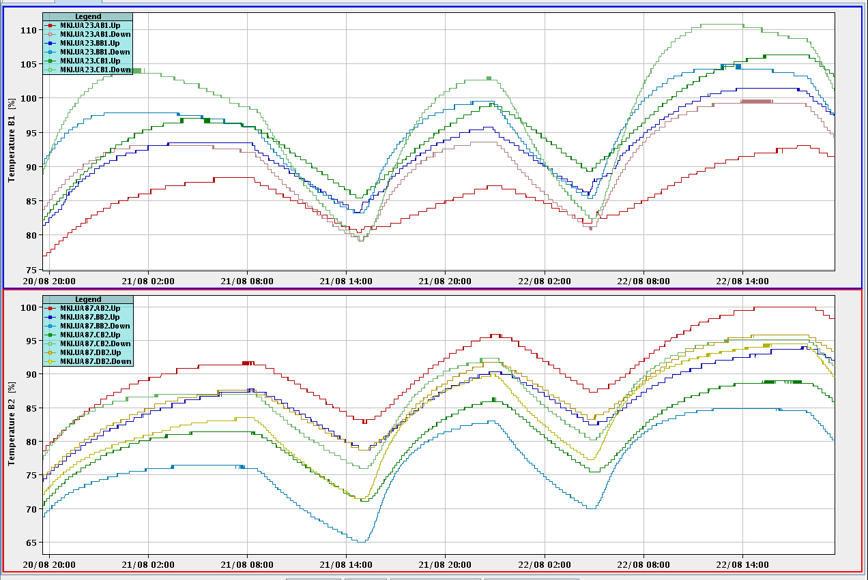
Wed Late
Kicker Temperatures after a some long runs:
110%
MKI c B1
≈ 1.5 h waiting time
CMS problem:
short MD study:
21:27h injection physics beam for H9 test
emittance after injection
went through complete cycle including luminosity

Slide 21
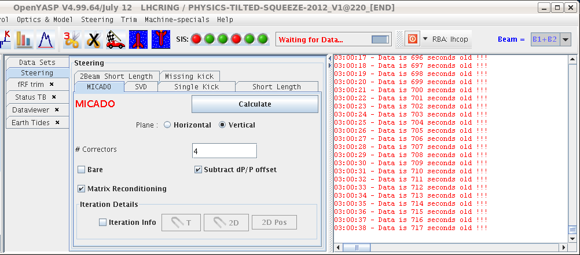
Wed Night
02:58h beam dump: OFB controller down.
SIS did not receive data for more than 10 min then triggered the dump.
expert(s) called
04:37h problem solved
server cs-ccr-ofc had to be restarted
(orbit feedback server)

Slide 22
Thursday morning
MKI2 faulty – heater module exchanged.
Q7.R4 trip. Intervention in the tunnel. Cable segment replaced on DFB.
05:00 TDI.4L2 stuck, interlock violated by 7 um.
checked by Chiara: ok, tolerance put to 100um

Slide 23
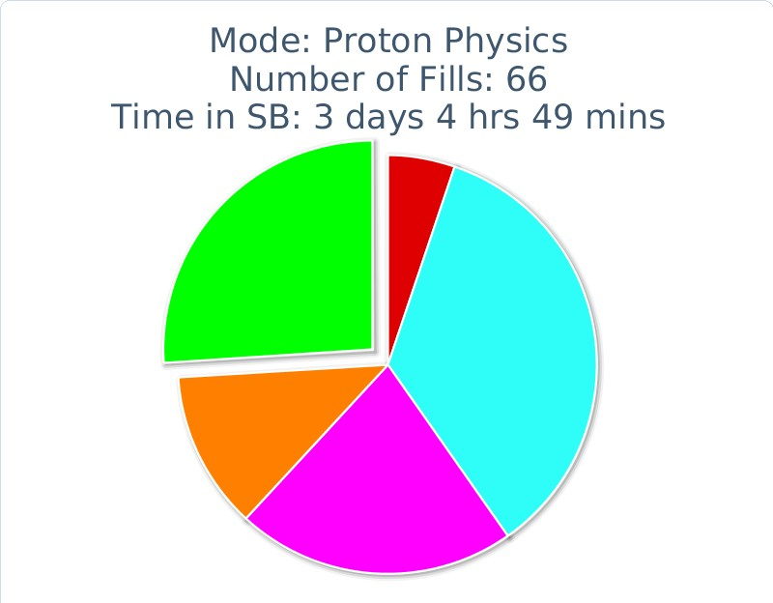
Week 34
Fill | length | L0 | int L | Dump
3007 | 2:47 | 7.0 | 57 | cryo Pt 4
3006 | 0:21 | 6.9 | 8.5 | Vacuum
3005 | 8:15 | 7.6 | 132 | SEU (BLM)
3003 | 0:42 | 7.3 | 16 | Vacuum
3002 | 12:39 | 7.3 | 177 | QPS
3000 | 2:23 | 7.4 | 52 | BLM (hardware)
2998 | 7:29 | 7.7 | 135 | FMCMn(D1 IR1)
2997 | 5:08 | 7.3 | 100 | QPS
2996 | 3:38 | 6.9 | 71 | FMCM (D1 IR1)
2995 | 0:23 | 7.1 | 88 | SIS (OFB)
2994 | 0:27 |  | 14 | Operation (H9)
2993 | 12:04 | 7.3 | 179 | matching-section L1
2992 | 6:41 | 6.5 | 105 | EDF
2991 | 13:45 | 6.7 | 171 | Operation
Run-Efficiency: 26 %
14 fills !! some very short

Slide 24
Special Issues we had / to be done:
TI2 needs some steering
OFSU / SIS
OFB server stuck
QPS trigger Q4.L1 50 Hz noise)
RF noise at injection
Unequal bunch intensties
ACCESS requests: LHCb , ATLAS 1hr (pixel)
LHCb polarity flip

